Slide 1
Using the CFS data Warehouse - LCD
Budget Officers Association
Sponsored Training

Slide 2
Agenda
Labor Cost Distribution – Data Elements unique to LCD
Review LCD Dashboards
Sample Reports

Slide 3
Data Elements unique to LCD begin with “LCD”
LCD Account Cd | LCD Empl Record
LCD Actual Salary Freq | LCD Job Function Code
LCD Base Salary Amount | LCD Name
LCD Benefits | LCD Pay Grade Fdescr
LCD CSU Account Cd Level | LCD Paycode Fdescr
LCD CSU Charge Period | LCD Paygroup
LCD CSU Comprate | LCD Position Fdescr
LCD CSU Paycheck Nbr | LCD Position Number
LCD CSU Type | LCD Position Pool ID
LCD Dept Fdescr | LCD Posted Total Amt
LCD Dept ID | LCD Salary
LCD Empl Class Fdescr | LCD Type
LCD Empl ID | LCD Union Cd Fdescr
LCD Job Code

Slide 4
Data Definitions
Accounting Period
  Common element on all CFS Dashboards
  The month the payroll was posted to the Ledger
  Displayed in PeopleSoft Terms
    1=July
    2=August
    Etc
CSU Charge Period
  NOT an element on any other CFS Dashboards
  The Month the payroll was earned
  Displayed in PeopleSoft Terms
    1=July
    2=August
    Etc

Slide 5
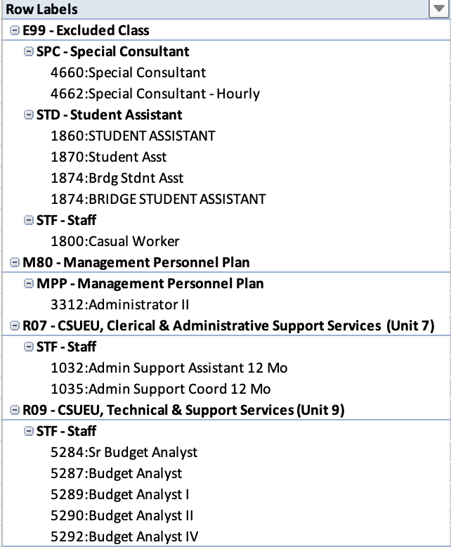
Data Definitions
CSU Type
  Salaries
    ERN
  Benefits
    DED
    TAX
Job Function
  Aggregate of Job Code
  Samples
    TEN=Tenure
    LEC=Lecture
    STF=Staff
    MPP=MPP
Job Code
  Samples
    2358 : Lecturer
    2360: Professor
    1870: Student Asst

Slide 6
DATA Definitions (continued)
EMPL Class Code
  Defines the “Employees” Status
  Samples
    3 –Temp 3 Year
    G – Regular
    H – Temporary
Paygroup
  Identifies the payroll calendar for the employees pay.
    ACD = Academic Calendar 10 Month appt paid in 12 Months
    MST = Master Calendar 12 Month appt paid in 12 Months
Paycode
  Identifies the specific Earnings (ERN) or “Benefit” (TAX & DED)
  Samples
    042 – Blue Shield NetValue
    127- Anthem Blue Cross
    150012 – Delta Care USA Basic

Slide 7
Labor Cost Distribution
LCD Dashboard
  Three Pages
    Employee Detail – Contains several key job and payroll elements for a single employee
    Payroll Detail – The most flexible dashboard for payroll analytical information.
    Payroll Summary – Designed for CSU Managers responsible for managing payroll. This dashboard is a roster of employees and their salary and benefits

Slide 8
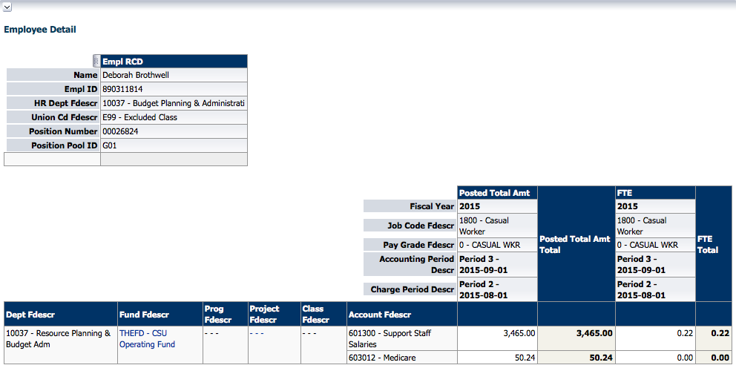
Employee Detail

Slide 9
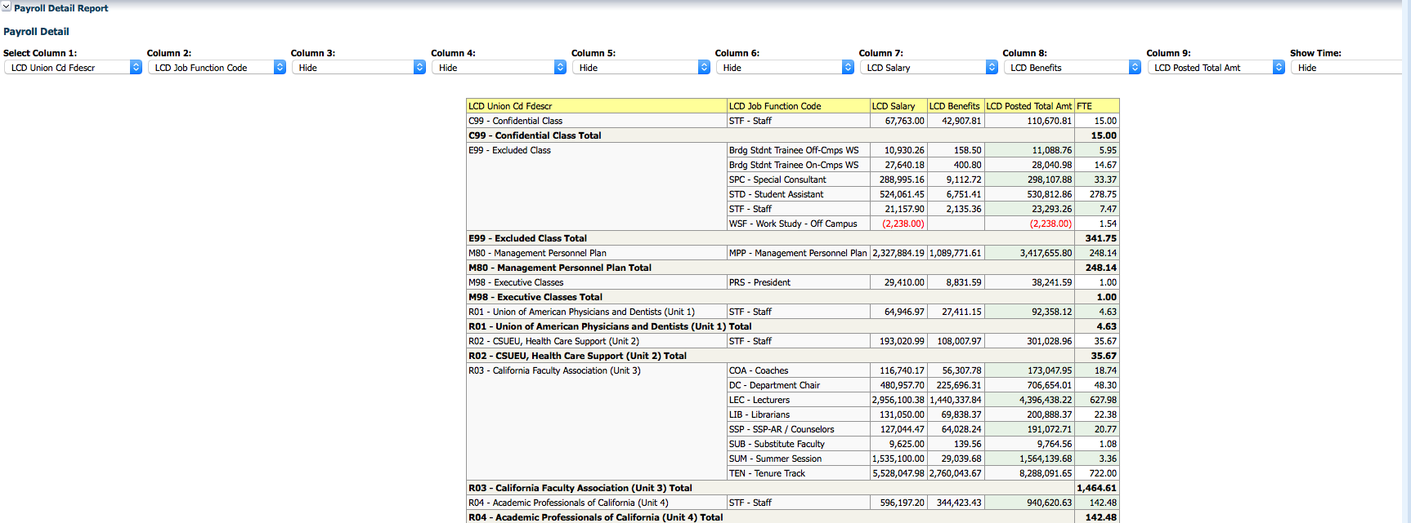
Payroll Detail

Slide 10
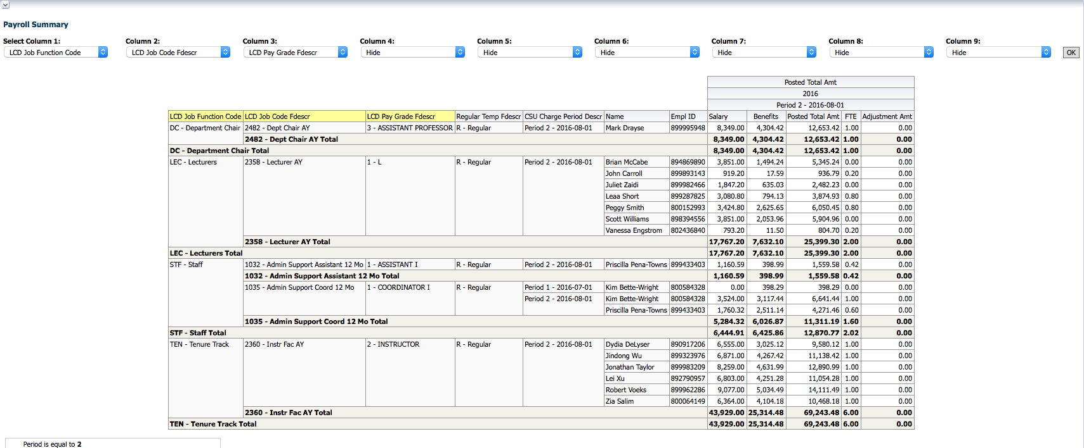
Payroll Summary

Slide 11
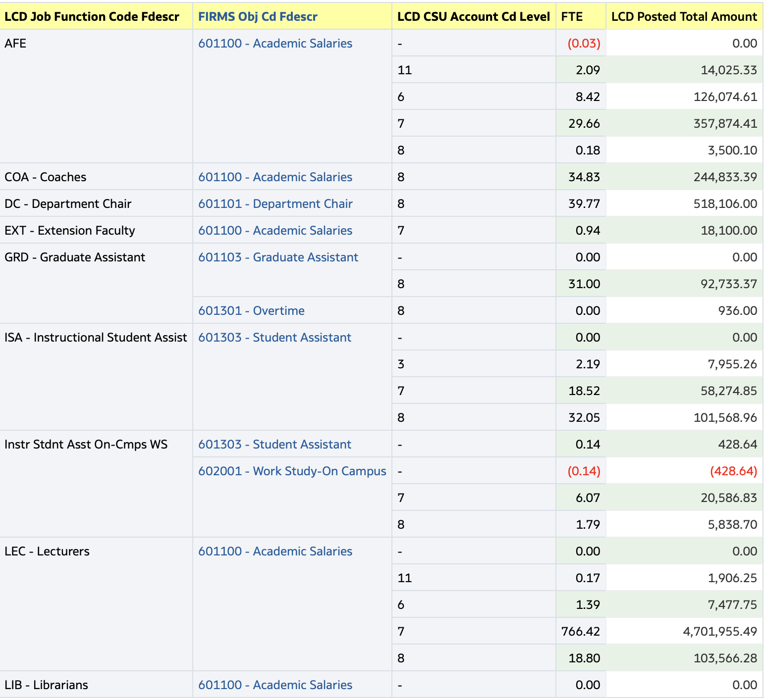
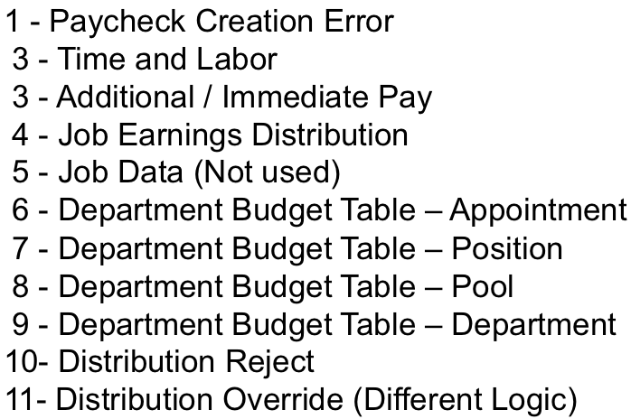
Review your charging payroll to the correct FIRMS Object Code

Slide 12
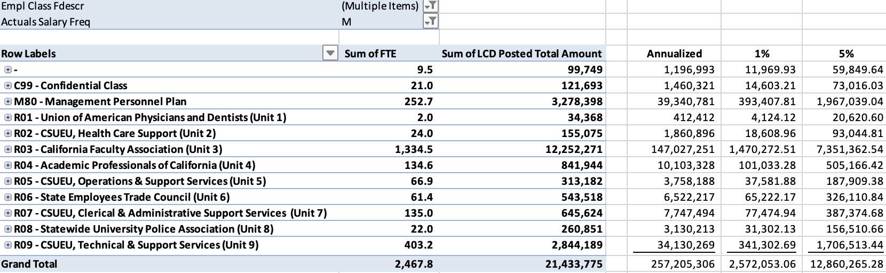
Sample Report by Bargaining Unit for High Level GSI projections

Slide 13
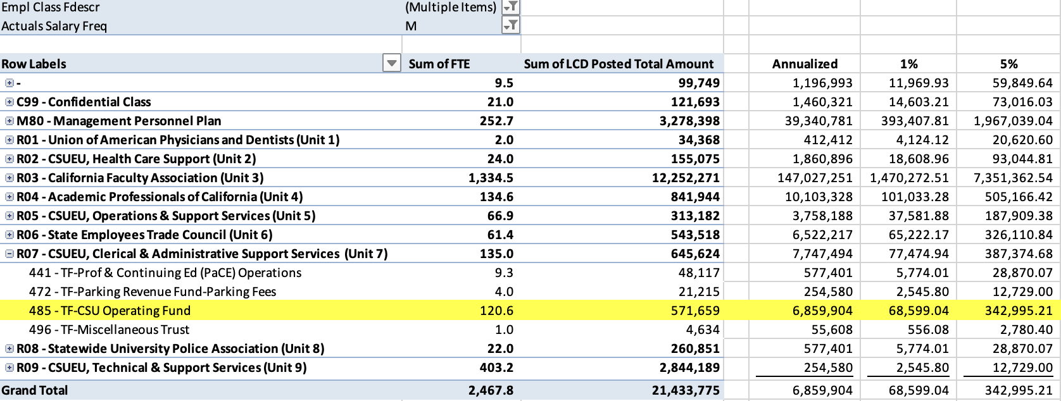
Sample Report by Bargaining Unit for High Level GSI projections – by CSU Fund

Slide 14
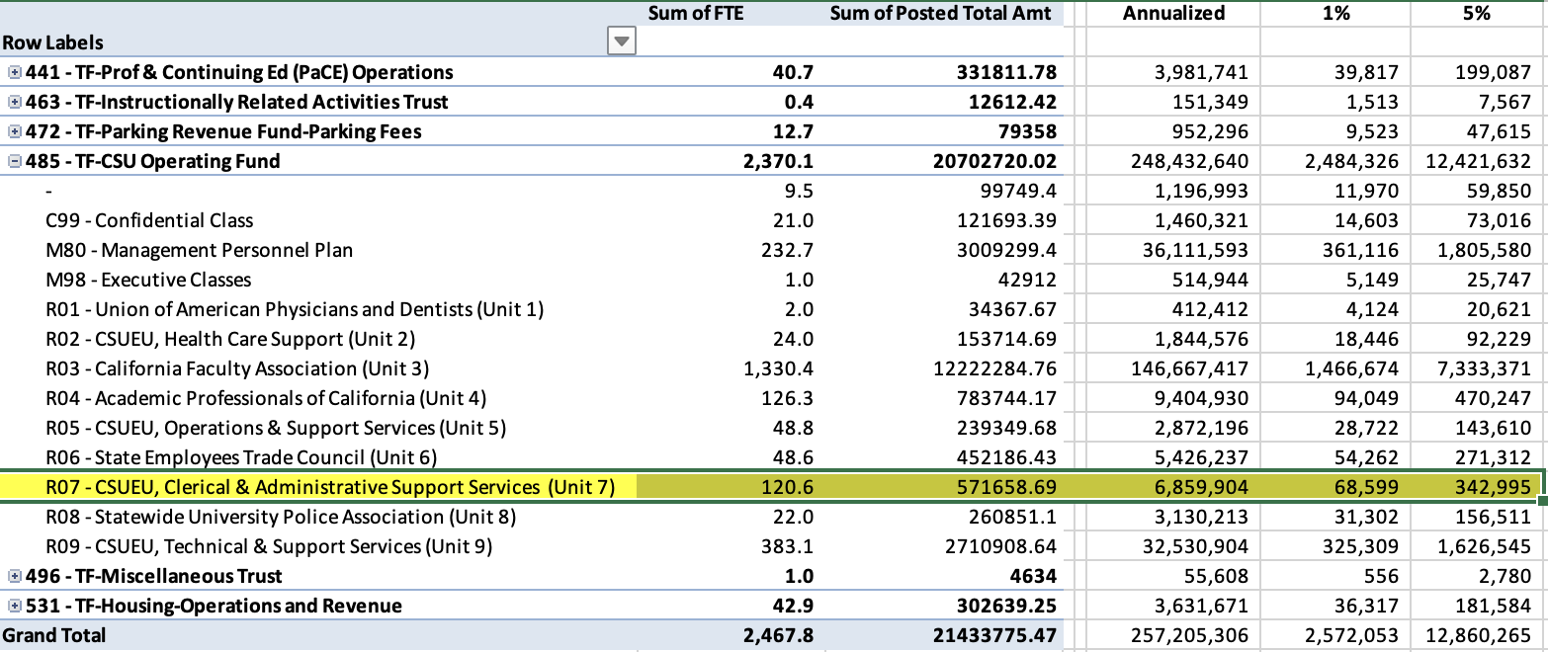
Sample Report by CSU Fund, Bargaining Unit for High Level GSI projections – by CSU Fund

Slide 15
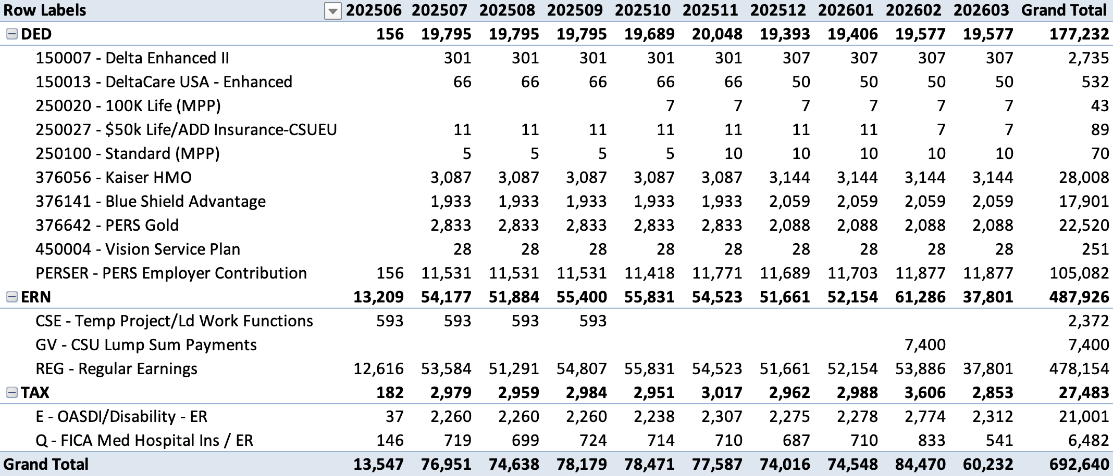
Reviewing Benefit Costs by Charge Period to establish rate increase for campus using LCD Paycode

Slide 16
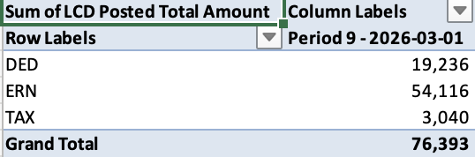
Report of March Payroll using Accounting Period (Would match Current month payroll in CFS General Ledger)

Slide 17
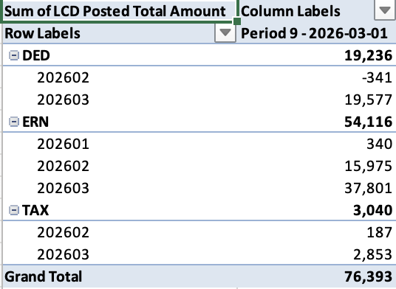
Same Report but added CSU Charge Period to the column

Slide 18
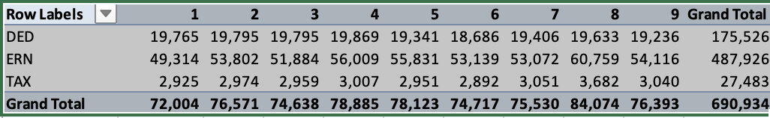
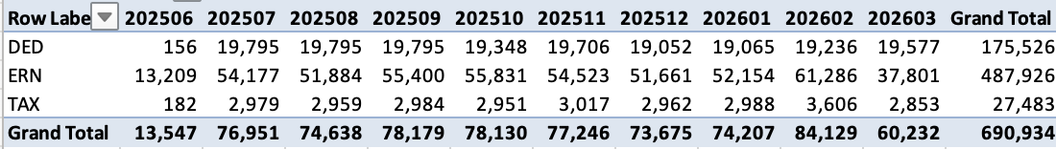
View by Accounting Period, Charge Period and Both by Paygroup (Pay type = ERN)

Slide 19
Data Elements unique to LCD begin with “LCD”
LCD Account Cd | LCD Empl Record
LCD Actual Salary Freq | LCD Job Function Code
LCD Base Salary Amount | LCD Name
LCD Benefits | LCD Pay Grade Fdescr
LCD CSU Account Cd Level | LCD Paycode Fdescr
LCD CSU Charge Period | LCD Paygroup
LCD CSU Comprate | LCD Position Fdescr
LCD CSU Paycheck Nbr | LCD Position Number
LCD CSU Type | LCD Position Pool ID
LCD Dept Fdescr | LCD Posted Total Amt
LCD Dept ID | LCD Salary
LCD Empl Class Fdescr | LCD Type
LCD Empl ID | LCD Union Cd Fdescr

Slide 20
Faculty Pay Calendar
Faculty get 6 checks per semester |  |  | Academic Year
 | Fiscal Year
 | 2018 |  |  |  |  |  | 2019
 | July | August | September | October | November | December | January | February | March | April | May | June | July | August | 18-19 Fiscal Year/FIRMS |  | Actual 2018-2019 Academic Year |  | Correct Academic Year FTE
Academic Full Time AY 2018-2019 | 0.5 | 0.5 | 1.0 | 1.0 | 1.0 | 1.0 | 1.0 | 1.0 | 1.0 | 1.0 | 1.0 | 1.0 | 1.0 | 1.0 | 11.0 |  | 12.0 |  | 12.0
Fall Only Full Time | 0 | 0 | 1.0 | 1.0 | 1.0 | 1.0 | 1.0 | 1.0 |  |  |  |  |  |  | 6.0 |  | 6.0 |  | 6.0
Spring only Full time | 1 | 0 |  |  |  |  |  | 1.0 | 1.0 | 1.0 | 1.0 | 1.0 | 1.0 |  | 6.0 |  | 6.0 |  | 6.0
Spring only Full time | 0 | 0 |  |  |  |  |  | 1.0 | 1.0 | 1.0 | 1.0 | 1.0 | 1.0 |  | 5.0 |  | 6.0 |  | 6.0
Part Time Different Time Base | 0.3 | 0.3 | 0.2 | 0.2 | 0.2 | 0.2 | 0.2 | 0.4 | 0.4 | 0.4 | 0.4 | 0.4 | 0.4 | 0 | 3.6 |  | 3.4 |  | 3.6

Slide 21
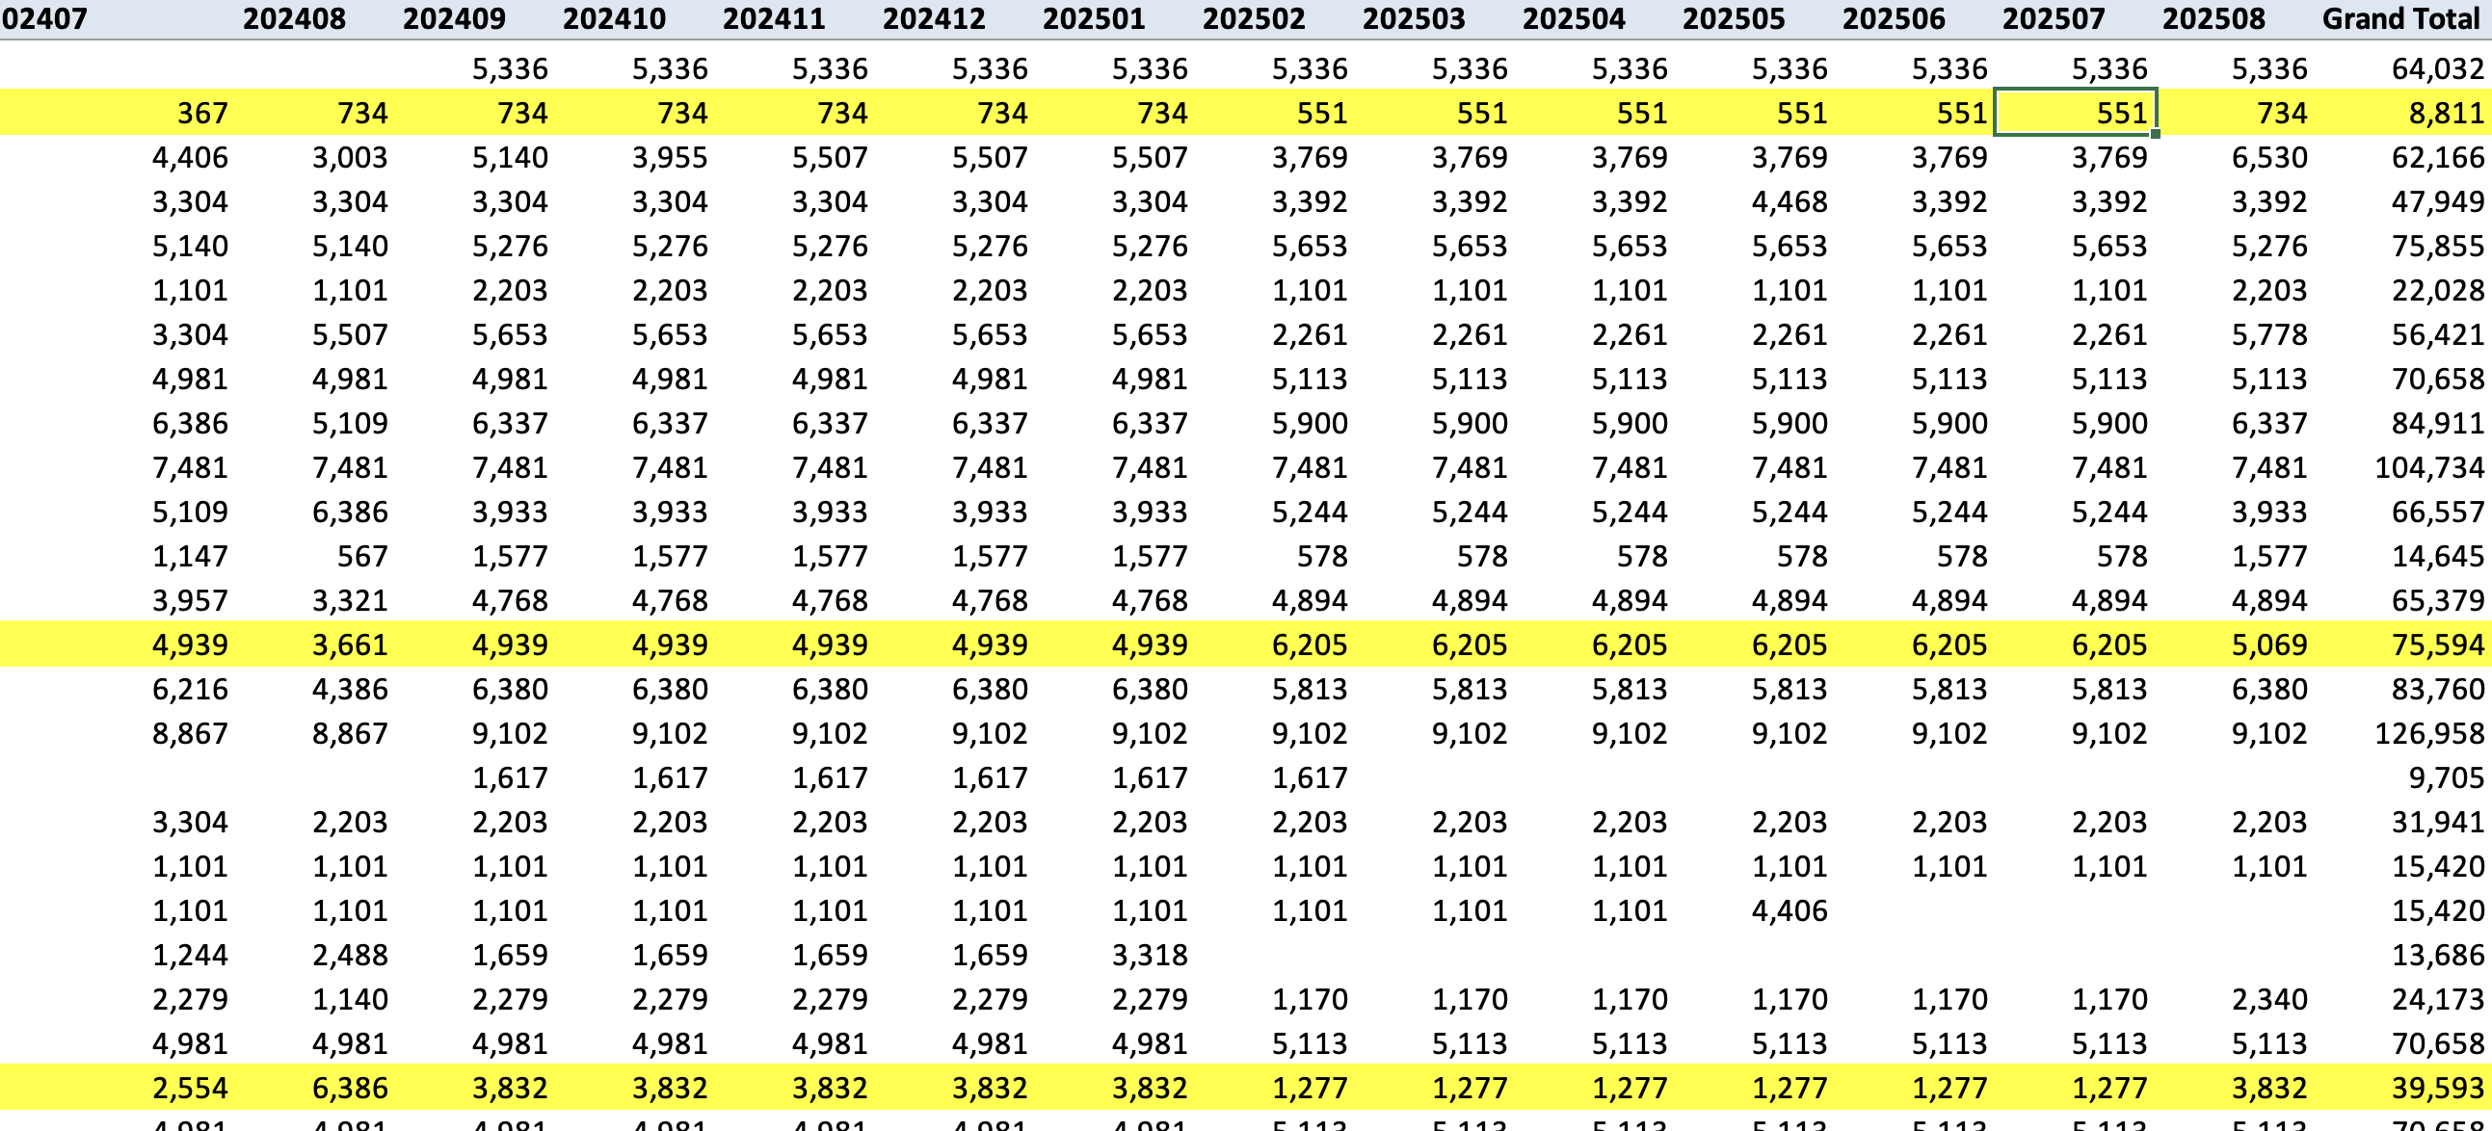
Sample Lecturer Pay by Charge Period

Slide 22
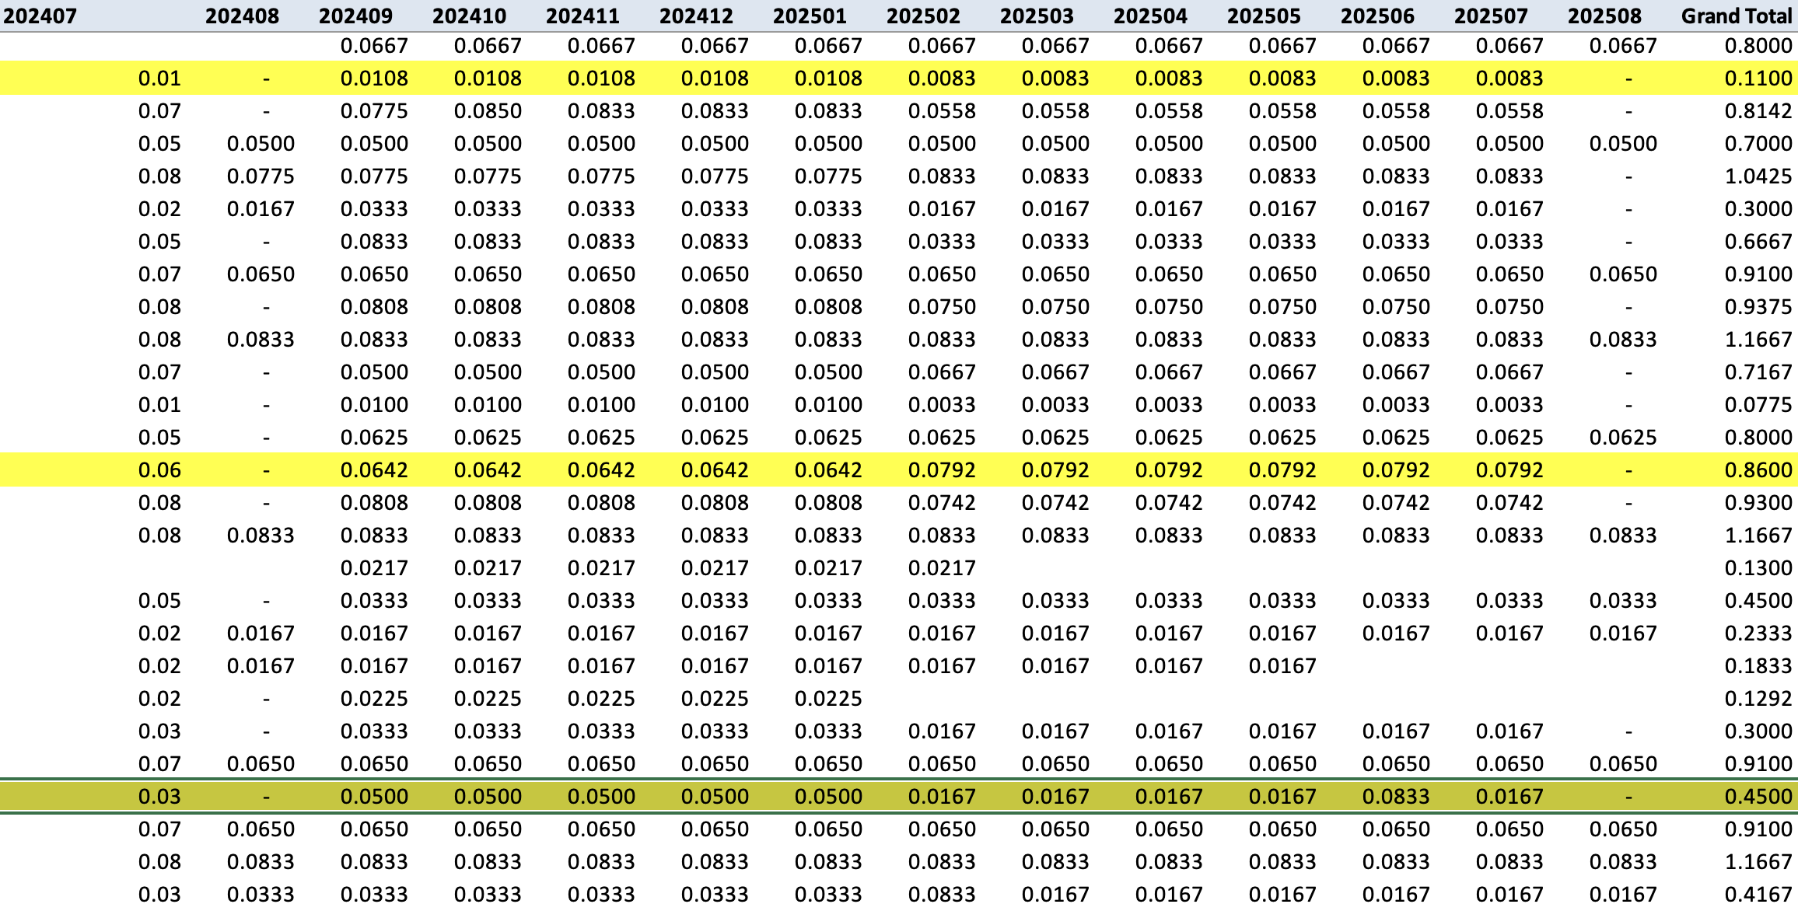
Sample Lecturer FTE by Charge Period

Slide 23
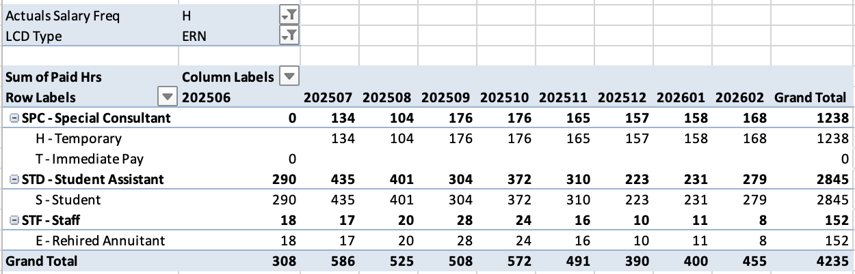
Analyze hourly employee by Charge Period

Slide 24
Questions?

