Slide 1
Using the CFS data Warehouse
Budget Officers Association
Sponsored Training

Slide 2
Agenda
Key Information
Definitions
  Field Names
  Views
Sample Uses

Slide 3
Key Fields to choose as both “Filters” and “Column Selectors”
“Dept Tree” for Campus Organizational Reporting
“CSU Fund” to identify governance for the funds in your report
“Firms Object Code” to group accounts according to primary expenditure reporting category
Account Category to group accounts at a summary level for primary expenditure category
Any custom tree to group any chartfield the way you would like to summarize/label it in a report

Slide 4
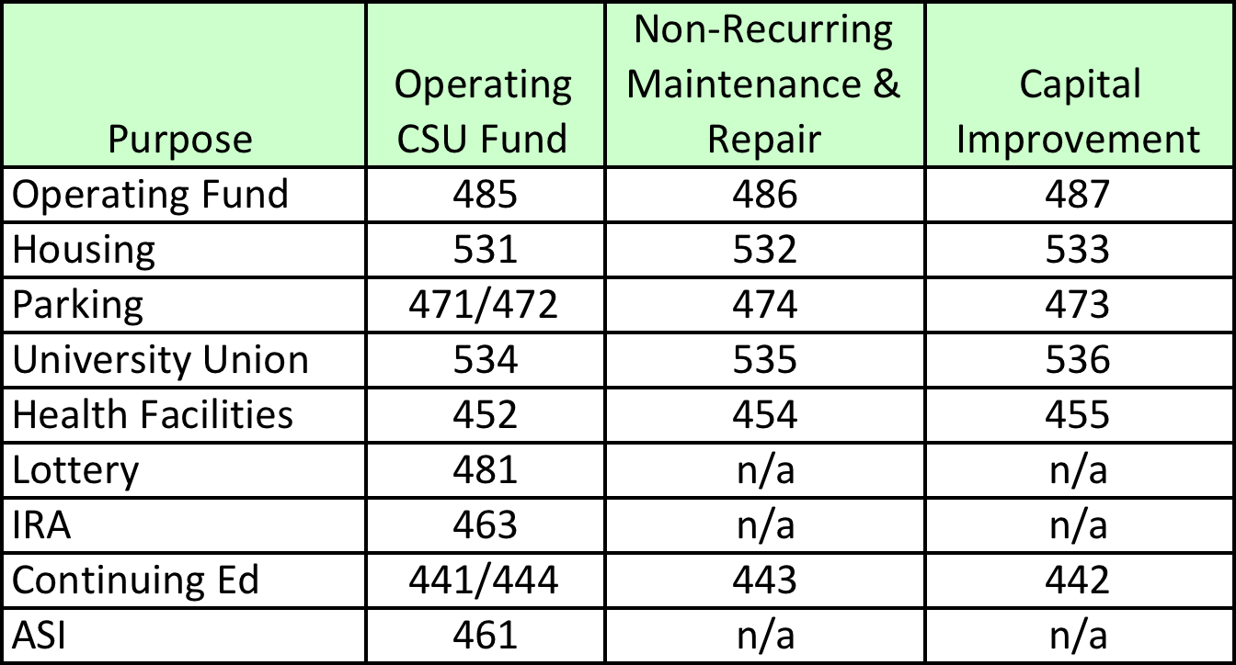
CSU Funds categorizes our Governance

Slide 5
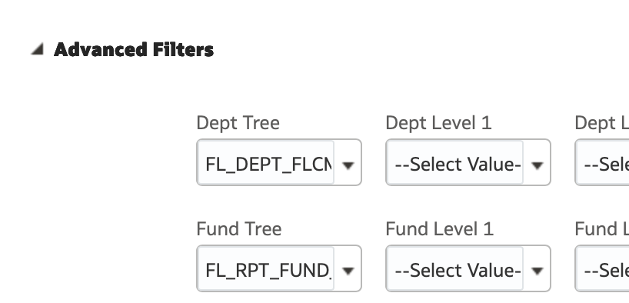
Once Data Warehouse trees have been created they can be used as an Advanced Filter

Slide 6
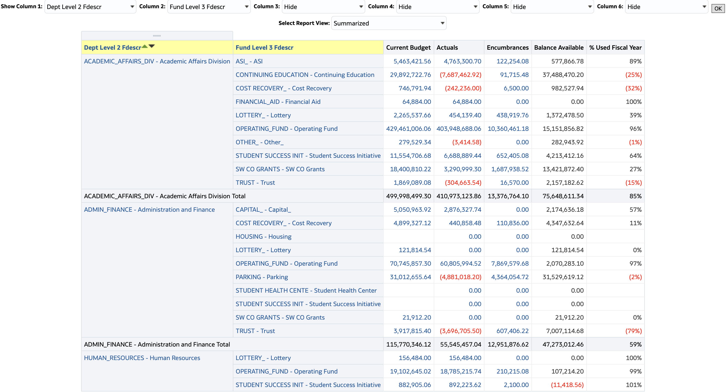
Sample Report using 2 Custom Trees – Dept and Fund

Slide 7
Summary Dashboards and Pages
Financial Reporting
  Manage My Budget
  Financial Summary As of Period
  Financial Summary Between Periods
  Financial summary by Year
  Inception to Date
  Fund Balance
Labor Cost Distribution
  Employee Detail
  Payroll Detail
  Payroll Summary
Transaction Inquiry

Slide 8
Dashboard Amount Fields defined by the ledger (or vice versa)
 |  |  | Views
Amount Field | Ledger | Period | Summarized | Standard | Scenario
Current Budget | CMP Budget |  |  |  | All
Original Budget |  |  |  |  | Entered on Home Page
Fiscal Year Budget |  |  |  |  | All Scenarios less Original
Year to Date Actuals | ACTUALS | Per 1 - Per 12 |  | X | n/a
Prior Year Actuals | ACTUALS | Per 0 |  | X | n/a
Actuals | ACTUALS | Per 0 - Per 12 | X |  | n/a
Encumbrances | KK_DTL_ENC | Per 0 - Per 12 | X | X | n/a
Pre-Encumbrances | KK_DTL_PRE | Per 0 - Per 12 | X | X | n/a
Balance Avaliable | n/a | n/a | X | X | n/a

Slide 9
Don’t forget the “Views”
Views | Manage my Budget | Fin Sum As of period | Fin Sum Between Per | Fin Sum by Year | Inception to Date
Summarized | X | X | X
Summarized with pre-encumbrances | X | X | X
Standard | X | X
Standard with Original Budget | X | X
Standard with Pre-encumbrances | X | X
Standard with Original Budget & Pre-enc | X | X
Summarized with Budget Detail | X
Activity Summary |  | X | X
Activity Summary by Acctg Period |  | X | X
Summarized by Period |  |  | X
Summary by Year (Actuals) |  |  |  | X
Summary by year (Budget Bal) |  |  |  | X
Summary by Year (Budget & Actuals) |  |  |  | X
Summary |  |  |  |  | X
Project Actuals by Year |  |  |  |  | X
Project encumbrances by Year |  |  |  |  | X

Slide 10
What are you looking for?
Dashboards are meant to provide high level summary information’s
  Exporting more detailed data to excel or other applications can often be more productive
  Excel Pivot reports
  Excel data

Slide 11
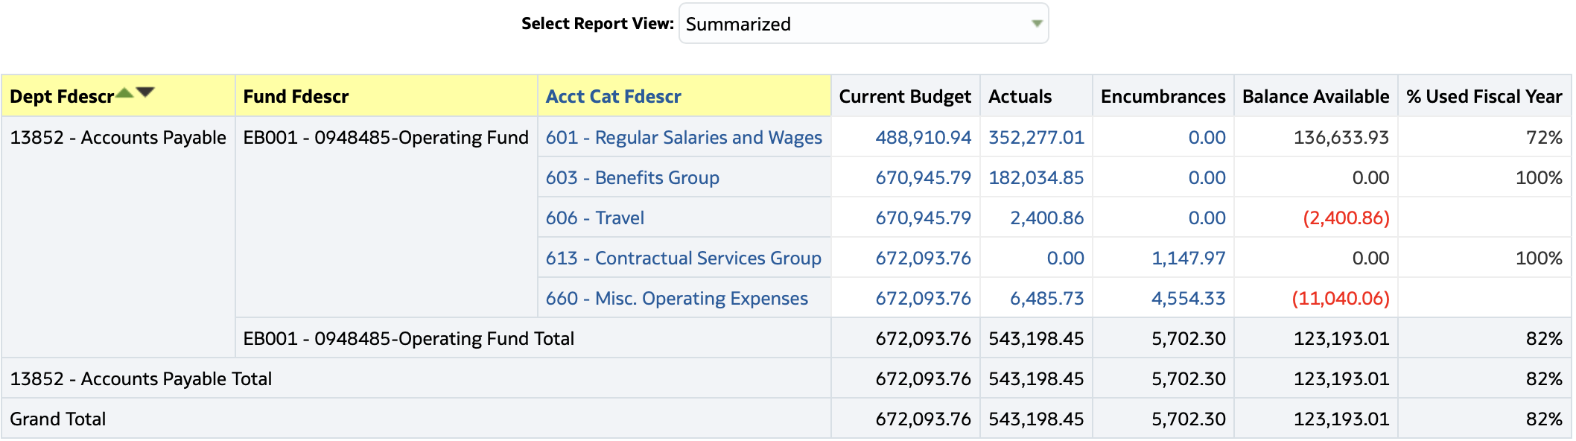
Summarized

Slide 12
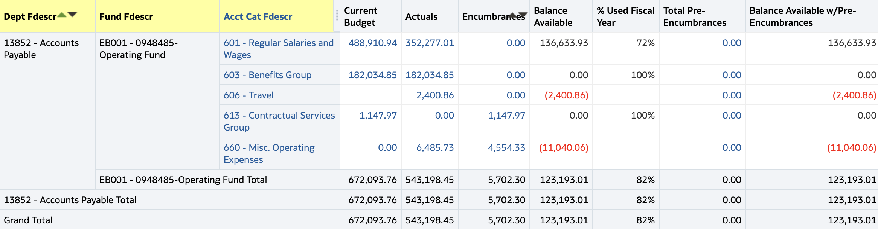
Summarized with Pre-encumbrance

Slide 13
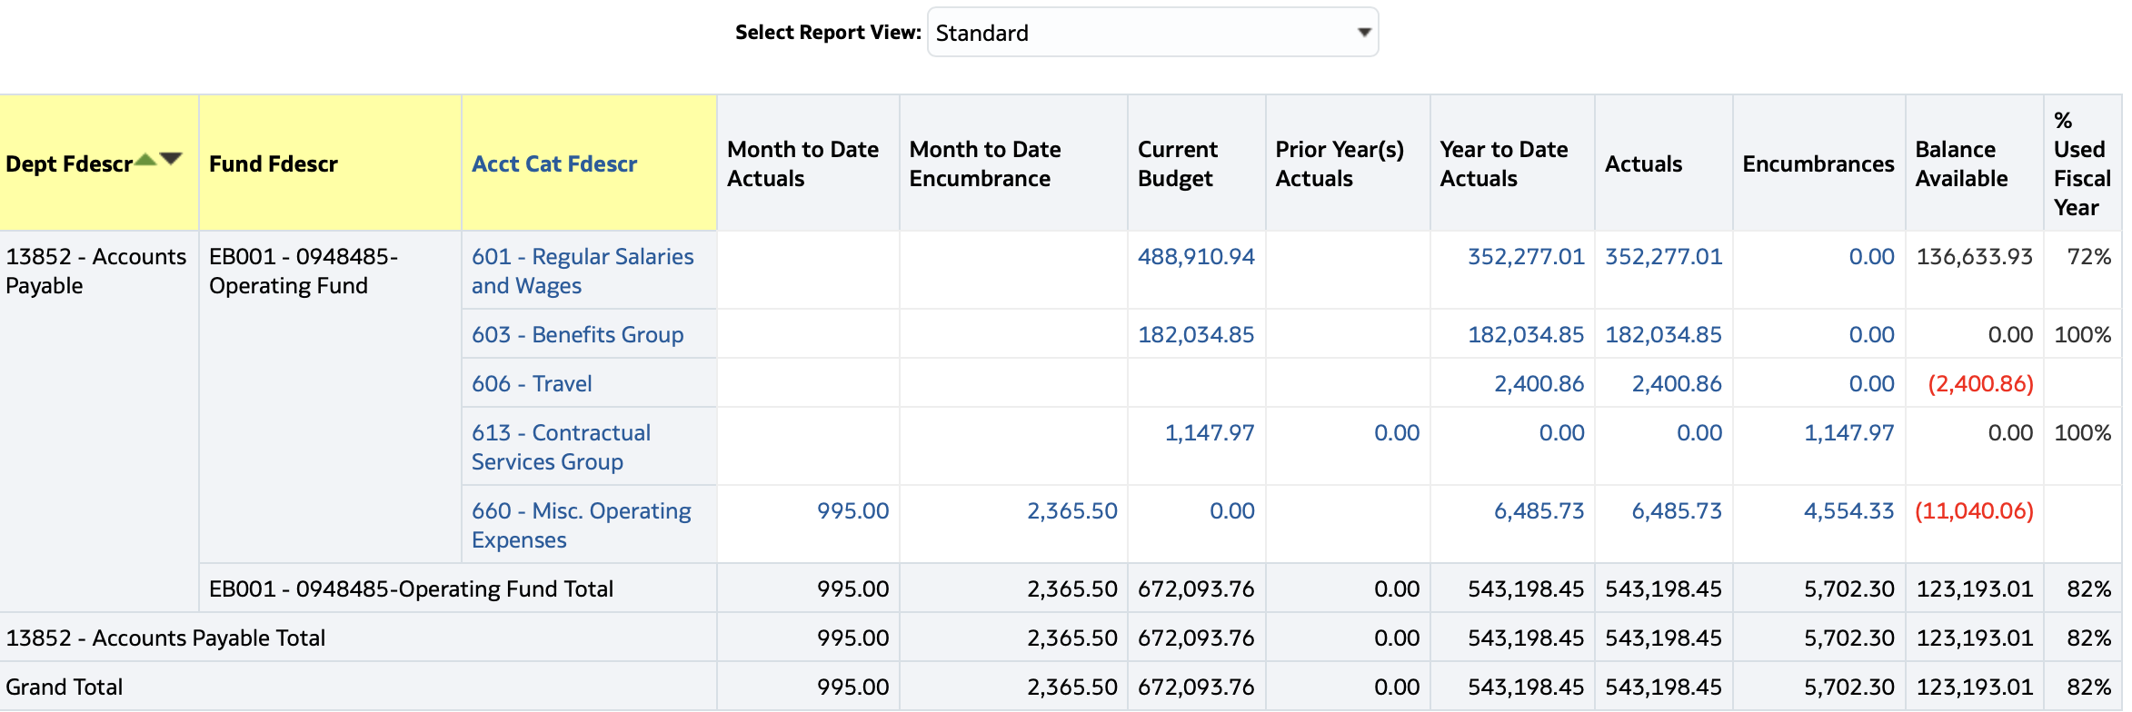
Standard

Slide 14
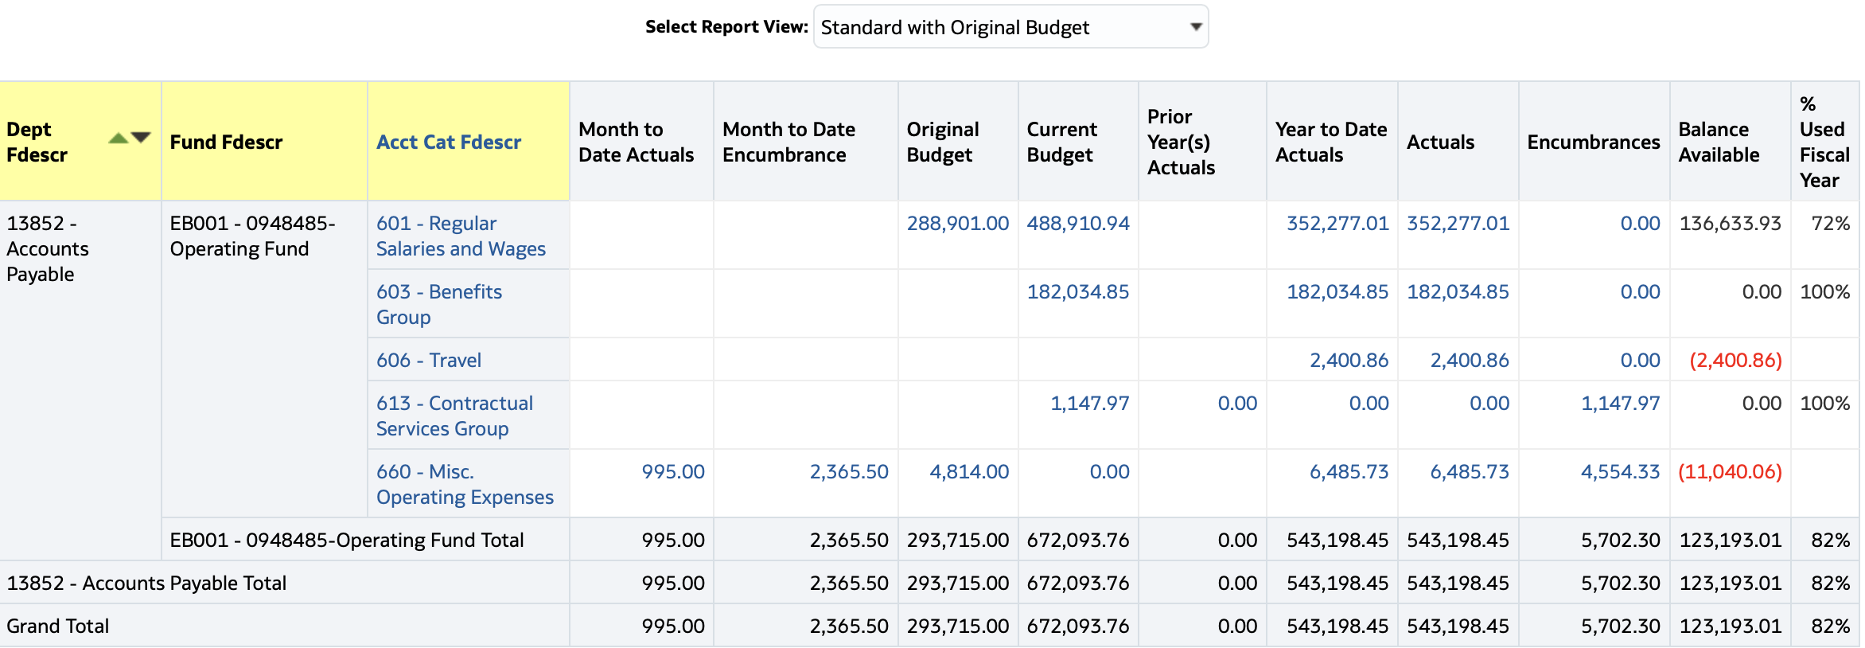
Standard with Original Budget

Slide 15
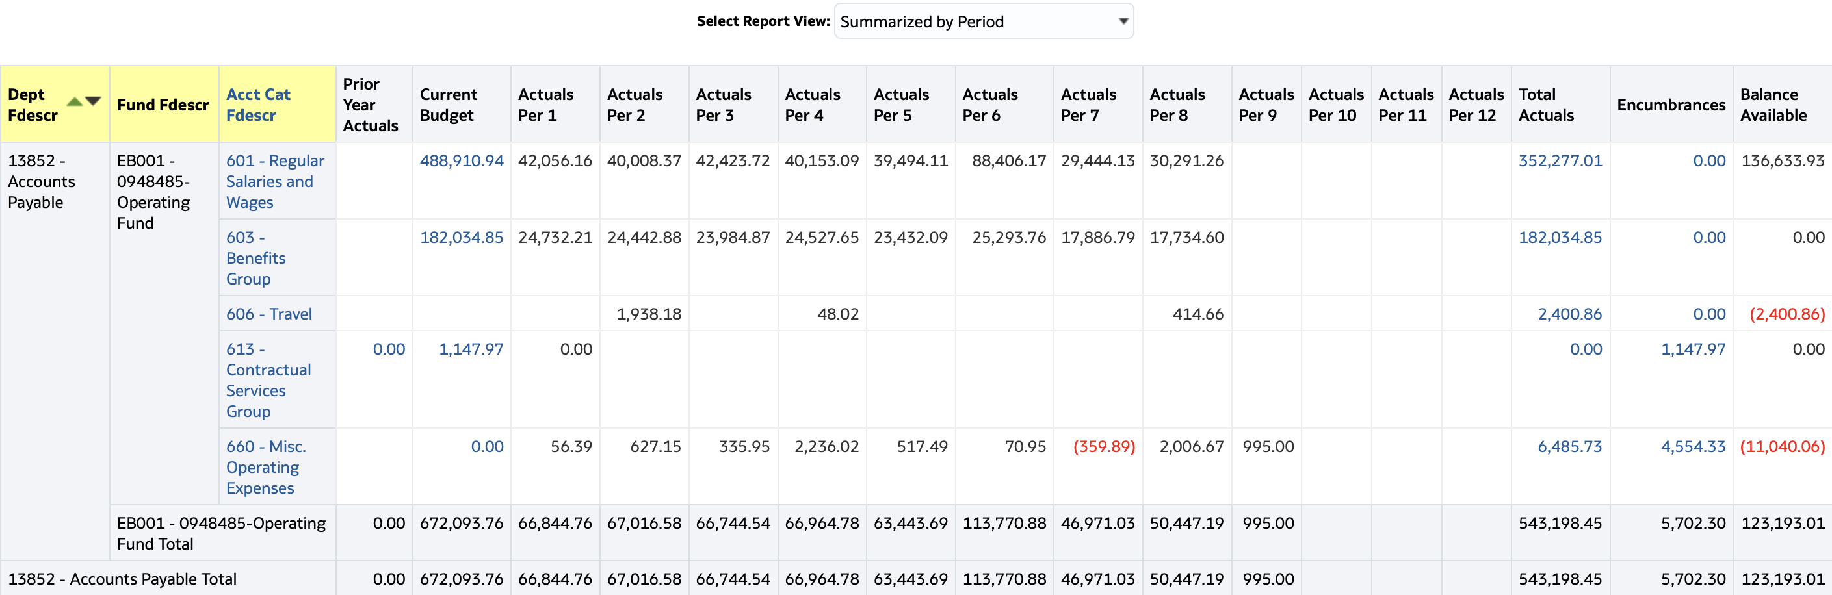
Summarized by Period

Slide 16
Sample information you can report on or research from CFS data Warehouse
Chart of Accounts
High level summary of all funds on the “state side” campus is responsible for
Expenditure patterns over multiple years
Various payroll information
Expenditure projections
Review Base Funds vs One time
Review Multi Funded Projects over multiple years
Deep Dive on a specific department, division, program or project

Slide 17
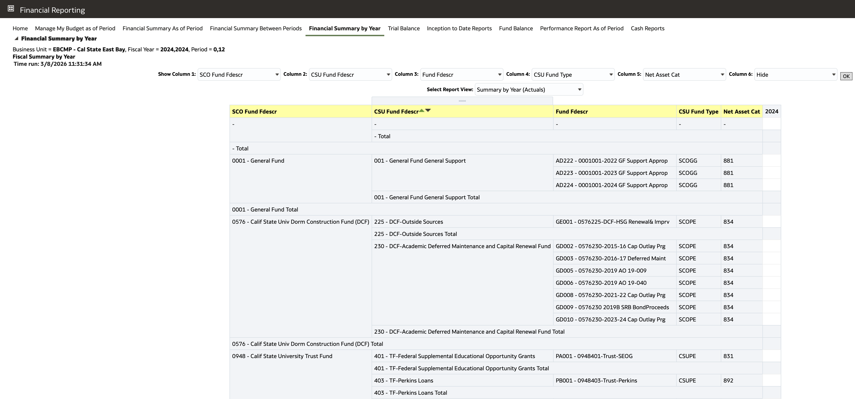
Sample
Chart of Accounts

Slide 18
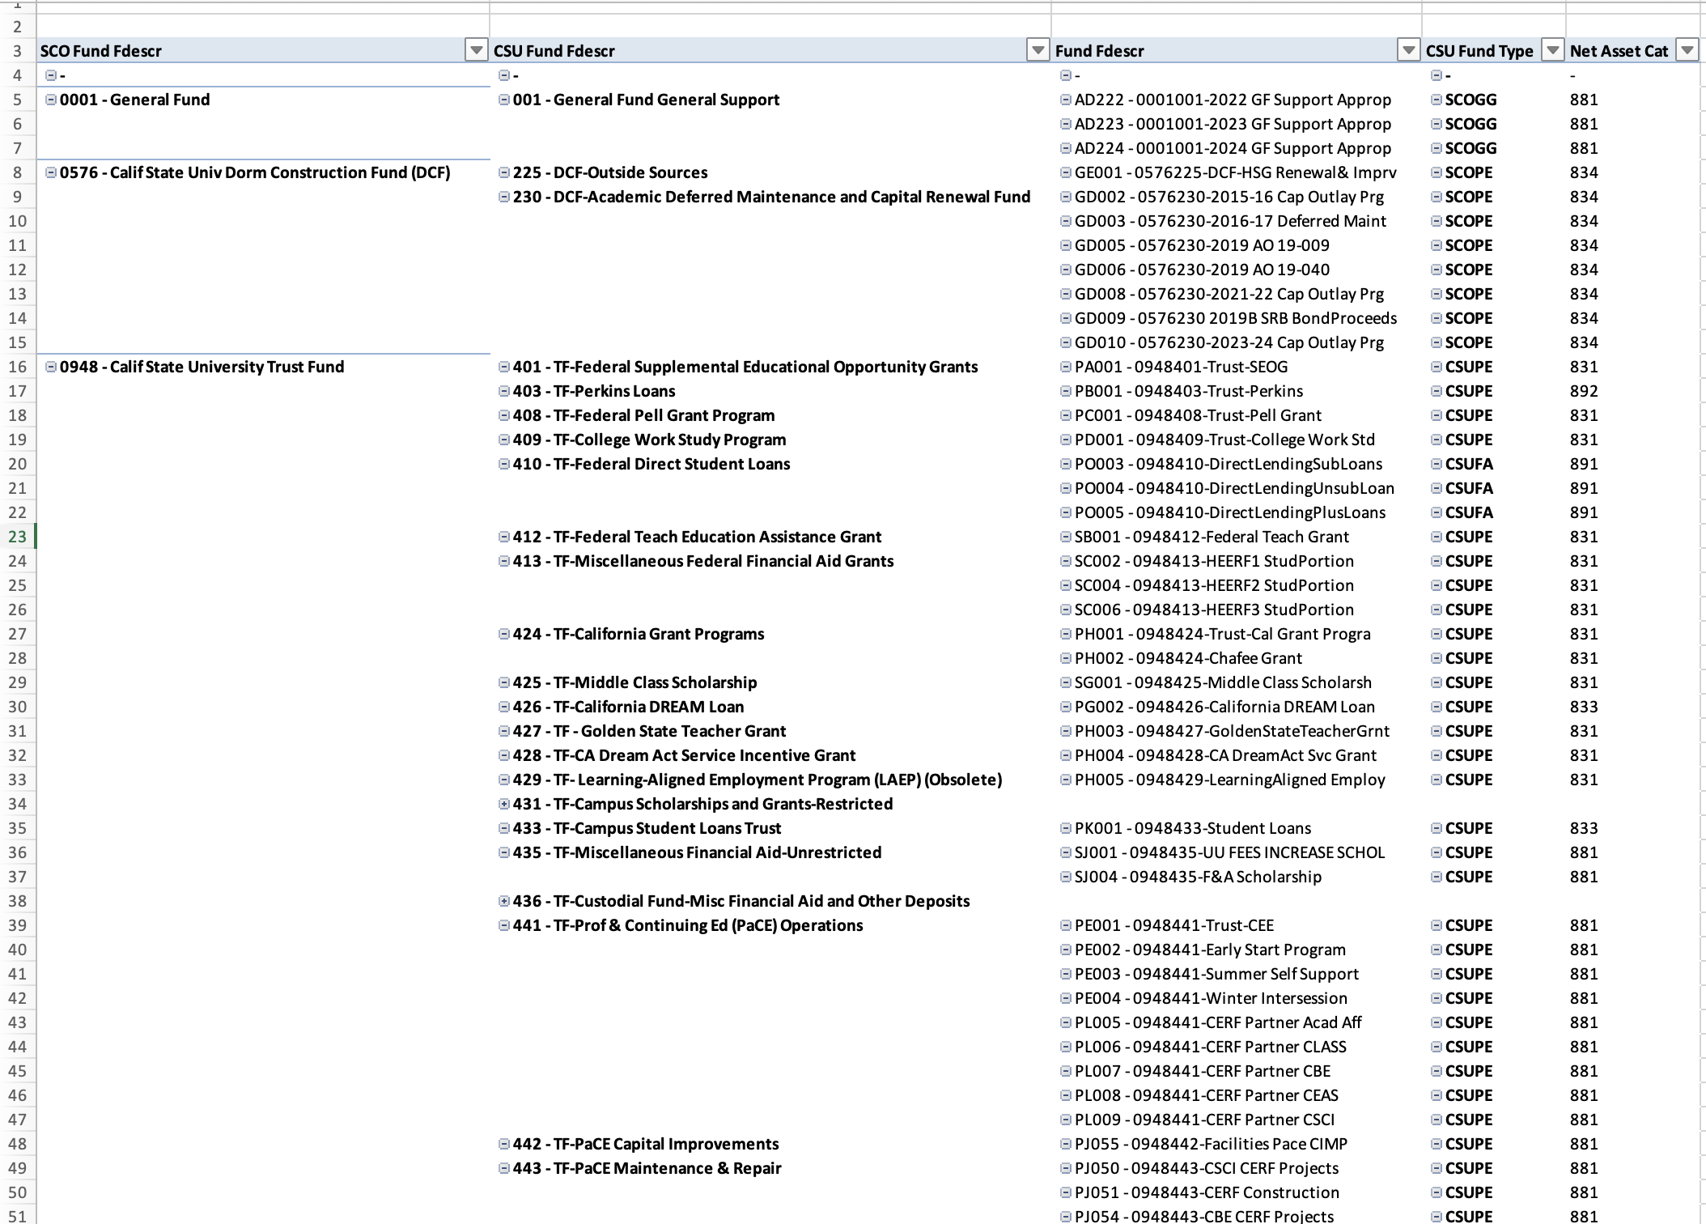
Chart of Account Exported to excel (Pivot Report)

Slide 19
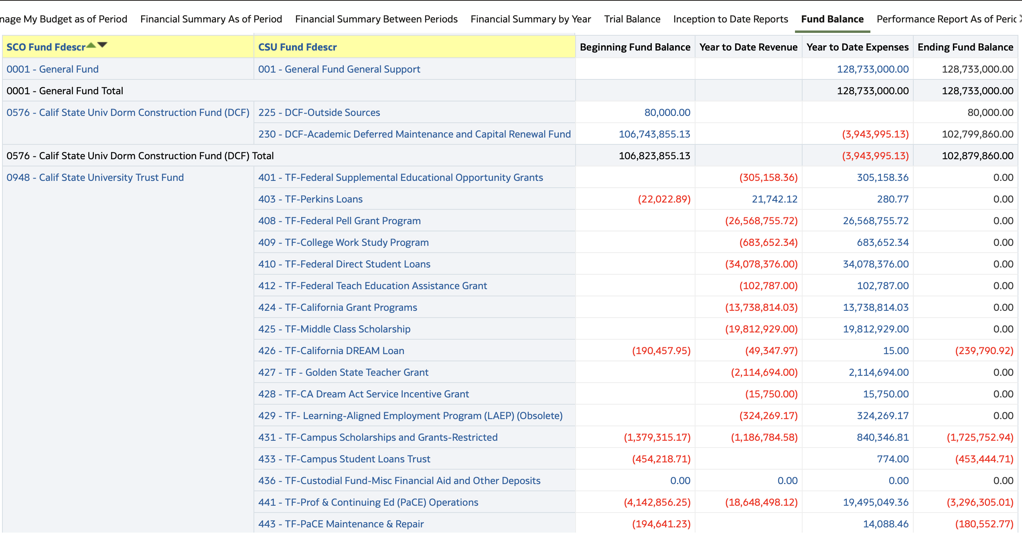
Fund Balance – Summary of All Monies governed on the state side

Slide 20
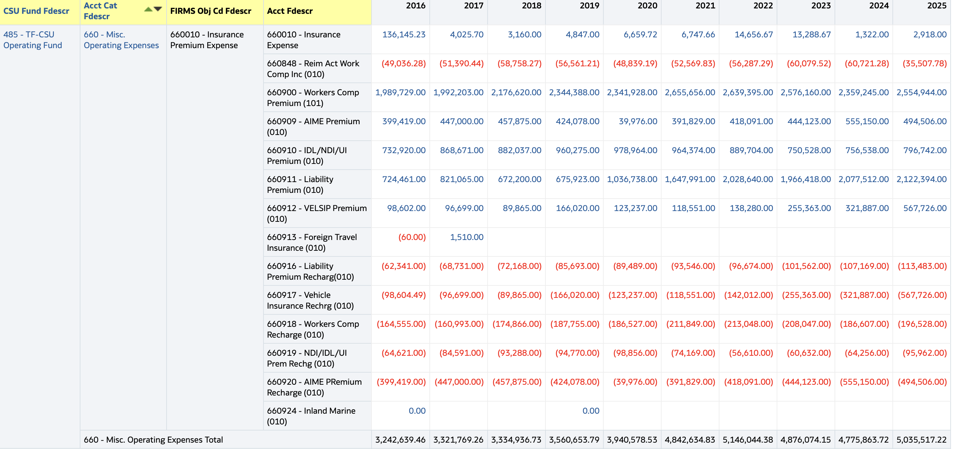
Review a cost area over multiple years

Slide 21
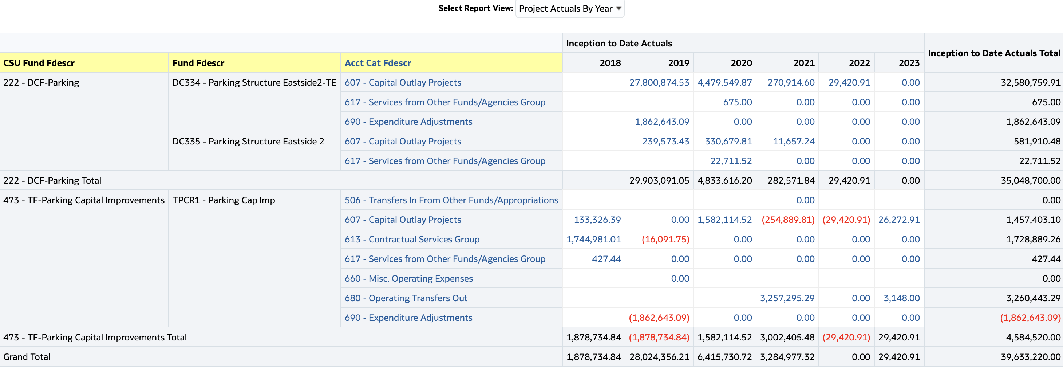
Project Actuals by Year (view)
Inception to Date Dashboard

Slide 22
Track Base Budget by Scenario over the Years

Slide 23
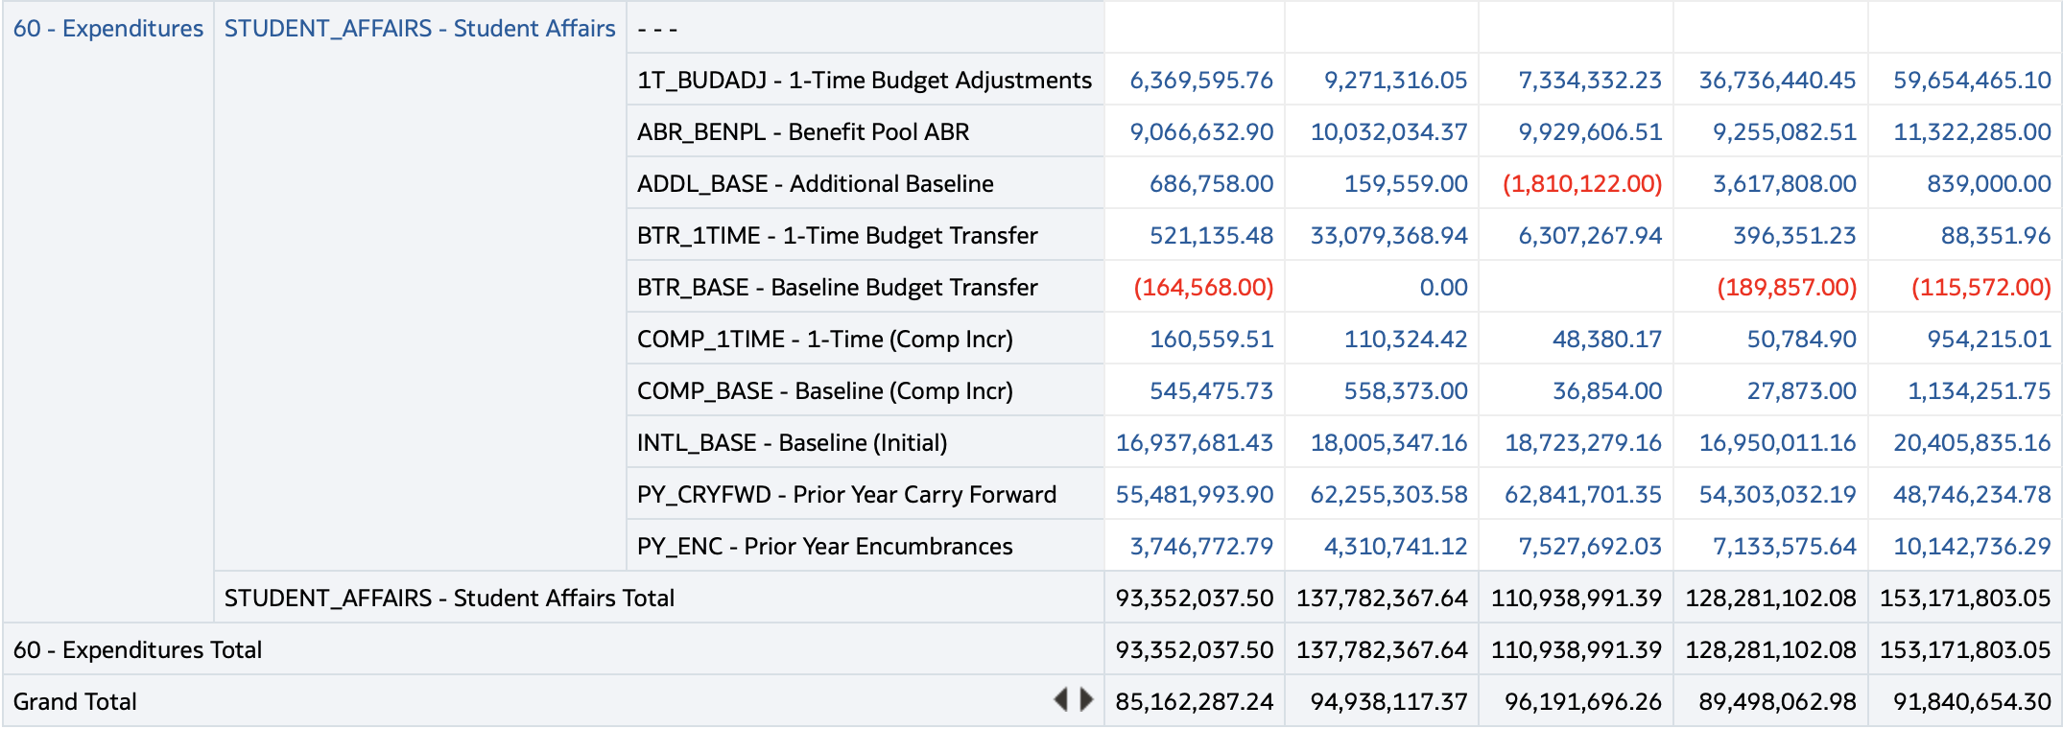
Track Budget by Scenario Over Time

Slide 24
Tracking Operating Budget Entries by Scenario for Posting errors
Row Labels | One Time ADJ | ABR_BENPL | ADDL_BASE | BTR_1TIME | BTR_BASE | COMP_1TIME | COMP_BASE | INTL_BASE | PY_CRYFWD | PY_ENC | Grand Total
50 - Revenues | (18,231,319) |  | (18,238,740) |  |  |  |  | (265,753,642) |  |  | (302,223,701)
60 - Expenditures | 18,231,319 | 0 | 18,238,740 | 0 | - | - | - | 265,753,642 | 150,823,907 | 12,919,923 | 465,967,531
Grand Total | - | 0 | - | 0 | - | - | - | - | 150,823,907 | 12,919,923 | 163,743,830

Slide 25
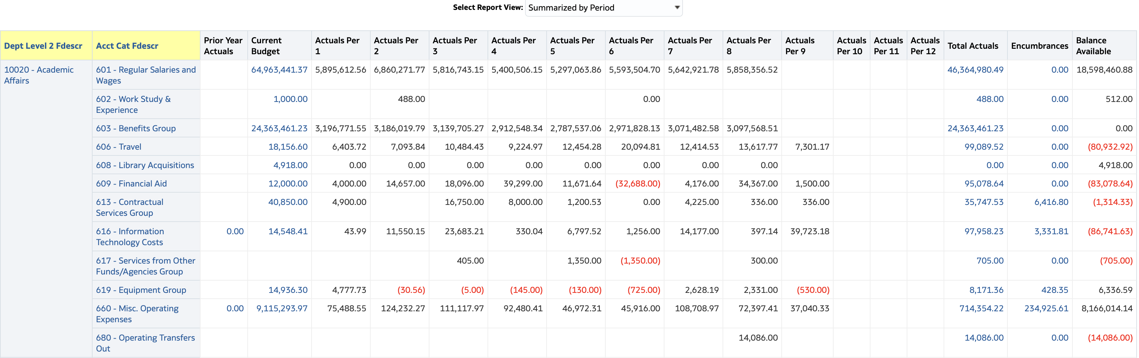
Financial Summary by Accounting Period – Assist with Projections

Slide 26
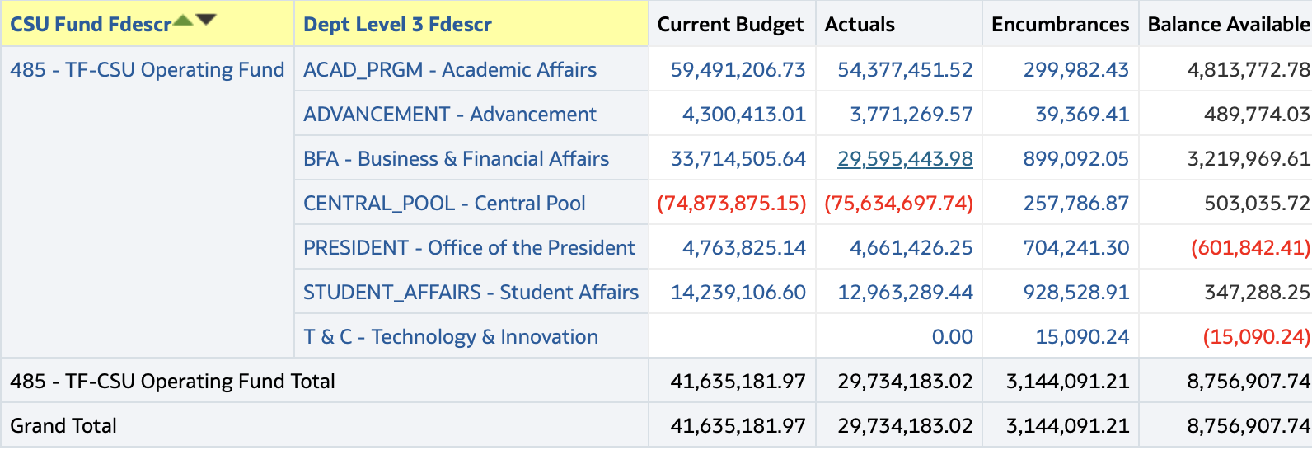
High Level Summary by Division based on the Dept Tree

Slide 27
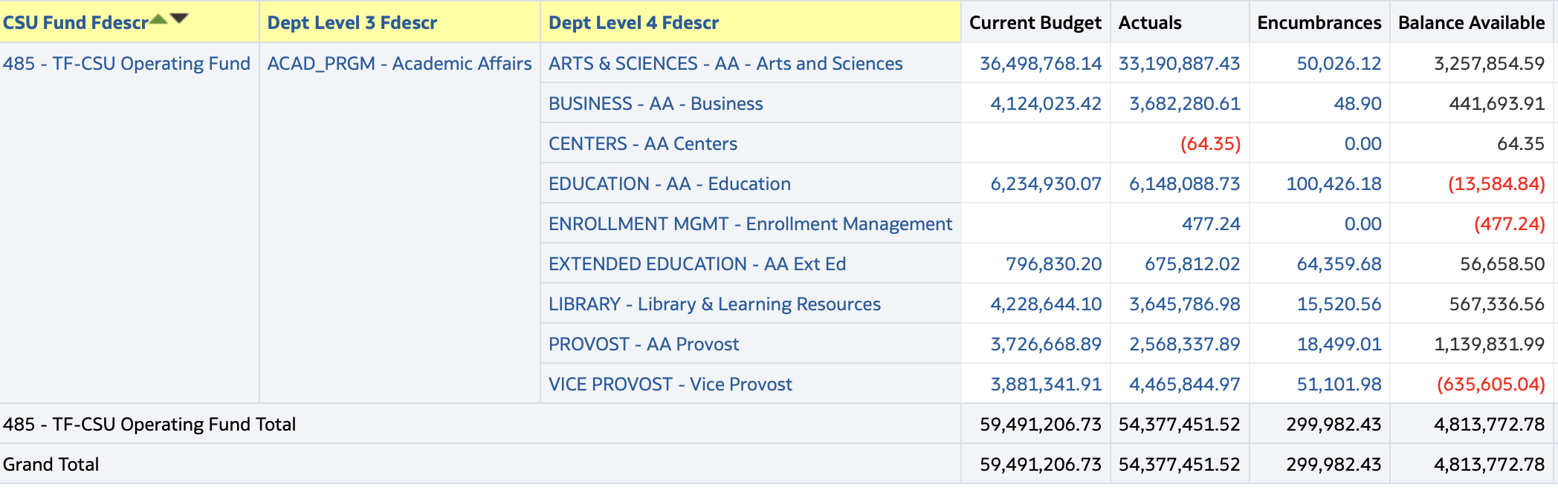
Filtering on one division and adding the next level of the tree

Slide 28
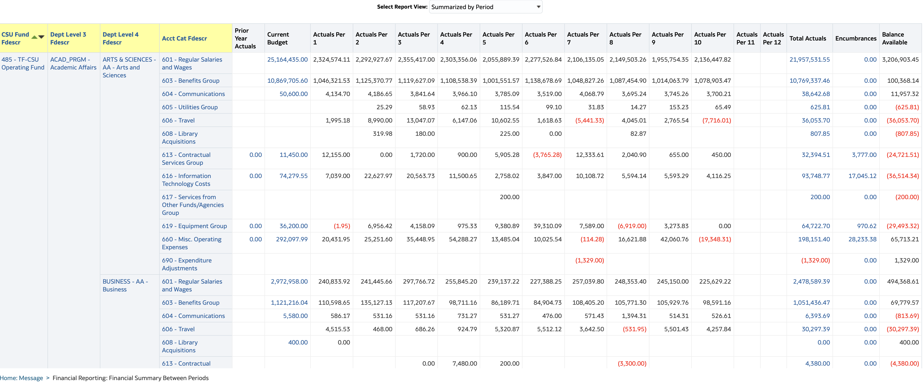
Adding another column and changing the view

Slide 29
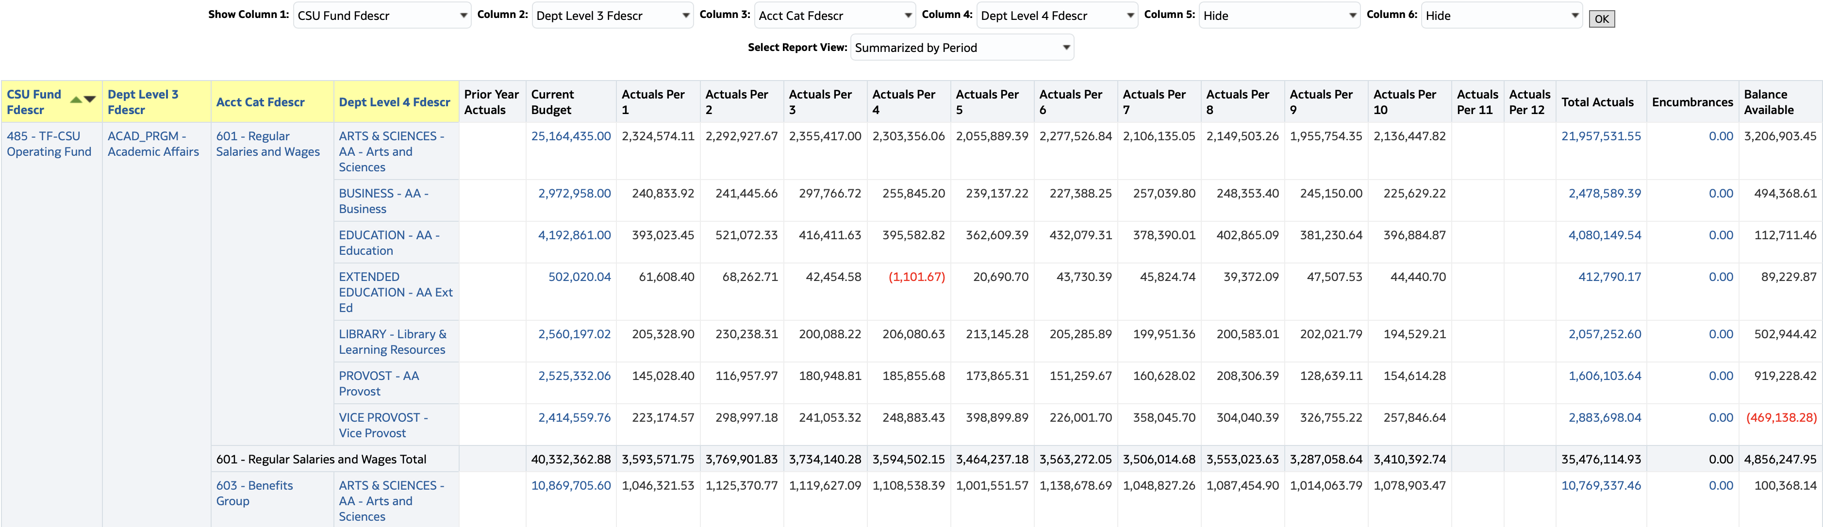
Switching the order of the last 2 columns

Slide 30
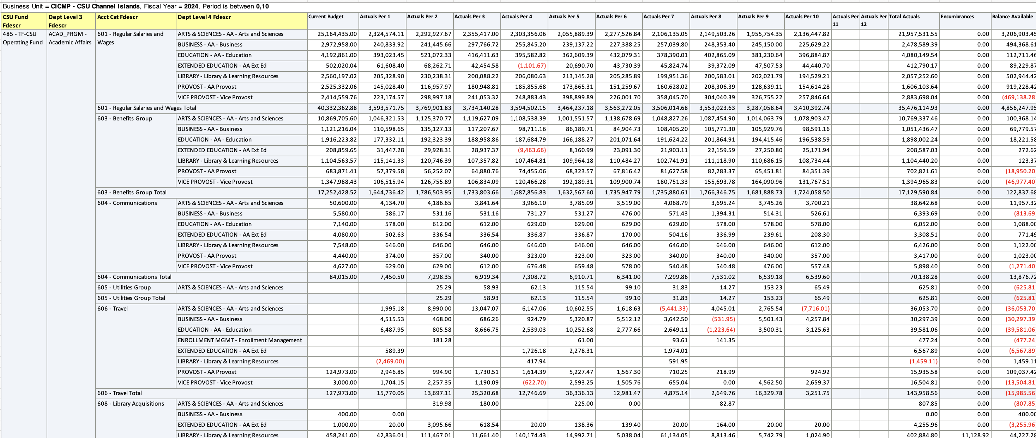
Export Formatted Data to Excel provides more flexibility for projections

Slide 31
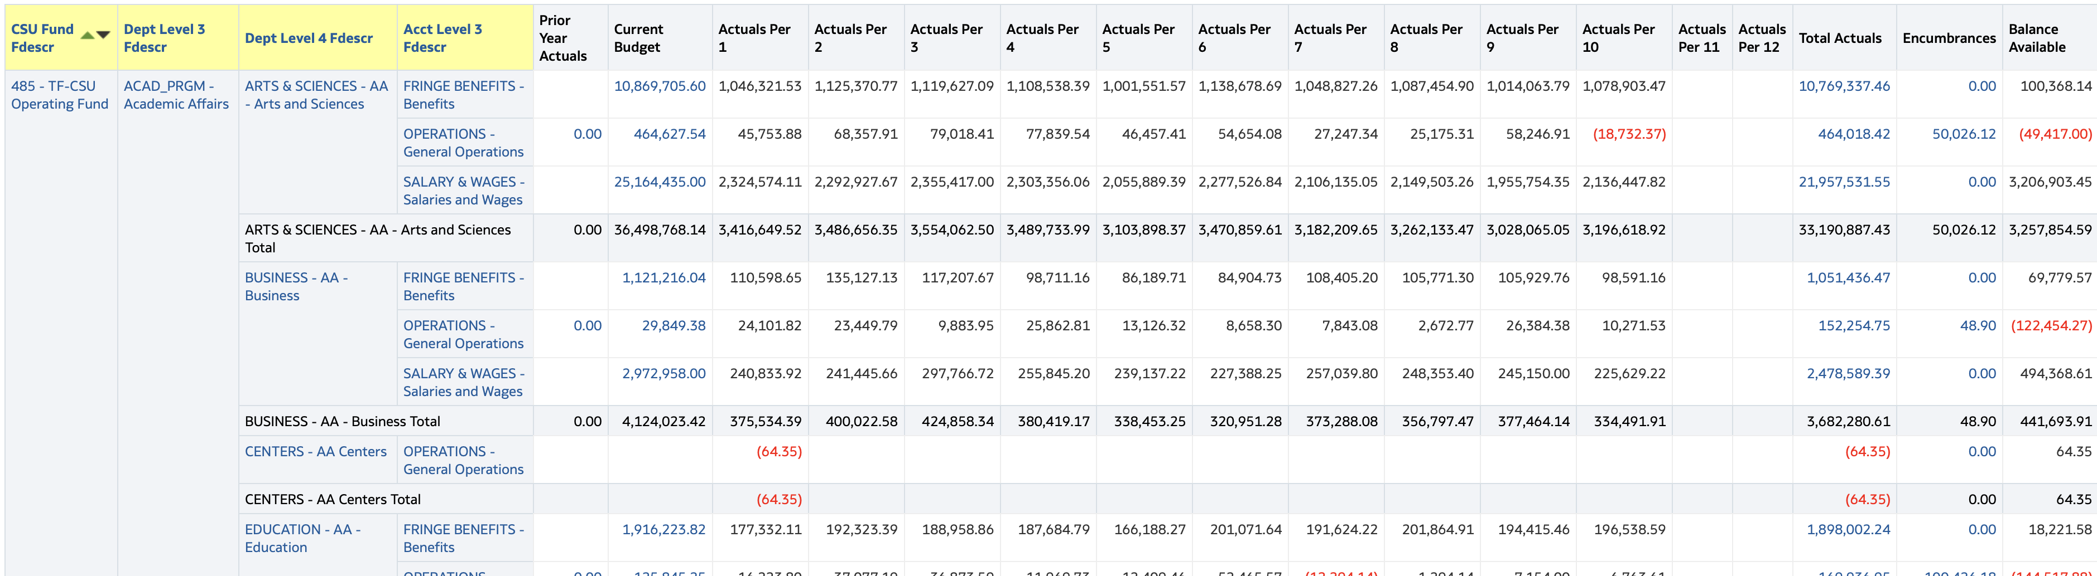
Set up for Projections at any level using custom trees
Acct Level 3 added from custom Account Tree

Slide 32
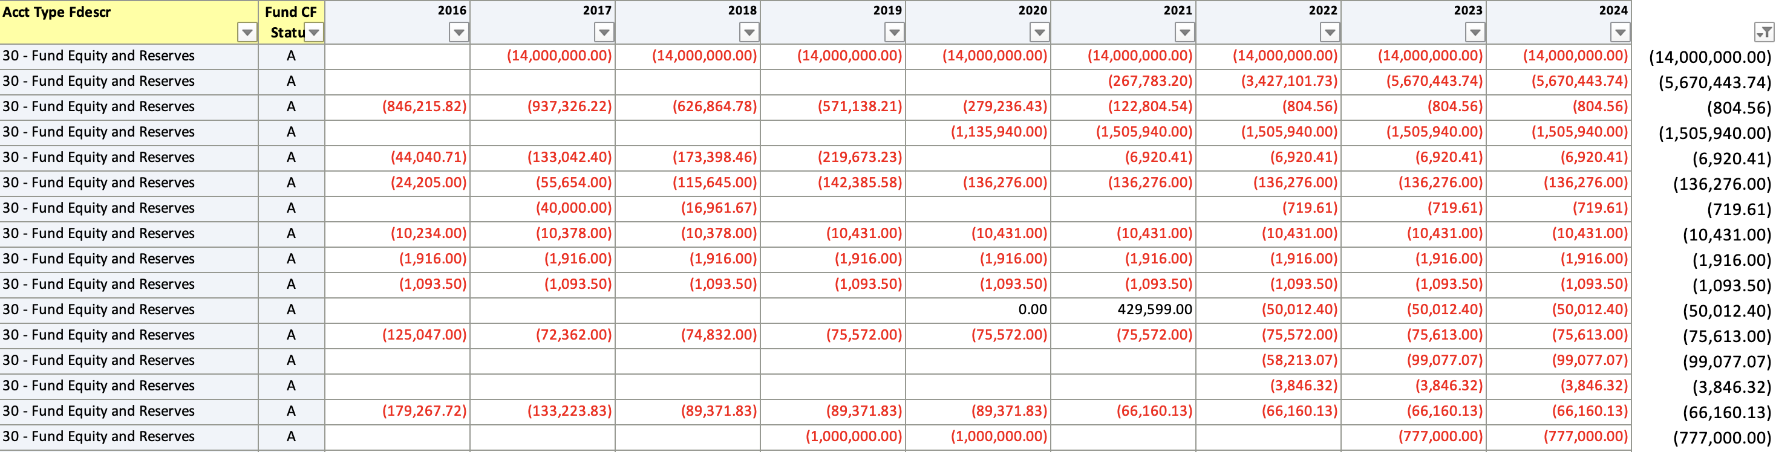
Monitor Funds with no activity greater than 2 years

Slide 33
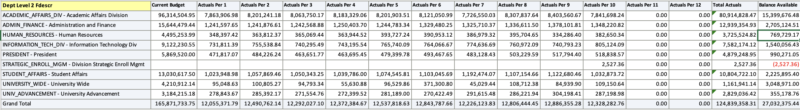
Monitor Benefit Pool for year end balance

Slide 34
Questions?

