Slide 1



February 26, 2026
Redwood Region RISE (Resilient Inclusive Sustainable Economy) Quarterly Collaborative Meeting (Zoom)
Learn More: bit.ly/Redwood-RISE

Slide 2


Welcome Everyone / ¡Bienvenidos todos!
You have arrived at the 2026, Q1 Quarterly Collaborative Meeting of Redwood Region RISE’s Implementation Phase.
Today’s theme is Arts, Culture, and Tourism
Please introduce yourself in the chat–name, affiliation (if applicable) and where you are zooming in from: https://native-land.ca/
What's a hobby or creative outlet you enjoy?
Let us know in the comments!

Slide 3
Land Acknowledgement
Redwood Region RISE’s Collaborative is located on the present and ancestral Homeland and unceded territory of Indigenous People. Tribes and Nations in our region include:
Bear River Band of the Rohnerville Rancheria; Big Lagoon Rancheria; Big Valley Band Rancheria; Blue Lake Rancheria; Cahto Tribe; Coyote Valley Band of Pomo Indians; Elem Indian Colony; Elk Valley Rancheria; Guidiville Indian Rancheria; Habematolel Rancheria of Pomo Indians; Hoopa Valley Tribe; Hopland Band of Pomo Indians; Karuk; Koi Nation; Manchester Band of Pomo Indians; Middletown Rancheria of Pomo Indians; Pinoleville Pomo Nation; Potter Valley Tribe; Pulikla Tribe of Yurok People; Redwood Valley Little River Band of Pomo Indians; Robinson Rancheria; Round Valley Indian Tribes; Scotts Valley Band of Pomo Indians; Sherwood Valley Rancheria; Tsnungwe; Tolowa; Tolowa Dee-ni' Nation; Trinidad Rancheria; Wailaki; Wiyot; Yurok Tribe of the Yurok Reservation; Yokayo Rancheria.
We also acknowledge the Mattole and Northern Pomo peoples, whose ancestral homelands are within this region and whose living descendants continue to steward their cultures, languages, and traditions.
We make this land acknowledgement in recognition that our words must be matched by action and approach. Learn more: "What Good Is a Land Acknowledgment?"

Slide 4
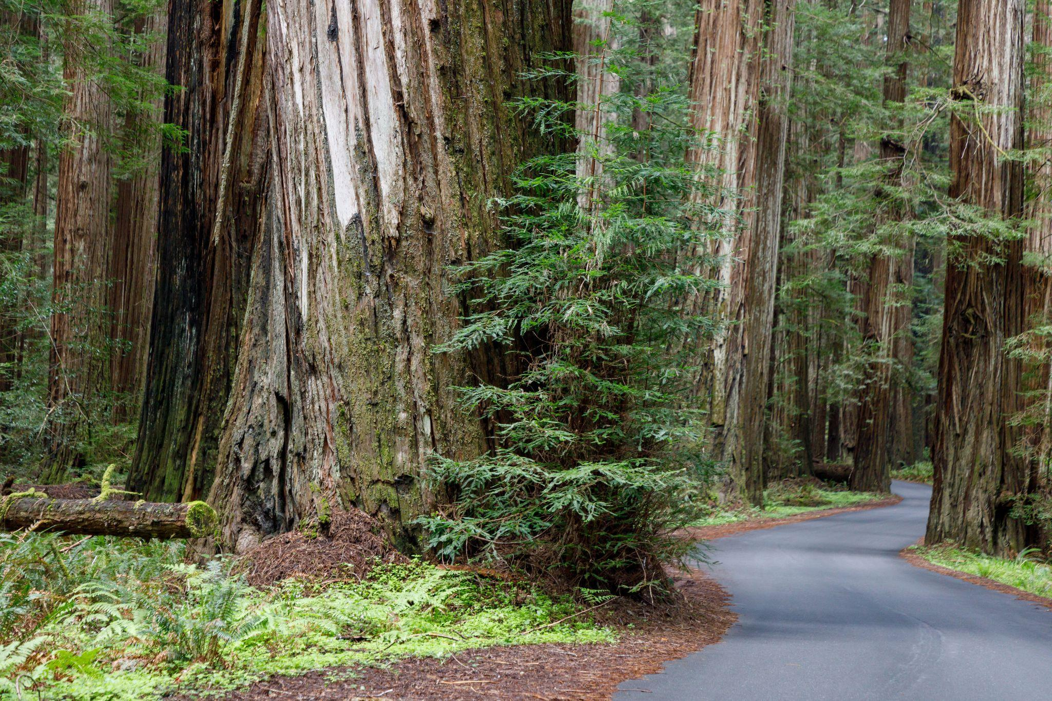
Housekeeping Notes
Reminder: This meeting is our check-in space to get updates and progress reports of Redwood Region RISE and California Jobs First. → The work happens at the Tables!
Welcome (Back)!
Convening Team👋🏽
Informational, Sector-Focused Sessions (No per diems)
Slides, Spanish recap will be shared after
Please mute your microphone
Questions in chat (DMs to the team)
→ we gather & answer your questions!

Slide 5
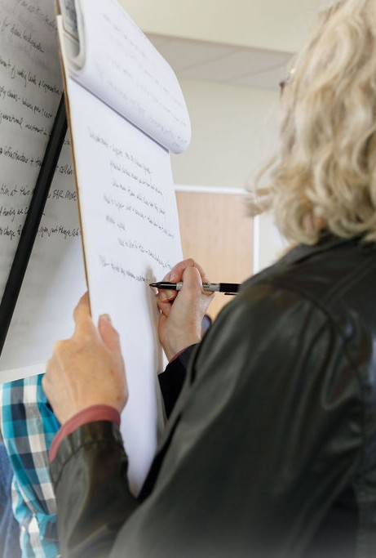
RRRISE Meetings - Let’s All Agree To…
Demonstrate good manners, courtesy, and consideration.
Let one person speak at a time and listen when they are speaking.
Aim to stay focused on the matters at hand.
Maintain a respectful and professional environment where disruptive or disrespectful behavior may result in suspension from participation or dismissal from the meeting.
Uphold zero tolerance for harassment, abuse, derogatory remarks, personal insults, threats, or any form of discrimination.

Slide 6
11:00- 11:05 | Welcome (Back)! | CCRP
11:05- 11:15 | Admin Updates Progress update: RRRISE’s key milestones in Q3 of 2025 | CCRP, Collaborative leaders
11:15- 11:45 | State of the Arts, Culture, and Tourism Sector Understanding the sector and its industries Current SWOT analysis Towards a regenerative model of tourism and cross-cutting possibilities What’s Next? The Sustainable Recreation & Tourism state-wide cohort | Sector Investment Coordinator Calder Johnson
11:45- 12:00 | Catalyst Project Highlights Del Norte Performing Arts and Civic Center Carving a Legacy: Tribal Traditions, Woodworking, and Workforce Development | Nick Rail (Partnership for Performing Arts), William Matsubu (Blue Lake Rancheria)
12:00- 12:25 | Other Arts, Culture, and Tourism Projects and Priorities Healthcare Clowning Project Grant-writing workshop Sacramento Advocacy Days Outdoor Recreation Economy Summit The Great Redwood Trail, Public Art, and Economic Development Ag Tourism Interested in getting involved? calder.johnson@gmail.com | Calder, Julie Douglas (Dell’Arte International), Capitol Impact, North Coast Growers' Association
12:25- 12:30 | Recap & next steps Join upcoming RRRISE meetings | CCRP
12:30 | Adjourn Meeting | CCRP
Agenda
Theme: Arts, Culture, and Tourism
Goals for today:
Understand the current landscape of the Arts, Culture, and Tourism sector, including regional momentum in outdoor recreation and cross-regional collaboration.
Explore economic trends and challenges impacting artists and tourism-related small businesses.
Identify opportunities to strengthen the sector.

Slide 7
Admin Updates: Overview
Philanthropic funding - new projects updates
Policy Working Group - draft RISE Policy Platform + implementation guide coming in June
State Implementation Funding - updates on March 2nd
Sustainability Working Group - draft report + model options coming in June
Semi-Annual Report - catch up with all our projects and sector support activities!
→ Want more info? Write us at ccrp@humboldt.edu

Slide 8
Get Involved With Our Sector-Based Work
Sector Investment Coordinators:
Arts, Culture and Tourism - calder.johnson@gmail.com
Health and Caregiving - RRRISE@nchiin.org
Renewable and Resilient Energy - mmarshall@bluelakerancheria-nsn.gov
Working Lands and Blue Economy - paloma@westcenter.org, aspen@westcenter.org, sarah@westcenter.org
Workforce Development (Capitol Impact) - annie@capitolimpact.org, cristina@capitolimpact.org, jasleen@capitolimpact.org
Check out our “Activation Plans” to learn more about RRRISE’s sector work
Announcements from our Tables
Equity Committee of the Voting Block: Elevate Funds (micro-grants program)
Tribal Table: supporting native youth development; Tribal Cultural Gathering in Summer ‘26
RRRISE Executive Committee
Walter Gray (Quarterly Chair), Heidi Moore-Guynup, Asa Mattice, Angela Shull, Annette Kamaloni, Paul Garza Jr., and Maria Dahlin

Slide 9
ARTS, CULTURE, TOURISM

Slide 10
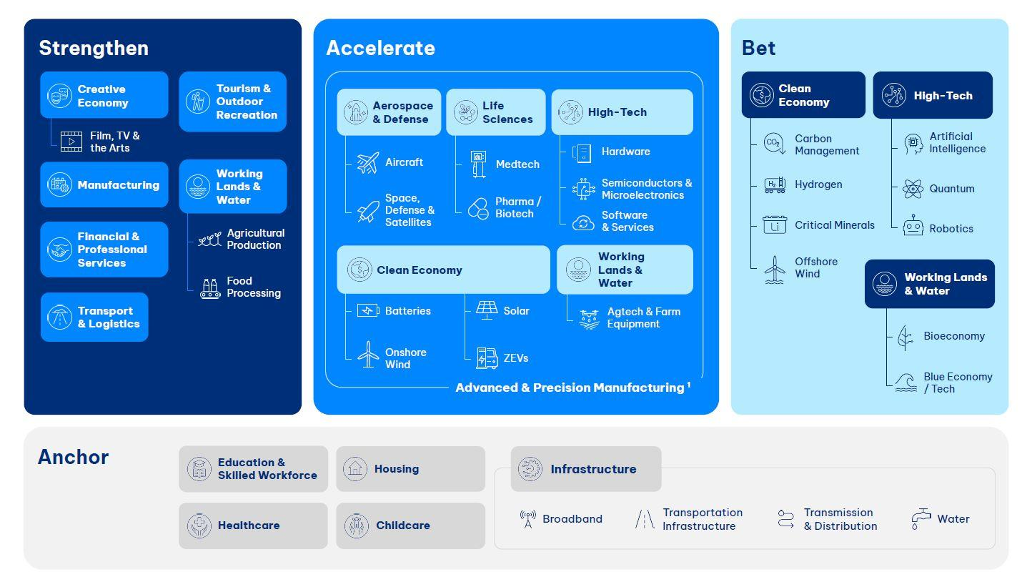
RRRISE Priority Sectors
Working Lands &
Blue Economy
Renewable Energy
Health &
Caregiving
Arts & Culture,
Tourism

Slide 11
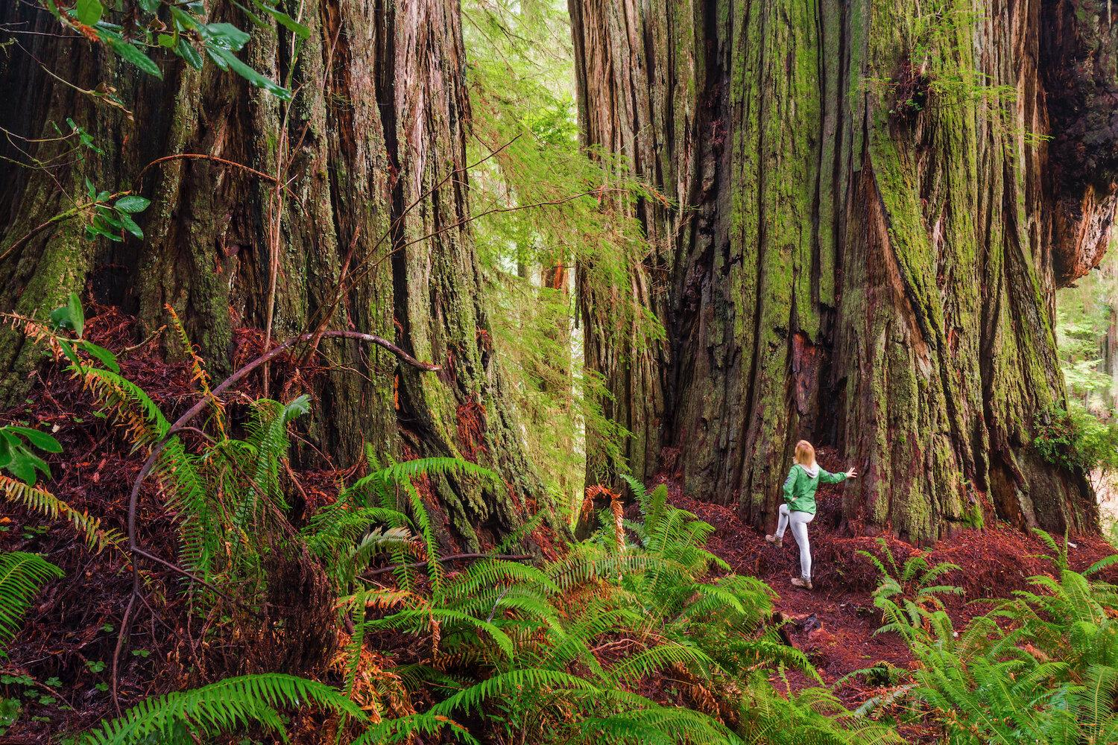
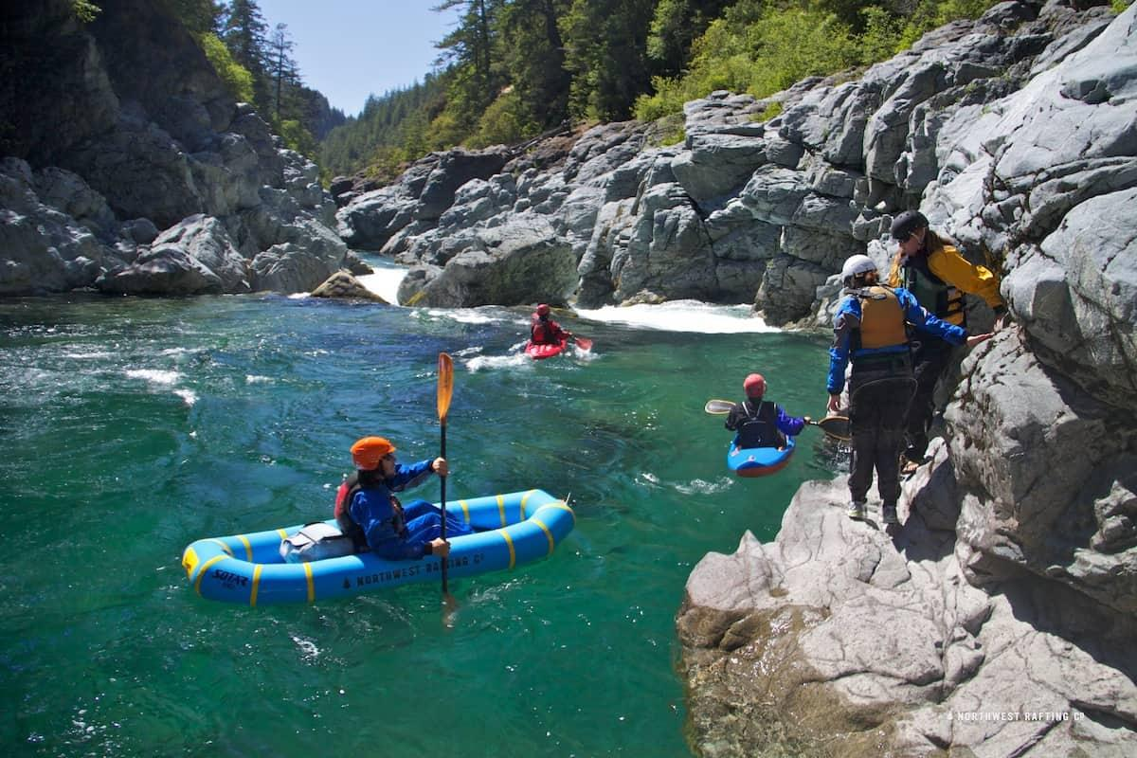
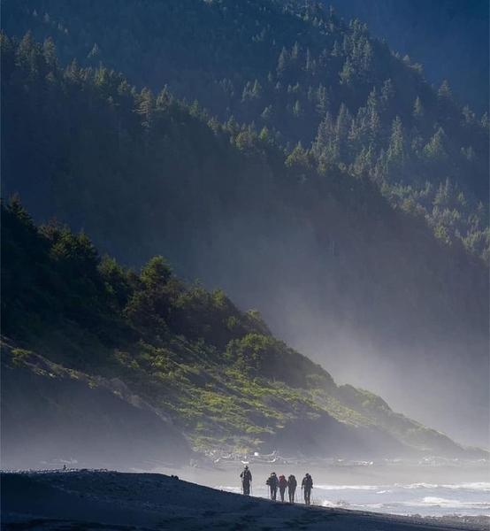
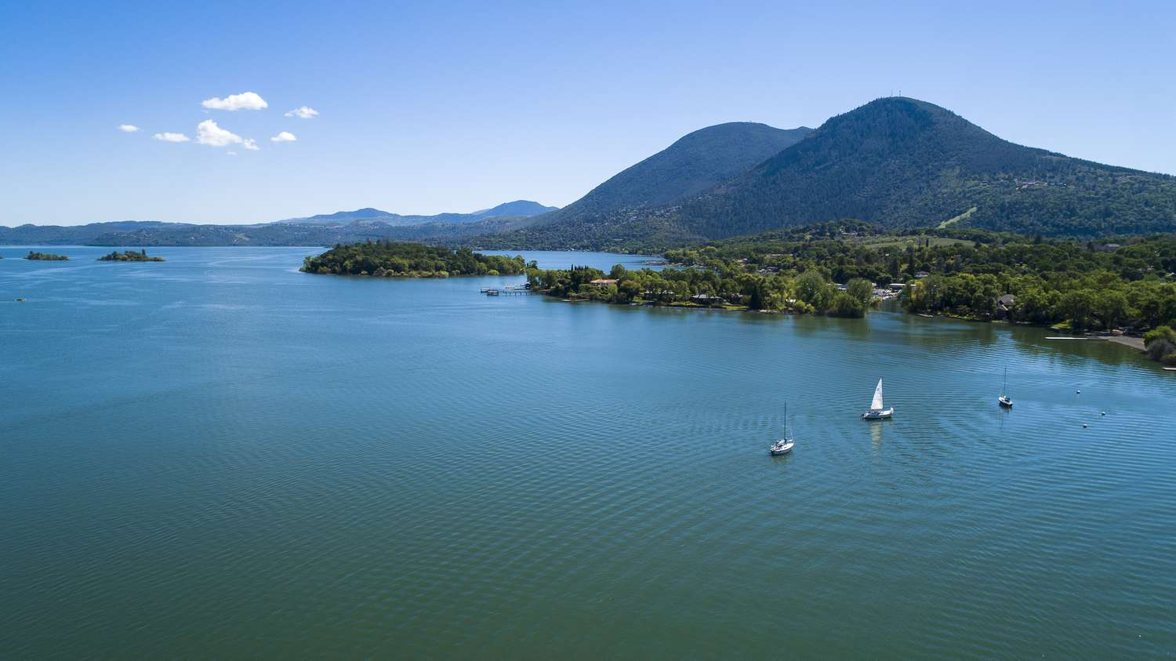

Slide 12

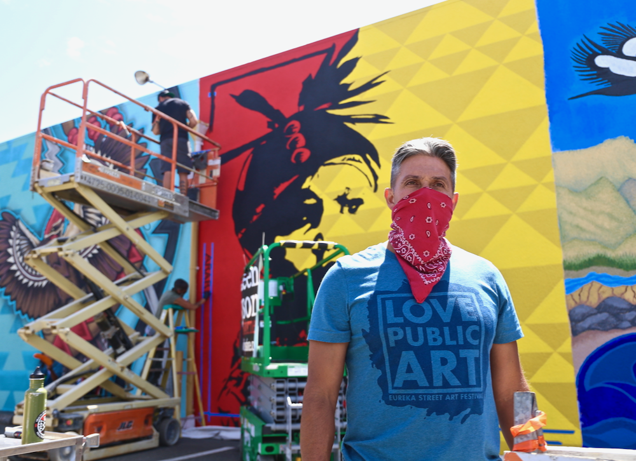
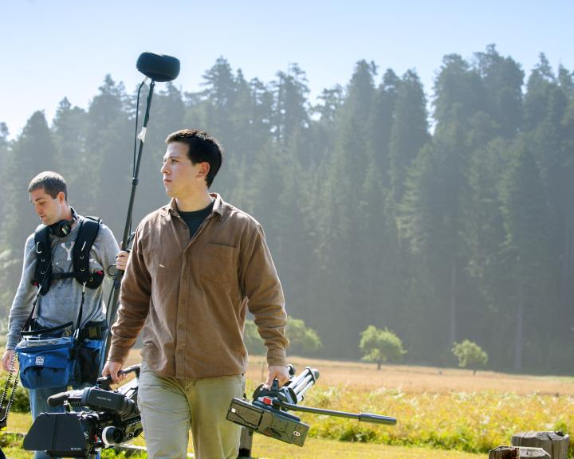
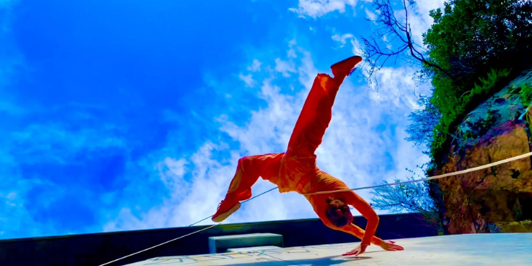
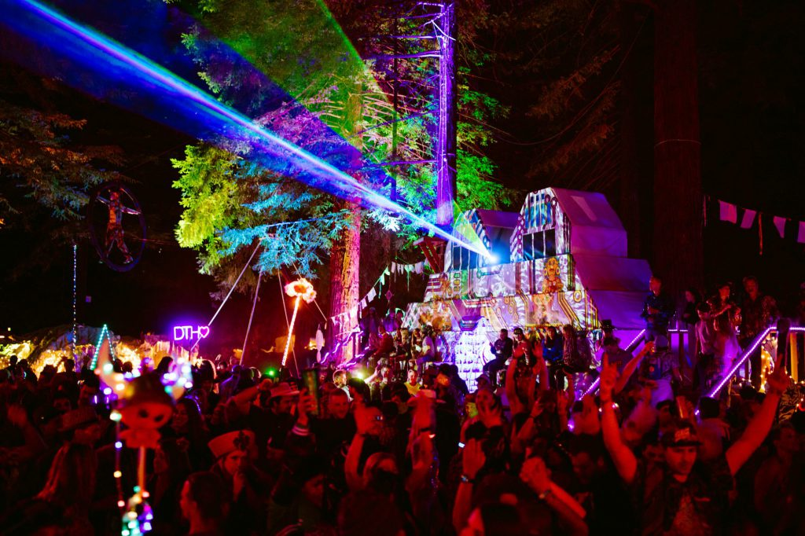
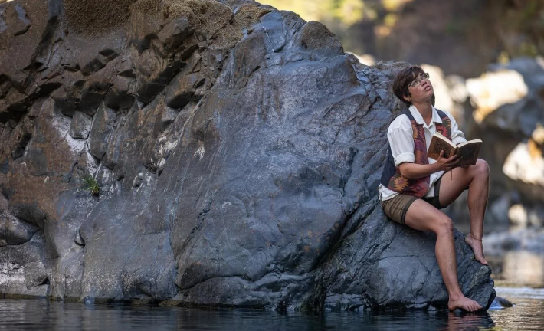

Slide 13

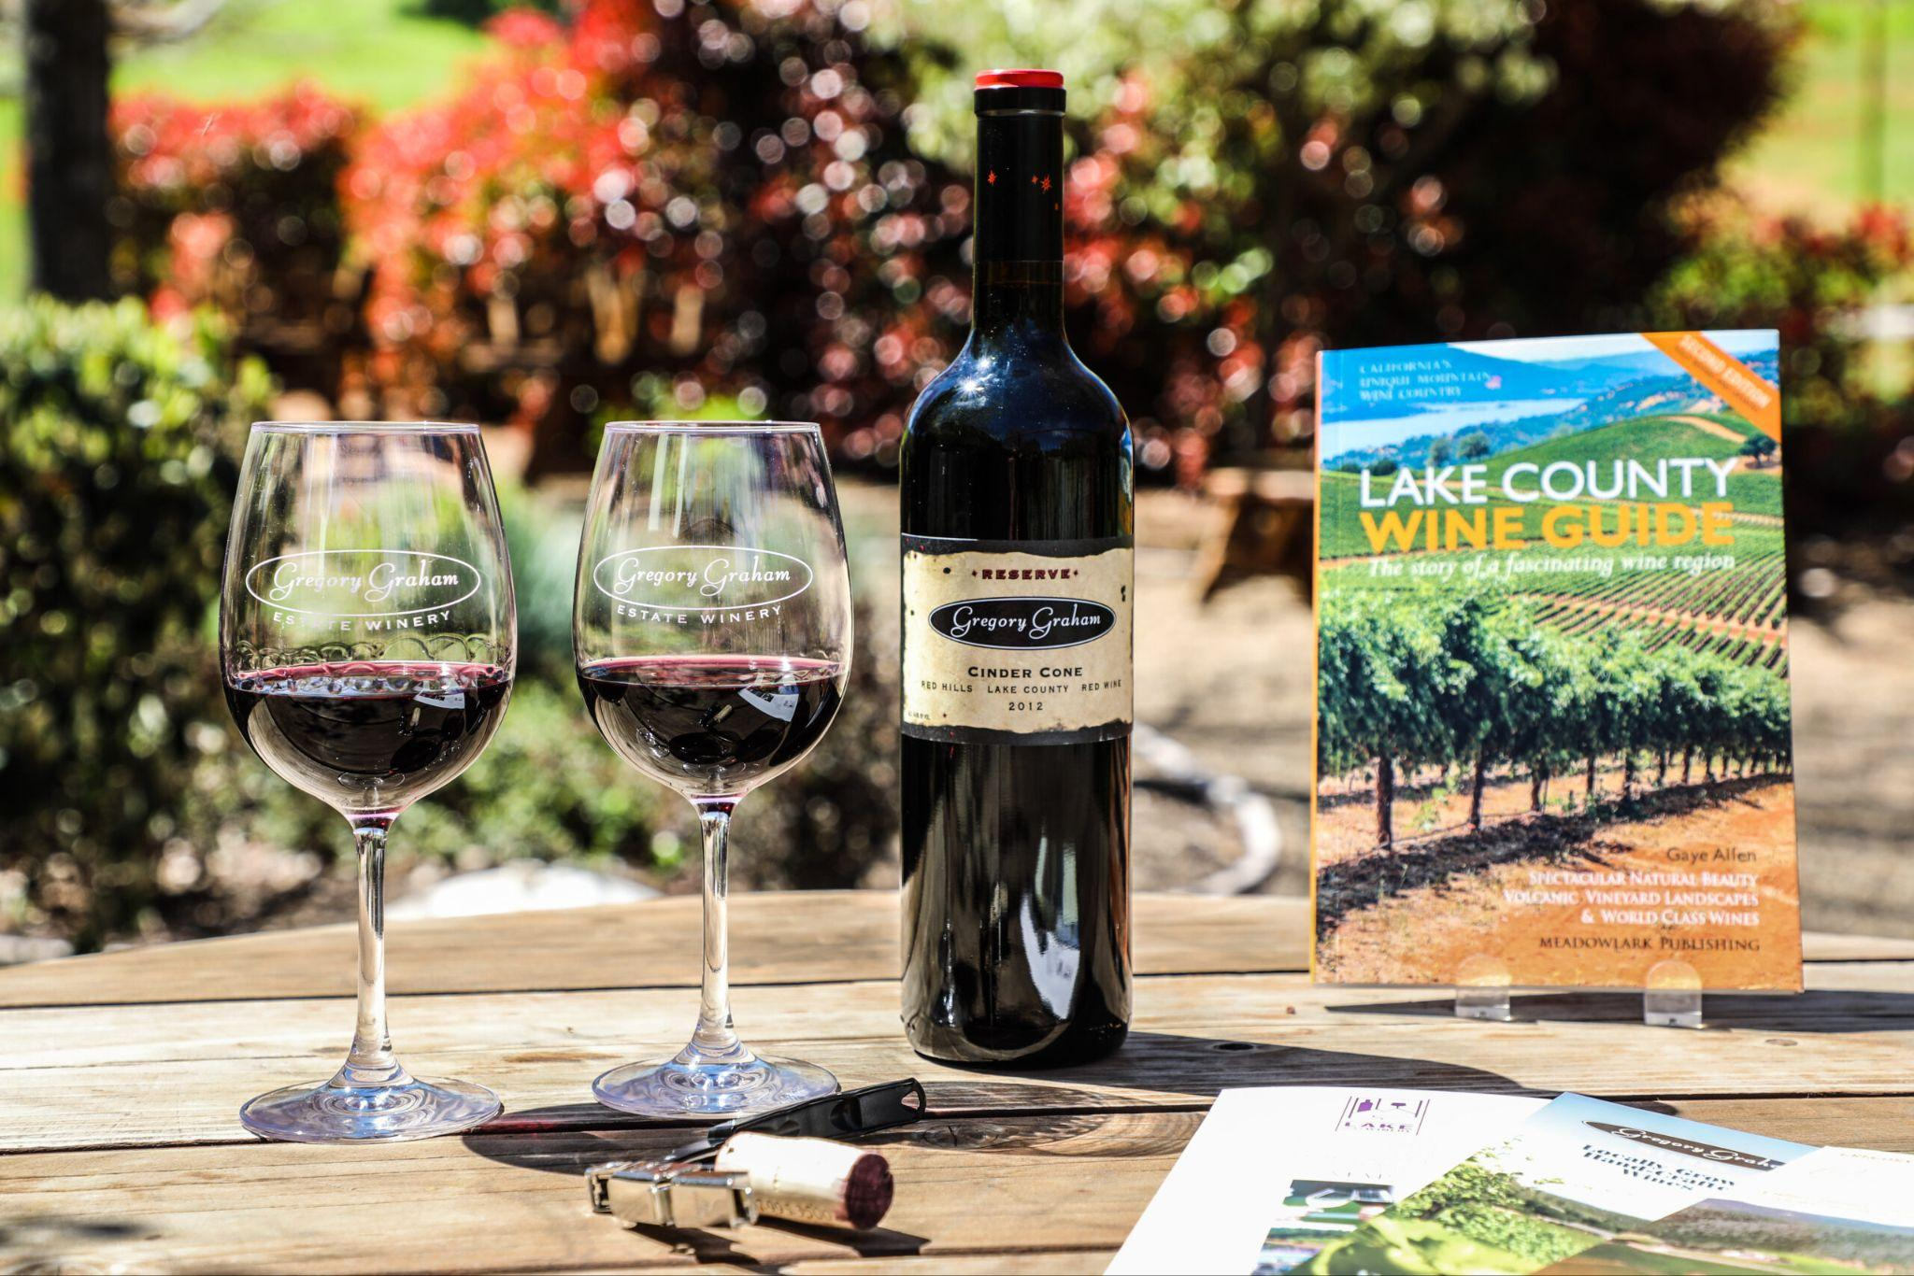

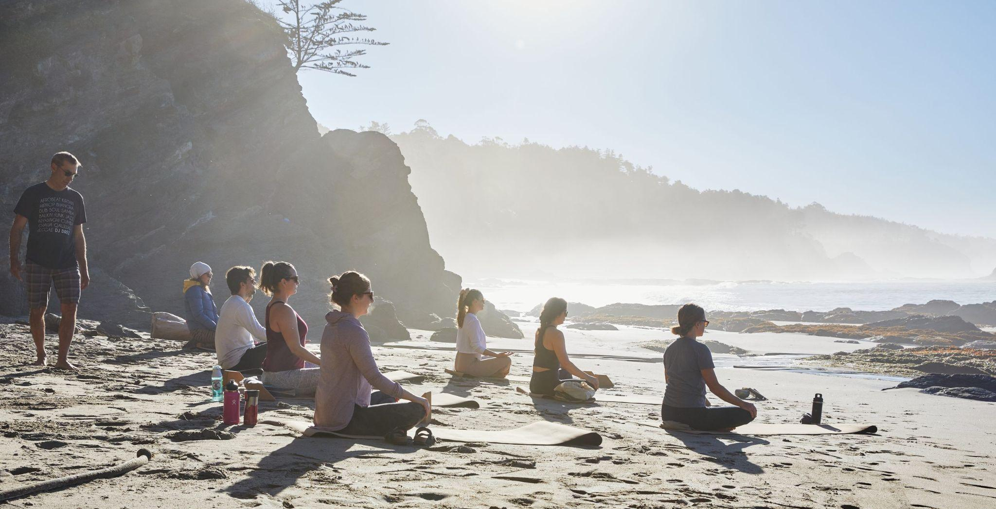

Slide 14
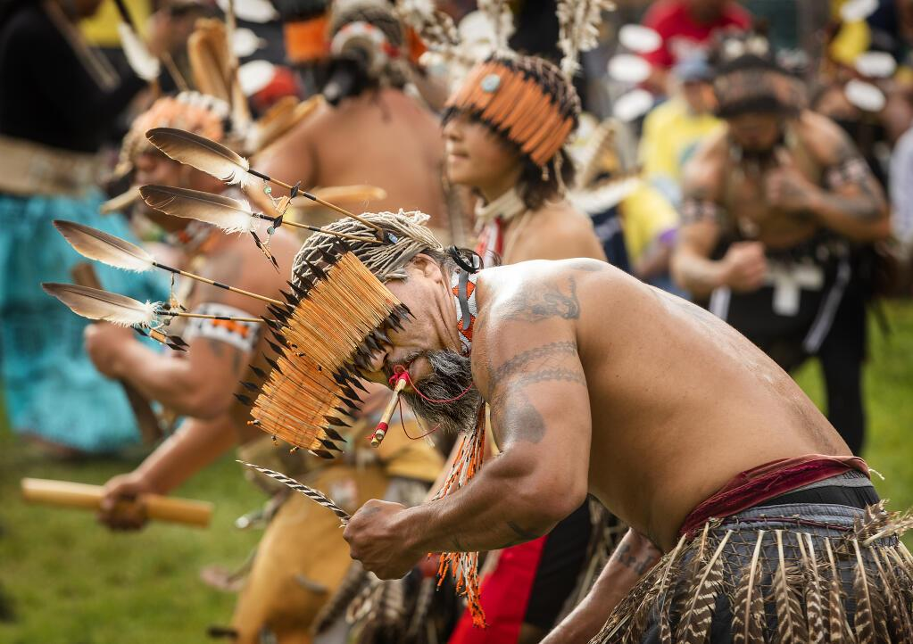
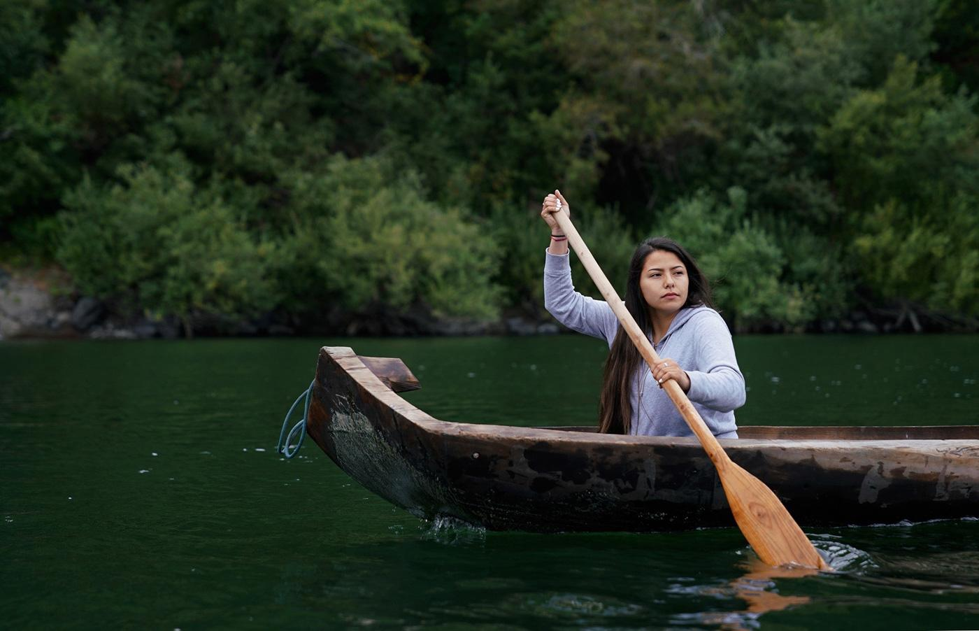

Slide 15
STRENGTHS
A vibrant mix of outdoor and cultural offerings
Previous history of a burgeoning tourism economy
Strong institutions
A famous and well-known ‘Out-of-the-Zone’ filming location
Creative and collaborative individuals and organizations
Core regional values

Slide 16
WEAKNESSES
Undefined regional identity and branding
Infrastructure/products have decayed over time
Organizations and individuals are stretched thin and resource-scarce
Film & TV production lacks infrastructure to attract more projects/investment
Ambivalent attitudes towards sector development
Work is needed to ensure high-quality careers are consistent across the sector

Slide 17
THREATS
Headwinds in international tourism
Challenging economic conditions for small business
Climate change
Ongoing threats to the California Film & TV industry
Concentration of public/private investment in established destinations/metro areas
Low levels of state investment overall in Arts & Culture
Lack of a coherent state strategy on Outdoor Recreation

Slide 18
OPPORTUNITIES
National/state-wide tourism is a growth opportunity
Small business growth revitalizes main streets
Tourism growth contributes to a ‘visit-move-work’ pipeline
More Film & TV projects may move ‘out-of-the-zone’, presenting a capture opportunity
Relatively nascent development across elements (branding, infrastructure, product) is an opportunity for strategic growth in accordance with core values, moving towards a model of REGENERATIVE TRAVEL

Slide 19
What is REGENERATIVE TRAVEL?
Move beyond definitions of ‘sustainability’ (minimize impacts) to ‘regeneration’ (virtuous cycles)
Virtuous cycles should promote ecological restoration, small-business growth, and community revitalization
Regenerative Travel is already aligned with core regional values and strengths, as well as growth niches in the tourism industry
“Honored guests, welcomed to a place well-loved by those who live there, leaving it better than when they arrived”

Slide 20
QUESTION/COMMENT BREAK

Slide 21


Catalyst Projects
Del Norte Performing Arts Center
Partnership for the Performing Arts
Presented by Nick Rail
Carving a Legacy
Blue Lake Rancheria
Presented by William Matsubu

Slide 22


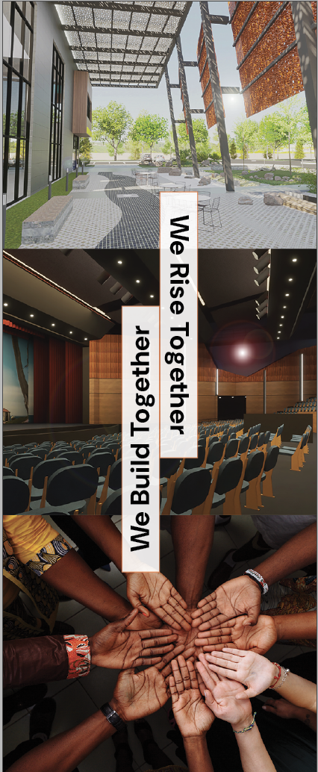
The Performing Arts
& Civic Center
Catalyst Project Update

Slide 23
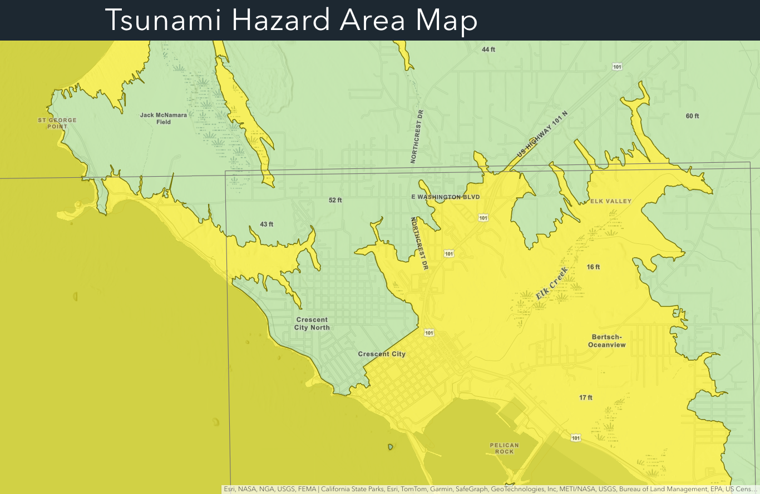


CRESCENT CITY
“There is no large accessible convening space outside the tsunami zone.”

Slide 24
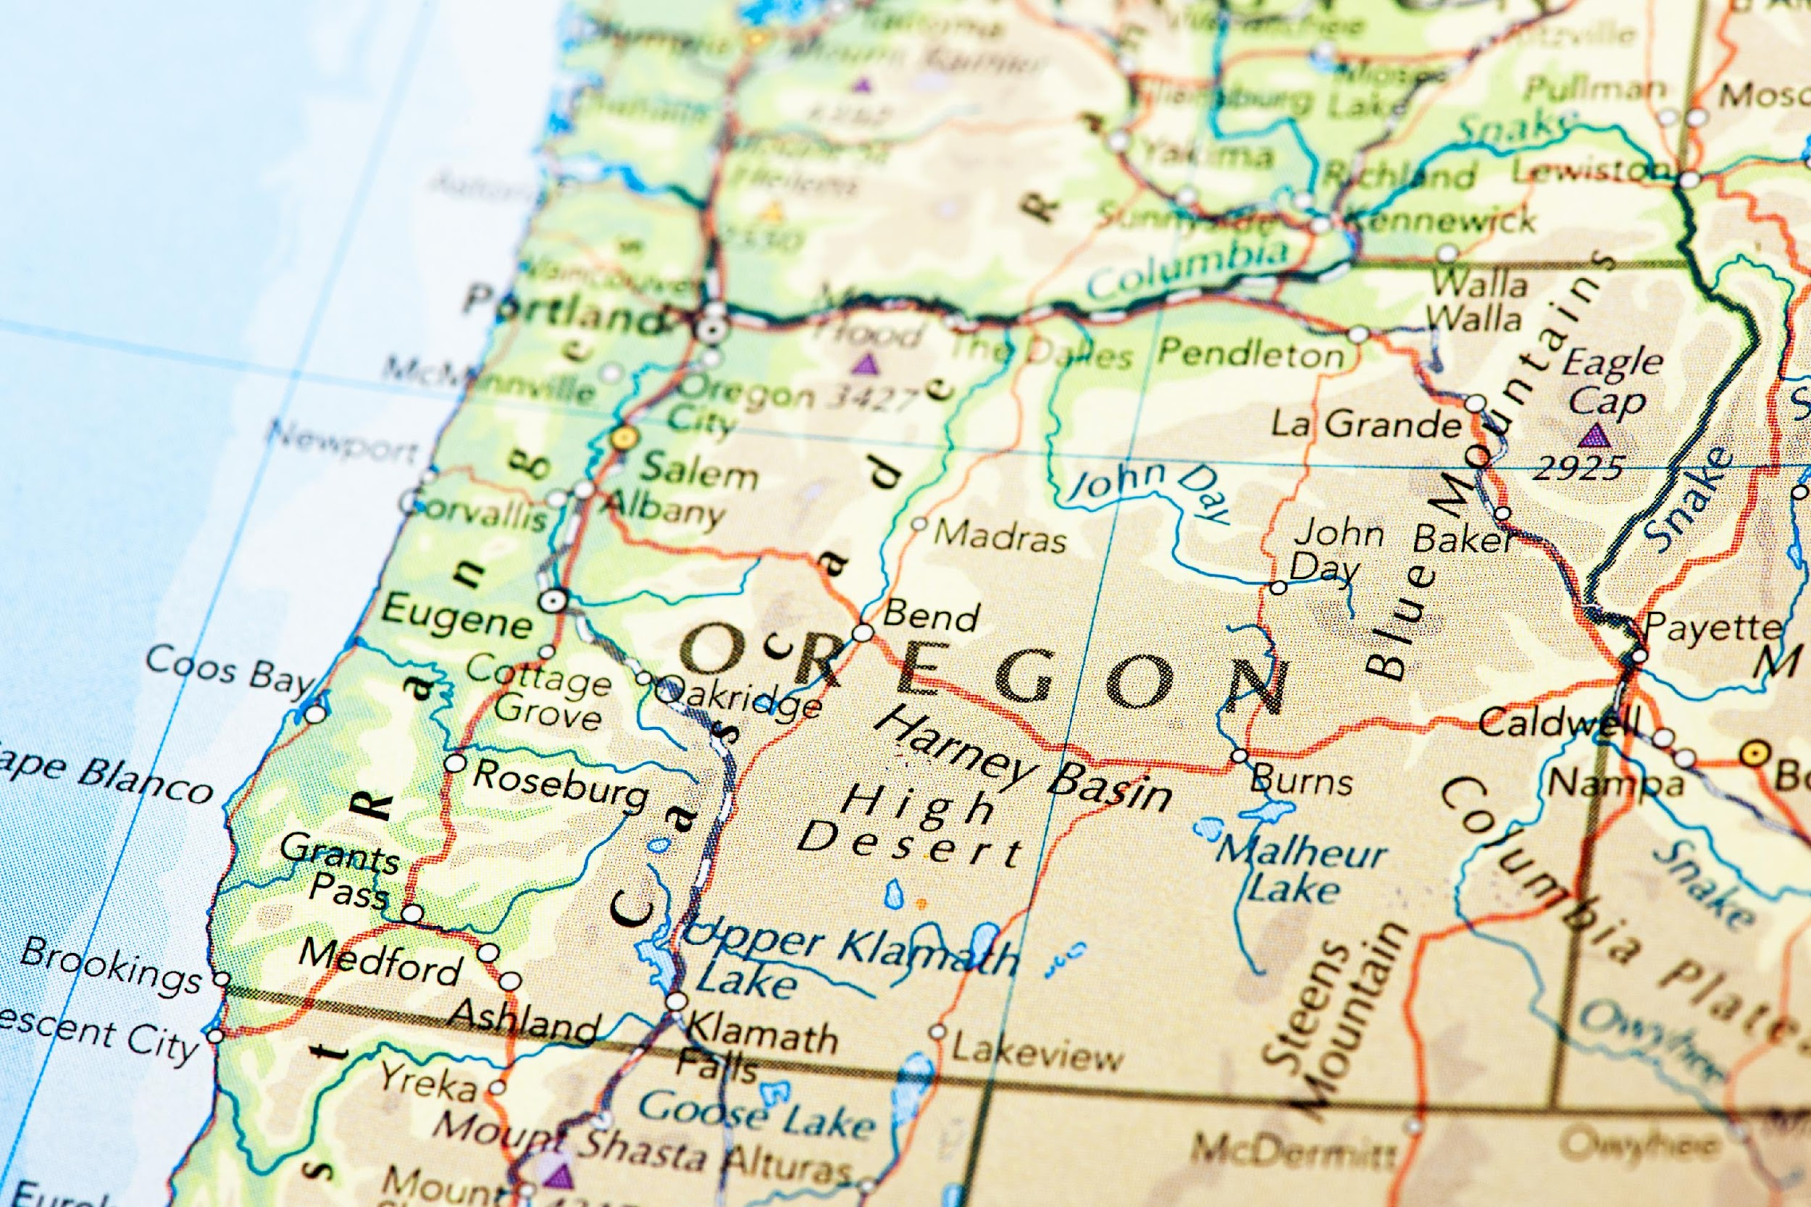

2 Centers
2 States
1 Opportunity
Brookings
Crescent City

Slide 25

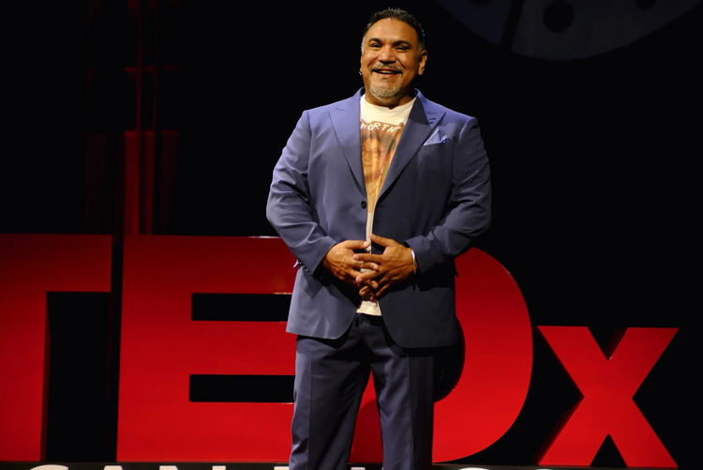
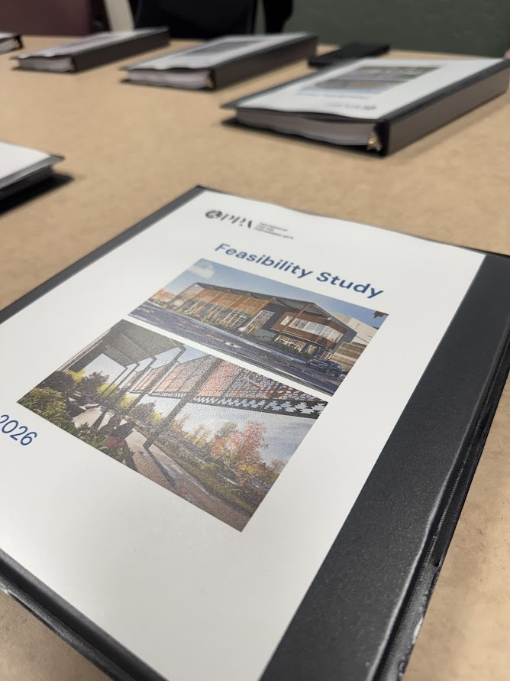


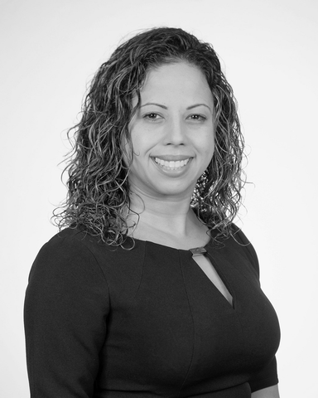
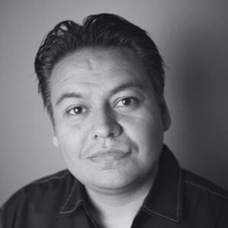
STRUCTURE & VALIDATION
COMPREHENSIVE FEASIBILITY STUDY

Slide 26
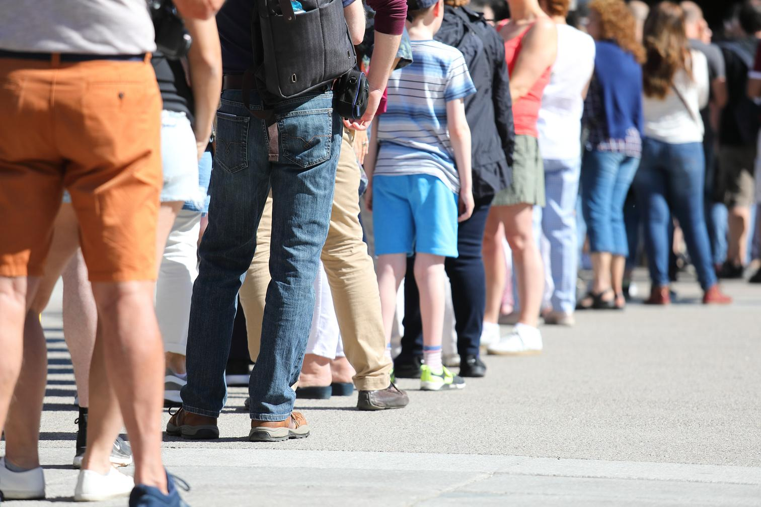
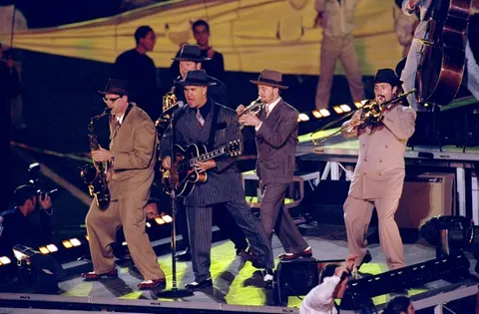
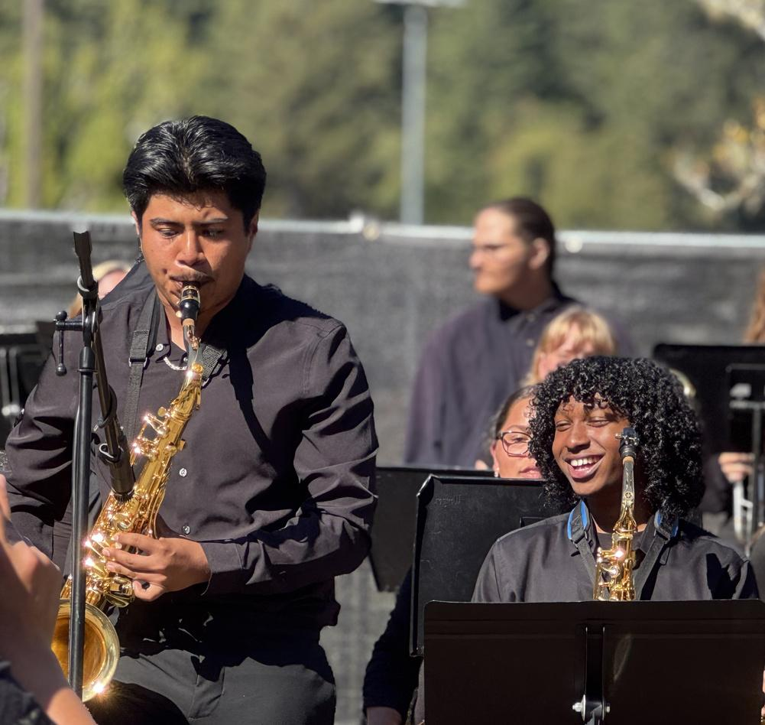
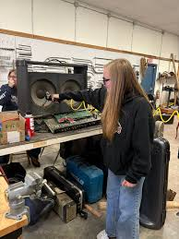
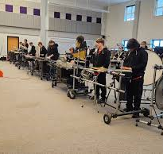
SOLD OUT SHOW IN SEPTEMBER SHOULDER SEASON
Local Students open for
BIG BAD VOODOO DADDY

Slide 27
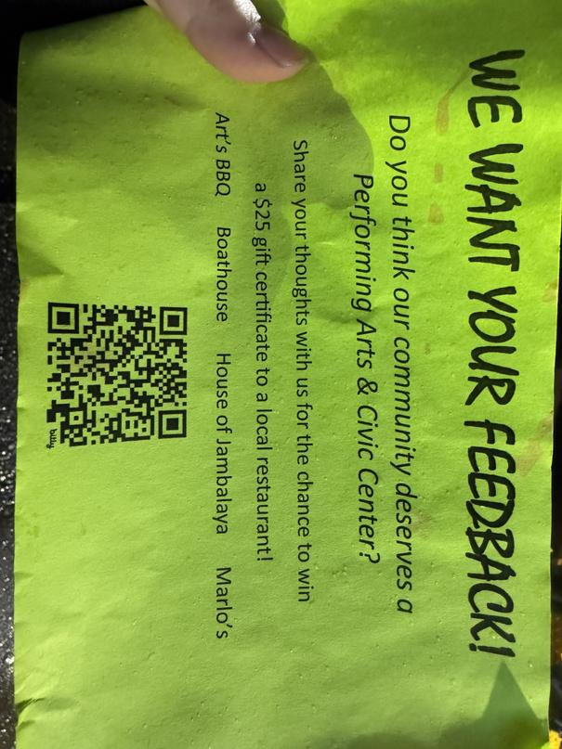
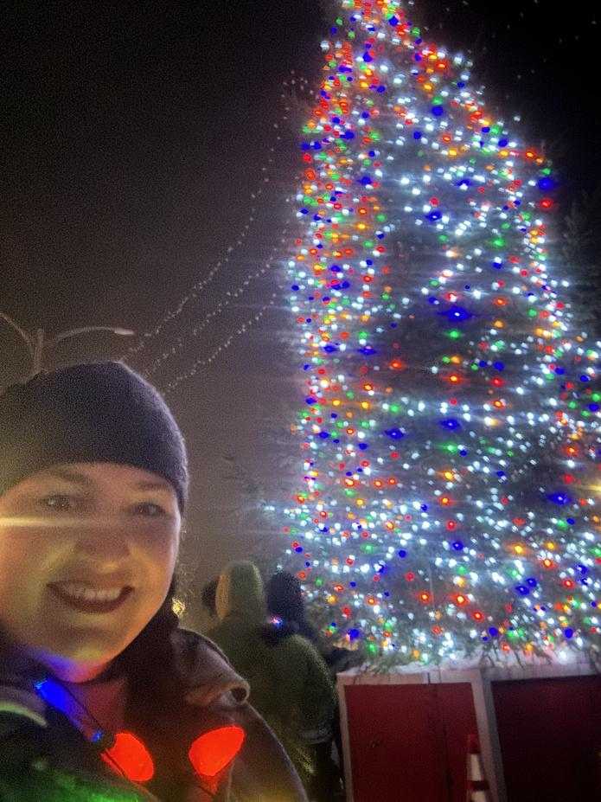
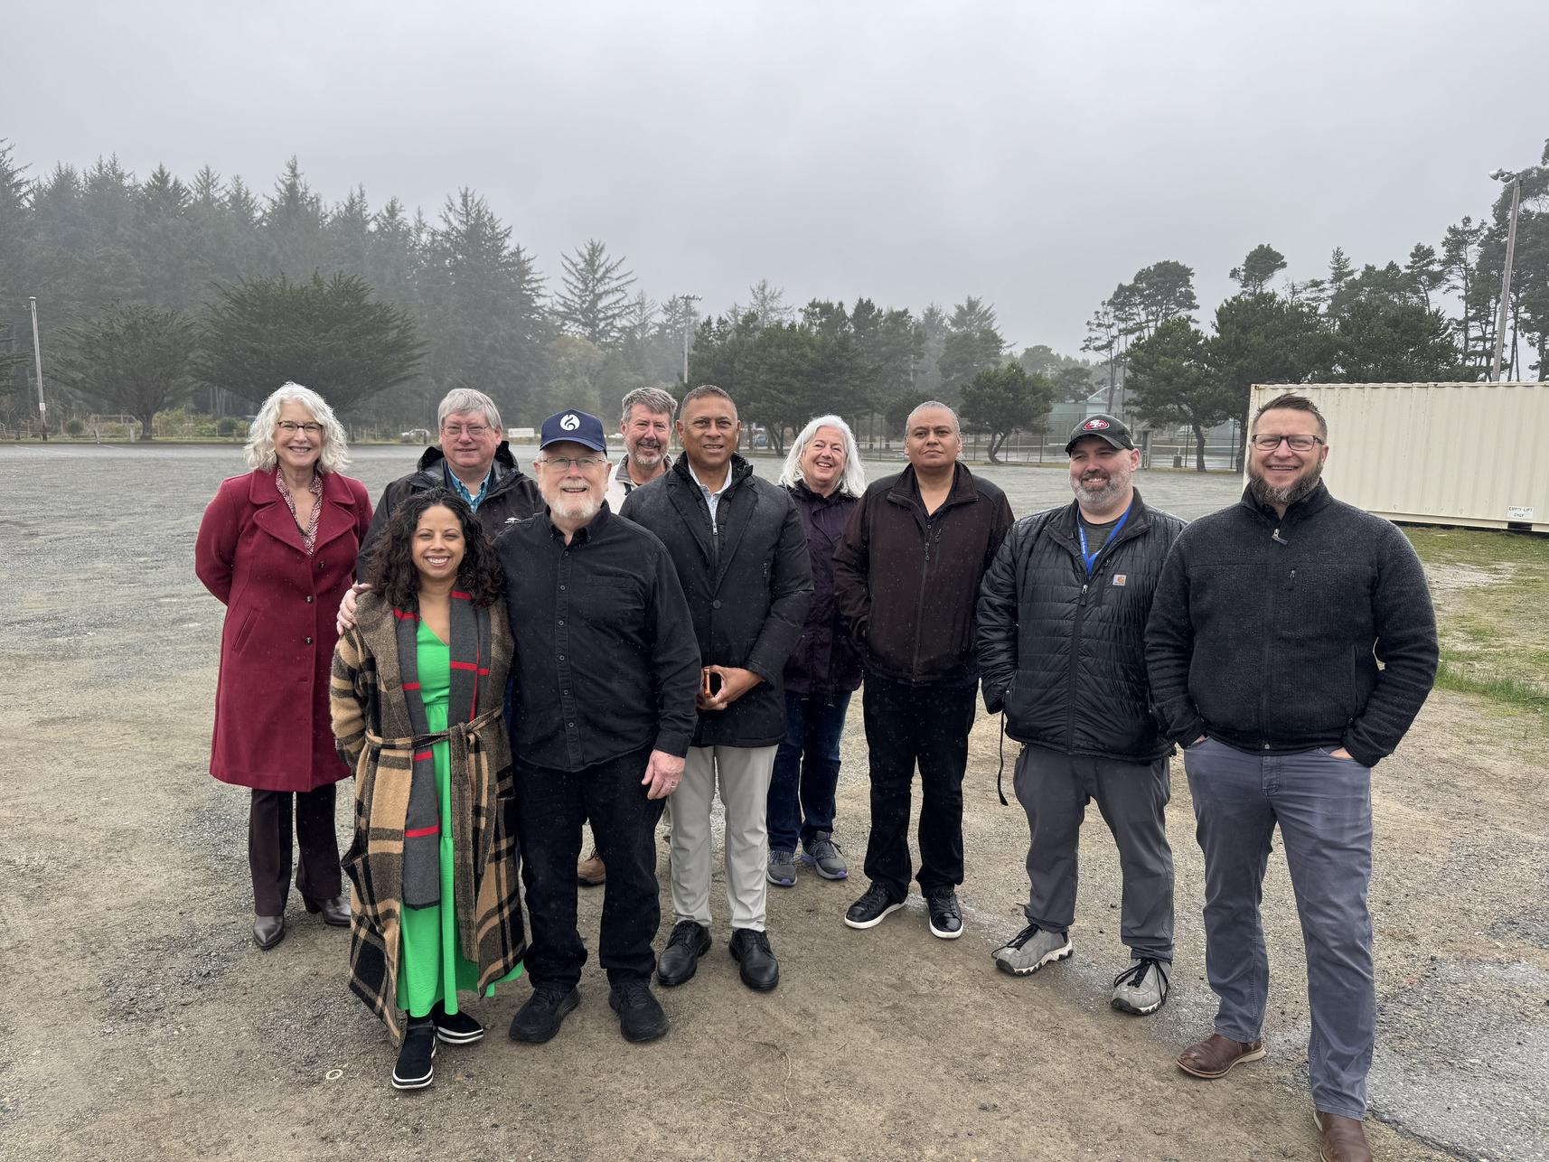
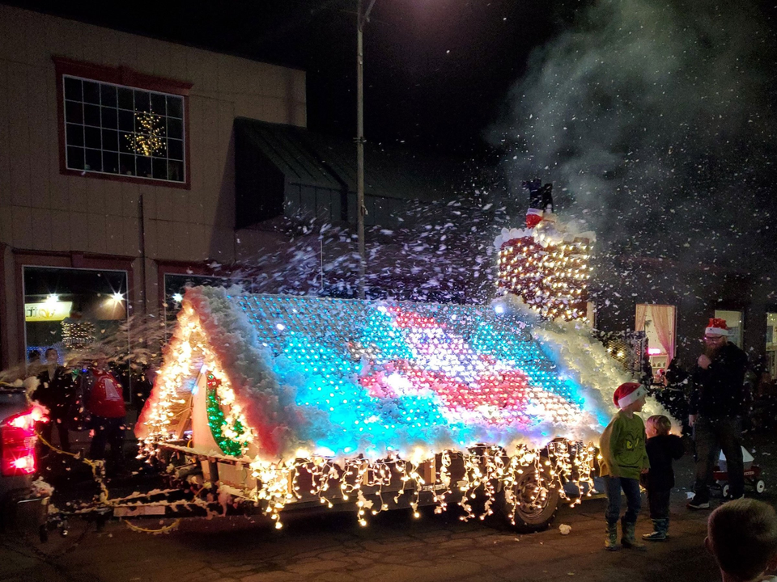
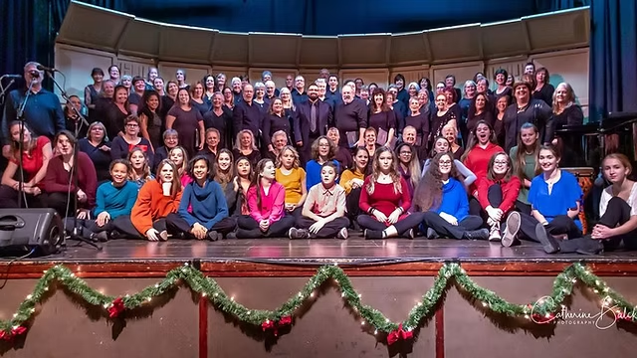

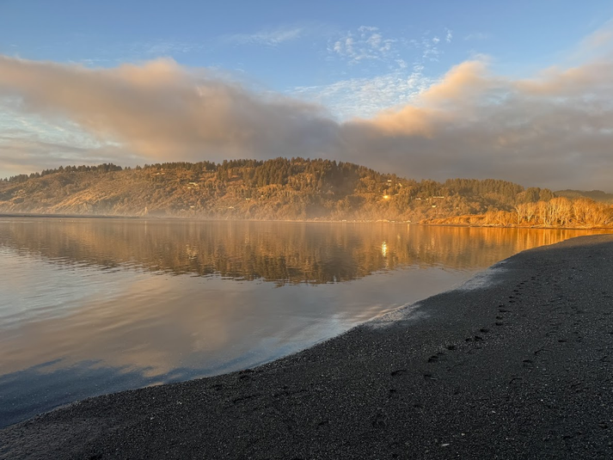
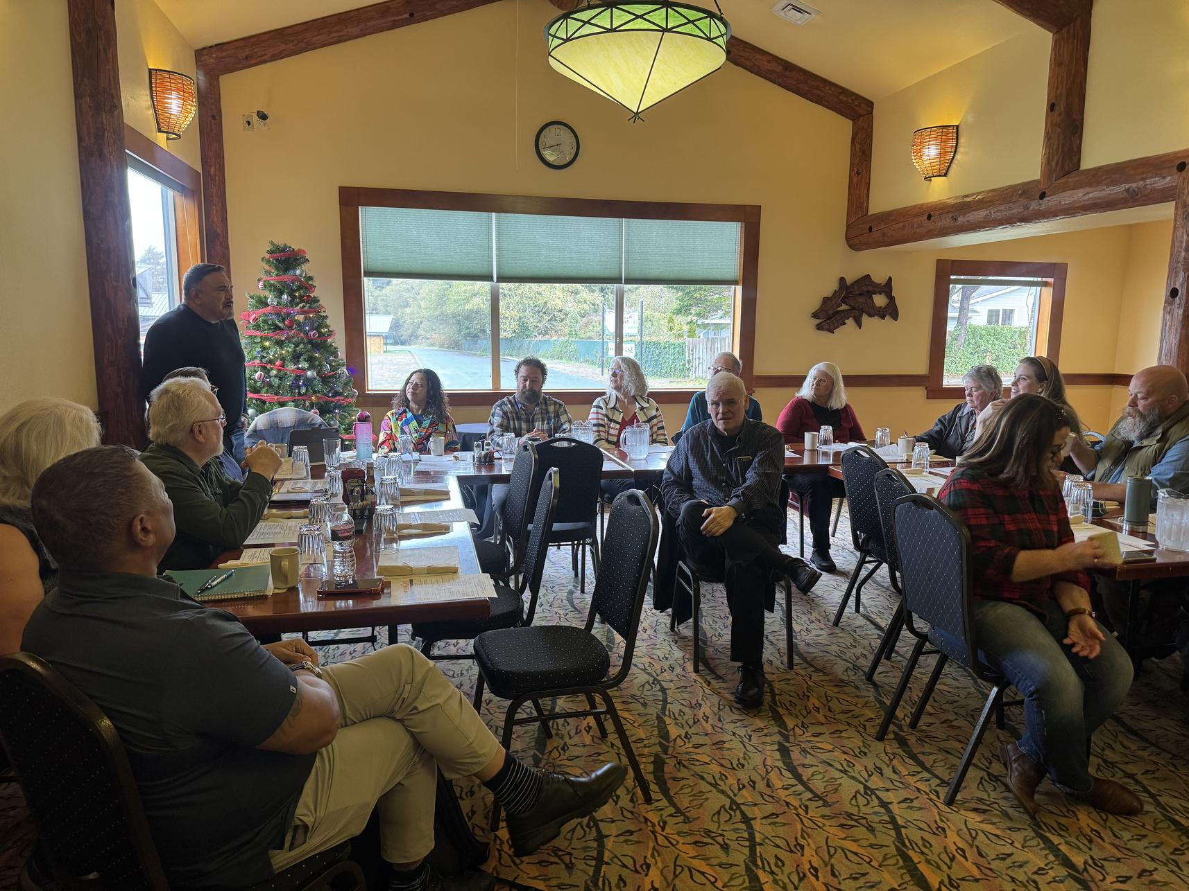
Site Visits
Surveys
Focus Groups
Culture & Arts Community Conversations

Slide 28
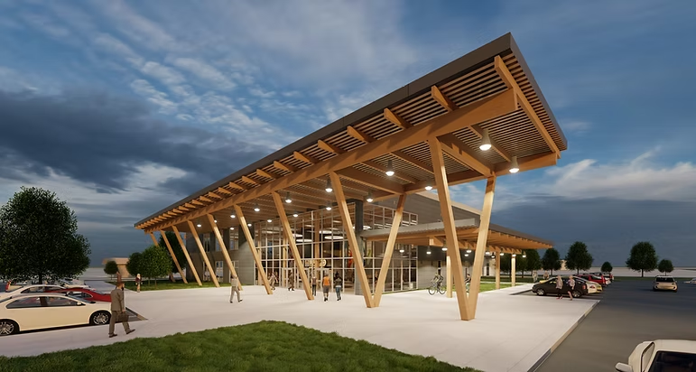
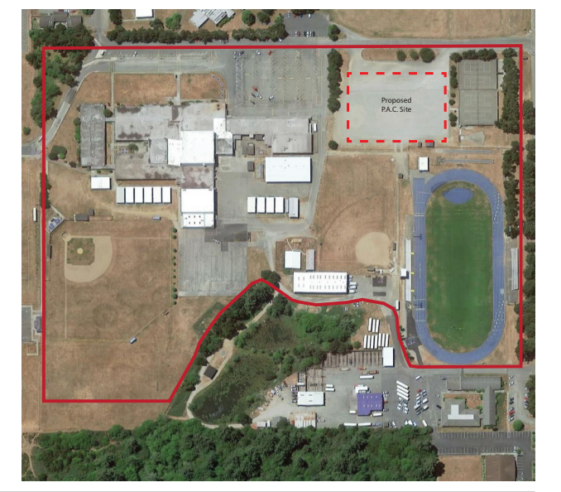
From Concept

Slide 29

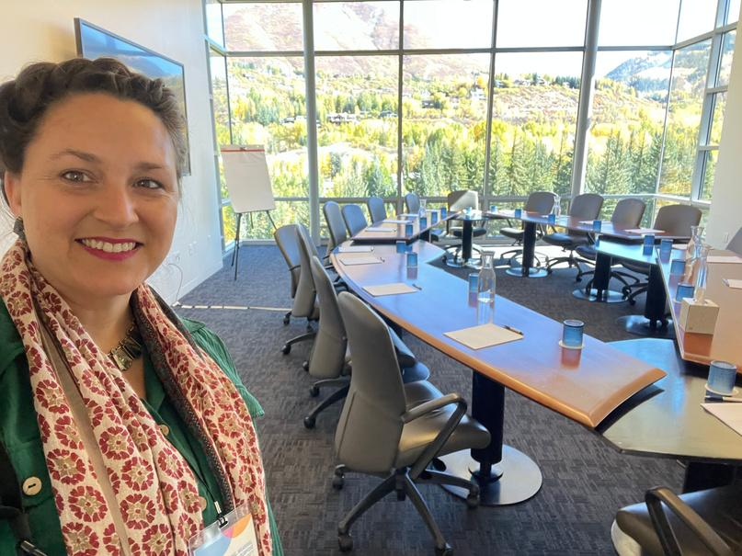
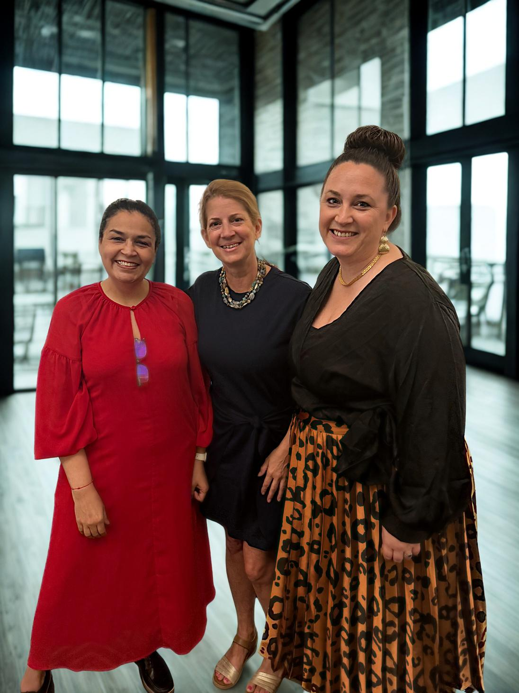


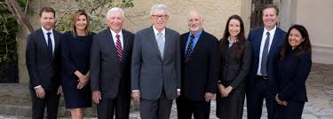
GOVERNANCE & CAMPAIGN INFRASTRUCTURE
STRATEGIC PARTNERSHIPS
360-MEDIA CAMPAIGN
MOU & GOVERNANCE

Slide 30
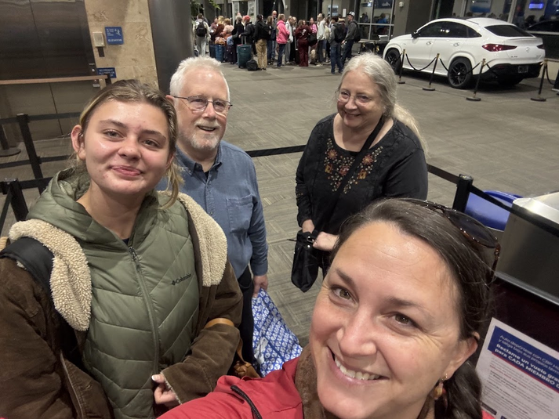
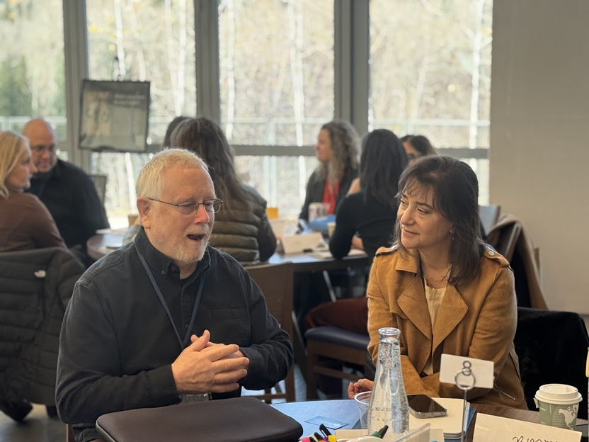
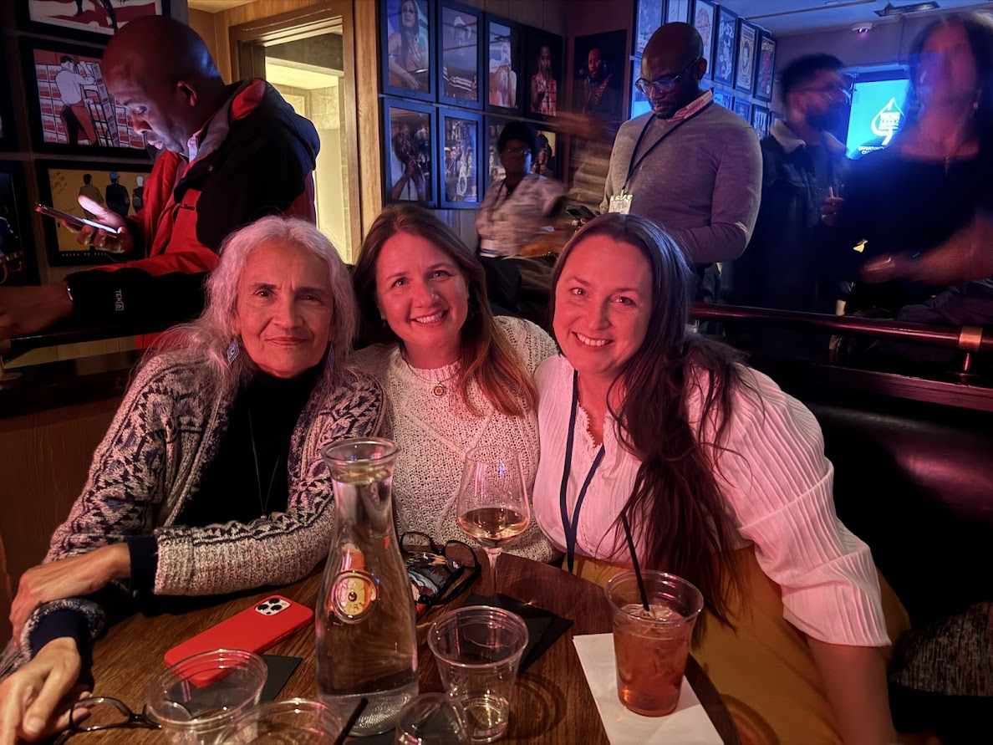
National Funder Networks & Partnerships
Youth Leadership & Connections
Local Leaders on National Stages

Slide 31
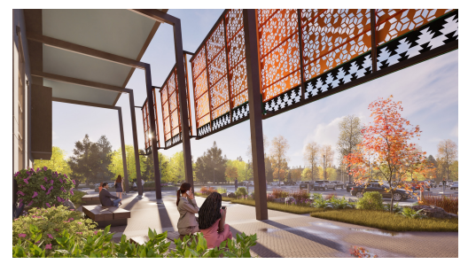
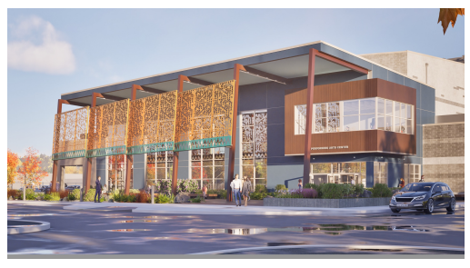
shu’shaa nin-la
Wok-hlew
ua tsaug
gracias
thank you

Slide 32
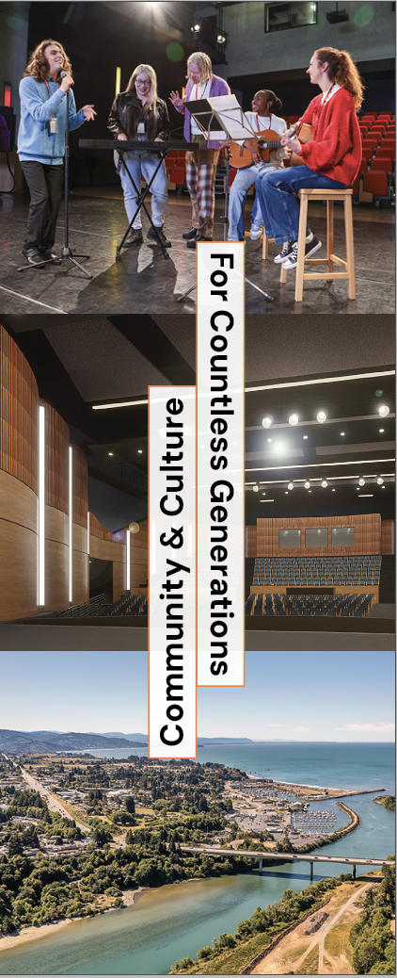



We Build Together We Rise Together

Slide 33


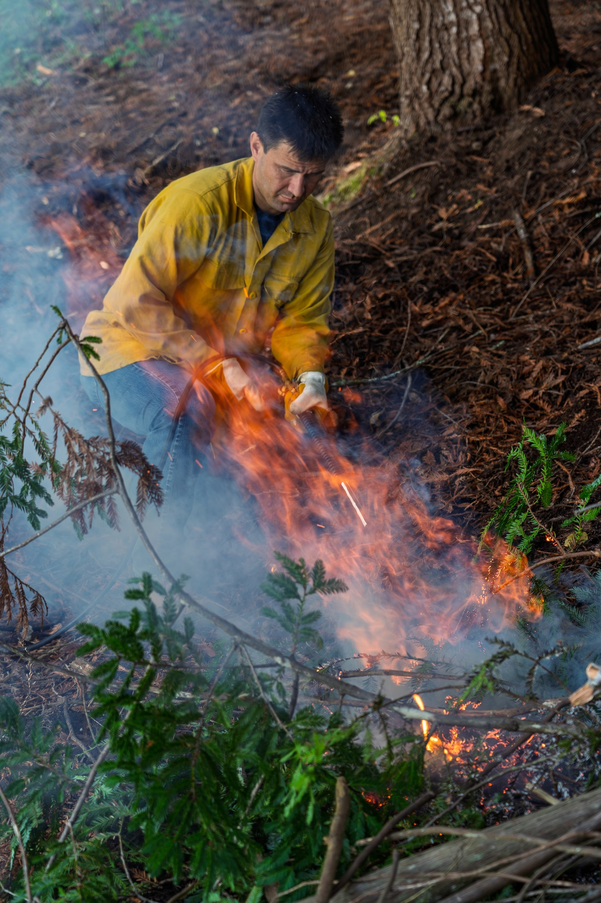



Carving a Legacy: Tribal Traditions, Woodworking, and Workforce Development
Bill Matsubu
Blue Lake Rancheria
Michael Shackelford
Project Manager
Notes:
Transforming forest restoration byproducts and traditional land stewardship into economic opportunity—creating local jobs, supporting artisans, and revitalizing cultural land management practices.

Slide 34
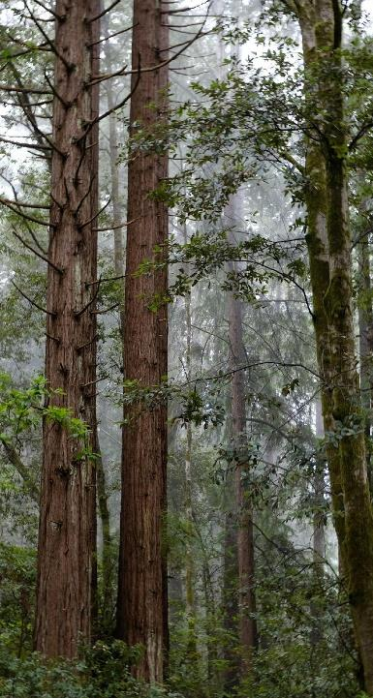
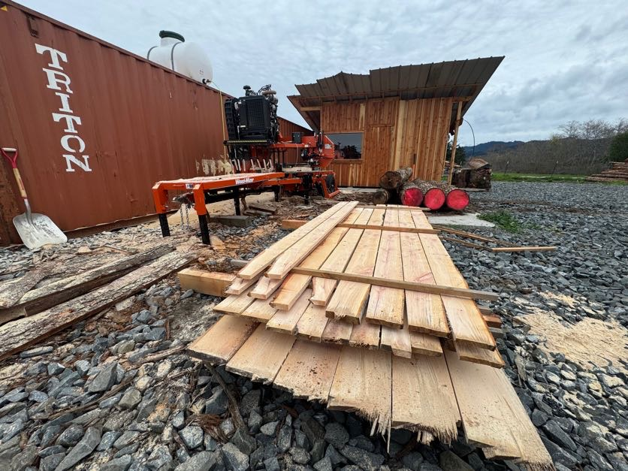
Project Updates
Hired 3 full time staff
Integrated resource management planning
Procured key assets
Began training and feasibility testing

Slide 35
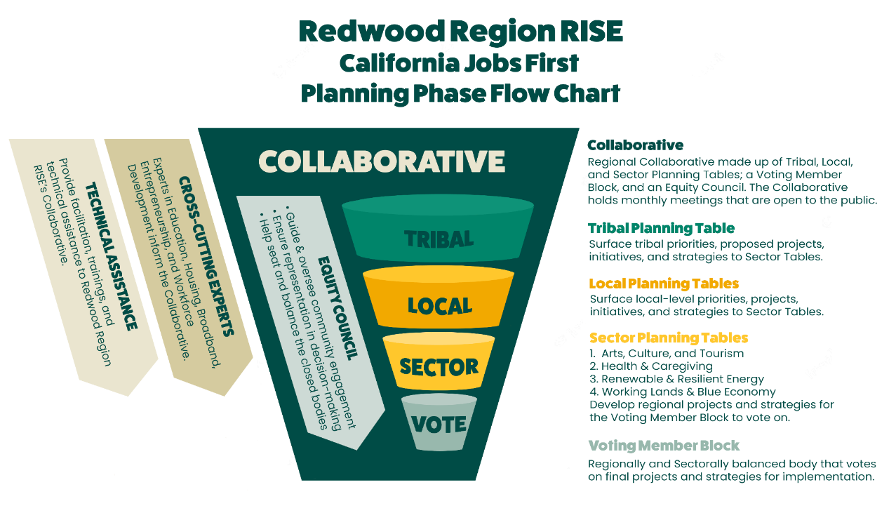








“Catalyzation”
Blue Lake Tribal Manufacturing
Notes:
Collaborated with Cultural Fire Summit earlier this summer, Catalyst Staff informed the selection and acquisition of over 450 additional forested acres (690 total additional acres for the year), Applied for Fire prevention funding (Cal Fire and BIA drafting), RRRISE project is part of our multi-pronged approach to promoting forest health while creating economic opportunities, Tentatively awarded Tribal Wildfire Prevention Funding to build a local Cultural Burn Team.

Slide 36


Additional Presenters
Healthcare Clowning
Dell’Arte International
Presented by Julie Douglas
Agri-tourism and Regional Branding
North Coast Growers Association: North Coast Food System Network
Presented by Megan Kenney

Slide 37
Healthcare Clowning
Dell’Arte International

Slide 38

Healthcare Clowning at Timber Ridge

Slide 39


Slide 40


Slide 41


Slide 42


Slide 43


Slide 44

Intro to Healthcare Clowning Intensive

Slide 45


Slide 46


Slide 47

Development Opportunities
Regional Sector-specific Grant Workshop
Coming this Spring (stay tuned!)
Presented in collaboration with Capital Impact
Creative Business Series
April 1-May 13 (in-person)
Presented by North Coast SBDC

Slide 48


Advocacy Days/Summits
California Outdoor Recreation Partnership
April 14-15
Californians for the Arts
April 19-21

Slide 49


A Big Year for Outdoor Recreation!
The Great Redwood Trail
Over $50 million allocated last year
Emerging opportunities for public art and other sector development
California Outdoor Economy Summit
June 3-5
Hosted here in the Redwood Region

Slide 50

Get Involved and Stay Informed!
Join the Regional Arts, Culture, and Tourism Cohort
Join the State Recreation & Tourism Cohort
Contact:
calder.johnson@gmail.com

Slide 51

THANK YOU!

Slide 52
Recap & Next Steps
Did we reach today's goals?
Did we get a clear picture of where Arts, Culture, and Tourism stands in our region — including outdoor recreation and cross-regional collaboration?
Did we dig into the economic challenges facing artists and small businesses?
And did we land on real opportunities to strengthen the sector?
→ What would you have liked to go deeper on?

Slide 53
Our Upcoming Meetings
Policy Literacy Working Group Meeting → March 4, noon-1:00 pm
EDF Working Session → March 4, 3:30-5 pm
Tribal Table Meeting (now on Thursdays) → March 5, 10-11:15 am
Sustainability Working Group Meeting → March 10, 1:00-2:30 pm
Equity Committee Meeting → March 11, 11:30 am-1 pm
Leadership Team Meeting → March 26, 11:00 am-1:00 pm
Our RRRISE Leadership team continues to meet monthly :)
Do you have events coming up? Drop ‘em in the chat!
Contact us with any questions or concerns: ccrp@humboldt.edu
Check out our Calendar

