Slide 1



Assertiveness
Adapted from CAPS Prezi by Cassandra Hernandez

Slide 2
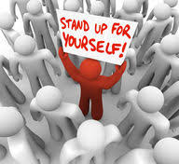
What Does it Mean to be an Assertive person
Standing up for your own or other people’s rights in a calm and positive way.
Assertive individuals get their point across without upsetting others or becoming upset themselves.

Slide 3
Characteristics of assertive people:
Understand RESPECT
Can relate to others in a sincere way
Understand and value themselves
Have self-control and emotional stability
Develop their ability to communicate effectively
Know their boundaries
Emotionally independent

Slide 4
How to become a more assertive person:
1. Decide to positively assert yourself
2. Aim for open and honest communication
3. Listen actively
4. Agree to disagree
5. Avoid guilt trips
6. Stay calm
7. Take a problem-solving approach to conflict
8. Practice assertiveness
9. Use “I” statements
10. Be patient

Slide 5
1. Decide to positively assert yourself
Commit to being assertive rather than passive or aggressive and start practicing it now.
The change needs to start from within, having that internal communication with yourself in a positive manner takes time.
Be easy with yourself all while being able to pin-point the positives of having that switch from being aggressive to

Slide 6
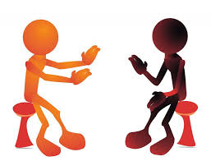
2. Aim for open and honest communication
Remember to respect other people when you are sharing your feelings, wants, needs, beliefs or opinions
Respect is mutual so what you give you will get in return so treat others with respect and you will receive that same respect in return

Slide 7
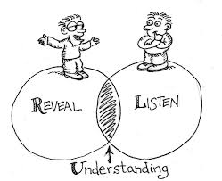
3. Listen actively
Try to understand the other person’s point of view and don’t interrupt when they are explaining it to you

Slide 8

4. Agree to disagree
Remember that having a different point of view doesn’t mean your right and the other person is wrong.
Keeping an open mind when reeling in new ways of thinking will make it easier to learn the other person’s way of thinking.

Slide 9
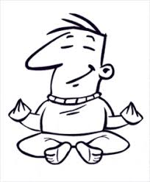
5. Avoid guilt trips
Be honest and tell others how you fell or what you want without making accusations or making them feel guilty

Slide 10

6. Stay clam
Breathe normally, look the person in the eye, keep your face relaxed and speak in a normal tone in your voice

Slide 11

7. Take a problem-solving approach to conflict
Try to see the other person as your friend not your enemy

Slide 12

8.Practice Assertiveness
Talk in an assertive way in front of a mirror or with a friend. Pay close attention to your body language as well as the words you say.

Slide 13
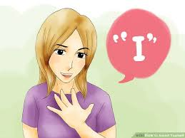
9. Use ‘I’
Stick with statement s that include “I” in them as much as “I think” or “I feel”. Don’t use aggressive language such as “ you always” or “you never”

Slide 14

10. Be patient
Being an assertive person takes practice . Remember that you will sometimes do better at it than at other times, but you can always learn from your mistakes.

Slide 15
Why it is important to be Assertive?
Build your communication
It builds better confidence
Stronger social bonds
Creates boundaries with people
Establishes mutual respect

