Slide 1
Growing A Happy And Healthy Love Relationship
Leta M. Perriello

Slide 2
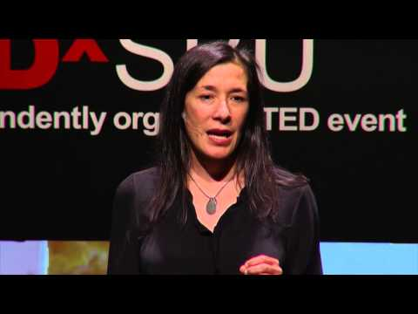
Building Strong Foundations

Slide 3
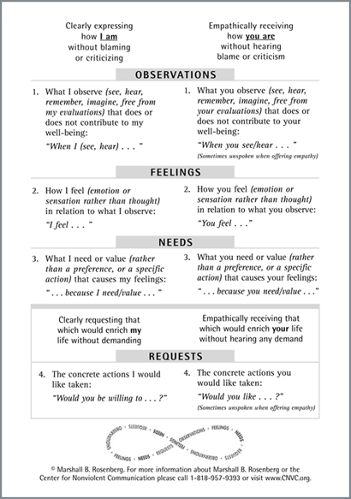
Set Clear Expectations
Communicate your expectations before problems arise.
Nonviolent Communication
Observations
Feelings
Needs
Requests
What is NVC?

Slide 4
Set Clear Expectations Pt. 2
Communicate clearly:
whether or not you expect commitment and what the boundaries of that commitment are. Ex. Will you see other people? Are you looking for a college fling, or a long-term relationship?
what you do or do not expect from a relationship. Ex. How often should you see each other? Who pays when you go out?
*Ask for and listen to your partner’s needs and expectations! Respect their autonomy while honoring your own.

Slide 5
Sex
Things to consider discussing before you and your partner have sex:
Boundaries
Pregnancy
STDs
Protection
Commitment
Preferences

Slide 6
Self-Care
Maintaining your own physical, emotional, and mental health is an essential component of having a healthy, loving relationship.
Take time to develop personal fulfillment.
Be honest with yourself about how you feel with your partner.
Set healthy physical, emotional, and psychological boundaries. Be clear about your needs.
Avoid toxicity. If your relationship repeatedly makes you feel bad, prioritize your well-being by surrounding yourself with people who do not make you feel bad.
Heal old wounds. Explore your attachment style and its origins to better understand yourself. 1. 2.

Slide 7
Warning Signs
Familiarize yourself with warning signs of toxicity and abuse to keep yourself and your partner safe: http://www.abuseandrelationships.org/Content/Resources/warning_signs.html

Slide 8
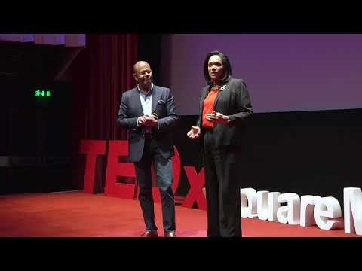
Nourish Your Relationship

Slide 9
Ideas to Nourish Your Relationship
Be honest
Communicate your needs as they evolve
Have fun!
Respect your partner
Work through problems
Pursue your individuality
Lean on each other
Maintain an emotional connection
Show affection
Develop intimacy

Slide 10

Problem Solving

Slide 11
Healthy Conflict
Your partner’s perception may differ from yours. (This is normal!) Communicate your interpretation while acknowledging their experience.
De-escalate tension by taking breaks, expressing appreciation, and sharing your honest emotions.
Soothe yourself and each other.
Compromise!
https://www.psychologytoday.com/us/blog/fixing-families/201101/the-art-solving-relationship-problems

Slide 12
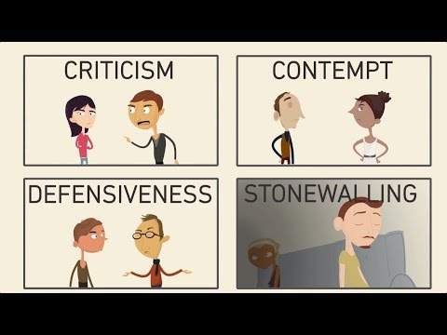
Unhealthy Conflict
Criticism
Contempt
Defensiveness
Stonewalling

Slide 13
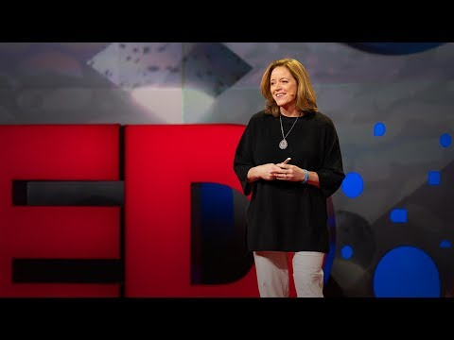
Happy & Healthy Love Relationships

Slide 14
Principles of Healthy Relationships
Continue to learn about one another
Show fondness and admiration
Turn toward one another
Compromise
Work to solve relationship problems together
Incorporate individual relationship goals
Create shared meaning
https://www.yesmagazine.org/issue/happy-families-know/2011/01/04/how-to-keep-love-going-strong/

