Slide 1
Healthy Relationships 101
Leta M. Perriello

Slide 2
Unhealthy Relationships
Examples of physical abuse:
Pushing someone
Hitting someone
Kicking someone
Slapping someone
Shoving someone
Punching someone
Grabbing someone
Choking someone
Shaking someone
Examples of emotional abuse:
Shaming/mocking someone
Constant criticism
Invading privacy
Coercion
Spreading rumors
Destroying property
Limiting another person’s autonomy
Threatening violence
Threatening suicide
Ignoring boundaries and needs
Frequent shouting

Slide 3
Warning Signs
Are you ever afraid of your partner?
Does your partner threaten you?
Does your partner control your money?
Has your partner physically or emotionally hurt you?
Has your partner forced you into sex?
Does your partner stalk you?

Slide 4
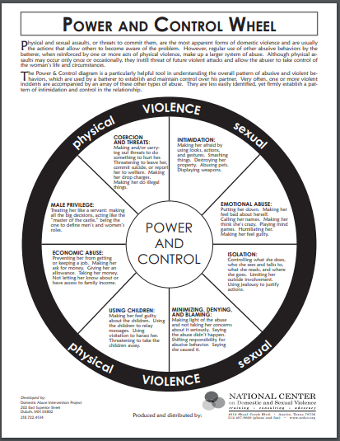
https://ywcaspokane.org/programs/help-with-domestic-violence/power-and-control-wheel/

Slide 5



Slide 6
Red Flags: Abusive Personality
Possessiveness
Controlling Behavior
Quick Involvement: person attempts to control your behavior
Isolation: person attempts to ruin your relationships with family and friends
Victim Complex
Cruelty to Animals or Children
Use of Force in Sex
Verbal Threats
Rigid Gender Roles
Volatile
Breaking Objects
Use of Force

Slide 7
Resources
National Domestic Violence Hotline: (800) 799-SAFE (7233) http://www.thehotline.org
National Resource Center on Domestic Violence: http://www.nrcdv.org/
Gay Men’s Domestic Violence Project: (800) 832-1901 http://gmdvp.org/

Slide 8
Signs of a Healthy Relationship
A healthy relationship is when both/all partners develop a connection based on:
Mutual respect
Trust
Honesty
Support
Fairness/equality
Separate identities
Good communication
A sense of fondness/playfulness
Healthy relationships require maintenance! No relationship is perfect, but your relationship should have more healthy than unhealthy traits. Within reason, accept what you cannot change and work to change what you can.

Slide 9
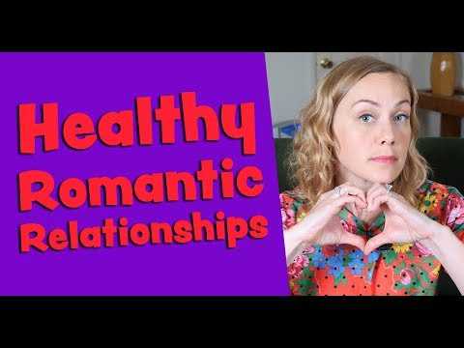

Slide 10
More Signs of a Healthy Relationship
Both/all partners have good self-esteem independent of the relationship.
Both maintain individuality within the relationship.
Both maintain relationships with family/friends outside the relationship.
Both are able to express themselves without fear of consequences.
Both take interest in one another’s hobbies/activities.
There is no violence in the relationship.
Both trust each other and are honest with each other.
Both have the option of privacy.
Both have respect for the other’s sexual boundaries.
Both are honest about sexual activity.
Both accept influence from one another, but do not coerce, manipulate, blackmail, or pressure one another.
Both try to resolve conflict fairly with a mutual goal of compromise.

Slide 11
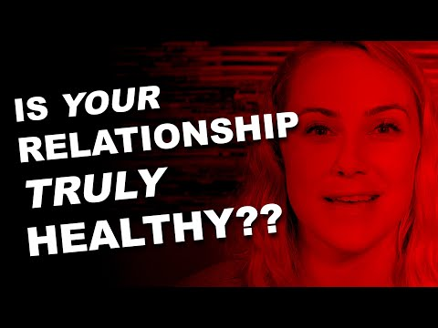

Slide 12
Fostering a Healthy Relationship
How?
Keep expectations realistic
Keep communication open
Be flexible
Develop your self-esteem
Be dependable
Fight fair
Show affection
Be yourself!
Why?
Healthy relationships help people to live more happy, healthy lives!
People with healthier relationships tend to experience less stress.
You deserve it!

