Slide 1
Depression: Help

Slide 2
Recognize the reciprocal influences:
Thoughts
Feelings
Behaviors

Slide 3
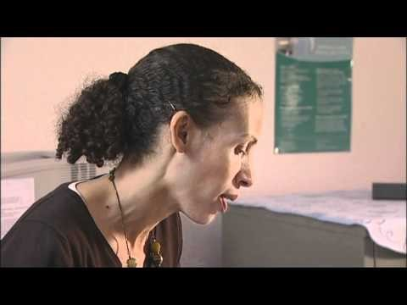
Managing Depression with 10 minute CBT

Slide 4
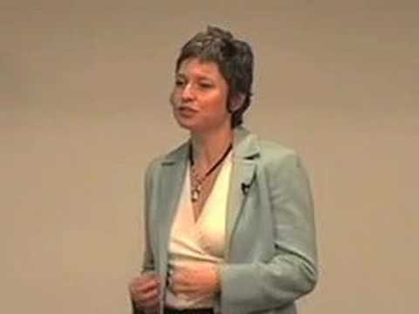
Get better control of your thoughts

Slide 5

…Another video on how to control your thoughts

Slide 6

How to stop negative thoughts…

Slide 7
Realize thoughts are not truths
Recognize your thoughts and feelings without judgment and without attachment
Live in the Now: We often keep ourselves depressed by focusing on our regrets about the past or our worry about the future. Practice Mindfulness.

Slide 8
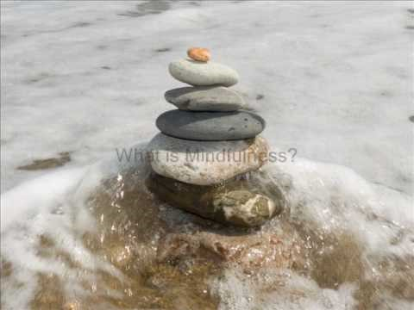
An introduction to mindfulness

Slide 9
Don’t give up
Hopelessness is a symptom of depression, it does not reflect your actual future
Create some structured activities in your day:
  Lack of structure can make you feel “lost,” and can give you too much room to get lost in negative thoughts.
  Having a plan for the day helps you to feel in control and to get things accomplished which feels good.

Slide 10
Be social; talk to your friends
Being around other people helps you feel less depressed, better supported, & reminds you to get “out of your head” and enjoy life.

Slide 11

Schedule in fun and engage in wellness activities
For example… go to a movie, read a good book, walk on the beach, finger-paint, journal, listen to music, take a bath

Slide 12
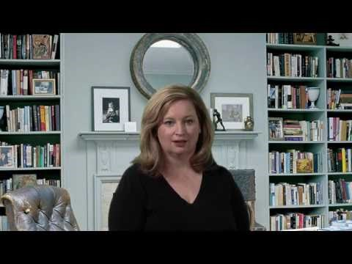
Consider therapy

Slide 13
Avoid alcohol and drugs
From WebMD: Does Alcohol Abuse Lead to Depression?
A Number of studies have shown that alcohol abuse increases the risk for depression. This connection may be because of the sedative effects of alcohol on the brain. Researchers know that heavy alcohol consumption can lead to periods of depression. Alcohol abuse also can have serious repercussions on a person’s life, leading to financial and legal troubles, as well as marital stress. If you’re struggling with money or grappling with a failed relationship, you’re more likely to feel depressed.

Slide 14

Get good nutrition
Eat plenty of fruits and veggies; avoid foods that are high in sugar and unhealthy fats.

Slide 15
Tend to your surroundings
Do your dishes and laundry, treat yourself to flowers. Now is not the time to have a chaotic and messy environment.

Slide 16
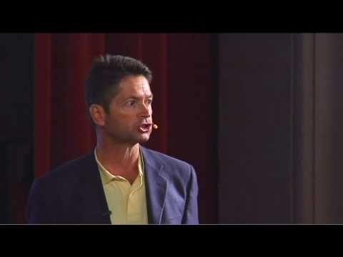
Gratitude: Recognize the good in the world…

Slide 17
Have gratitude for what is working in your life
Each morning when you wake and/or evening when you go to sleep: Think of all the things you feel grateful for – big and small.
Consider writing these in a journal or sharing gratitude with someone else.

Slide 18
Practice relaxation techniques
Such as yoga, meditation, visualization, deep breathing…

Slide 19

Get inspired
Try something new

Slide 20

Trying something new for 30 days

Slide 21

Set and work towards goals
Check out this blog: marcandangel.com for some great articles, including this one:
“7 ways to change your life in 7 days”

Slide 22
Take these steps…
Recognize the good in the world
Recognize the good in you
Do good in the world
Get enough sleep
Get exercise

Slide 23

Exercise
Studies show that regular exercise can be as effective as antidepressant medication at increasing energy levels and decreasing feelings of fatigue.

Slide 24
Reduce the stressors in your life
E.g., consider dropping a class, reducing your work hours, or taking a break from a stressful relationship

Slide 25
Consider Antidepressant Medications
If you’ve tried the steps suggested here, you’ve tried therapy, etc. it may be time to consider adding medication to your plan for overcoming depression.
Consult your physician or a psychiatrist to discuss your options

