Slide 1


CSU Audit 101
Sarah Long, Audit Liaison
MPP Meeting | 10/10/25

Slide 2

Agenda
Why audits matter and how they support our campus
Who we partner with and what they do
What to expect when an audit happens
Everyone’s role in staying ready
Clearing up common myths
Key takeaways and support resources

Slide 3
Why audits matter to all of us
Any area can be audited - audit readiness matters for everyone.
Audits are part of how we keep our university healthy and accountable.
They help us spot gaps early and strengthen the way we work.
When we’re prepared, audits run smoothly and build trust across campus.

Slide 4
How audits strengthen our campus
They confirm that policies, controls, and systems are working as intended.
They help identify ways to strengthen efficiency, transparency, and compliance.
A successful audit benefits everyone - our departments, our campus, and the CSU system.
Audits aren’t about catching people - they’re about catching gaps in how we operate

Slide 5
Who we partner with at the CSU
Audit & Advisory Services (A&AS)
  A&AS serves all CSU campuses, auxiliaries and the CO.
  They report directly to the CSU Board of Trustees
  They provide independent, objective reviews - focused on improvement, not punishment.
  Their mission: strengthen controls, reduce risk, and share best practices system wide.

Slide 6
How A&AS supports continuous improvement
Continuously perform data analytic audits across all CSU campuses.
Provides broader coverage of risks systemwide.
Generates timely feedback to campuses on potential anomalies.
Examples:
  Payroll
  Procards
  Travel (travelers are contacted directly by A&AS)
Notes:
I

Slide 7
How A&AS supports the campus & auxiliaries
Audits – Operational, financial, compliance, and IT reviews that ensure resources are used effectively and systems are secure.
Internal Control Reviews – Check safeguards like payroll, cash handling, and system access.
Advisory Services – Offer proactive guidance to strengthen processes and controls.
Systemwide Value – Identify risks, share best practices, and support continuous improvement across all CSU campuses.

Slide 8
How audit areas are chosen
CSU Risk Assessment period takes place from January - April.
  Topics come from systemwide risk assessments and data analysis.
  Input from campus leadership helps identify focus areas.
  Previous audit results and regulations guide selection.
  The goal: address the areas with the greatest impact or opportunity.
CSU Audit Plan is approved at the May CSU Board of Trustees meeting for the following fiscal year.
Notes:
The risk assessment begins in January, with campus input in Feb and Mar before the final audit plan is presented and approved at the May CSU Board of Trustees meeting.

Slide 9
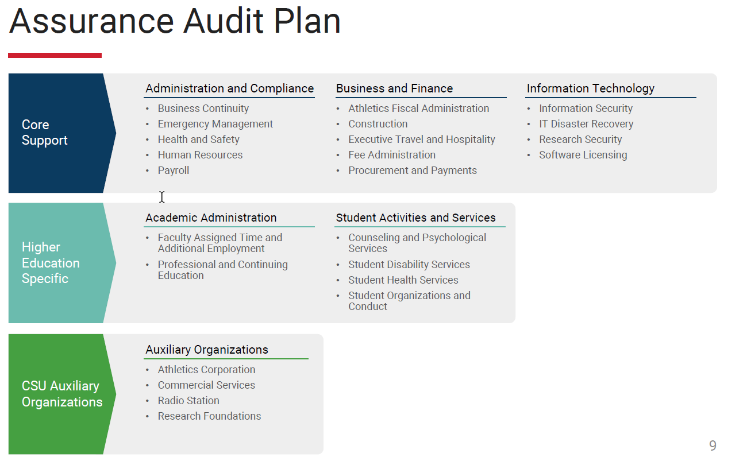
2025-26 CSU Audit Plan
Notes:
The risk assessment begins in January, with campus input in Feb and Mar before the final audit plan is presented and approved at the May CSU Board of Trustees meeting.

Slide 10
Areas recently audited at Humboldt
A&AS has reviewed several campus areas to help strengthen operations and accountability, including:
🧑‍🤝‍🧑 Human Resources & Training
🔐 Sensitive Data Management
💼 Sponsored Programs Foundation
🌍 International Programs
🍽️ Executive Hospitality & Travel
🚓 Police Services

Slide 11
My role as audit liaison
Provide guidance and support to the audited area before, during, and after the audit.
Help with logistics as needed (meeting coordination, audit translation, etc.).
Submit initial set of documents and follow up documents to A&AS.
Distribute weekly summaries, draft/final reports and coordinate campus responses.
Keep the President and other stakeholders updated.

Slide 12
Your Role (and Your Team’s)
Managers/Staff/Experts:
Share your team’s expertise and context for how things work.
Oversee responses and keep things on track.
Provide supporting documents, walk through processes, and explain details.
Provide resolutions, including proof, for any audit recommendations.

Slide 13
What to expect when an audit happens
📢Audit Announcement
(6–8 weeks before fieldwork)
- Official notice sent to campus.
- Audit Liaison hosts kickoff session: overview, tools, and Q&A.
- Early chance to share questions or concerns.
🔍Fieldwork
(3–5 weeks )
(larger scope audits can be up to 10 weeks)
- Entrance conference, testing, weekly meetings, exit conference.
- Open communication = fewer surprises.
🔁 Follow-Up Audit
(6–12 months later)
- A&AS confirms that recommendations are addressed.
- Celebrate cleared items and lessons learned! 🎉
📋Preparation Period
- Complete Internal Control Questionnaire (ICQ) and Request for Documents (RFD) requests.
- Gather documents and assign contacts.
📝 Reporting
(4–10 weeks after fieldwork)
- Draft and final reports issued.
- Departments work to clear recommendations within 6 months.

Slide 14
Common myths
❌ Myth | ✅ Reality / Takeaway
Audits mean we’re in trouble. | Audits help us spot gaps and strengthen how we work.
Auditors are out to get us. | Auditors are partners in accountability and success.
We only think about audits when one starts. | Audit readiness is part of how we operate every day.
Audits just create more work. | They improve systems, reduce risk, and make things easier long term.

Slide 15
Key Takeaways
Audits aren’t something to fear - they’re tools for improvement.
Foster a culture of readiness and accountability.
Communicate openly and stay organized.
Use the audit liaison as a resource to navigate the process smoothly.
Turn each audit into an opportunity to strengthen your area.
Celebrate progress!

Slide 16
Resources
Sarah Long - Audit Liaison
  snl20@humboldt.edu
  707-826-4036
Audit & Advisory Services Website
  Previous Humboldt Audit Reports

Slide 17
Questions?

