Slide 1
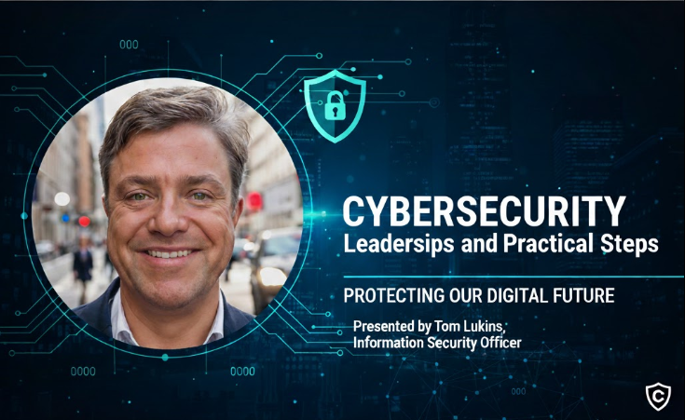
October 9, 2025

Slide 2
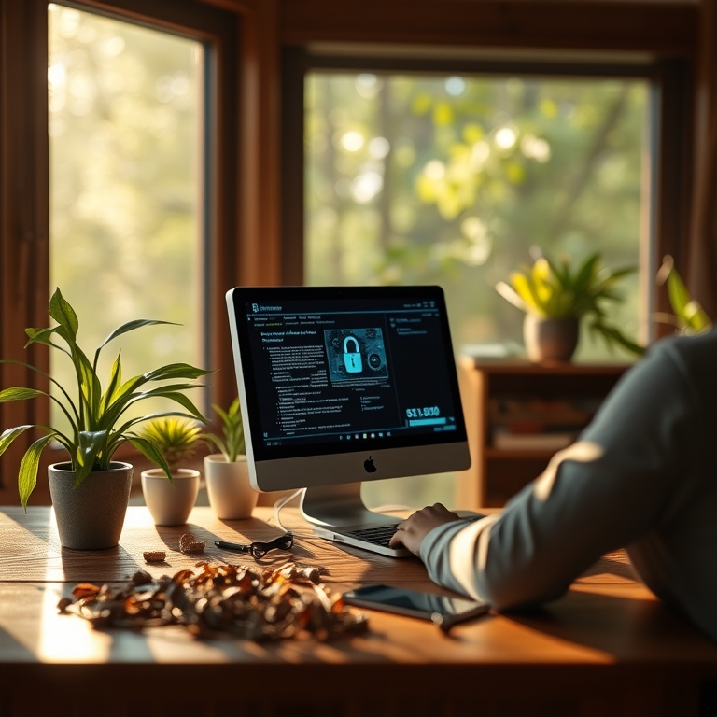
Agenda
How ITS and campus leaders work together to reduce risk and build resilience
Current Threat Landscape
Cybersecurity and Data Stewardship
Data Classification
Data Handling & Communication
Building a Culture of Awareness
Secure Practices
Key Takeaways & Discussion

Slide 3






Current Threat Landscape
Threats
Phishing Dominates Breaches
Human Factors in Breaches
Account Compromise
90% of breaches in higher ed originate from phishing
Human factors contribute to 60% of security breaches
Compromise of accounts facilitate rapid propagation
Ransomware Entry Points
Email as the Primary Vector
Importance of Awareness
Ransomware frequently starts with an email link
Most security incidents initiate via email
Enhancing awareness is critical to prevention
Understanding the current threat landscape helps us work together more effectively to protect our students, research, and campus operations.

Slide 4
Cybersecurity and Data Stewardship
Leadership
Most issues come from everyday actions:
Email, shared drives, and data sharing decisions
Slow down before releasing sensitive information
Managers play a key role in reinforcing secure practices and modeling awareness to prevent breaches and disruptions

Slide 5
Data Classification
Standards
Confidential - L1 Data
Private - L2 Data
Public - L3 Data
SSNs, financial records, and health information. Stored only in campus-approved systems.
Grades, HR data, and research information. Stored in Google Shared Drives or other ITS approved software.
Directory information and job titles. Stored in standard Google Drive.
When in doubt, reach out — we’ll help you review the right storage and sharing option.

Slide 6
Data Handling & Communication
Communication
Gmail
Use Cal Poly Humboldt Gmail for all official communication- Do not auto-forward
Never email Level 1 data
Be Careful with Level 2 data
Sharing Sensitive Data
Share Level 2 data via Google Shared Drive links and Share Level 1 data with ITS-approved systems
Report suspicious emails and suspicious data requests right away.

Slide 7
Building a Culture of Awareness
Awareness
Report quickly- Attackers often act within the first hour of unauthorized access.
We should encourage all team members to understand phishing and common attack methods. Regular discussions and encouraging reporting are essential.
Communication about cybersecurity policies strengthens individual responsibility and builds a vigilant, resilient team against cyber threats.

Slide 8
Supporting Your Team in Secure Practices
Leadership
01
02
03
04
05
06
Model Behavior
Supporting Access
Shared Drives
Approved Systems
Promote Awareness
Encourage Reporting
Sensitive Info
Approved Software
Access audit
Update permissions
Shared Drive policy
Regular reviews
PeopleSoft
Adobe Sign
MoveIT
Shared Drives
FERPA Training
Discussions
Report data disclosure or suspicious activity

Slide 9
Key Takeaways & Discussion
Takeaways
01
02
03
04
05
Leadership
Risk
L1 Data Handling
L2 Data Handling
Reporting & Offboarding
Shared leadership responsibility
Phishing attacks; awareness and training
Approved systems; do not email
Handle securely
Prompt reporting; Access removal
Security leadership isn’t about technical expertise. It’s about partnership, communication, and modeling good habits. We’re here to support you. Together, we can make cybersecurity part of our campus culture.

