Slide 1


De-Escalation Techniques
Dr. Elizabeth McCallion, Director of Counseling & Psychological Services (CAPS)
March 13th, 2026

Slide 2

Context
About me & how I can help
Acknowledgment of our recent protest and heightened emotions on campus
De-escalation skills can also be helpful in tense meetings or customer service settings
When people care deeply about issues, emotions can run high.
Administrators can play an important role in lowering tensions and keeping conversations constructive.

Slide 3
A Trauma Informed Approach
Acknowledges the role that trauma can play in a person's life
Trauma and early life adversity can affect:
Emotion management
How their nervous system responds to stress
People who have trauma backgrounds are more sensitized to escalation
You never know what someone’s story is.

Slide 4

What Happens During Escalation
People escalate when they feel unheard, disrespected, or powerless.
In emotional moments, tone and body language matter.
Goal: Lower the emotional temperature before solving the problem.

Slide 5
What we know about protests & acts of political violence
Protestors are not a homogenous group of people.
Authorities can engage in de-escalation while still enforcing laws/rules/regulations
Protestors themselves can play a role in de-escalating one another.

Slide 6
Warning Signs of Escalation
Physical signs (e.g., red face, clenched fists/jaw, rapid breathing, trembling, dilated pupils)
Heightened anxiety/hypervigilance (e.g., pacing, restless behaviour, repetitive movements, excessive sweating)
Physical intimidation (e.g., slamming doors, pounding tables, making threatening movements)
Verbal intimidation (e.g., swearing, sneering, taunting, raising voice)
Threatening (i.e., verbal threats of physical assault)

Slide 7
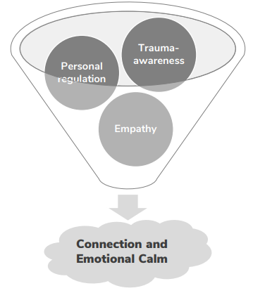
Co-regulation
The process of managing emotions through connection with another person. When we offer safety, stability, and calm, we can reduce the other person's survival response.

Slide 8
The L.E.A.D. Framework
L – Listen: Allow people to express concerns fully before responding.
E – Empathize: Acknowledge emotion without agreeing with every demand.
A – Ask: Use clarifying questions to move from anger to explanation.
D – Direct: Provide structure and explain next steps or process.

Slide 9
Helpful Phrases
“I hear that this issue matters deeply to you.”
“Let’s slow down for a moment so I can understand what you’re asking for.”
“Help me understand what concerns you most right now.”
“I want to have this conversation, and it will be more productive if we speak one at a time.”
“Here’s what I can do right now, and here’s the next step.”

Slide 10
Practical Tips for Connecting
Lower your voice
Slow your pace
Shorten your sentences
Stand at equal height
Avoid crossing arms or pointing

Slide 11
Administrator Roadblocks
We defend before listening.
We cite policy before acknowledging emotion.
We speak in legal language instead of human language.
We threaten consequences too early.
We confuse empathy with endorsement

Slide 12
Take-Aways
Universities are places where strong ideas and strong emotions exist.
De-escalation can help keep disagreement constructive rather than destructive.
Remember LEAD: Listen, empathize, ask, then direct.
Take care of yourself & each other!

Slide 13
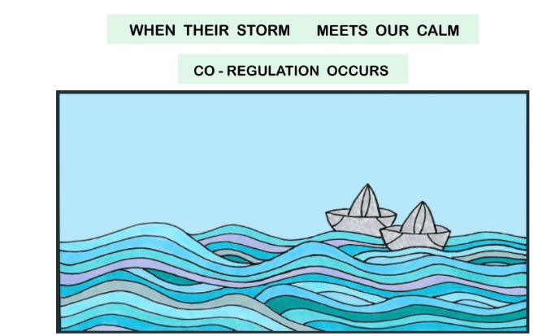
Contact: eam162@humboldt.edu, X5736

