Slide 1

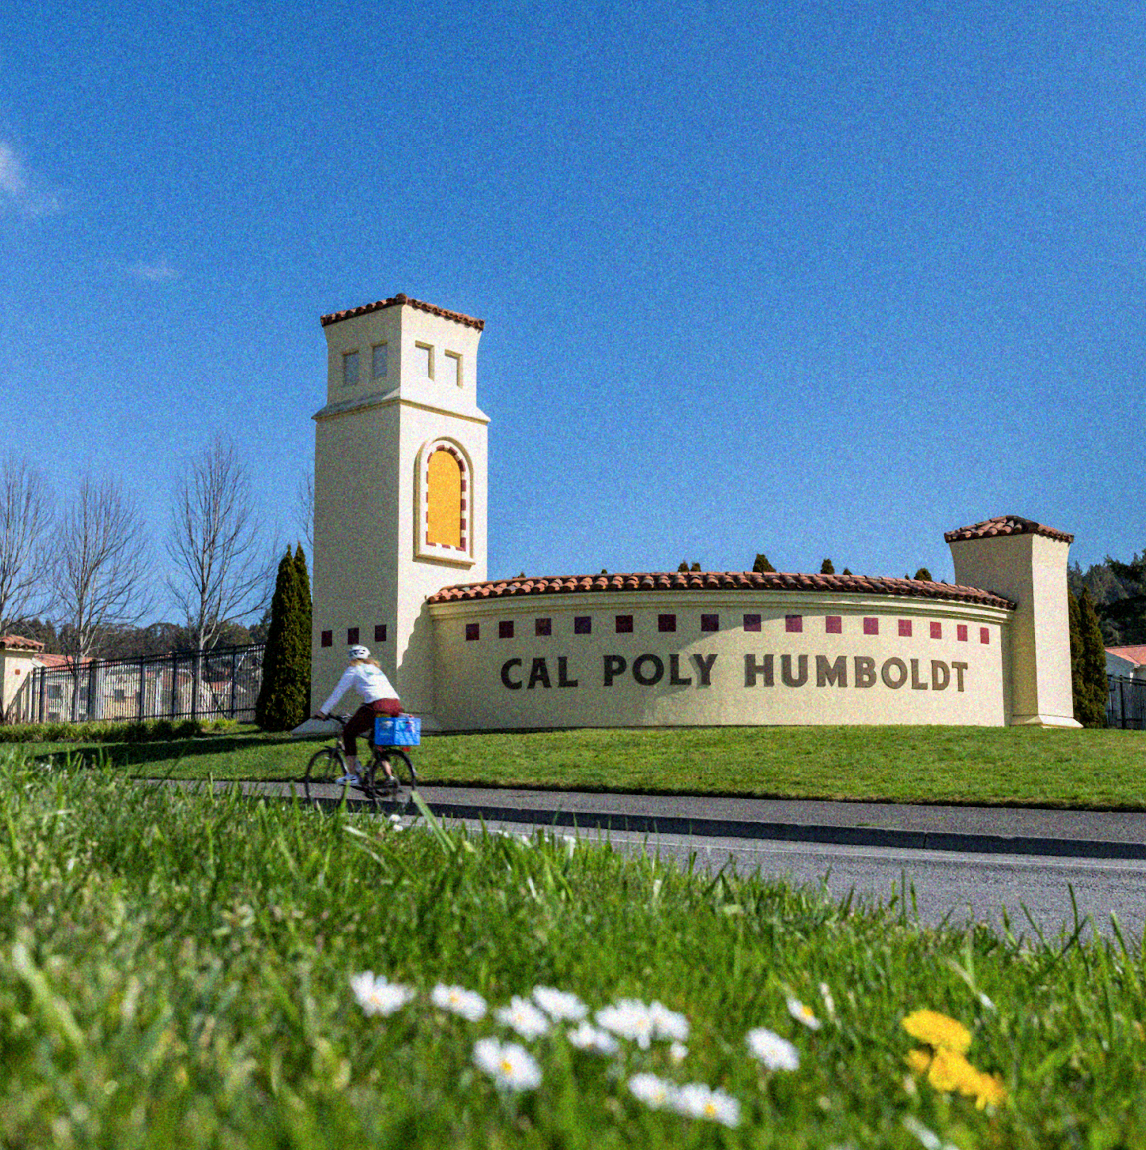
Free Speech Overview
MPP Meeting
March 13, 2026
Dr. Chrissy Holliday, VP EMSS
Heather Honig, Constructive Engagement Manager
Ravin Craig, Interim Dean of Students
MPP Presentation | March 2026

Slide 2


First of all . . .
Notes:
Appreciation - Thank you for everything the last few weeks, already busy schedules and willingness to pitch in.

Slide 3
Free Speech - humboldt.edu/free-speech
What is Freedom of Speech?
The U.S. constitution states: Congress shall make no law respecting an establishment of religion, or prohibiting the free exercise thereof; or abridging the freedom of speech, or of the press; or the right of the people peaceably to assemble, and to petition the Government for a redress of grievances.
Free Speech is defined by the California Constitution as: Every person may freely speak, write and publish his or her sentiments on all subjects, being responsible for the abuse of this right. A law may
not restrain or abridge liberty of speech or press.
Notes:
Chrissy

Slide 4
Freedom of Expression vs
Civil Disobedience
While the first amendment does protect the right to free expression, please keep in mind that the Constitution does not guarantee any right to engage in civil disobedience — which, by its very definition, involves the violation of laws or regulations — without incurring consequences.
Even when performed in the pursuit of worthy causes, civil disobedience can have a negative effect on the protected interests of others. It might also interfere with University business, create a public safety concern, or endanger University assets. In these instances, the University may need to act to protect those interests.
Notes:
Chrissy

Slide 5
Time, Place & Manner (TPM)
What is Time, Place and Manner?
Standards set by the CSU that establish the “time, place and manner” (TPM) in which all activities may be conducted on university property.
Policy ensuring those who participate in lawful expressive activities are protected and do not disrupt university operations or infringe on the rights of others.
Also addresses responses to disruptions and the provision of supportive services for those impacted by the activity.
Notes:
Chrissy

Slide 6
Time, Place & Manner (TPM)
What about free speech?
The Supreme Court has held that speech may be regulated in some circumstances, including under TPM regulations.
What is “viewpoint and content neutrality”?
The concept that TPM restrictions apply across the board, without regard to the substance or the message.
The university may NOT limit the content or the viewpoints of what is expressed on university property, the University may limit where, when and how these activities take place through content and viewpoint neutral TPM restrictions.
Notes:
Chrissy

Slide 7
TPM Examples
Public spaces vs. non-public spaces
Reservation and notice requirements - with allowance for spontaneous events
Limitations on the use of amplified sound
Flyer posting and tabling guidelines
Notes:
Chrissy

Slide 8
What is a Constructive Engagement Manager?
Supports free speech and TPM initiatives
Provides training and professional development on free speech and TPM-related topics
Collaborates with FSSRT on free speech initiatives and events on campus
Coordinates response at free speech events and adjusts based on the activity
Collaborates with individuals and groups planning free speech activities and provides any needed support at the event
Establishes contact with the group or key individuals at a spontaneous free speech event
Notes:
Heather

Slide 9
Who is on the Free Speech Support and Resource Team?
A cross-section of campus is represented on this 29 member team.
Staff
Faculty
Administration
*Includes responding members (MPPs) and advisory members (represented faculty and staff)
Notes:
Heather
Staff - Representatives from staff council and CSUEU
Faculty - Across colleges
Administration - Across divisions and various levels

Slide 10
Response to Free Speech Activity
Planned events vs. Unplanned/Spontaneous events
Support team
DUO and CEM
Risk
Facilities
MarCom
CES
Health and Wellbeing
Notes:
Heather
Development of plan and members of the support team

Slide 11
Event Planning
CEM connects with organizers and provides a space to discuss any concerns and address any questions prior to the event.
If it is unplanned (i.e. social media, flyers, etc.), the CEM attempts to reach out to the organizers.
A safety response plan is developed and CEM checks with the support team for availability.
During the event, the support team monitors for safety and engages with individuals as appropriate to provide guidance on TPM or provide safety reminders.
After the event, we review the activity with FSSRT and use the feedback to improve future events.
Notes:
Heather

Slide 12
If we need assistance . . .
The ask may be to support with monitoring an area in order to assist with student and staff safety. Duties can vary depending on the event. Your personal safety is a priority!
You are not alone in these situations. There is a team of people to help!
Typically, the support team interacts with the individuals directly involved with the free speech activity. We may need peripheral assistance.
If you encounter media, direct them to MarCom (news@humboldt.edu). Please do not give them a statement.
Notes:
Heather?
Examples - building closed, class relocation.

Slide 13
Student Development and Free Speech
Time, Place, Manner Education
Orientation - respectful dialogue presentation, TPM specific content in online orientation and in person DOS content
Registered Student Organization Training - TPM specific in both student leader training and advisor training
Campus Events - a number of campus presentations about the content
CSU Learn for Students in the Fall
Notes:
Ravin

Slide 14
Student Development and Free Speech
Conduct and TPM:
Deeper Dive on Conduct/CARE in the future
Lack of knowledge doesn't equate to a lack of responsibility
Most conduct, including TPM specific is educational at the core
Developing more robust ways to engage education around free speech issues
Notes:
Ravin

Slide 15

Any questions?

