Slide 1
So you want to drive on University Business?
Presented by Cris Koczera and Travis Fleming

Slide 2
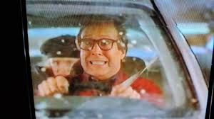
Is it my job or am I a volunteer?
Driving MUST be in the employee’s job description
Most represented employees do NOT include driving in their PD
Anyone with out driving mentioned in their PD MUST complete a volunteer form to drive for the University

Slide 3
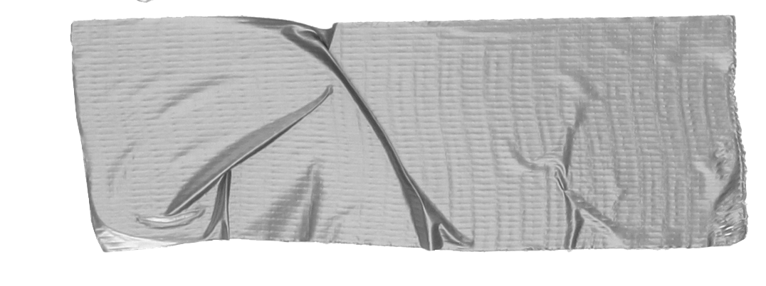

Requirements for drivers:
Passed a DMV check
Completed defensive driver training
If driving personal vehicle: Permission from supervisor must be in writing PRIOR to driver AND the driver must have provided
the University with their proof
of insurance
Tip:.
DMV pulls can take some time…be sure to give yourself 30 days to have the DMV pull, complete the training and the processing of the volunteer form

Slide 4
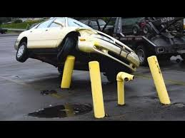
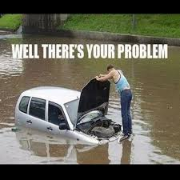
Accident Reporting
State Owned Vehicle Complete the Accident vehicle form within 24 HRS and email to the risk-managment email
Enterprise Vehicle Notify Enterprise
Complete the Accident vehicle form within 24 HRS and email to the risk-managment email
Personal Vehicle Complete the Injury report form-any damage to the vehicle is the responbility of the driver

Slide 5
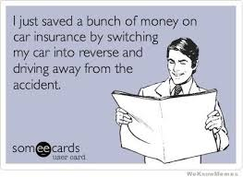
Things I didn’t think I needed to say outloud…
Hitting property still requires an accident form to be submitted
Hitting another driver OR property and driving away is ILLEGAL
Drinking before or during driving on University business is STRICTLY PROHIBITED
Totaling an Enterprise vehicle still requires you to notify the Unviersity

Slide 6
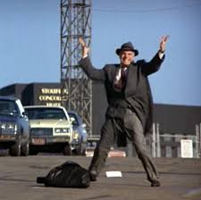
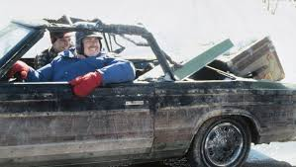
Can I get a ride?
How does one get a hold of a state owned vehicle?
Tip
If you scratch, bump or bruise a state owned vehicle even if it’s assigned to your department you MUST report that to FM

Slide 7
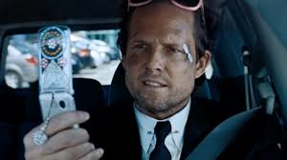
Resources
https://www.humboldt.edu/campus-resilience-and-response/risk-management/vehicle-use-accident-reporting
https://share.google/un2UctvriGVpo2Igw
Questions?
Reach out to Cris,
Travis or Anthony!

