Slide 1


Wildfire Smoke Protocol
Emergency Management | May 2026

Slide 2

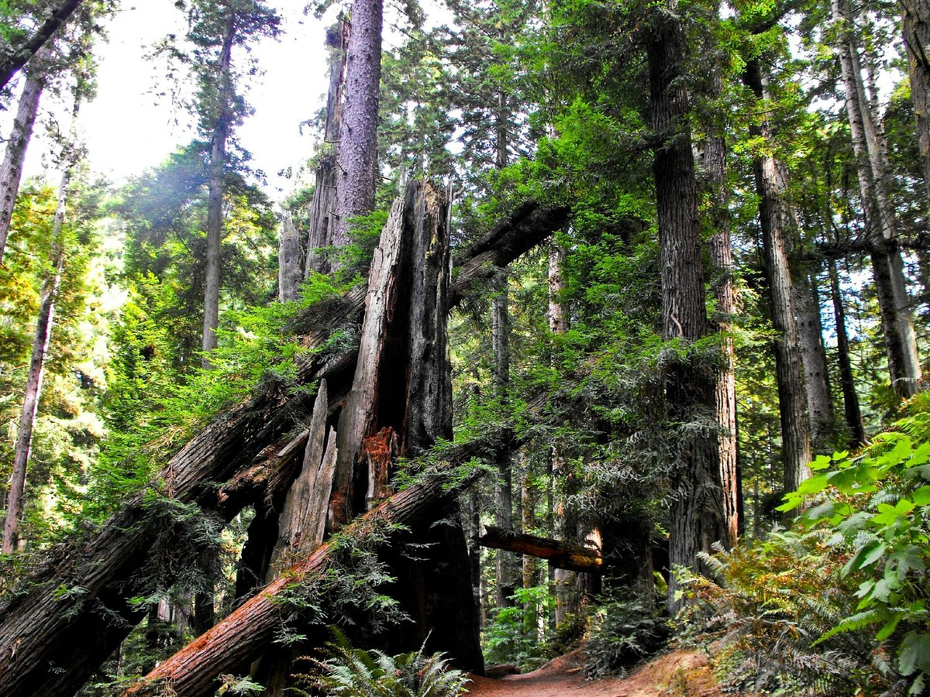
Smoke/Air Pollution
Direct wildfire threat is currently low. Smoke impacts are much more likely
Traditionally, Humboldt’s coastal zone maintains higher fuel moistures and lower Energy Release Component (ERC) values due to marine influence. However, recent warming and drying trends are allowing fuels to cure earlier and remain receptive closer to the coast, increasing the probability of coastal ignition and sustained fire spread during offshore wind or heat events

Slide 3
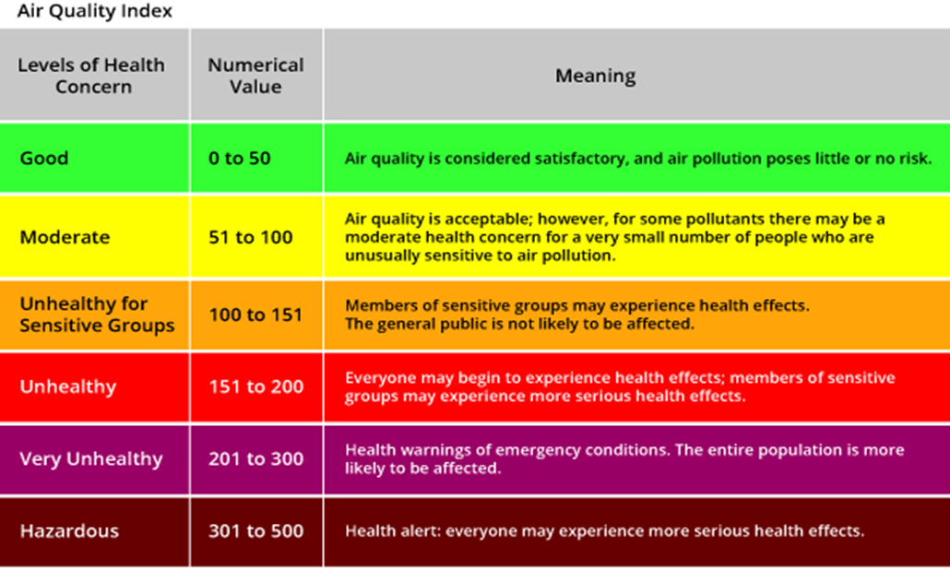
*Graphic from airnow.gov

Slide 4

Potential Campus Impacts
Outdoor events & athletics
Field work & research activities
Housing indoor air quality concerns
HVAC/filtering considerations
Employee outdoor work modifications
Messaging volume increase

Slide 5
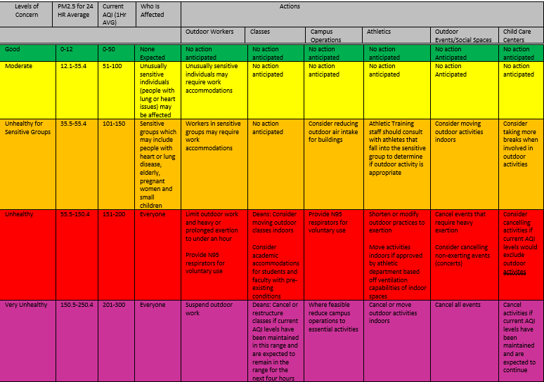

Slide 6
Monitoring
Emergency management will monitor current as well as projected air quality forecasting
AQI | Operational Consideration
101-150 | Increased monitoring, communication
151-200 | Consider partial operational impacts / low EOC activation
200+ | Significant operational modifications possible / expand EOC activation
Both fire.airnow.gov and purpleair.com will be utilized along with our Purple Air monitor

Slide 7
Campus Response
Changes to operations or planned actives should be considered in the following blocks:
Prior to 6am
Full day/partial day operational cancellation decision point
10am
Reevaluation for partial day impacts
11am
A partial day change to operations or activities will go until noon with another evaluation occurring at 10:00 am and follow up messaging to go out no later than 11am either confirming campus operations returning to normal or cancelling the remaining activities for the day
Ongoing
Continuous AQI and forecast monitoring
Operational decisions may be accelerated if AQI thresholds are exceeded unexpectedly

Slide 8
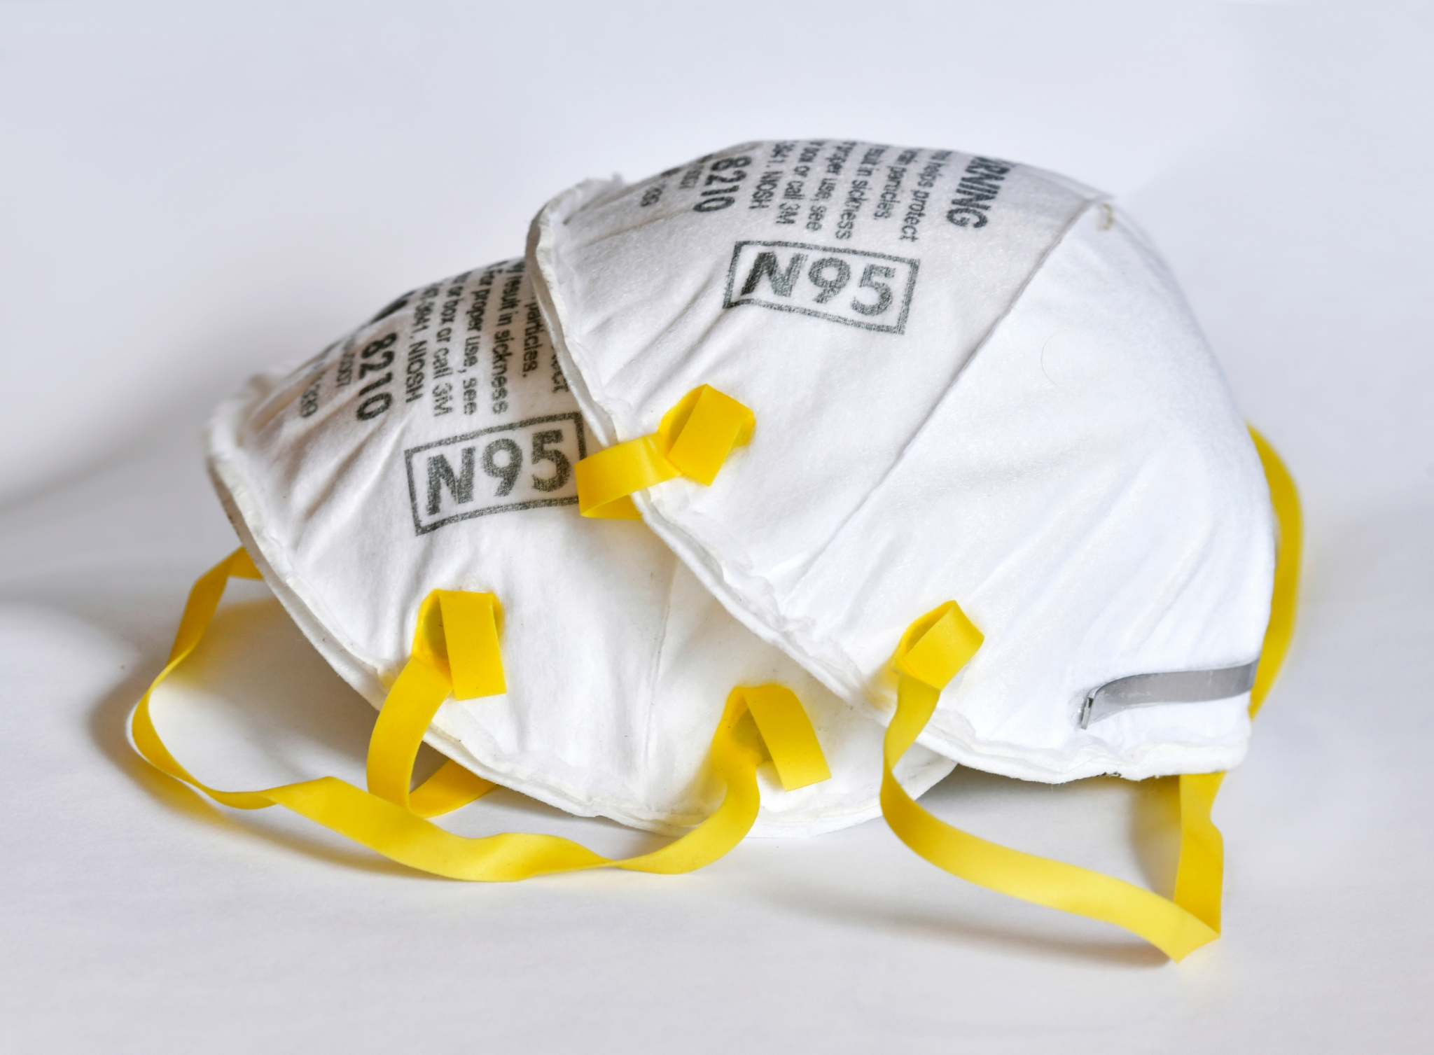
PPE Protocols
N95 Mask requests through EHS
Shelf life 3-5 years
8hrs continuous use, 40hrs cumulative non strenuous use
Voluntary vs. Involuntary
Potential localized cache: Athletics, FM, Grounds

Slide 9
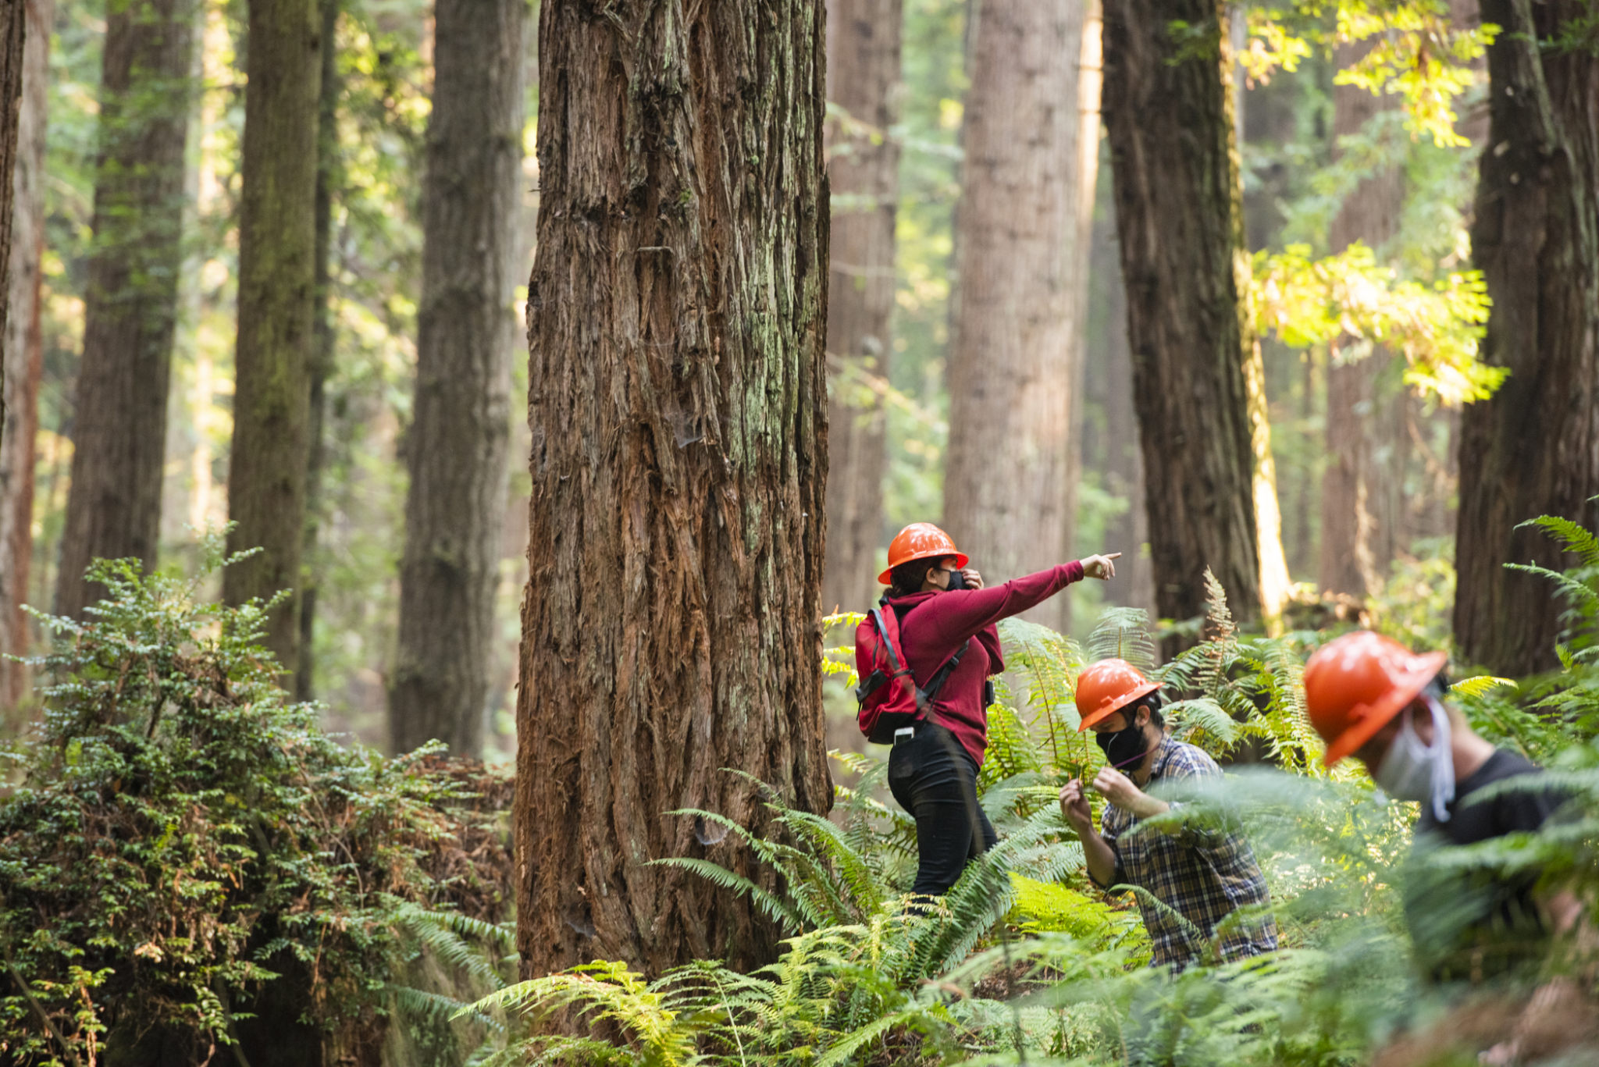
Thank you!
Questions?

