Slide 1


Other Conduct of Concern (OCC): What MPPs Need to Know
Recognize it. Respond to it. Document it.
Presentation by Pam Kirschner - August 14, 2026

Slide 2

What is OCC?
Other Conduct of Concern (OCC) is the term that the CSU came up with to describe behavior that negatively impacts the working, learning, or living environment but does not violate an existing CSU policy or law.
The goal is to support individuals who report OCC so that they feel heard, valued.. AND provide an avenue for resolution resolved before complaints escalate into larger concerns.
OCC is not a disciplinary process. If a potential violation is identified while processing a complaint, the matter is referred to the appropriate campus process.
OCC is about early intervention, not punishment.

Slide 3
Why does OCC exist?
How we got here:
2023 → Review of all CSUs (Cozen O’Connor) identified a *gap
2024 → CSU drafted Guidance based on ^^^ findings
2025 → Systemwide Guidance Released
*Concerning behavior (below the bar of a policy violation) was occurring but there was not a consistent way to respond or track complaints.
Addressing OCC has always been a core responsibility of supervisors and administrators at Humboldt. We were doing our job. What we lacked was a consistent process for documenting, tracking, and closing the loop.
Our response was to create the Complaint Coordinator position = Me!

Slide 4
What OCC is - and isn’t
OCC may include:
Unprofessional interactions
Workplace conflict
Repeated boundary issues
Disruptive behavior
Communication concerns
Departmental practices
Complaints about instructors
Student vs. student disputes
OCC would NOT include:
Severe, pervasive, or objectionable offensive behavior that breaks a law or violates an existing policy, such as:
  Title IX/DHR matters
  Student Conduct violations
  Disputes involving collective bargaining members
  Grade Appeals
It can be confusing - Reach out to us if you're unsure.

Slide 5
Goal: Address OCC behavior before it escalates
When appropriate, encourage:
*Direct communication with offending party
Enlist assistance from Supervisor/Department Chair
Utilize the University Ombuds
Informal resolution may be possible BUT it is not a prerequisite to formally reporting OCC
*An affected party may not feel safe, comfortable, or empowered to address the other party directly.
Requiring people to confront the person first can create an unfair barrier.

Slide 6
When should OCC be reported?
Factors to consider, as an MPP:
The behavior is repeated or escalating
It is significantly affecting someone's ability to work, learn, live, or participate
The situation needs documentation for future reference
The matter crosses departments or is outside your authority
You believe the affected party may need additional support
You're not sure if what’s going on is actually a violation of another policy
When in doubt = report it out!

Slide 7
Who can submit an OCC Report?
Anyone!
  Students
  Staff
  Faculty
  Parents
  Community Members
There are NO mandated reporting requirements for OCC
You can offer to submit one on someone’s behalf
Best practice is to direct them to the reporting website
If you take away only one practical resource from today, please remember the information on the next slide.

Slide 8



Go to: humboldt.edu/reporting
  Options for reporting unprofessional behavior involving members of the campus community.
  Concerns & Actions Guides for most common issues with contact numbers and direct links to forms
  Tips for resolving disputes before it escalates
  Resources for navigating through conflict
Email: complaints@humboldt.edu Phone: 707-826-3387

Slide 9
What happens after a Report is submitted?
REPORT → ASSESS → ASSIGN → RESPOND → DOCUMENT → FOLLOW UP → CLOSE
My Role as the Complaint Process Coordinator:
Review and assess
Determine appropriate process
Open and tracks OCC case
Assign/consult with applicable administrator
Provide support
Track case through *conclusion
Close the loop
* It’s the University's responsibility to respond appropriately to OCC but there is no guarantee that every reporting party will receive the outcome they want.

Slide 10
What to do if YOU Are the Assigned Administrator
FIRST: DON’T PANIC. THERE’S A GUIDEBOOK!
Suggested process:
Send *outreach with invitation to meet
Meet with affected and offending party (as appropriate)
Determine what is reasonably possible
Communicate: meeting summary, next steps, findings
Determine when to close case and notify affected party
*Ideally all correspondence and documentation should be sent via Maxient (our secure case management system).
DOCUMENT! DOCUMENT! DOCUMENT!
Each division has their own protocol for dealing with ongoing/unresolved conflict.

Slide 11
Closing thoughts:
Confidentiality is respected → very limited access to case files
Early intervention → small concerns can become patterns
Not every problem has a perfect resolution → but every concern deserves an appropriate response
Listening is important → People need to know they’ve been heard
Closing the loop is crucial → Silence can feel like nothing happened

Slide 12
Thank you!
QUESTIONS???
Email: complaints@humboldt.edu 707-826-3387

Slide 13
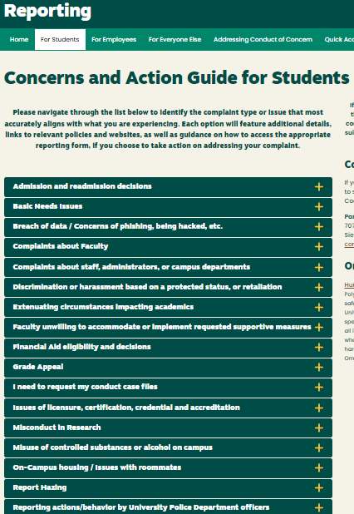
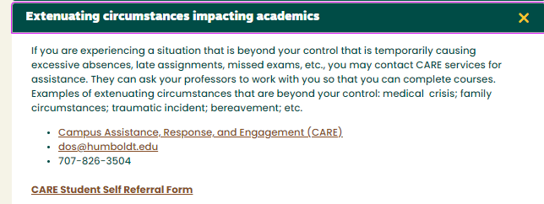
Go to: reporting.humboldt.edu
Select a tab for dropdown menus with options for addressing your concerns:
Example:
There will also be links to reporting forms & contact info

Slide 14
Quick Guide To Reporting Concerning Behavior:
Click HERE to report student behavior or misconduct (Violations of the Student Code of Conduct)
Click HERE to report a student who needs support due to an extenuating circumstance (CARE)
Click HERE to report allegations of Sexual Misconduct (Ex. Sexual Assault, Dating/Domestic Violence, Stalking)
Click HERE to report Discrimination & Harassment (Based on a Protected Status)
Click HERE to report “Other Conduct of Concern” which is any behavior by a campus member that would not fit into one of the categories listed above OR if you are unsure which form to use.

