Slide 1


Purchasing
& Compliance Refresher
Contracts & Procurement
Information Technology Services Environmental Health & Safety
Facilities Management
Marketing & Communications
Purchasing & Compliance Refresher | September 11, 2026

Slide 2

What We’ll Cover
01 Purchasing Overview
check_circleHow to purchase check_circleChoosing the right method check_circleKey Reminders
02 Compliance & Approvals
check_circleInformation Technology (IT) check_circleFacilities Management check_circleRisk Management check_circleMarketing & Communications
03 Resources
check_circleWhere to go check_circleWho to Contact check_circleGetting Support

Slide 3


Purchasing: Start Here
★ Best Choice
2nd Choice
Last Resort
01
P2P Marketplace
Preferred Method
Punchout catalog item
Use CSU-contracted suppliers whenever available
Don’t go straight to Amazon
02
Requisition to PO
Submit a form in P2P When:
Always as a first option
To automate compliance and DOA approvals
03
ProCard Option
Established Limits:
One-time purchase
Unable to purchase via P2P

Slide 4
P2P: Approval Workflow
P2P automates compliance and fiscal approvals before the purchase.
01
Create Request
Enter the request in CSUBUY P2P using the appropriate form and provide the required purchasing information and documentation.
02
Workflow Routes
Based on the commodity or service, the requisition will route through the workflow in a transparent way.
03
Compliance/DOA
Each requisition routes to the appropriate campus compliance and DOA approval:
IT • MarCom • Facilities • Risk Management
04
Purchase
Once all required approvals are complete, Procurement reviews and then the PO is issued to the Supplier.

Slide 5
P2P: Payment Workflow
P2P ensures the commodity or service was received before payment is issued.
01
Invoice Submitted
Invoice must be submitted to P2PInvoices@humboldt.edu with PO number.
*Otherwise the transactions sits with no action
02
Voucher Created
Invoice is attached to the PO, the voucher is created, and routed for approval to pay.
03
Verify Receipt
The PO owner needs to verify that they received the good or service in P2P (either with a verification or receipt creation).
04
Payment
Once the PO owners verifies receipt, it goes back to AP for final review and payment issuance.

Slide 6
Make It Easy on Yourself
⏰ Start Early
Submit as soon as you can and allow
~2 weeks for workflow and approvals.
Anticipate procurement needs before they become urgent.
📋 Help Us Help You
Include complete documentation and a clear business justification.
More context upfront = less back-and-forth later.
🛒 P2P Is Your Friend
P2P should always be your first option.
Automated approvals, tracking, and compliance.
ProCard is still available as a backup.
🙋 Don’t Go It Alone
Come to Procurement drop-ins and use available resources.
Lean on follow subject matter experts.
P2P should be used by fewer centralized frequent users.
Bottom line: Plan ahead • Give us the details • Use P2P • Ask for help

Slide 7
Resources/Purchasing Support
Contracts & Procurement
procure@humboldt.edu
Campus P2P Drop-In Sessions
Tuesdays: 10:00 a.m. - 11:00 a.m.
Wednesdays: 3:00 p.m. - 4:00 p.m.
Thursdays: 2:00 p.m. - 3:00 p.m.
Specialized Purchasing
Reach out directly to specialized compliance partners for specific purchasing needs:
💻 IT Purchasing
🔧 FM Purchasing
📣 MarCom Print Services
⚠️ Risk and EH&S

Slide 8
P2P: IT Compliance
⏰ When is an IT Review Required?
Most hardware and software purchases
No-cost software does require a review
NOT required for computers and pre-approved products such as keyboards, mice, and speakers
📋 Computers, Tablets, & Printers
Create a Help Desk ticket to request a quote or consultation
ITS will email the quote to you to submit it to P2P
🛒 Common Issues and Reminders
Full IT Review process normally takes 1-2 weeks, but may take longer (more on this in a minute)
System-wide hardware and software questions may be challenging to answer. ITS will soon be posting detailed instructions, and is always happy to guide you through them
Documentation!
🙋 Need More Info or Assistance
hum.link/tech-purchasing for more information
If needed, create a Help Desk ticket at humboldt.edu/techhelp or email help@humboldt.edu
Email itar@humboldt.edu

Slide 9
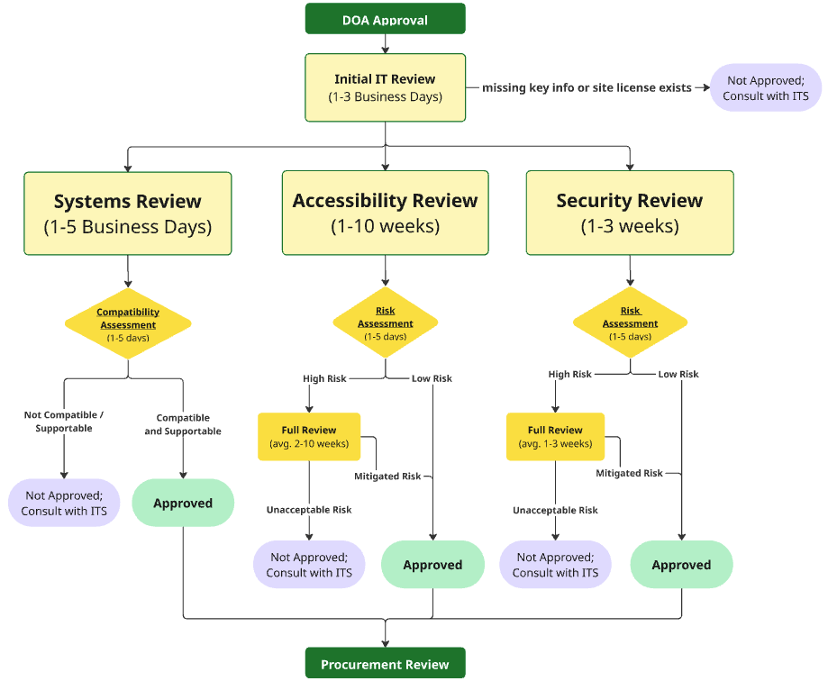
P2P: IT Compliance Workflow
Overview
Initial IT Review
(1-3 business days)
Quick check before moving the requisition to the 3 teams
Systems Review
(1-5 business days)
X,Y, and Z
Security Review
(1-2 weeks)
X,Y, and Z
Accessiblity Review
(1-3 weeks)
X,Y, and Z
Approval
Notes:
After DOA approval, hardware and software requisitions move to the IT Review process.
The first step is an initial review where we just confirm that the needed information is included and make sure that the request is not something we already have a site license for. This is usually completed in a day.
Then the requisition moves to the Systems, Accessibility, and Security Reviews. All 3 reviews occur in parallel,
Systems Review (1-5 business days)
Determine if there an existing product that provides similar functionality
Confirm that the product can be installed and supported by ITS at an enterprise level
Verify product compatibility with Humboldt computer hardware, operating systems, and virtual environments (i.e. VLab)
Research the product’s requirements in terms of infrastructure (e.g. SSO), integrations (e.g. with Canvas or Peoplesoft), and programming. And make sure that ITS has capacity for this work.
Validate that the vendor provides sufficient training and support
Accessibility Review (1-10 weeks)
Perform a risk assessment. High risk areas include public websites, enterprise applications, and required or recommended academic software. The number of users also impacts the risk
Review vendor accessibility documentation (VPAT)
Test accessibility: keyboard navigation, screen-reader compatibility, color contrast, text resizing, captions, and accessible forms. This is done using both automated tools and hands-on testing.
If accessibility issues are discovered and they will prevent users with disabilities from completing essential tasks, we’ll work the vendor to resolve the issues
Or, try to develop and implement a Temporary Alternate Access Plan (TAAP) to provide a different way for users to complete these tasks
Security (1-3 weeks)
Identify what the tool does and what CSU data is involved.
Confirm the requester’s data classification and vendor access and custody.
Review vendor security documentation (HECVAT), if risk warrants it.
Confirm required contract protections, including the Data Privacy and Security Rider where applicable.
Recommend proportional controls and a clear approval, remediation, or risk-acceptance path.
We will be updating our website with all of this information sometime soon.
Final note: requisitions are actually very rarely rejected. Even if there are issues, ITS can usually work through them with the requestor and vendor to find satisfactory solutions.

Slide 10
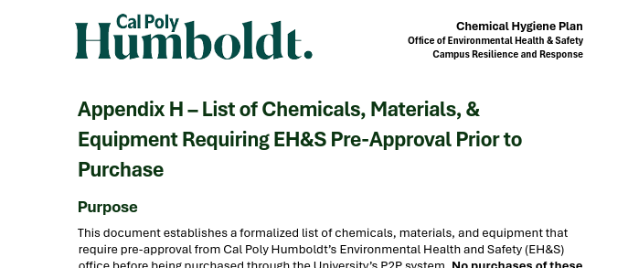
Environmental Health & Safety
What We Review:
EHS reviews purchases that may create significant health, safety, or regulatory requirements before they are ordered
Examples Include:
High Hazard Chemicals
Regulated Materials
Safety-Sensitive Equipment
Full List on our website under Chemical Hygiene Plan

Slide 11
Environmental Health & Safety
When purchasing:
The Chemical & Hazardous Materials Purchase Request Form may need to be completed to provide EHS with necessary details
Be prepared to provide:
Product Info
SDS
Intended Use
Storage/location info
Training Provided
SOPs

Slide 12
Facilities Management
Furniture
Confirm furniture meets egress, fire/life safety, accessibility, and compatibility requirements
Consider maintainability, durability, sustainability, and expected service life
Coordinate installation requirements when applicable
Vehicle Related Purchases
Coordinate the purchase of new vehicles, trailers, and vehicle-related equipment
Confirm vehicle specifications and compatibility with campus fleet requirements
Identify ongoing insurance, maintenance, fuel, and replacement responsibilities

Slide 13
Facilities Management
Equipment Purchases
Confirm the proposed installation location before purchase
Identify required electrical, plumbing, HVAC, structural, or other infrastructure modifications
Consider delivery, installation, access, and long-term maintenance requirements
General Purchases
Identify purchases that may have Collective Bargaining Agreement (CBA) impacts
Coordinate items such as custodial equipment, supplies, or other purchases that could affect represented work
Engage Facilities Management when there is uncertainty about installation, maintenance, or operational impacts

Slide 14
Supporting the University Brand
The Brand Promise
Our brand is a big idea or
core promise, not just graphics and colors.
It is a verbal and visual representation of the Cal Poly Humboldt story—what we do and what sets us apart.
Required MarCom Approval
Marketing & Communications and Affinity Licensing ensure proper usage of the University name and symbols. Prior approval is required for:
Any branded item, logo, or use of the Cal Poly Humboldt name
All print, digital, promotional, advertising—especially recruitment
All campus entities: state/non-state funds, clubs, and auxiliaries

Slide 15
MarCom Approval Workflow
P2P automates brand and policy compliance before the purchase.
01
MarCom Approval
Email your artwork
and project request to marcom@humboldt.edu for initial approval.
02
Submit Requisition
Attach approval email with artwork to P2P Requisition. MarCom will approve in P2P.
03
Purchase Products
Using an approved vendor, place your order. NOTE: if step one was not completed the process can start over.
04
Licensing Approval
The vendor submits artwork through Affinity Licensing.
More info and full guidelines
brand.humboldt.edu

Slide 16

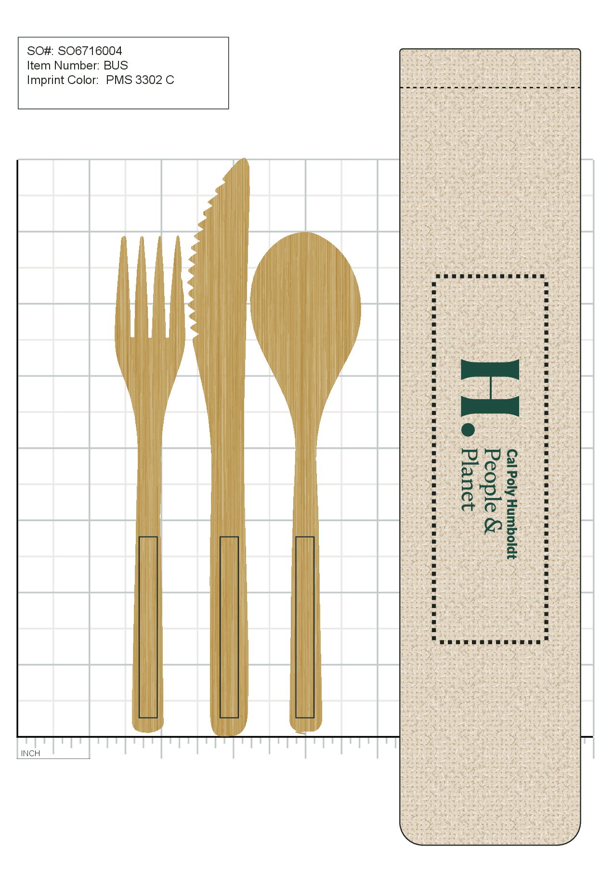



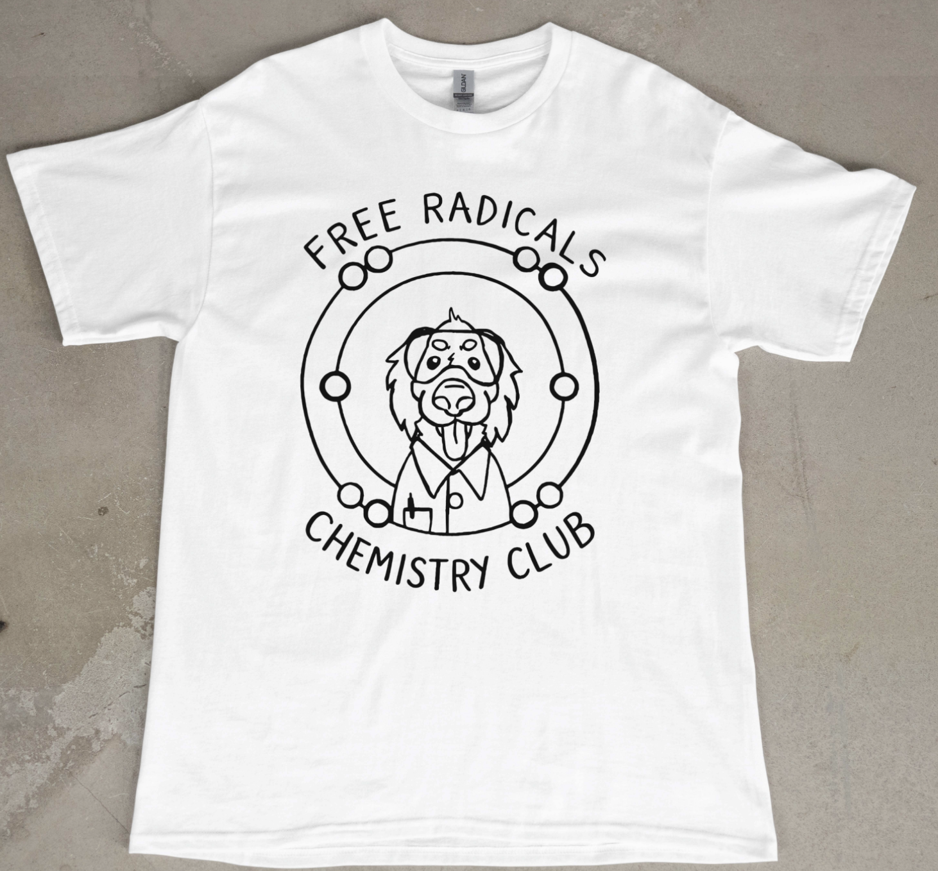

Approved Designs

Slide 17

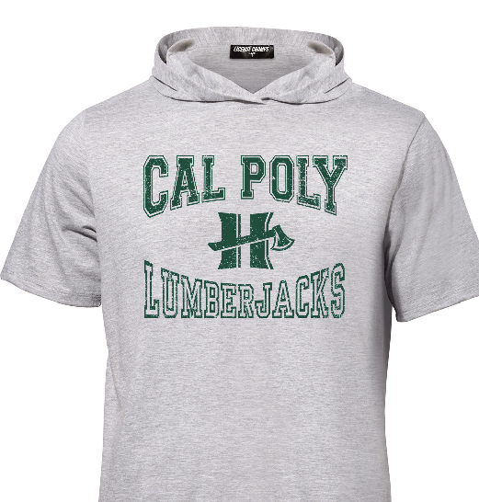
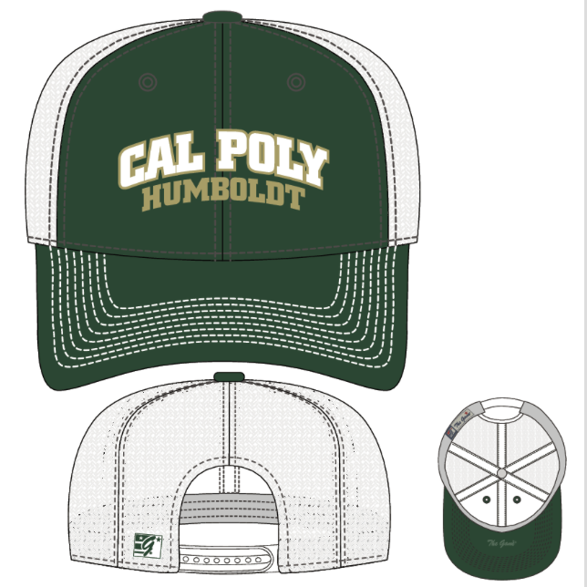




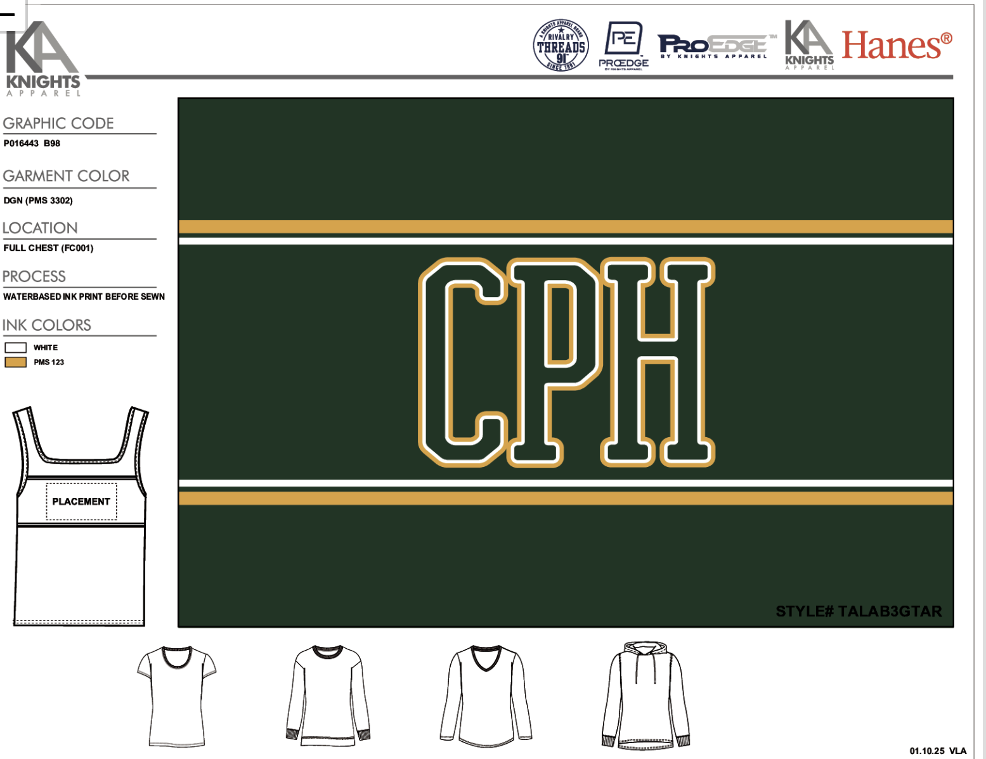

Rejected Designs

Slide 18
Print Services
Guidelines & Policies
Print Policy: Submit all printing needs to MarCom in advance. We can print or outsource as appropriate or provide an exception when necessary. Campus Print Policy
Paper Policy: All departments must purchase process chlorine-free, 100% post-consumer recycled or 100% agricultural- waste fiber letter-sized office paper. Campus Paper Policy
What We Do
Humboldt Branded items: Business cards, stationery, & signs
Automated mailings: Bulk mail distributions (200+)
Environmental & Displays: Wall,
window, & event signage
Large Format: Posters, canvas, vinyl stickers, banners, & table covers
Digital & UV printing: Brochures, flyers, books, and printing on rigid surfaces
Finishing & Swag: Folding, laminating, cutting, and custom swag ordering

Slide 19



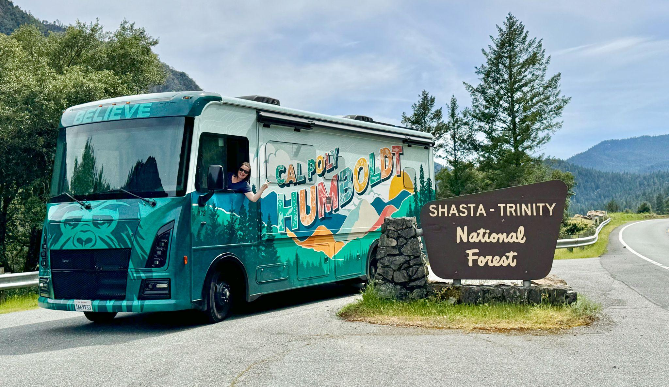


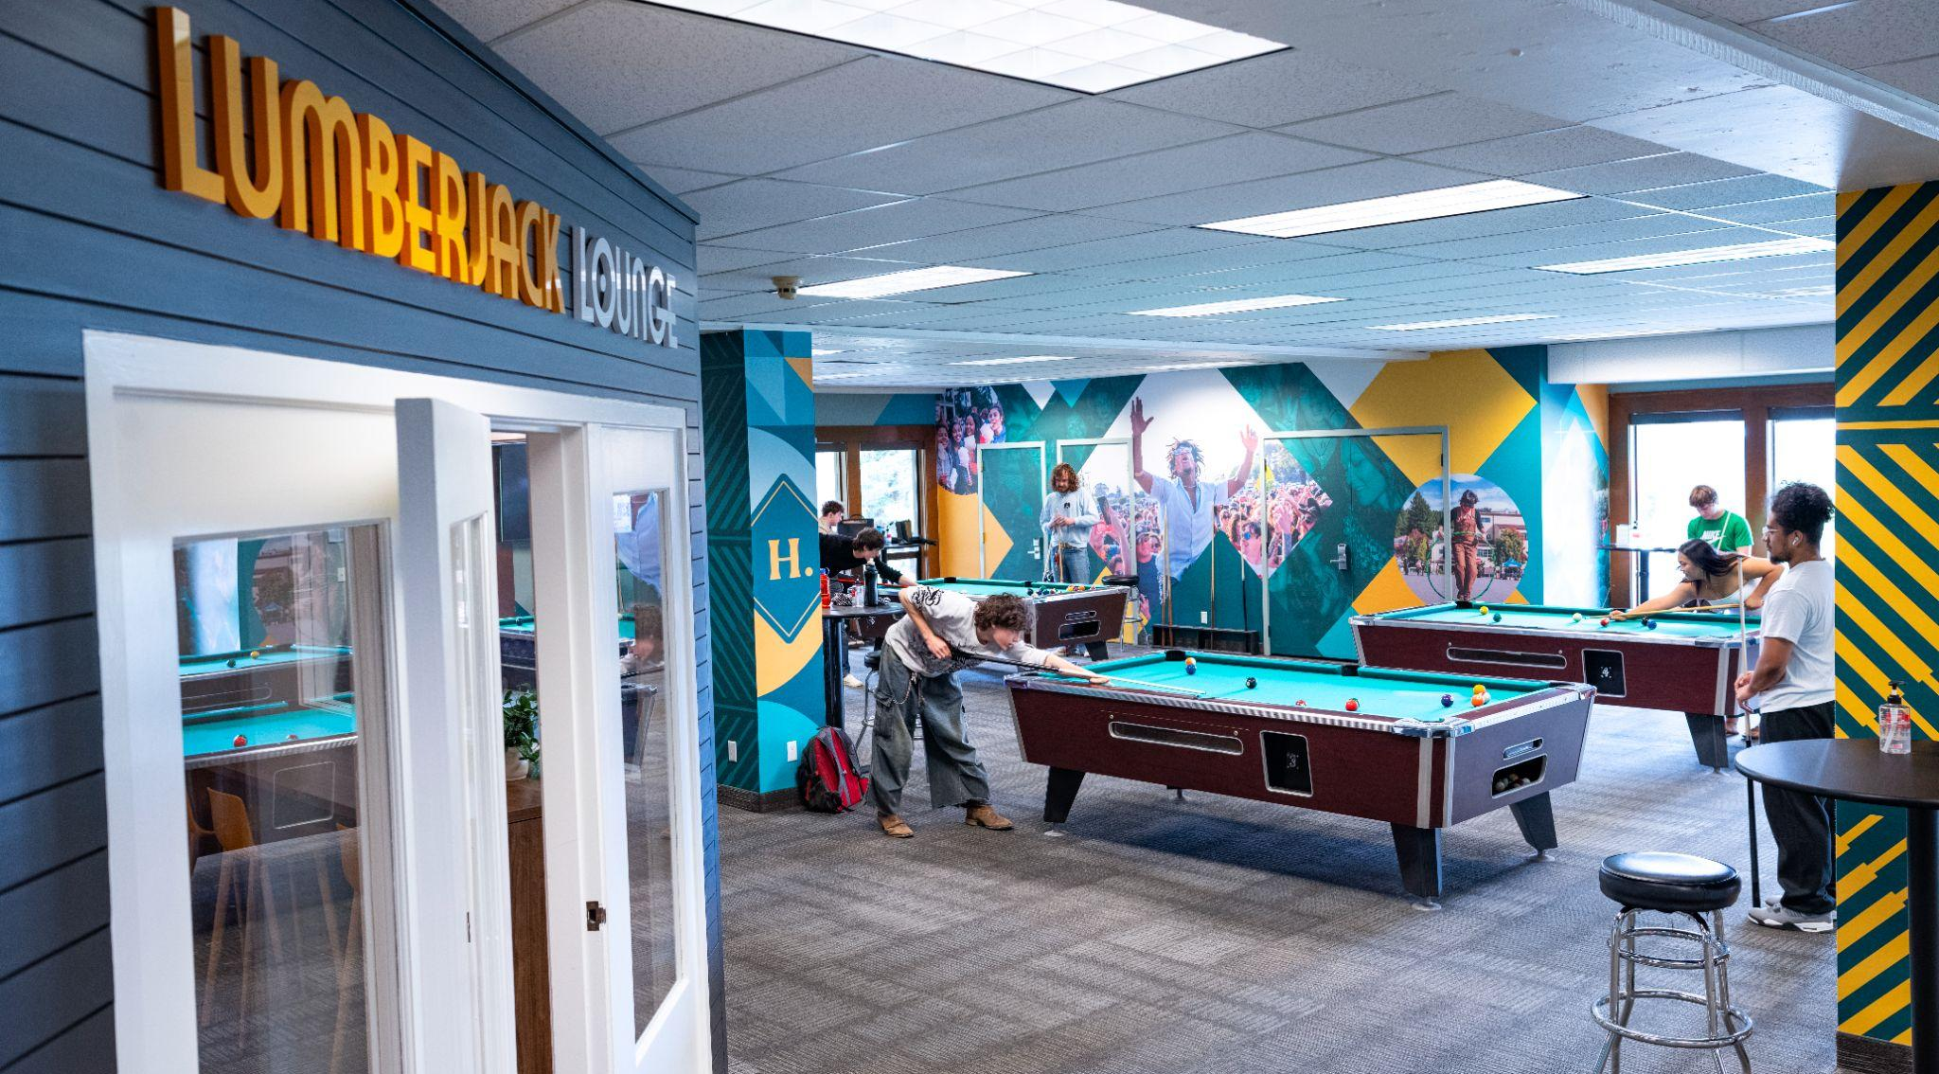

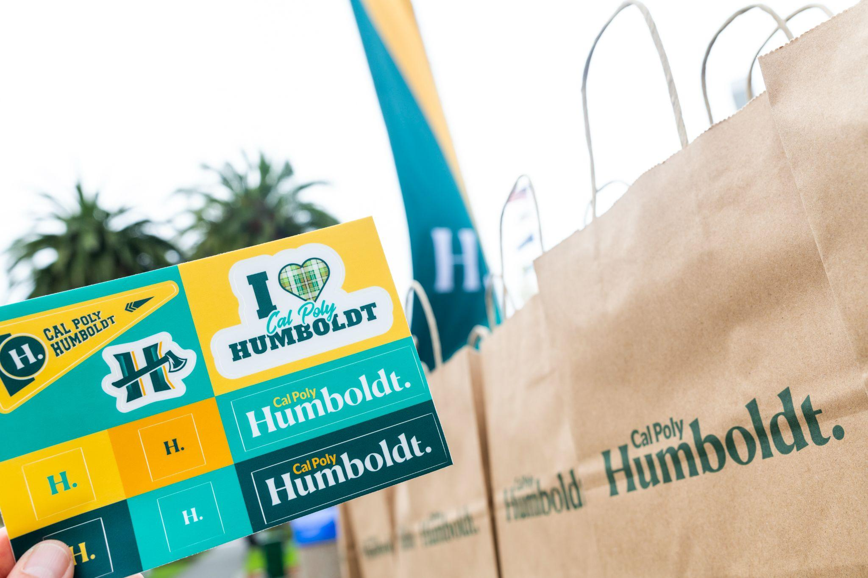
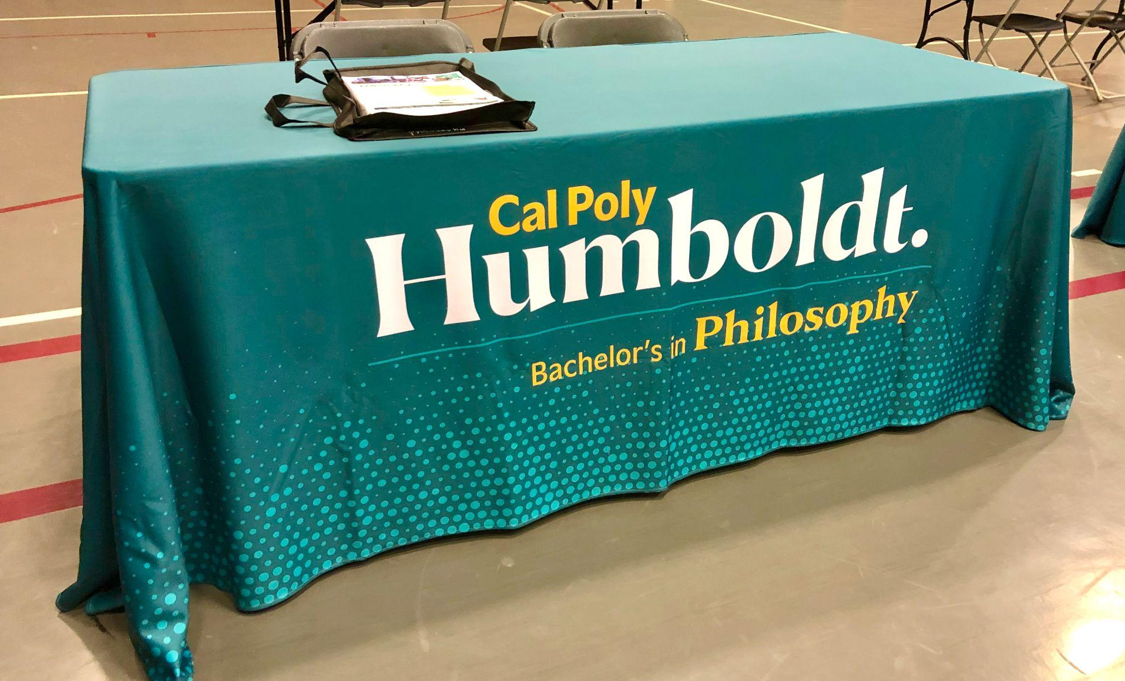



Slide 20
Creative Services
About Us
Who we are: Team of web/graphic designers, photographers, videographers, social and digital media specialists creating effective, on-brand University communications from initial concept through design, production, and implementation.
Our Support: We provide creative expertise, digital accessibility training, and guidance to ensure communications authentically represent Humboldt and align with University brand standards.
What We Do
Graphic Design: Print, digital, promo materials, signage, ad campaigns.
Multimedia: Photography, videography, and manage University image library.
Web Services: Design and maintenance of University websites, Drupal themes, and tools.
Digital Content: Development of social media and digital content, including podcasts.
Accessibility: Training for accessible communications and content.

Slide 21
News & Information
About Us
Who we are: A team of communicators sharing Cal Poly Humboldt’s news and stories with the campus and the public.
Our Support: We help ensure your messaging is accurate, consistent, and aligned with university goals.
Why partner with us: We promote good news, provide perspective and context, and can assist in correcting inaccuracies.
What We Do
Pitch stories to media, write press releases and university-wide messages.
Produce key publications
(e.g., Humboldt NOW newsletter,
Humboldt Magazine).
Coordinate media inquiries and provide interview preparation.
Contact us as soon as you receive a media inquiry or if you have a story idea: news@humboldt.edu

Slide 22






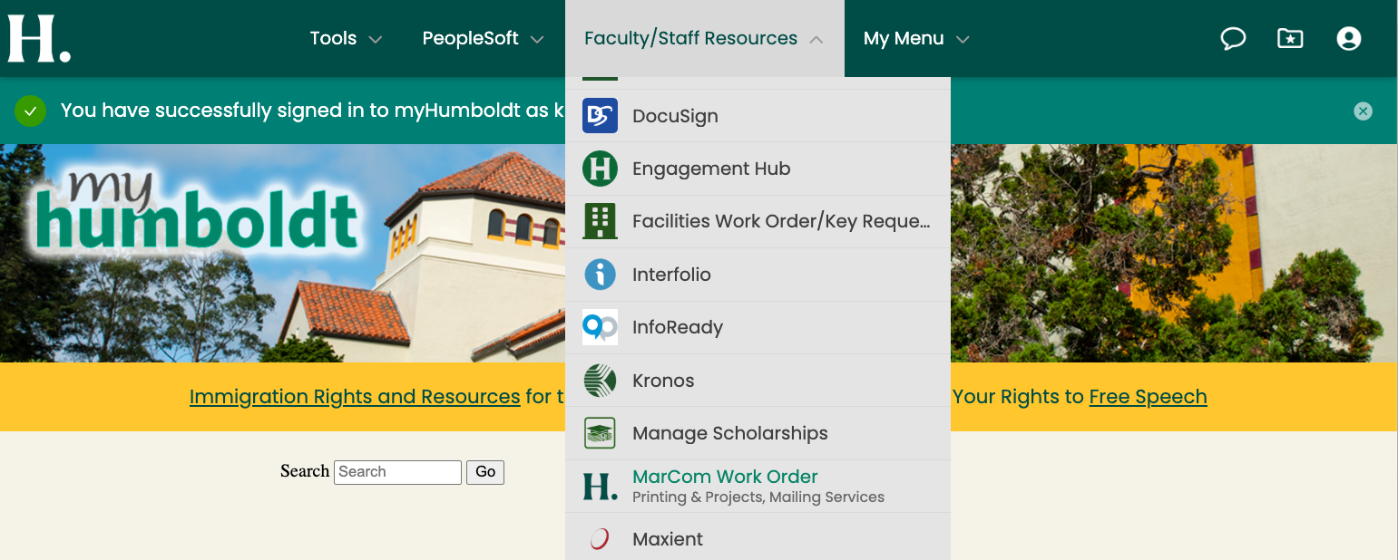
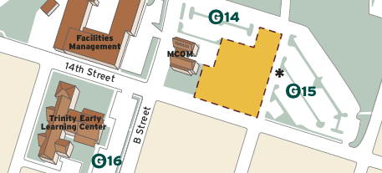
MarCom Can Help!
Start an order
marcom.humboldt.edu

