Slide 1


Meet the Position Description Helper
Human Resources – October 2026

Slide 2
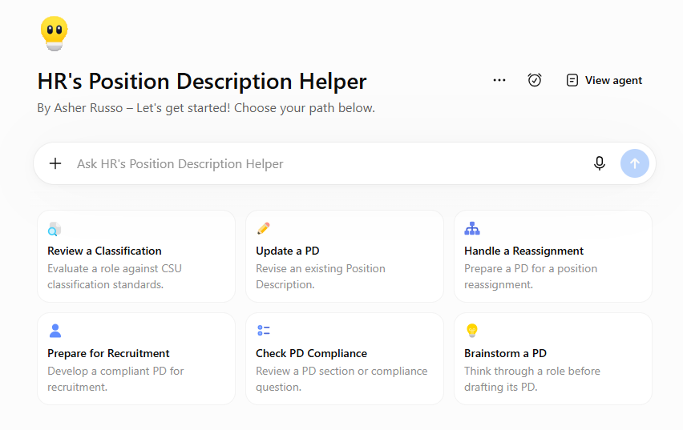
Meet the Position Description Helper
A new HR tool to help you create, review, and improve Position Descriptions.
The PD Helper guides you through the Position Description process in a structured, conversational way - helping you save time, provide the right information, and prepare a more complete PD for HR review.

Slide 3
What Can the PD Helper Help Me Do?
Use the PD Helper when you need help with:
Creating a New PD
Start with what you know and let the PD Helper guide you through to a completed PD.
Reviewing or Updating a PD
Upload an existing PD and get feedback and suggestions for improvement.
Preparing a PD for Classification Review, Reassignment or Recruitment
Get guidance based on Humboldt’s PD template and CSU Classification Standards
Answering PD and Compliance Questions
Ask questions as you work through the process
You don’t need to know all the answers before you begin. The PD Helper will guide you.

Slide 4


Getting Started is Simple
1. Open PD Helper
Choose the type of help you need and start the conversation.
2. Upload What You Have
Have an existing or partially completed PD? Upload it. *
3. Answer Questions
The tool will ask focused, step-by-step questions based on what you’re trying to accomplish.
4. Receive
the PD
Download the completed PD document for review.
* No PD yet? That’s OK - you can start from scratch. The process will take a little longer, and you’ll still need to provide additional information before submitting it to HR.

Slide 5
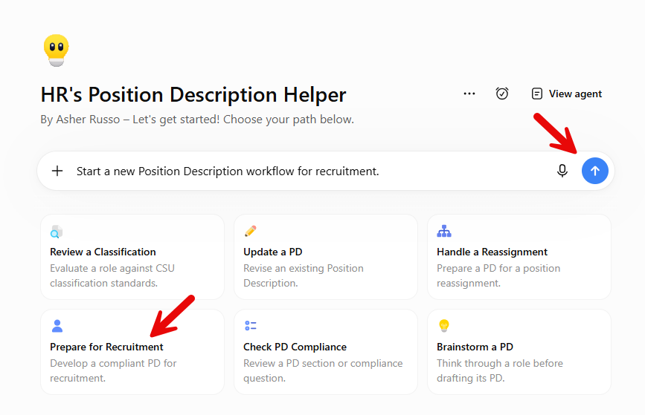
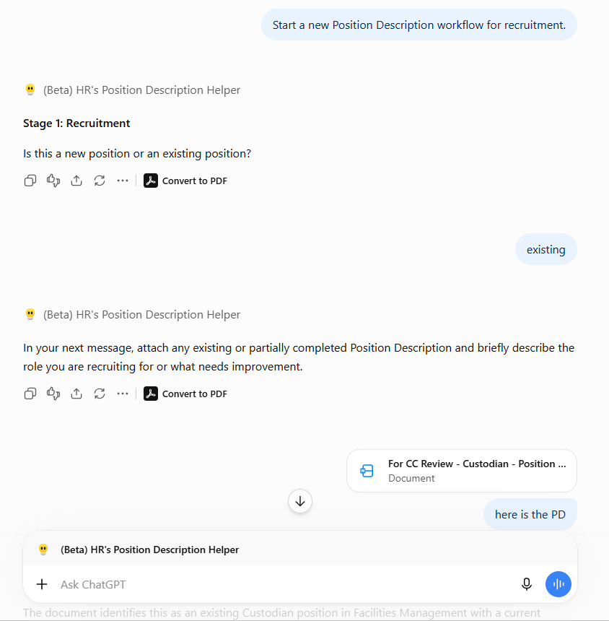
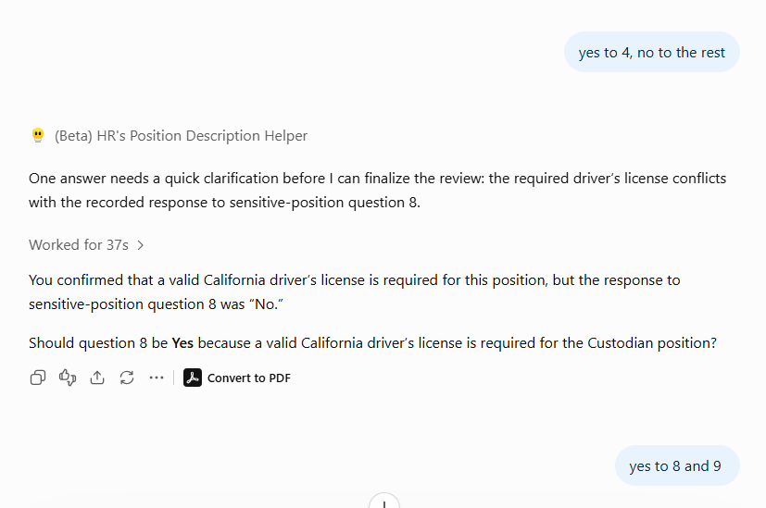
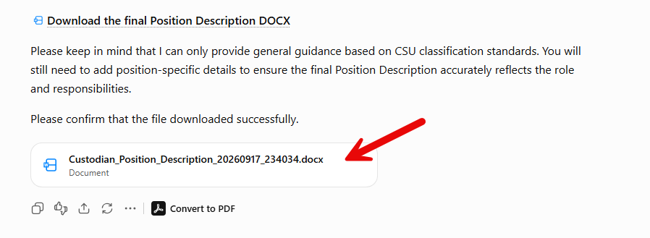
Here’s What It Looks Like
1. Open PD Helper
2. Upload What You Have*
3. Answer Questions
4. Receive
the PD
*When uploading a document, add text so it recognizes the upload

Slide 6
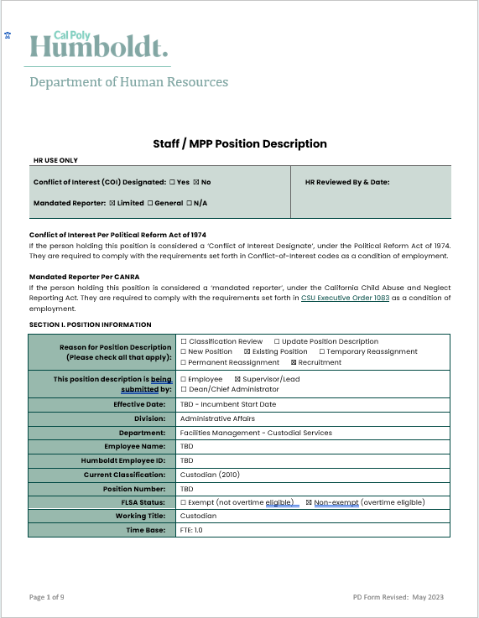
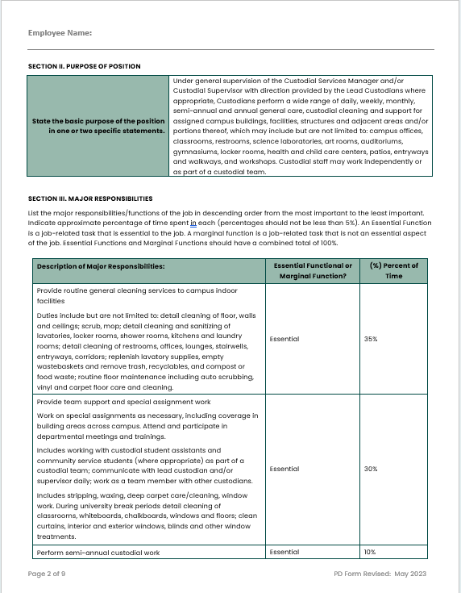
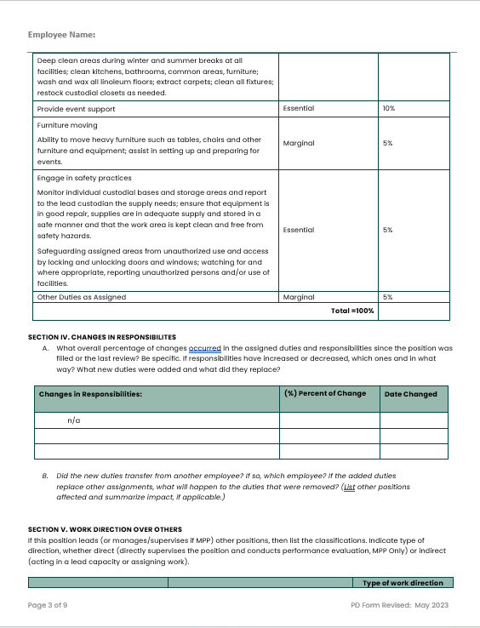
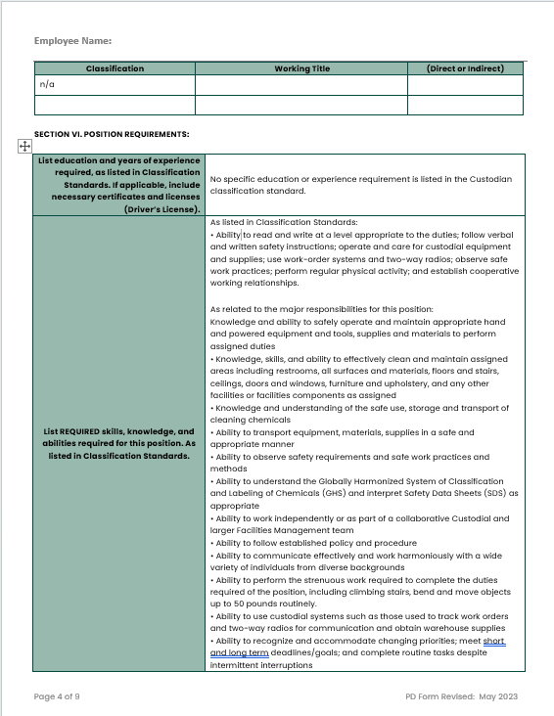
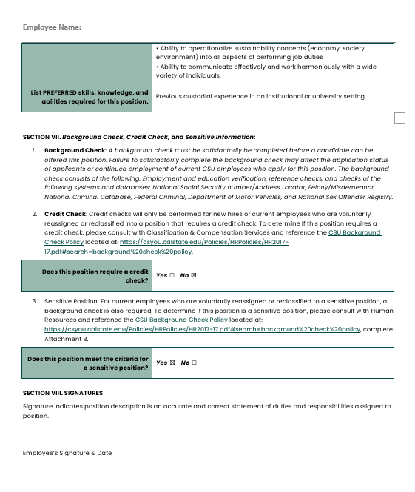
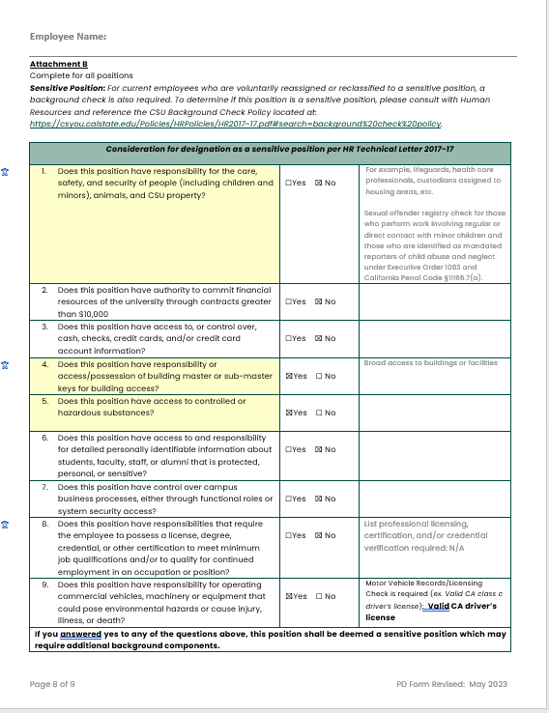
From Conversation to Completed PD
As you work, the PD Helper will:
Review the information you provide
Identify areas that may need clarification or additional information
Offer feedback and suggestions
Help develop and improve key sections of the PD
Create a completed Position Description document for you to download
Review the suggestions, decide what to use, and make any position-specific additions before submitting your PD to HR.

Slide 7
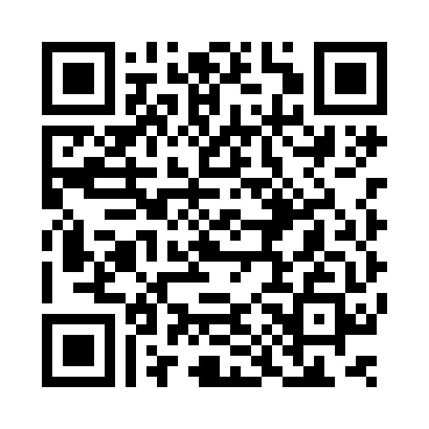
Give It a Try
  https://hum.link/ZEL
Have one of these coming up?
New Position Description
PD update
Classification review
Reassignment
Recruitment
Use your Humboldt credentials to login and give the PD Helper a try!
Questions or Feedback?
If you have questions or have suggestions about your experience with the PD Helper, contact:
Sarah Myers
sew49@humboldt.edu

