Slide 1

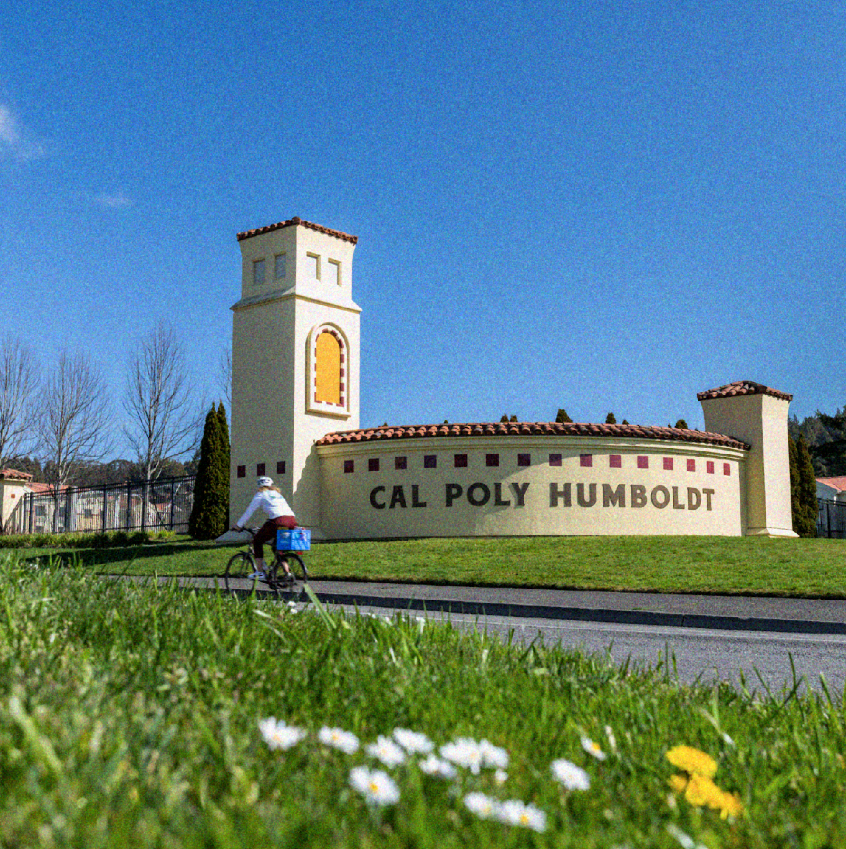
MPP MEETING | OCTOBER 9, 2026
Student Success Framework
& Student Experience Simulation

Slide 2

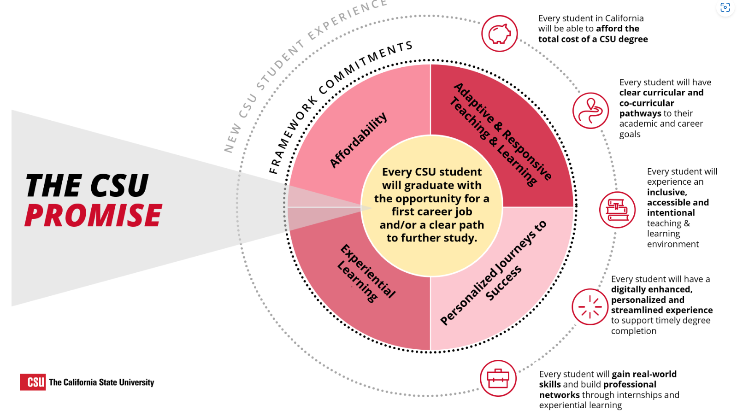
Notes:
Big picture — What is this?
CSU’s next chapter after Graduation Initiative 2025
Broadens student success beyond graduation rates
Focus: degree completion and career readiness, further education, and economic/social mobility
Five principles: student-centered, equity-driven, data-informed, collaborative, transparent
CSU Promise: students graduate with an opportunity for a first career job and/or clear pathway to further study
Four commitments:
Affordability
Personalized Journeys to Success
Adaptive & Responsive Teaching & Learning
Experiential Learning
Prompt: What would students actually experience if we did this well?
Affordability — Can students realistically stay and succeed?
Beyond tuition: food, housing, transportation, books, work, unexpected costs
Not about every employee solving every problem
About helping students navigate a connected support system
Humboldt examples: Financial Aid, Oh SNAP!, CARE, other basic-needs/support resources
Can students find the right support before a financial challenge becomes an academic barrier?

Slide 3
CSU Student Success Framework
The Next Chapter After Graduation Initiative 2025 | Degree completion, career readiness, and pathways to further study
GUIDING VALUES • Student-centered • Equity-driven • Data-informed • Collaborative • Transparent
Affordability
Ensuring accessible, high-value education by minimizing financial barriers and optimizing total cost of attendance.
Personalized Journeys
Tailored academic pathways, proactive support, and streamlined guidance for every student.
Responsive Teaching & Learning
Inclusive, adaptive pedagogy and modern curricula that reflect evolving student needs.
Experiential Learning
Hands-on opportunities, internships, and real-world skill building to ensure career readiness.
Core Reflection
What would students actually experience if the CSU and Humboldt nailed these guiding values?

Slide 4
Clear Pathways & Shared Student Support Team
Coordinated Support Network
Moving beyond a single advisor to an integrated network bringing diverse campus expertise around every student.
Equity & Culturally Responsive Care
Student-centered support recognizing structural barriers. Holistic, culturally responsive care is a campus-wide responsibility.
Ecosystem of Services & Engagement
Connecting Admissions, Financial Aid, Housing, Advising, Cultural Centers, Peer Mentoring, Labs, and Student Employment.
Not every student needs every resource — we build tailored pathways, not a one-size-fits-all system.
Notes:
How do we support this vision? We continue to develop Clear pathways and a shared student support team
CSU framework emphasizes students having coordinated people and resources around them
At Humboldt, think beyond a single advisor - a student support network
Different people may know different parts of the student and bring different expertise…
Equity - responsive learning and support - Student-centered doesn't mean one-size-fits-all - Recognize structural barriers without assuming we know an individual student's experience. Holistic and culturally responsive care is a must and is the responsibility of the whole campus.
Make Humboldt easier to navigate
Students currently navigate many offices, policies, systems, deadlines, acronyms
Framework emphasizes streamlined systems, proactive support, communication and technology
Technology is a huge part of the CO’s effort but with the goal of making things clearer and making the institution easier to navigate and easier for all of us to share in the effort - DARS, Navigate360, even common job posting and recruitment processes for student employment… - They help support - proactive outreach, shared information, easier referrals, equitable access
How much institutional expertise does a student have to develop just to get help?
6. Career AND experiential learning throughout the degree
Career preparation shouldn't begin senior year
Connect academics with experiences throughout college
Humboldt examples:
Career Development - careers, internships, jobs
COMPASS/INRSEP - STEMM research and graduate pathways
YES - community engagement
Faculty - research, mentorship, disciplinary/professional connections
On Campus Jobs - are some of the most significant parts of the student experience and their experiential learning.
Are students discovering these opportunities intentionally—or only if the happen to know where to look? This ties into common systems across campus.

Slide 5
Humboldt is not starting from zero
Campus Relationships
Strong first-year support and shared campus relationships
Student Opportunities
Career, research, community engagement, and campus employment opportunities
Integrated Support Systems
Proactive support, culturally responsive advising, Navigate360, assessment, and career integration are already priorities
KEY TAKEAWAY
CSU provides shared direction. Humboldt determines how we build it locally.
Notes:
Humboldt takeaway
We aren't starting from zero. Many pieces already exist here
Current Humboldt priorities already include shared advising, proactive support, faculty/professional partnerships, career integration, culturally responsive advising, Navigate360, assessment, and strengthening the advising ecosystem.
CSU provides a shared direction; Humboldt determines how we build it locally
We are incredibly strong on the front end - first-year support at our institution is ahead of the game and coordinating a large amount of work already… Our experiential learning and campus employment opportunities are strong.
How does this actually move forward at Humboldt?
We have two campus-wide efforts happening in tandem:
Humboldt Strategic Planning process
Student Success Framework Implementation Team
These groups will help translate the larger CSU direction into Humboldt’s context
Important balance:
Respond to priorities and specific asks coming from the Chancellor’s Office
Continue advancing Humboldt’s own goals and priorities
Preserve what is distinctive about our students, community, polytechnic identity, programs, and approach
This isn’t just an advising initiative or Student Affairs initiative - student success crosses the institution
The support network we just described is a good example: faculty, staff, advisors, mentors, student employees and supervisors, academic programs, administrative offices, and specialized resources all shape the student experience
Alongside those larger planning and implementation efforts, we also want to create an opportunity for our campus community to actually experience this —not just discuss it.

Slide 6

Spring PD Day: Student Experience Simulation
Student Journeys
Participants step into one of ~20 Humboldt student journeys
Balanced Scenarios
Scenarios include strengths and successes — not just barriers
Active Simulation
Navigate offices, systems, choices, time, resources, opportunities, and unexpected events
Holistic Observation
Notice where Humboldt connects well and where students experience friction
Experience the system instead of only talking about it.
Notes:
Spring Professional Development Day
Main focus of Spring Professional Development Day
Big thank-you to the Center for Teaching and Learning
Sharing PD Day with this initiative
Helping tremendously with logistics and planning
Campus-wide, interactive experience
Goal: move from talking about the student experience to trying to navigate it ourselves
What does Humboldt look and feel like when you're trying to navigate it as a student?
Where the idea came from
Huge acknowledgment to Project Rebound
Project Rebound developed a very successful re-entry simulation
Participants stepped into the experience of navigating systems, requirements, barriers, decisions, and competing demands associated with re-entry
They generously shared the model with us
We're adapting that experiential approach to look more broadly at the Humboldt student experience
Project Rebound’s simulation showed us how different it feels to experience a system—even in simulation—rather than simply have someone explain that system to you.
Participants will be given one of approximately 20 student scenarios
Each represents a different Humboldt student journey
Scenarios will include a combination of:
Academic goals and requirements
Finances and employment
Housing/basic needs
Belonging and community
Advising and mentoring relationships
Career and experiential goals
Family/work responsibilities
Navigating campus processes and systems
Opportunities, successes, unexpected events, and challenges
Learning Outcomes
By the end of the Student Experience Simulation, participants should be able to:
Experience the institution from a student perspective
Better understand the complexity involved in navigating multiple systems, offices, expectations, deadlines, relationships, and responsibilities
Recognize the student support network
Notice connection points and friction points
Practice connected support
Reflect on our own role
The goal isn't for us to leave believing we now know exactly what it feels like to be a Humboldt student. We can't simulate that. The goal is to become more curious about their experience—and more aware of how all of our individual pieces come together to create it and take that into our work of strategic planning, coordinating our programming, and responding to the call from the CO for the Student Success Framework.

Slide 7
Spring PD Day: Student Experience Simulation
Student Profile & Strengths
• 2nd year Biology major passionate about wildlife and natural resources.
• Works 12 hrs/wk on campus landscaping crew; enjoys hands-on teamwork and supportive community.
Academic Challenge
• Struggling in Chemistry and fallen behind on assignments in another class.
• Instructor submitted an Early Alert encouraging connection with academic support.
• Wants to do better, but feeling discouraged and unsure where to begin.
YOUR STARTING GOALS
Respond to the Early Alert and find support to get back on track academically.
Notes:
Scenarios include strengths and successes — not just barriers - The goal is not focusing on offices or getting stuck on institutional issues, it’s seeing and understanding the challenges students face in balancing education and life in complicated situations and institutions and what we can do to make it better.
Holistic Observation - Notice where Humboldt connects well and where students experience friction
Not every scenario will use every resource
We don't want 20 deficit-based stories about students having problems
Students will have strengths, goals, relationships, opportunities and successes
Some things should go right!
Participants should experience the value of finding a helpful person, getting a clear answer, discovering an opportunity, or having a process work well
We're not trying to perfectly reproduce a student's life
We're creating a structured way to notice how our systems connect—or sometimes don't—from the student's perspective

Slide 8
Spring PD Day: Student Experience Simulation
Housing Challenge
• Your current housing arrangement is ending unexpectedly. You've just learned that you need to move out in 30 days.
• You don't have another place lined up, and the rentals you've looked at are more expensive than you can afford.
Work & Academic Pressures
• You love your campus landscaping job, but your wages aren't enough to cover a more expensive apartment. You don't want to lose the job because it's one of the few places where you feel confident, valued, and connected.
• You're already struggling in classes, and now you're worried about where you'll live.
SIMULATION PROMPT
You have 30 days to find somewhere to live. What do you do next?

Slide 9
What can you do to help>
01
Share Stories
Share stories to use to build the profile
02
Join the Working Group
Help plan, design, and shape the simulation experience
03
Uncover Opportunities
Surface opportunities students may not know about
04
Review Scenarios
Review scenarios for accuracy and nuance
05
Lead & Facilitate
Help plan, staff stations, test logistics, and facilitate reflection
December trial run → Spring Professional Development Day
Pathways to Success: The Student Experience Lab - January 15, 2027
Notes:
Prompt: We don't want the planning group inventing Humboldt in a room by ourselves.
Developing approximately 20 student scenarios
We'll be reaching out to departments and programs for:
Common challenges students encounter
Processes that can be difficult to navigate
Examples of things that work really well
Opportunities students may not know about
Expertise reviewing scenarios for accuracy
Especially important: don't presume the student experience
Scenarios should represent plausible circumstances without turning student identities, GPA, disability, financial status, first-generation status, etc. into predictions about what a student will experience
Campus partners help us make scenarios realistic, nuanced and accurate
That aligns with Humboldt's culturally responsive advising principle: be aware of patterns and structural inequities, but don't presume that a demographic characteristic tells us an individual student's story.
Trial run - invitation to participate
Hoping for a December trial run
May put out a call for volunteers for that test
We'll need people willing to:
Help plan
Review scenarios
Staff stations/resources
Participate in the trial
Help troubleshoot logistics
Facilitate reflection/debrief
And when Spring PD Day arrives: please participate
The value comes from having people from across Humboldt experience this together
If this sounds fun—or if you're already thinking, “I know exactly what our office could contribute”—we want to hear from you.

