Slide 1


Risk Management and Safety Services
Environmental
Health Programs
Sabrina Zink
EH&S Specialist

Slide 2
Environmental Health
Applies to programs, policies and procedures for the protection of the environment .
  Air
    Pollution control from emission sources such as heavy equipment, cars, power generation etc…
  Land
    Proper storage and disposal of waste
  Water
    Waste Water and Storm Water pollution control

Slide 3
Everything is connected….

Slide 4
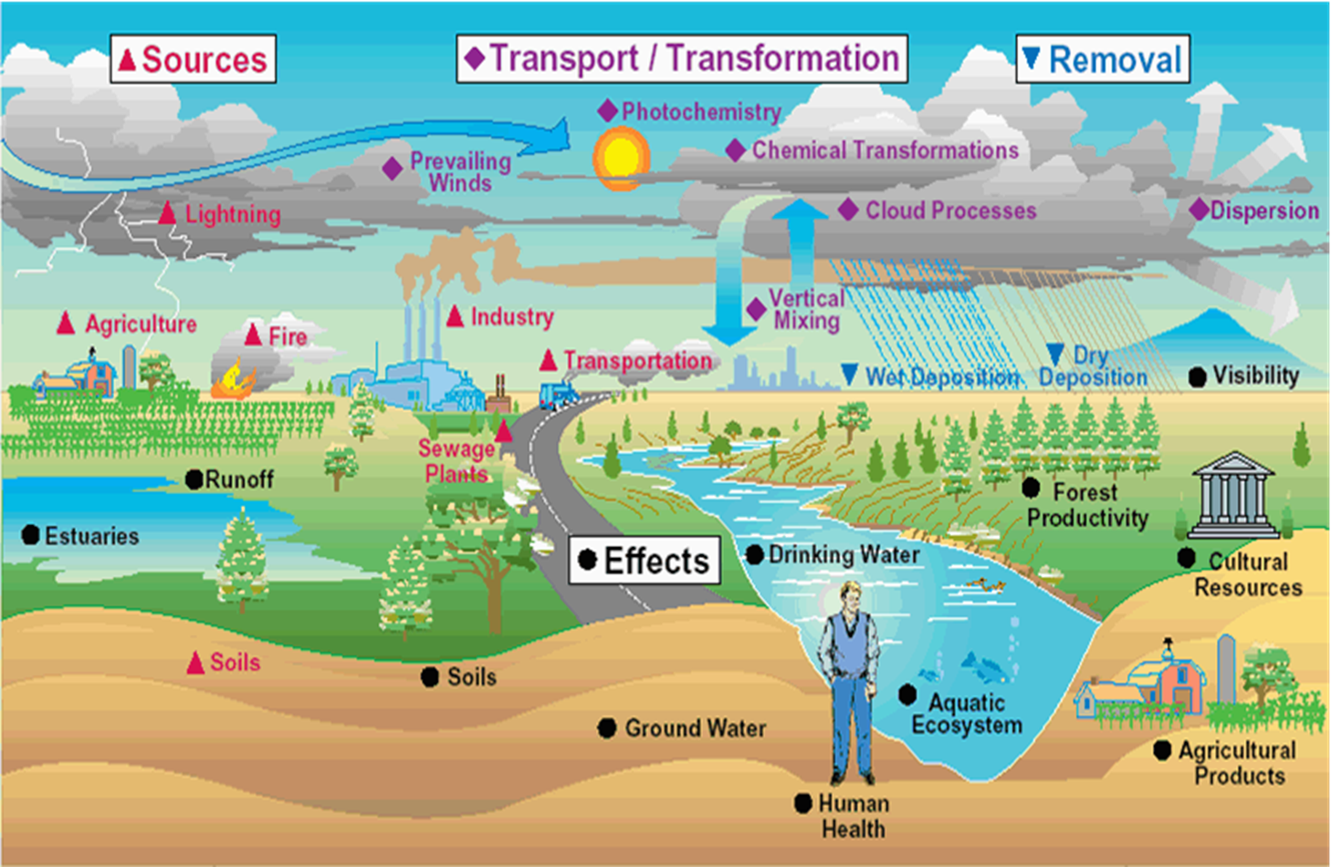

Slide 5
How Does This Affect Humboldt State?
Humboldt State conducts activities or has potential for environment impacts that are regulated by various regulatory agencies.
  These agencies issue permits with various requirements that must be met
    These requirements are overseen by the Department of Risk Management and Safety’s EH&S Specialist
      Many of these requirements impact day to day activities of HSU students and employees

Slide 6
What Types of Permits/Programs Are There?
Storm Water Permit
  Main Campus and Marine Lab
Waste Water Permit
  Pre-treatment and sanitary sewer
Waste
  Includes electronic, hazardous and universal waste
Hazardous Materials
  Including biological, medical, and radiological materials.
Food Safety
  For any sale or distribution of food on campus

Slide 7
What is Your Role in All of These?

Slide 8
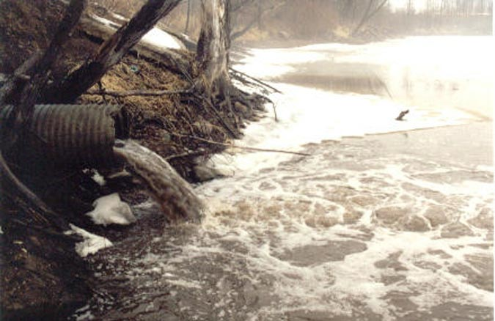

Storm Water

Slide 9
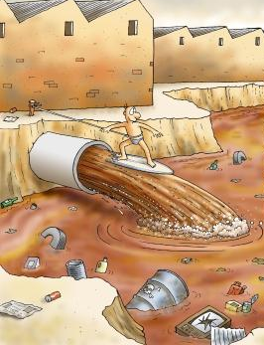
Why the Fuss? It’s just rain…
Water is everyone’s concern:
  Pollutants are picked up in the rain and carried to surface water
  This water is not treated and will remain in the water cycle forever

Slide 10
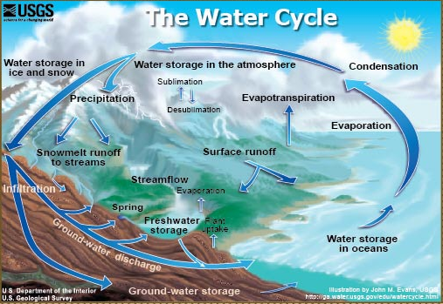

Slide 11

Why the Fuss? It’s just rain…
Secondly-HSU has a permit that requires:
  Best Management Practices for all activities that could potentially result in Storm Water pollution
  Education and outreach to all campus community
  To ensure that Humboldt State reduces it’s threat to water quality to the “Maximum Extent Practicable”

Slide 12
As a Potential Contributor or General Steward You Should…
Report anything other than rain water going into a storm drain
  Even potable water(sprinkler run-off) should not go to storm drains
  Neither should rain water carrying trash or excess sheen from oil residue
Making sure if you do any work outdoors you use best practices to reduce any impact
  Use a carwash with catchment instead of hosing it off into the street
    Don’t wash tool or equipment outside or dump anything into a drain
  Clean up any outdoors spills
  Don’t litter or drop cigarette butts
  Pick up poop or educate animal owners who don’t
  Don't drive leaking vehicles
Store items under awnings or indoors to keep rain from carrying pollutants off that material
  Drums, Tires, Metal Scrap, Green waste etc…

Slide 13

Waste Water

Slide 14
How Might I Impact the Waste Water Program?
Sewer overflows can be caused by flushing inappropriate things or improperly handling grease and oils
  These overflows threaten public health and open HSU up to liability
Dumping chemicals down sinks at HSU
  Is a violation of HSU’s pre-treatment permit
  Can affect the treatment capacity of the city (which uses wetland treatment) would allow pass through of pollutants back to surface water

Slide 15
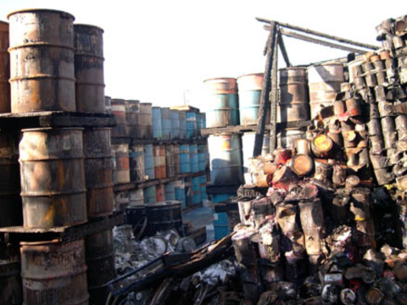
Waste

Slide 16
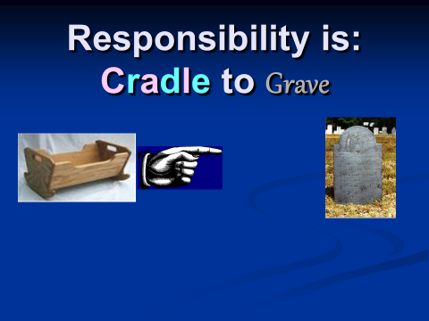
Hazardous Materials

Slide 17
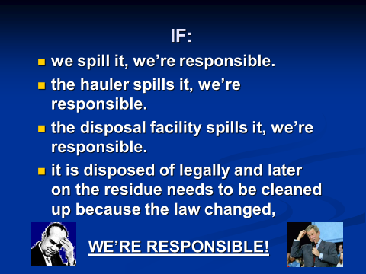
That Means….

Slide 18
How Might I Impact the Waste Program?
If you work with chemicals on campus:
  You will likely generate some sort of hazardous waste
  Otherwise, you likely generate universal waste or e-waste
Mercury containing wastes;
  thermostats, switches, thermometers, pressure/vacuum gauges, rubber gym floors, etc.
Lamps
  Fluorescent, sodium vapor & HID
Non-empty aerosol cans
CRT’s (TV’s and monitors)
Electronic waste (PC’s, LCD displays, disk drives, etc.)
  Anything that has a printed circuit board!
Batteries (next slide)

Slide 19
If you generate waste you must:
Label it
  With specific information
Store it securely
  In specific(approved) locations
Dispose of it a timely manner
  EH&S will pickup your waste upon request and store in the storage facility until it's final disposal
Sustainability will pick up your e-waste and some universal waste
Do not put any hazardous, electronic or universal waste in the trash
  There are e-cyclers on campus for your convenience

Slide 20
If You Work With Hazardous Materials(some OSHA overlap)
You must follow safety guidelines for your material
  In some instances you must receive approval from EH&S for use
  You must know what to do if it spills or there is an exposure or other release.
  Make sure you are working in an appropriate facility with the appropriate engineering controls and safety equipment prior to beginning work
You must ensure it is accurately accounted for in an inventory system and reported appropriately
You must make sure it is labeled properly and stored safely and securely
You must make sure anyone working with or around it receives proper training

Slide 21
Food Safety
Policy does not apply to potlucks or other closed events
  Like today’s meeting! Cheers!
If you sell(or otherwise distribute) food to the campus community, you are required to apply for a food permit through EH&S.
  To ensure safe food handling and compliance with health and safety code.
This applies to clubs, athletics concessions, and other on campus events.
  Exception: using Dining Services to cater your event

Slide 22

ENVIRONMENTAL STEWARDSHIP
YOU MATTER!!
Everything you do both positive and negative adds up-
Please help HSU reduce overall impact by becoming a steward!

