Slide 1
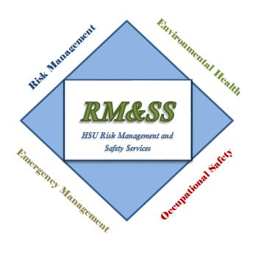
Occupational Health & Safety
Risk Management & Safety Services Department

Slide 2
What is OHS and what do we do?
To ensure a healthy and safe working environment for all employees.
Prevention, elimination & mitigation of hazards throughout campus community which could result in injury or harm.
Interpretation and delivery of documents, programs and training of state and federal regulation for HSU to provide a safe and healthy workplace for all employees.
Programs – this is not a comprehensive list:
Incident Investigation | Ergonomics | Health and Safety Committees
Workplace Inspections | Lock out / Tag out | Fall Protection
Confined Spaces | Hazard Analysis | Shop Safety
Notes:
Why is OHS important to an organization – international standards and studies have been done and proven that have a fully integrated health and safety program increases productivity and morale while reducing workers’ compensation costs.
Other programs – Compressed cylinders SOP, Lighting & material handling, Office safety, Construction, Tool Safety, Fire Safety, First Aid & AED.

Slide 3
The Rundown of OSHA
Occupational Safety and Health Act of 1970
  Enacted by Congress to reduce accidents, injuries, medical illnesses and death.
Seems fairly important and easy to comprehend, but have you asked yourself “what and why is this important to me as a worker or supervisor?”
OSHA can be overwhelming, lots of information that is not easy to absorb.
Primary goal is foster and nourish a healthy and safe working environment for all individuals in the work field.
60% (deaths) & 40% (injuries & illnesses) reductions since creation of OSHA.
Notes:
Osha was enacted by Nixon in 1970 to provide each and every man and woman a safe and healthy workplace.
Labor Department.
-At the same time, U.S. employment has nearly doubled from 56 million workers at 3.5 million worksites to 115 million workers at nearly 7 million sites.
71 – STANDARDS ADOPTED FOR BASELINE
72 – OSHA TRAINING INSTITUE ESTABLISHED TO ISNTURCT PUBLIC AND INSPECTORS
78 – COTTON DUST “BROWN LUNG” STANDARD
95 – WEBPAGE FOR ASSISTANCE
OSHA APPLIES TO US ALL. Life’s not fair, we do not have equal responsibilities and abilities.

Slide 4
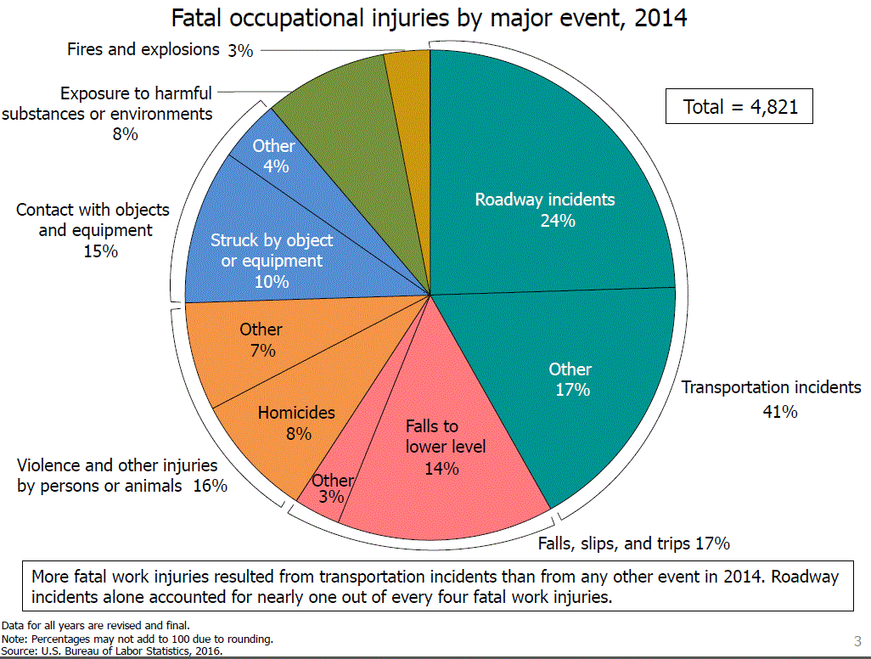

Slide 5
Regulation & EO
Cal/OSHA
  Injury and Illness Prevention Program
  PPE Program (JHA)
    (2) The employer shall verify that the required workplace hazard assessment has been performed through a written certification that identifies the workplace evaluated; the person certifying that the evaluation has been performed; the date(s) of the hazard assessment; and, which identifies the document as a certification of hazard assessment.
  OSHA Penalties (State Plans)
OSHA
CSU Executive Order 1039
  Collective Bargain Agreements
Notes:
Department of Labor Federal Civil Penalties Inflation Adjustment Act Catch-Up Adjustments
I. WILLFUL OR REPEATED VIOLATION OF THE OSH ACT, 29 U.S.C 666(A)
Section 17(a) of the OSH Act, 29 U.S.C 666(a), provides that employers who willfully or repeatedly violate the requirements of section 5 of the OSH Act, any standards, rules or orders promulgated under section 6 of the OSH Act, or applicable regulations may be assessed a civil penalty of not more than $70,000 for each violation, but not less than $5,000 for each willful violation. No minimum penalty is set forth in the OSH Act for repeated violations. To adjust the existing civil money penalty for this paragraph, the Department multiplied the penalty amounts by the inflation adjustment factor for 1990 of 1.78156, which resulted in a maximum penalty of $124,709 for willful and repeated violations, and a minimum penalty of $8,908 for willful violations. The updated civil monetary penalties for willful and repeated violations are set out in § 1903.15(d)(1) and (2).

Slide 6

Proactive Vs. Reactive
“Somebody is going to get hurt over there…”
“That’s an accident waiting to happen”
“I’ll be fine, my knee hurts, but I can still do my job.”
These situations could result in injuries or incidents to our coworkers, students, members of the public or ourselves.
We want to capture information through Hazard Identification and Reporting of Deficiencies for prevention of future incidents.
Providing controls to eliminate or mitigate the hazards in timely manner.

Slide 7
Hazard Controls
Some control measures are more effective than others at reducing or eliminating hazards.
Different types of controls normally carry benefits and limitations.
First consideration of hazard control is eliminating the hazard or substitution of a less hazardous activity, material or process.
  An example: using water-based paint rather than solvent-based paint.
  This will minimize the flammability and eliminates the health hazard for employees.
Notes:
You can prevent exposure to a hazardous substance by:
substituting it with another substance which presents less, or no risk;
using another process which doesn't create a hazardous form of that substance.
For example
substituting a powder for a liquid;
removing the need to weigh out powders by buying it pre-packed.
There are seven steps to practical, well thought out decisions about substitution.
Decide whether the substance or process is a hazard. Is there a significant risk involved in storing, using or disposing of a substance?
Identify the alternatives.
Think about what could happen if you use the alternatives.
Compare the alternatives with each other and with the substance or process you are using at the moment.
Decide whether to substitute.
Introduce the substitute.
Assess how it is working.

Slide 8
Hazard Controls
When it is not possible to eliminate the hazard or substitute the hazard:
    Engineering controls
    Administrative controls
    Personal protective equipment
Applying this hierarchy is a systematic approach to identify the most effective method of reducing the risk. We want to select the highest level of feasible control!
Notes:
If hazard elimination or substitution is not feasible, engineering controls should be considered next.
Engineering controls are physical changes to the work area or process that effectively minimize a worker’s exposure to the hazard(s).
Enclosing the hazard (noise reduction)
Isolating the hazard (machine guarding, interlocks, welding curtains, doors)
Removal or reeducation of the hazard (think local and exhaust ventilation)
Redesign workplace (to minimize ergonomic injuries)
Administrative controls
No physical changes
Documentation & safe work practices
Examples include:
Limited time of exposure to hazards
Written procedures (SOP)
Work practices, and
Health and safety rules
Alarms, signs and warnings
Working together, not working alone
Training
Stretching exercises
Personal Protective Equipment
Used when hazards cannot be eliminate through engineering or administrative controls.
Must consider the right personal protective equipment (PPE) for appropriate employee protection.

Slide 9

Question – Poll Audience
PPE questions, when do you use or what activities require PPE use.

Slide 10
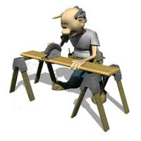
Hazard Control
What is the most effective method
to control hazards?
  Ventilation system to control dust in a shop
  Employees are trained and signage is posted to warn of the hazards associated with the equipment.
  Safety glasses and gloves are required for the activity and equipment.

Slide 11
Risk – Probability Matrix
 |  | IMPACT
 |  | Trivial | Minor | Serious | Fatal | Catastrophic
PROBABILTY | Rare | Low | Low | Low | Medium | Medium
 | Unlikely | Low | Low | Medium | Medium | Medium
 | Moderate | Low | Medium | Medium | Medium | High
 | Likely | Medium | Medium | Medium | High | High
 | Very Likely | Medium | Medium | High | High | High
Definitions
Impact
Trivial: Minor abrasions, bruises, cuts, first aid type injuries.
Minor: Disabling injury, but not permanent.
Serious: Non-fatal injury, permanent disability.
Fatal: Approximately one fatality or major property damage.
Catastrophic: Numerous fatalities, irrecoverable property damage and productivity.
Probability
Rare: Is practically impossible and has never occurred.
Unlikely: Has not been known to occur for many years.
Moderate: Might occur sometime in the future.
Likely: Has a good chance of occurring and is not unusual.
Very Likely: The most likely result of the hazard/event being realized.

Slide 12
Important information to know
Reporting injuries immediately – serious injuries reported with 8 hours to Cal/OSHA or we will be fined by citation. Call EHS or WC.
What do we need to be trained & educated for?
  Training may differed from position to position
  Trained to hazardous activities that they are LIKELY to encounter throughout their work day including; tasks, equipment, and environment.
    Carpenter vs. Dean of Art vs. Clinical Laboratory Scientist
  How do I get trained and what if we do not have the training available now?
  Frequency of training
SkillPort & Canvas are on-line based modules for training purposes
Classroom and practical training
Notes:
Section 330 – definitions of Cal/OSHA (h) "Serious injury or illness" means any injury or illness occurring in a place of employment or in connection with any employment which requires inpatient hospitalization for a period in excess of 24 hours for other than medical observation or in which an employee suffers a loss of any member of the body or suffers any serious degree of permanent disfigurement, but does not include any injury or illness or death caused by the commission of a Penal Code violation, except the violation of Section 385 of the Penal Code, or an accident on a public street or highway.
Moving Targets and Living Programs --- Never ending, constant maintenance for health and safety. Constantly changing and growing. Unexpected stuff can happen at any time.
Trained to haz activity versus: Carpenter – shop, first aid, respirator (asbestos), PPE, forklift, fall protection, confined space
Dean of Art – Accident reporting, supervisor training, general IIPP, ergonomics, chemical mgmt., fall protection, hazardous materials (silica), welding, theatre.
Clinical lab scientist – PPE general iipp, health code standards, BBP, HIPPA, transporting hazardous materials, waste, sharps, workplace violence.

Slide 13
What are some ways to start promoting safety in my area?
Daily cleaning and maintenance
Securing your workplace
Prepared for emergencies
Getting informed
Staying equipped
Attitude for the culture change
Be the example
Brother’s keeper
Participation for training and time
Notes:
Daily cleaning & maintenance – one of the largest causes of work-related injury is slips & falls. Monitor spills and unsafe obstacles are cleaned up and fixed in appropriate timely fashion. People get into a rush. “Leaving office drawers open --- spills --- hurrying to go home or finish a job --- lunch break --- not using proper foot paths”
Securing your workplace- unauthorized individuals in areas where they should not be & peace of mind. “Culture in Humboldt county, shops and laboratories, theft, liability”
Preparing for emergencies- knowing what to do if an individual has a heart attack* (90% of heart attack victims die on the way to the hospital before they get there- believe it or not) earthquakes & walkways, exit paths.
Getting informed– understanding the standards associated with your daily activities and the activities which are controlled in your area.
Staying equipped- maintaining PPE, providing PPE, storing and maintenance. “gloves – providing the appropriate gloves for the tasks or activities” “eye protection – glasses, goggles, shields” “cartridges and respirators”
Attitude- wrong attitudes about safety can be infectious. Using your influence to emphasize the importance for everyone to go home safe and happy at the end of every day. Following up with injuries and checking in with employees. Friendly peer checks – approach or heads up. We want to do the right thing.
Be the example - practicing what you preach. Lesson for us all.
Brother’s keeper- if you see someone struggling or fooling around doing something hazardous to themselves or others, reach out to them for assistance or direction. Even if you catch slack for this, at the end of the day you will both be happy about it.
Participation for training and time- this is retroactive of about 20 years and will take more than 2-3 individuals to get us to where we need to be. We need to invest and make time. First Aid/CPR training available.

