Slide 1
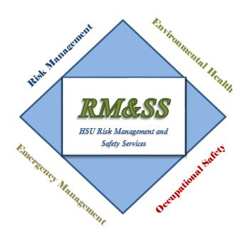
Campus Wide Safety Committee
Initial Meeting 11/9/16

Slide 2
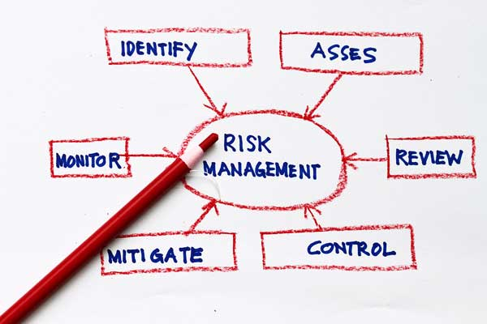
Risk Management
Define
Types of losses
How to anticipate and identify risks
How to evaluate
How to implement control
Control Techniques
Risk Matrix

Slide 3

Common Definition
The risk management practices of Humboldt State University are specifically designed to identify and assess all types of risk to the campus, and to implement appropriate risk management techniques in order to protect the university so it can carry out its mission. It is the goal of Risk Management and Safety Services to aid in the identification and evaluation of risk, to facilitate the selection and application of the best risk management techniques to mitigate risks, and to monitor the results.

Slide 4
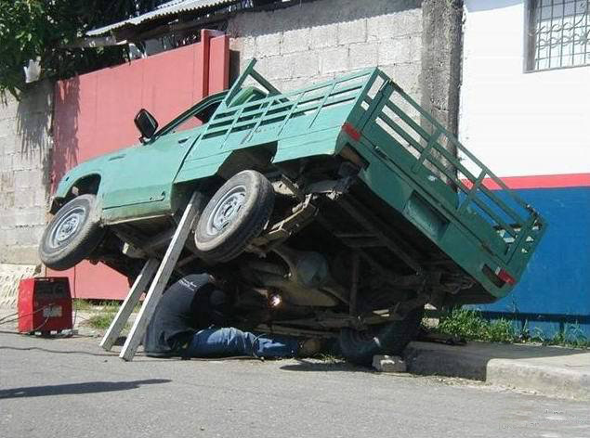
Types of losses
Death, injury or inappropriate treatment of employees, students and guests
Physical damage to university property
Loss of campus revenues due to property damage
Liability claims against the university due to damage to non-university property
Losses resulting from fraud or criminal acts

Slide 5

How to anticipate and identify risks
Review and assess workers’ compensation claims and employer’s report of occupational injury or illness documents
Campus safety inspections
Investigate accidents and near misses
Investigate and assess reported safety hazards
Review allegations of inappropriate treatment of student, faculty, staff and visitors
Review and evaluate, as appropriate, student activities including academic field trips, projects, high hazard experiments, travel abroad, sanctioned activities, etc.

Slide 6

Evaluation
Identify risks which pose a potentially precedent-setting, broad or major impact to the university to be evaluated
Criteria
  Severity – The amount of human harm or property loss that can occur
  Frequency of Exposure – How often the event or activity takes place
  Predictability – the ability to anticipate losses associated with specific activities or conditions
  Probability The actuarial chance of a loss

Slide 7

Implement Control
The liability exposure the campus and the CSU faces for activities linked to the mission of the CSU can be mitigated in variety of ways:
  Transferring risk through third party waivers, hold harmless agreement, vendor contracting or by purchasing personal liability, health, travel and life insurance
  Reviewing and recommending specification for insurance purchases for the university
  Preventing/controlling risk through staff training and supervision
  Implementing internal controls
  Redesigning processes and systems
  Monitoring health and safety compliance
  Conducting internal audits

Slide 8
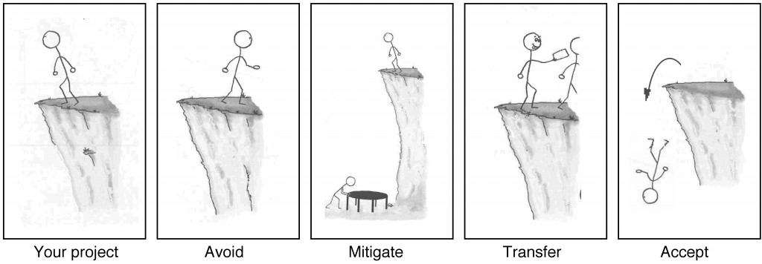
Control Techniques
Avoidance
Loss prevention and reduction
Risk transfer

Slide 9
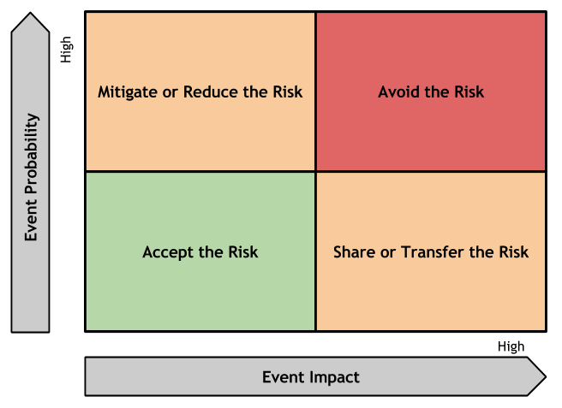
Risk Matrix

