Slide 1

California State Polytechnic University, Humboldt
JOC Pre-Bid Meeting:
Bid Solicitation # IFB PW-25
March 18, 2025, 10:00amPDT

Slide 2

Nothing written in this presentation supersedes what is provided in your bid package. Any deviations or changes to the bid documents will be provided in the form of an addendum.

Slide 3
Pre-Bid Conference Agenda
Introductions
JOC Process
Understanding the CTC
Calculating the Bid
Solicitation Details
Questions

Slide 4

JOC Key Players
- Bids out JOC contract
- Attends JOC Training
- Collaborates on scope - Provides price proposal - Executes work based on agreed upon scope of work
- Furnish JOC procurement software
- JOC training
- Technical support
- Operational support
- Program oversight
- Job Order process management (in some cases)
- Administers and manages contracts
- Identify projects
- Adhere to contract general conditions
- Provide scope of work
- Provide direction and campus perspective on projects
CSU Campus
Gordian
JOC Contractor

Slide 5
JOC Process

Slide 6
Job Order Contracting
Indefinite delivery/indefinite quantity process (IDIQ)
Enable contractors to complete a substantial number of individual projects with a single bid
Tasks based on competitively-bid, preset prices
Saves time and money
Provides transparency and auditability
Definition
Value

Slide 7
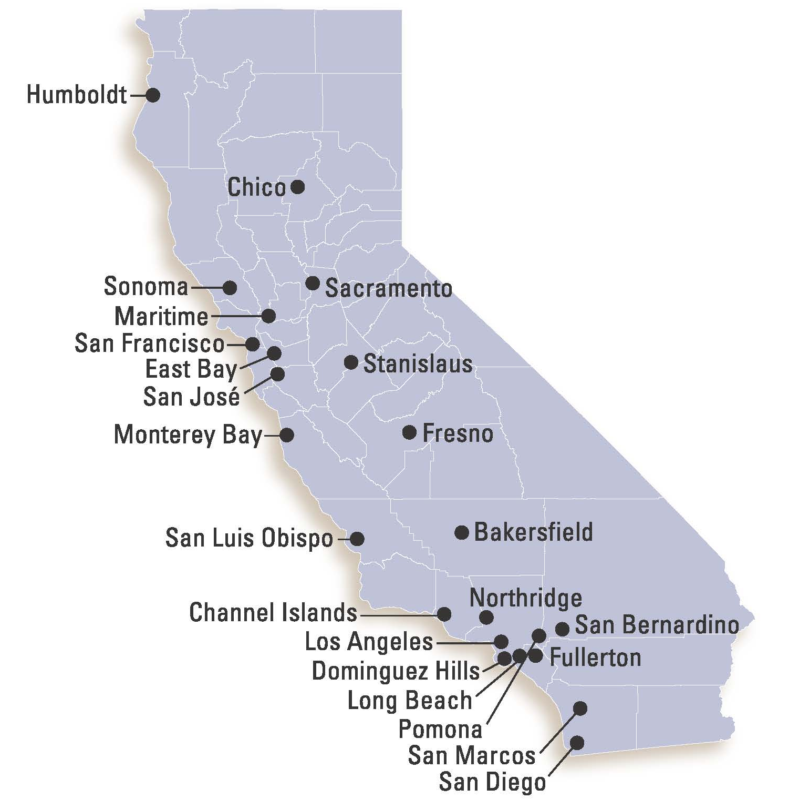
CSU Projects Since 1999
More than $900 MM completed:
Classroom, Science Lab, Dorm Room, Locker Room remodels
Roofing Repair and Replacement
Mechanical (HVAC), Electrical and Plumbing
Parking lot repaving
IT Upgrades
Deferred Maintenance
HAZMAT

Slide 8








Types of Projects
Contract Values: $0-$3,000,000
Minor Cap Limit: $1,103,000
Remodeling
Repairs
Renovations
Replacement
in-kind
Maintenance
Time sensitive
projects
Alterations
Notes:
Speak to the RRR and no new construction
From one competitively awarded contract,
campuses can complete an indefinite number of projects

Slide 9


The Benefits
JOC Benefits
Simplifies the procurement process
Responsive Services
Improves the quality of work
Increases local subcontractor participation
Volume is driven by performance
Develop partnership with University
Reduced Risk & increases transparency
A Fixed Priced, Fast Track Procurement Process
  Eliminates pricing negotiations
No Shelf Life for Prices or Job Orders
The JOC process allows for a higher percentage of projects to be delivered on time and within budget
Notes:
Procurement team is involved with a traditional bidding process to award the lowest cost adjustment factor for a master JOC contract.
Under the master contract approved Job Proposals become Final Purchase Orders submitted to CSU, streamlining to NTP.
JOC projects traditionally involve established detailed scopes of work owners need completed in a short, specific, or immediate period of time.
The on-going financial incentive for the contractor is to receive sequential job orders by executing the JOC process as described and completing projects with a high level of quality.
Job Proposals are built in Cloud, using the costs found in the CTC, based off the construction activities detailed in the scope of work documents.
A long-term partnership is expected to develop between the Owner and the contractor.
The structure of JOC enables a continuing, non-adversarial relationship that allows the contractor to function as partner in the development of each Job Order.
When construction professionals use the JOC program, Gordian Cloud, and eGordian software create a transparent process for everyone involved.

Slide 10
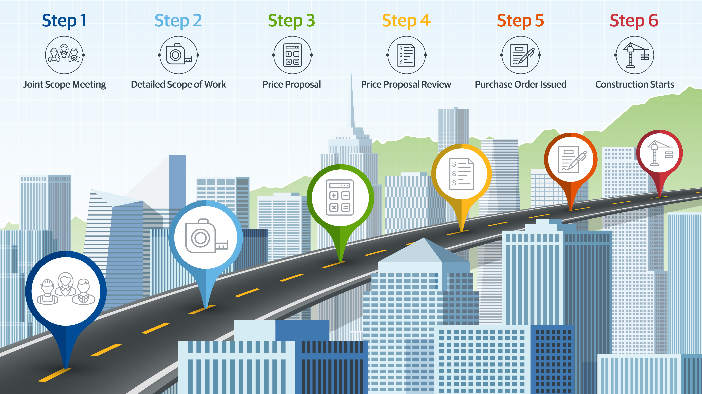
JOC Process
Request for Proposal
NTP / JOA Issued
Notes:
Joint Scope Meeting:
You schedule a meeting at the site for those involved to discuss project and design details
This is meant to be a collaborative meeting where the PM and contractor can finalize the Scope of Work
Detailed Scope of Work:
You prepare a DSOW that describes the work the contractor will perform
Price Proposal:
The contractor prepared a Price Proposal by selecting the appropriate tasks from the Construction Task Catalog (CTC)
Price Proposal Review:
You review the Price Proposal to ensure the contractor has selected the appropriate tasks and quantities
Job Order Issued:
Once the Price Proposal is approved, you issue a Job Order for the contractor to proceed
Gordian stops at this point and the campus, and the contractor will move to Step #6 together.

Slide 11
Understanding the CTC

Slide 12

Construction Task Catalog
Catalog of Pre-Priced Construction Tasks
Organized by Construction Specifications Institute (CSI)
Based on Local Labor, Material & Equipment Costs, based on Campus location.
The tasks selected represent the “Scope of Work” for every individual job order under the contract.
NPP tasks are available for use, with campus approval.
Notes:
Cynthia to check on the 25-mile radius distance.
There is an option for adding a non-pre-priced task if that is needed, details found in the GC’s.

Slide 13
Using the Construction Task Catalog
(Pages 1-6 of the CTC)
Contractor must review and understand “Using the Construction Task Catalog®” before submitting the bid package to the campus.
Make sure you get paid for all appropriate tasks
Inclusive of the JOC Contract Documents.
Notes:
Contractor to ensure that all employees read the first 6 pages prior to bidding the adjustment factor and again before walking the job presented.
Explains what is included and excluded in tasks.

Slide 14
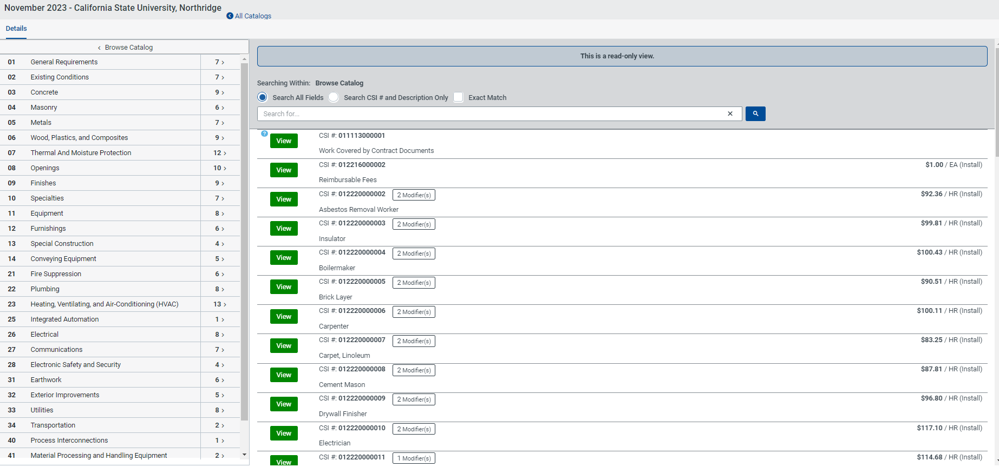
Sample CTC in Gordian Cloud

Slide 15
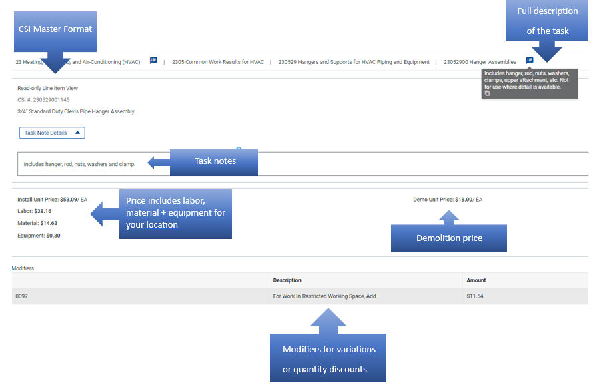
Sample CTC – Task Details

Slide 16
Solicitation Details

Slide 17
What are you bidding?
Contract Number | Contract Type | Minimum Contract Value | Maximum Contract Value | Contract Term | Bid Bond | Initial Payment & Performance Bonding (Each)
PW25-JOC | General Construction “B” | $0 | $1,000,000* | 1 Year | $25,000 | $1,000,000

Slide 18
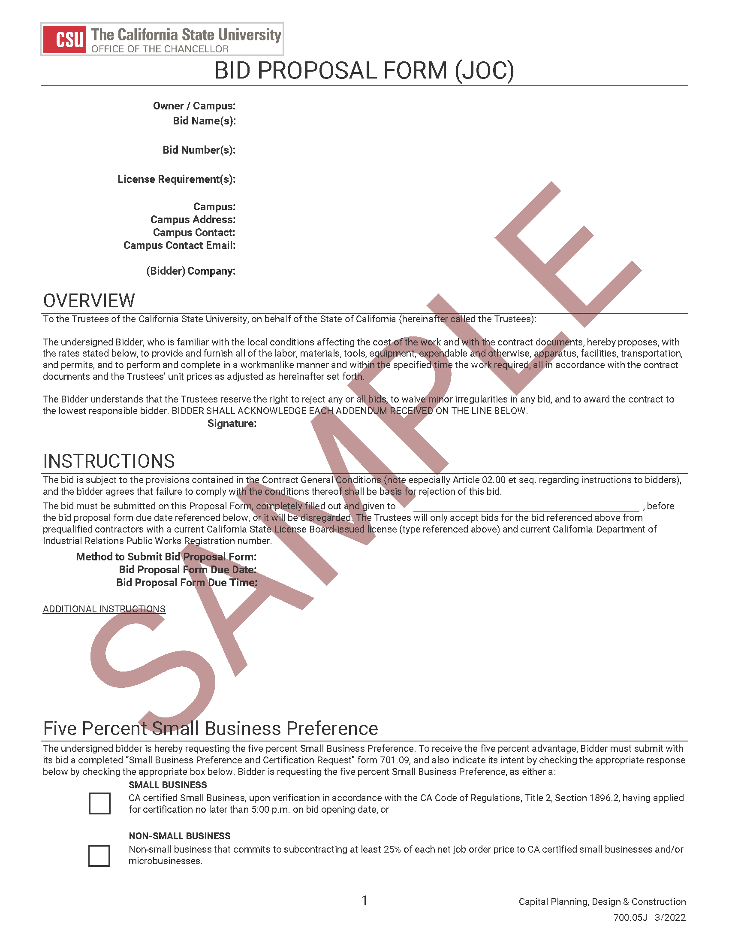
Front End Documents
Notice to Contractors
Bid Form (Sample)
General Conditions (Chancellor’s Office)
Supplementary General Conditions (Chancellor’s Office)
Special Conditions (University)
Sample Forms

Slide 19

General Conditions
  Bidding
  Award and Execution of Contract
  Conduct of Work
  Scope and Procedure for Job Order Work
  NonPre-Priced Tasks
  Interpretation of and Adherence to Contract Requirements
  Changes in the Work
  Claims and Damages
  Payment and Completion

Slide 20
What is your 1st Step?
Prequalification
Prequalification
Each bidder offering a proposal must comply with bidding provisions of Article 2.00 et seq. in the Contract General Conditions and should be familiar with all the provisions of the Contract General Conditions and Supplementary General Conditions, especially Article 2.02, regarding the necessity to prequalify with the Trustees ten (10) business days prior to the bid date.
Financial and Supplementary Prequalifications due not later than :
Tuesday, March 25, 2025, by 3:00pm.
Bidders must be prequalified with the Trustees. To apply for prequalification, bidders must register and log in to “PlanetBids”.
Detailed prequalification instructions are available at http://www.calstate.edu/contractor-prequalification.
Notes:
Does procurement have anything to add?

Slide 21
Bidding Process

Slide 22
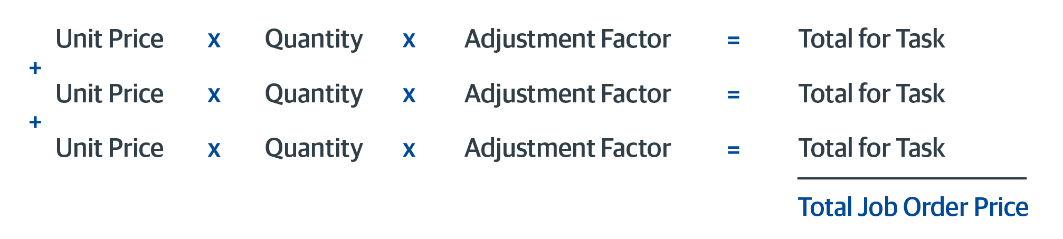
What is an Adjustment Factor?
Definition: Multiplier on the cost of construction tasks listed in a unit price book.
Importance of Adjustment Factors:
  Determines Lowest Bidder AND
  Used to Price Individual Work Orders
  Price Proposal Total Becomes the Lump Sum Job Order Amount

Slide 23
What is Included in Adjustment Factors?
(not limited to)
  All overhead, profit and taxes for the contractor and subcontractor
  Prep and modifications of proposals
  Office trailers and portable toilets
  Construction vehicles and storage devices
  All PPE
  Daily and final clean-up
  Protection of all surfaces
  Mandatory site supervision and management meetings
* comprehensive list – 1st six pages of the
Construction Cost Catalog®*

Slide 24

What Should Contractors Expect?
  Prepare Incidental Drawings or Sketches for Some Projects
    Justify Quantity Calculations
    Explain Detail of Work
  Prepare Proposals for Some Projects That Might be Canceled
  Margins on CTC Tasks Vary
  Some Projects are More Profitable than Others
  Maintain a Fully Functioning Local Office
  Hold Required Licenses

Slide 25
How do you bid?
Must bid 3 separate adjustment factors:
  Normal working hours: 7:00am to 5:00pm Monday thru Friday, except Holidays
  Other than normal working hours: 5:01pm to 6:59am Monday thru Saturday
  Premium working hours: Sundays and Holidays
Adjustment factors apply to all tasks in the CTC for the duration of the contract.
Each adjustment factor is weighted to create an award criteria.
Lowest composite score from a responsive, responsible bidder is determined to be the lowest bidder.

Slide 26
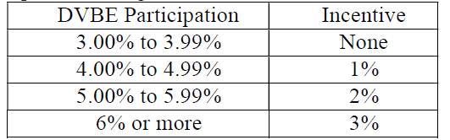
DVBE Adherence and Requirements
A. Incentive.
In accordance with Government Code section 14838(f), and Military and Veterans Code sections 999.5(a) and 999.5(d), the Trustees are granting a bid incentive for bid evaluation purposes only to bidders that exceed the three percent DVBE participation requirement. The level of DVBE incentive will correlate to the level of participation; that is, the more DVBE participation proposed, the higher the incentive. The bid incentives are as follows:
The DVBE incentive may not exceed $50,000. When used on combination with the Small Business Preference, the cumulative adjustment amount shall not exceed $100,000. If the lowest responsive, responsible bid is a California certified small business, the only bidders eligible for the incentive will be California certified small businesses.

Slide 27
Sanction for Contractor’s Failure to Adhere to DVBE %
B. Sanction for Contractor’s Failure to Achieve the DVBE Incentive.
The Trustees will sanction any Contractor who receives the DVBE incentive and does not contract the incentive percentage dollar amount of its net bid price to DVBEs. The sanction will be no more than two times the amount of the bid incentive received. For example, if the Contractor received a bid incentive of $49,000, and does not contract the incentive percentage dollar amount of its net bid price with DVBEs, then the Trustees will assess an amount to be forfeited by the Contractor of $98,000.
KEY TAKEAWAY:
Ensure what participation percentage you select is what can meet throughout the contract lifecycle. Gordian and the Chancellor’s Office is available to walk you through the process of DVBE adherence.

Slide 28

Method to Calculate Factors
Use Historical Project Data
Select a Completed Project You Know Scope and Direct Costs
Price Project From CTC
Add on Overhead and Profit
Calculate the Adjustment Factor

Slide 29
Sample Adjustment Factor Comparison
*Sample Only. Contractor to determine adjustment factor.
CTC | $64,000.00 | $64,000.00
Adjustment Factor | 1.2289 | 0.9040
Project Value OH/P | 78,650.95 | 57,856.00
Sub Cost | (65,000.00) | (65,000.00)
Direct Cost | 13,649.60 | (7,144.00)
Notes:
Here are 2 examples of sample adjustment factors and how they correlate to the same base cost in the CTC

Slide 30
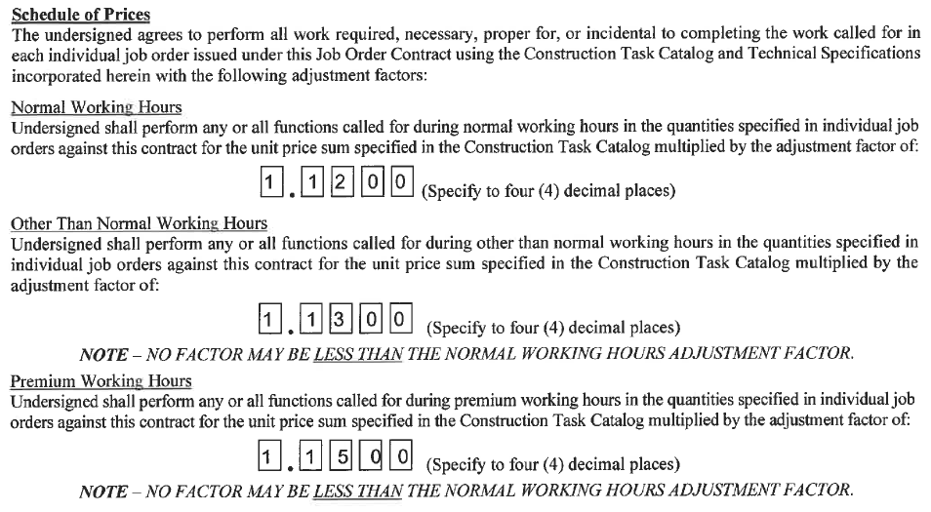
Filling Out The Bid Form (Sample)

Slide 31
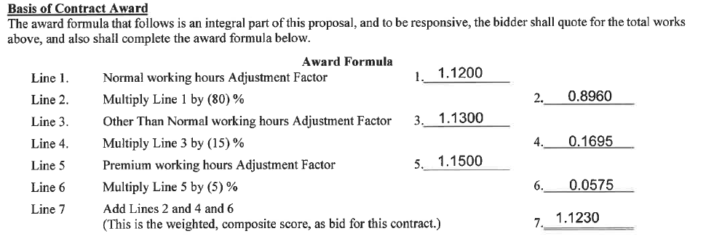
Filling Out The Bid Form (Sample)

Slide 32
When and Where to Send Questions
All questions concerning this solicitation must be received via email no later than:
Tuesday, March 25, 2025
Submit questions to:
Addie.Dunaway@humboldt.edu

Slide 33
How do you submit your bid?
Bids due : Wednesday, April 9th, 2025, by 3:00 PM
Proposal submissions will be received by delivering an Electronic Copy of the Bid Documents and required supporting documentation via email to:
Addie.Dunaway@humboldt.edu
With the words JOC Contract Bid, the bid solicitation number and the company name in the subject line
not later than 3:00PM at which time the proposals will be publicly opened and read
  The bid opening meeting will be held via ZOOM. It is the bidder’s responsibility to advise of your desire to attend the bid opening zoom conference by emailing: Addie.Dunaway@humboldt.edu to request an invitation.
  A Zoom invitation will be sent to bidders upon receipt of proof of their physical bid submission.
,
The Bid Solicitation Number and your Company Name must be reflected in the subject line and failure to do so may result in the inadvertent opening of the message and may cause your bid to be rejected.

Slide 34
Questions ?

