Slide 1


Financial
Management Training
Presented by:
RSO Financial Coordinator
Clubs-finance@humboldt.edu

Slide 2
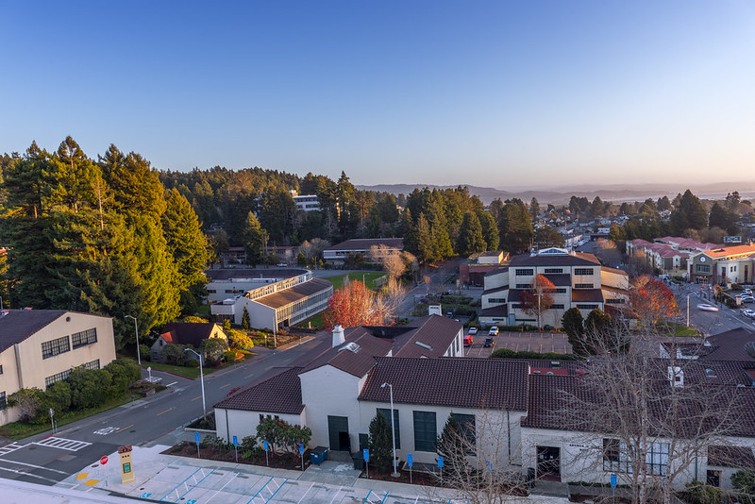
Contact Info
SBS 285 Cashiers Office
707-826-6789
Clubs-finance@humboldt.edu

Slide 3

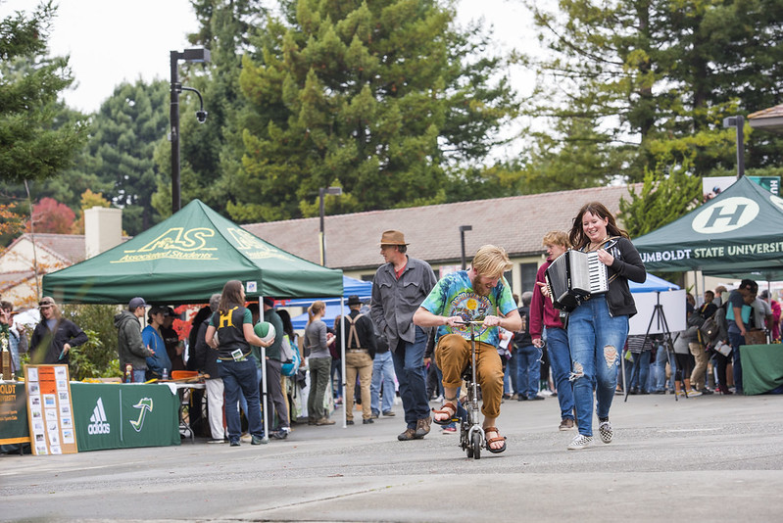
Why are you here?
Financial Management Training
The CSU Chancellor’s office requires every campus to protect the assets of Registered Student Organizations by ensuring that cash handling policies are practiced.
Policy ICSUAM 3141.01 – Administration of Student Organization Funds.
As the President, Treasurer, and Advisor for each Registered Student Organization (RSO), You are required to complete this training.
It is important that you familiarize with the Financial Handbook, as well as other useful links available in the Student Financial Services website.
https://www.humboldt.edu/student-financial-services/handbook-training

Slide 4
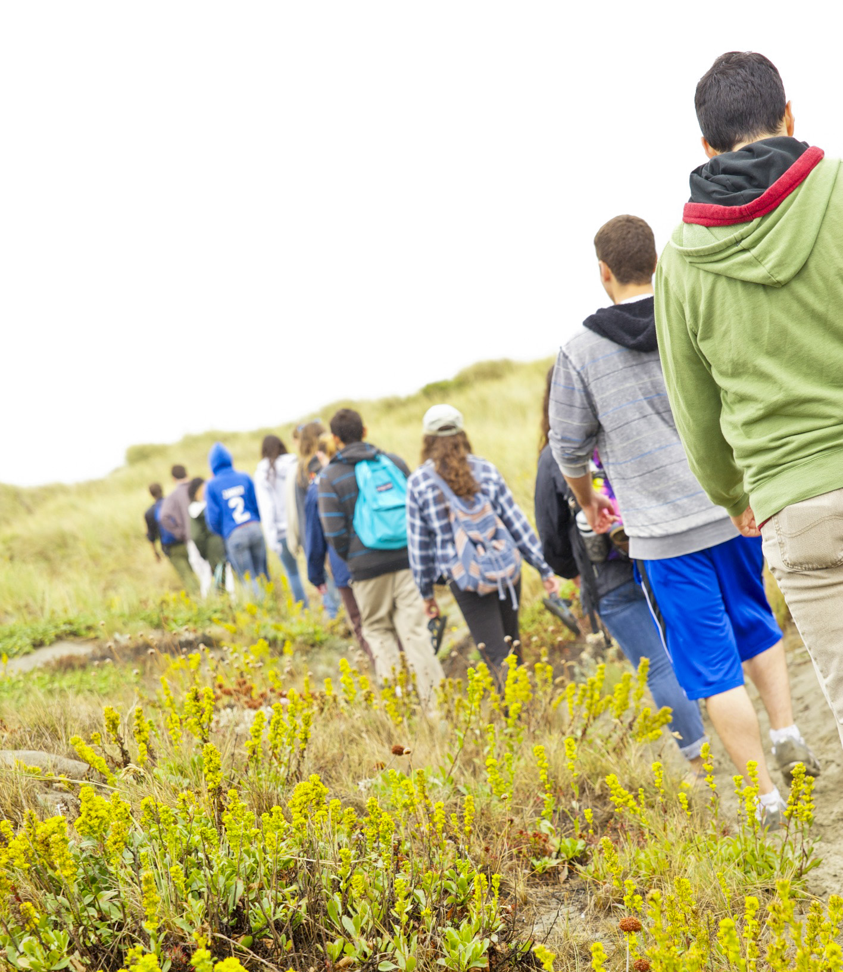
RSO Leadership
Expectations
As the President and Treasurer, you are expected to actively participate in your Team’s fundraising efforts and other financial activities.
When questions arise about events, the RSO Coordinator will reach out to you expecting that you know the answers.
It is required that you keep organized and legible records. First, because you may be required to provide your records if questioned or audited. And second, to leave a legacy of success behind you as you pass these duties on to other future presidents and treasurers.
It is also your responsibility to know and uphold your club members to the Financial Management procedures. The whole club will be accountable if any member is found to be in violation of the Financial Handbook.

Slide 5
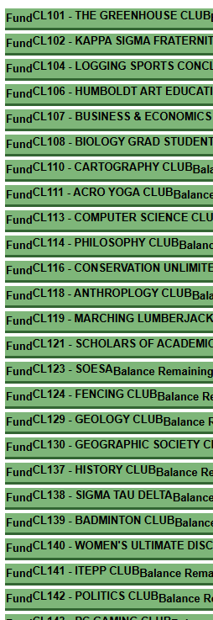
What is a Trust Account?
On-Campus Club Account
Trust account is basically your clubs bank account on campus. All your funds will be deposited here, and any purchases are charges you make will come from this account.
One of the first things to do as a club is to create a Trust Account. This is your club campus account from where all money earned and spent by your club comes from. We call this account the CLNumber (CL#).
Note that all your requests and forms will require you to know and input your CLNumber. It is strongly recommended you save this number for your records.
No Off-Campus bank accounts are allowed. Do not deposit club funds into any off-campus account. Specific national organizations do have an exception to this and must be confirmed with your RSO Financial coordinator.

Slide 6
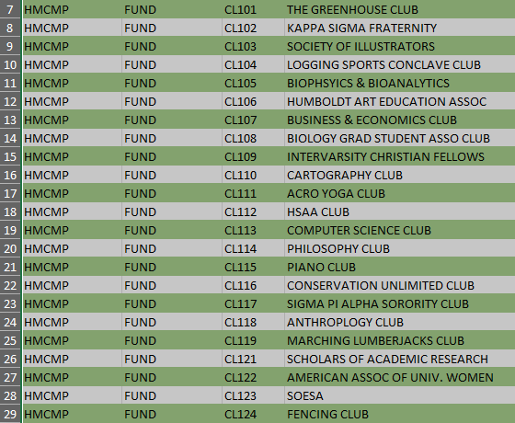
Finding your Trust Account
If your club has an established CLNumber, you can find it by opening the Chart Accounts page in the Financial Services website.
https://www.humboldt.edu/financial-services/chart-accounts
Scroll down until you find the Fund link and click it.
An excel spreadsheet will download to your computer.
Open the spreadsheet and click the HMCMP tab at the bottom.
You will find the list of club trust accounts in this page. You can search the list using your club’s name to find the CLNumber required. Example: TANGO CLUB - CL647
If you can’t find your club’s name, then there may not be an active trust account for it.

Slide 7
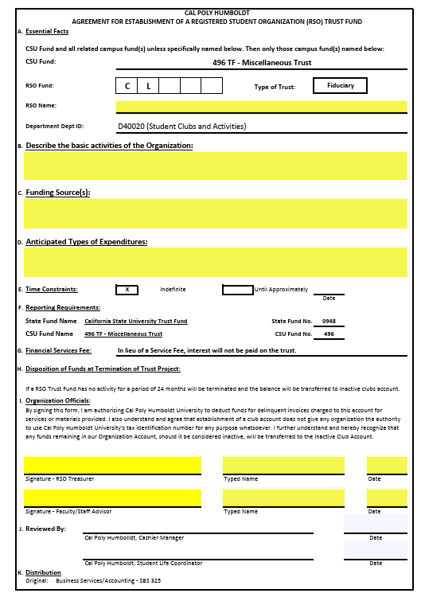
New Trust Account
If you are a new club, you will need to apply for a new CLNumber.
To get the application, access the Registered Student Organizations Financial Services website
https://www.humboldt.edu/student-financial-services/registered-student-organizations-rso-financial-services
Scroll down to the group of links.
Click the Forms and Applications link.
In the resulting page, scroll down until you see the Establishment of a Trust Fund link and click it.
The pdf form will download to your computer.
Fill out the Highlighted areas
Once complete, email the form to the following email: Clubs-finance@humboldt.edu.
The RSO Coordinator will route it to the appropriate approvers and get you access to your CL#.

Slide 8
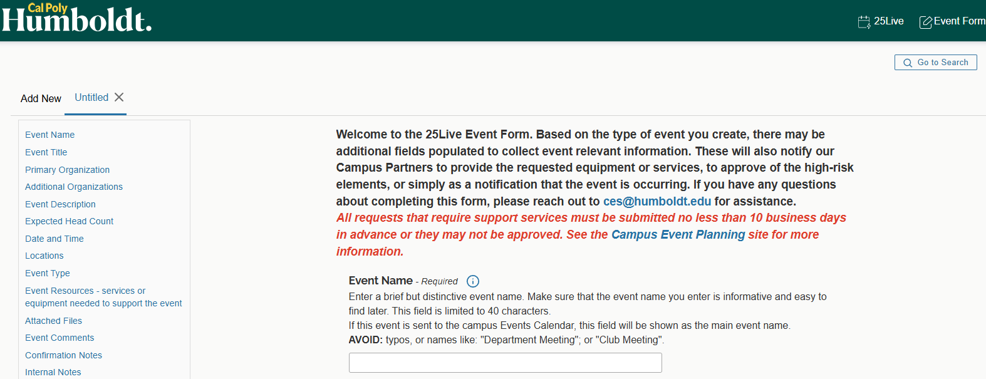
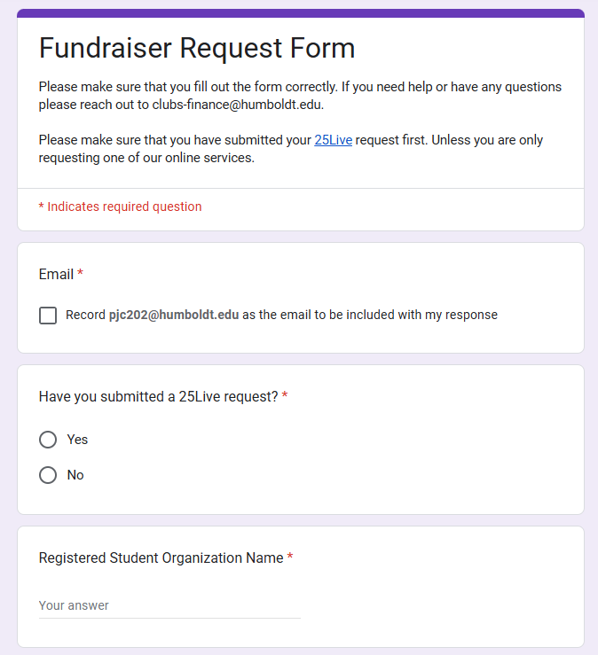
Event Requests
Requesting Events
After completing all the mandatory requirements for your club to become active, you will be ready to request your club’s events.
Requesting events is done through the 25Live and Club’s website. https://www.humboldt.edu/clubs/rso-forms
It is important to try and get your requests in as early as possible. Some events may take longer to get approved. Between two and four weeks before your event is the time frame you want to get your requests submitted.
These are very important and vital tools for all clubs. Without following the procedures and submitting the forms on these sites you will not be able to use any of the club’s funds.
For more information and training on the use of these tools, please contact us at the following email: clubs@humboldt.edu and sec@humboldt.edu for 25Live

Slide 9
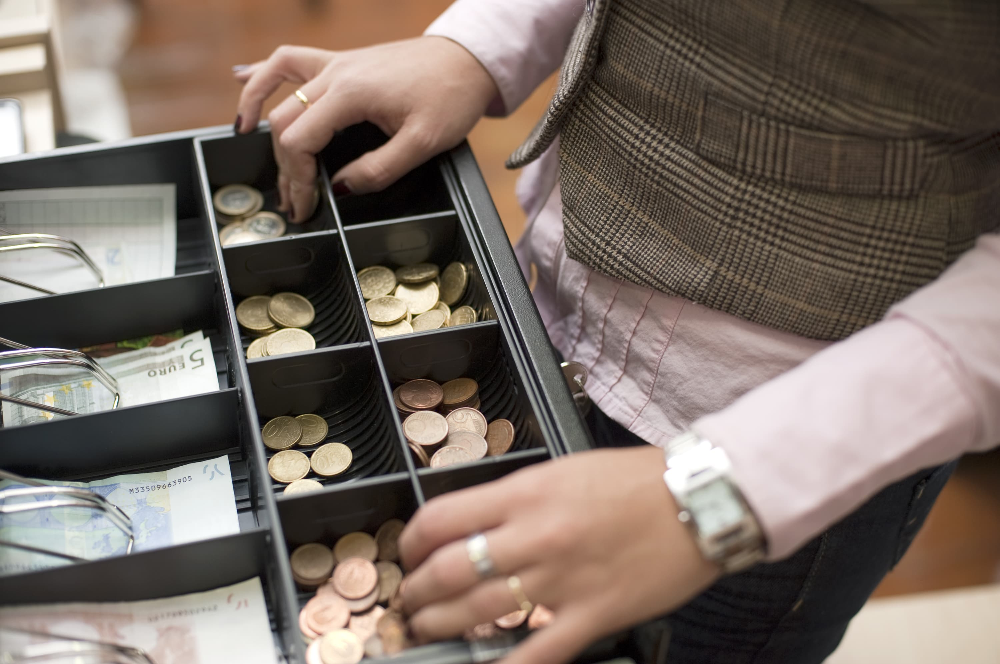
Event Requests
Cash Handling & Dual Custody
Anyone handling any form of currency is required to take a Cash Handling training every academic year. This course covers the basics of cashier transactions and procedures.
This training is available for any club member, not just for the officers. If you are part of more than one club, you only need to take the course just once per academic year.
To schedule a training appointment, send an email to the following address
clubs-finance@humboldt.edu
Dual Custody is the procedure of making sure that two people are present at an event to verify each other’s count of money, thus lowering the chance of making an error.
For that reason, at least two people who has taken the Cash Handling course must be present at each event.

Slide 10
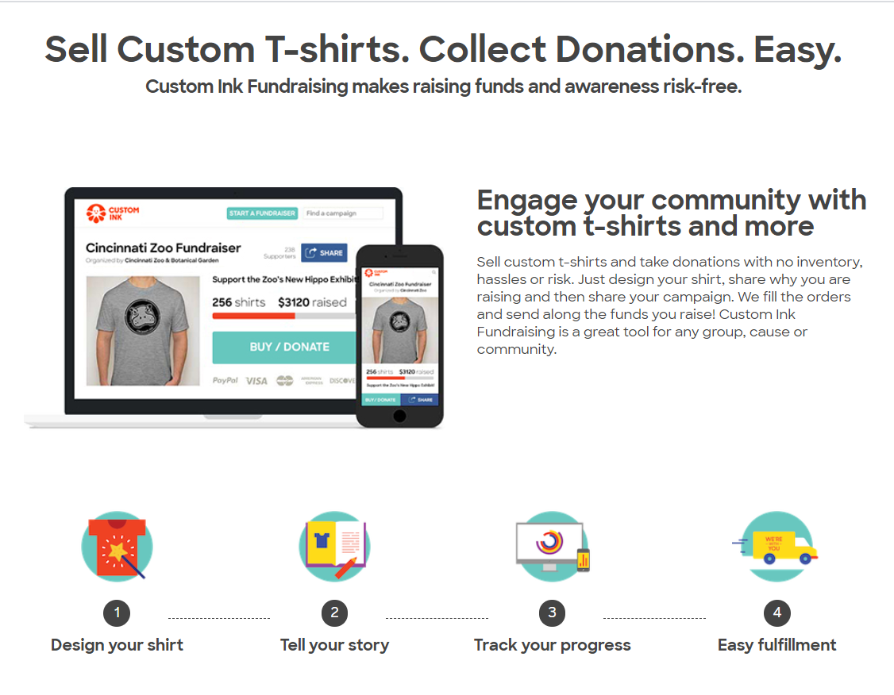
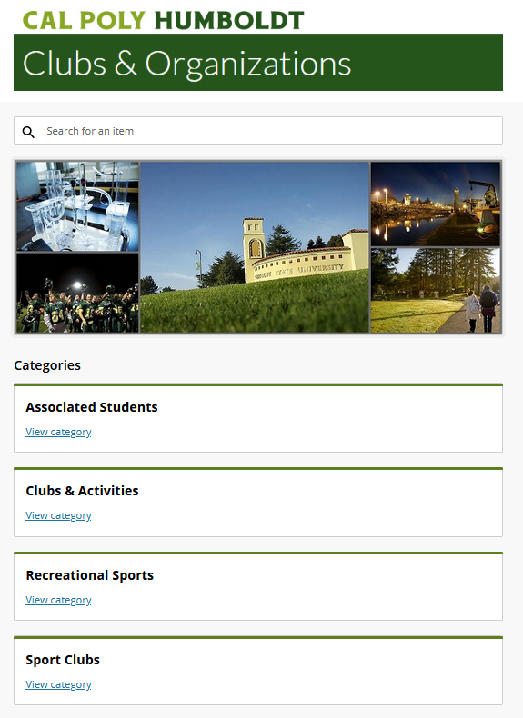
Fundraisers
A fundraiser is an event held with the purpose of generating financial support for an organization or goal.
Fundraisers can take the form of many different things, varying from merch sales to a performance. The main distinction is that you are offering some sort of good or service in exchange for a financial gain.
All fundraisers must be approved before being held. You must submit your request two weeks before your event’s date.
For larger events, you must submit the request one month in advance to allow for more preparations to be made and make sure all departments are aware of the event.
During a fundraiser you must make sure to take accurate receipting of your transactions. This might be a tally sheet with what you sold, how much it cost, and how many were sold. If correctly done, your tally sheet should add up to exactly the amount in the box.
You may also request an online store be made or adjusted for your event. This is the best way to allow credit card purchases to be made at your events.

Slide 11
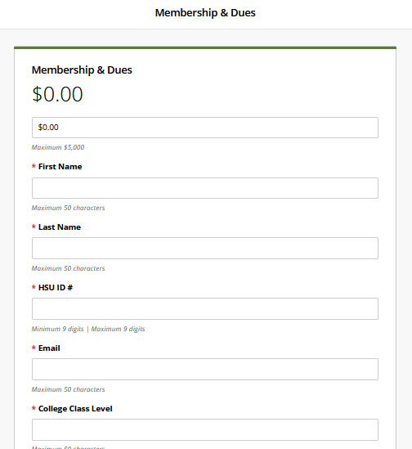
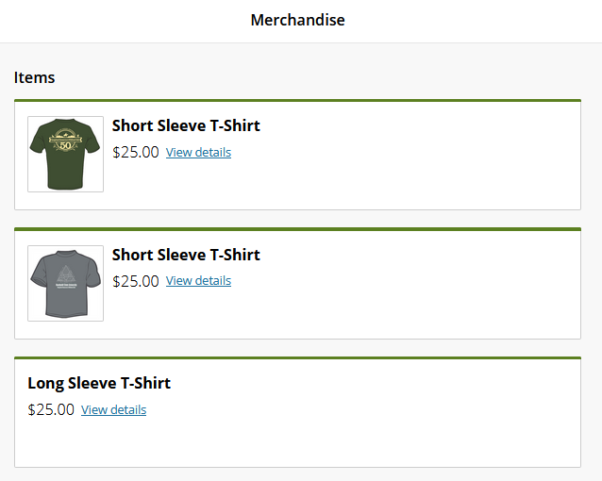
Online Store
You may also request an online store be made or adjusted for your event. This is the best way to allow credit card purchases to be made at your events.
You can set up a store with items you wish to sell, sales tax will be added to items that apply automatically. This is a great way to allow more people access to make purchases. You may also use the online store for Presale tickets or event entry, as well as club dues.
Credit card fees will not be applied to Club dues.
You will receive reports about your online store sent to your club's email. Please make sure that you have access to that. If you still need to gain access, please reach out to clubs@humboldt.edu.

Slide 12
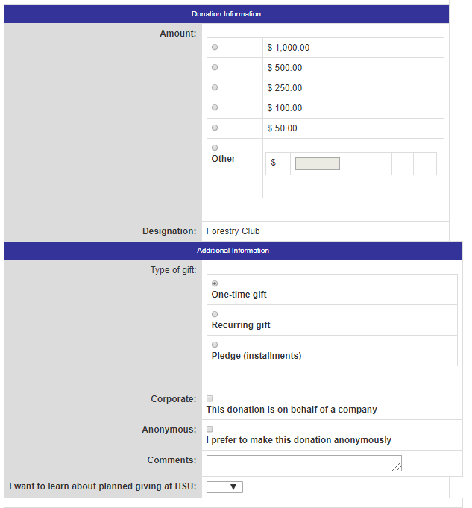
Donations
A donation is anything given to your club without giving anything in return. There are two main donation types: Cash/Check and In-Kind. In-kind donation is one that might be an object or service that has a monetary value.
All donations must be kept separate from any fundraising money as they go into two completely different funds.
If you are at an event and someone wants to donate money to your club, make sure to keep a record of the donation separate from any fundraising money.
To the right is an example of your club’s Giving Page. You may go here to check if you have one, if you do not please reach out to the RSO Coordinator to get one setup.
https://giving.humboldt.edu/our-funds
Have donation forms at hand or gather the donor’s contact information and submit one later.
Donations & crowdfunding webpage https://www.humboldt.edu/student-financial-services/donations-crowdfunding

Slide 13
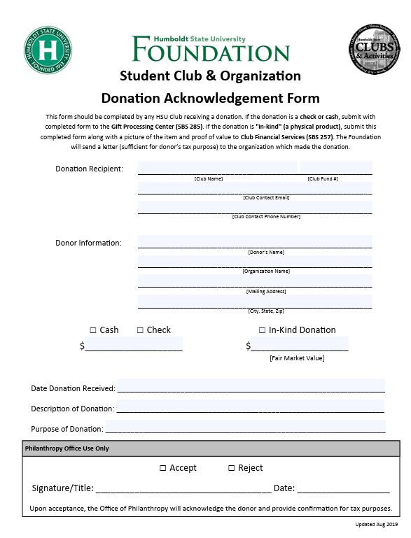
Types of Donations
Cash/Check and In-Kind Donations
When receiving a cash or check donation, you can fill out a donation form that will allow the donor to get a tax credit for their donation. When it comes to an In-Kind donation you would fill out the current value of the item or service they donated.
Here is a link to the website to download the form.
https://www.humboldt.edu/student-financial-services/forms-applications
Donations may be unsolicited and you don’t have to be approved to get them.
You can also solicit donations, but to do so, you must get pre-approved. To begin the process, submit a Fundraising Request Form on Club’s Website and attach your proposed solicitation in a word document.
The form will be sent to the Office of Philanthropy who will make edits or suggestions to what needs to be changed. Once the proposed solicitation is updated and your request has been approved, you may send out your solicitations.

Slide 14
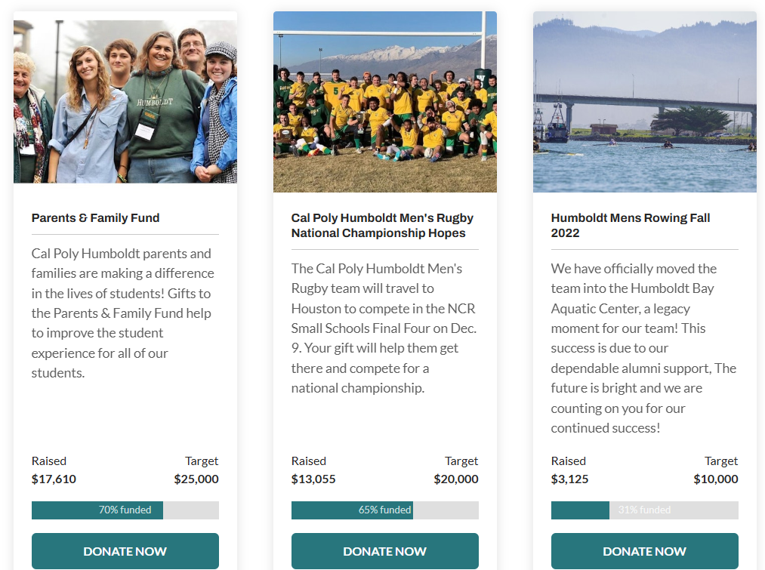
Crowd Funding
Crowd Funding is another option when you have family or friends outside of the area who want to give toward your cause, but may not be able to attend a fundraising event. This option is very good for purchasing expensive equipment for your club or group travel.
You need to request this option through Club’s website. The Advancement team would set up an interactive webpage that is updated with each donation to show progress towards a goal. This does require more time to set up so the request for this must be at least a month before it goes live.

Slide 15
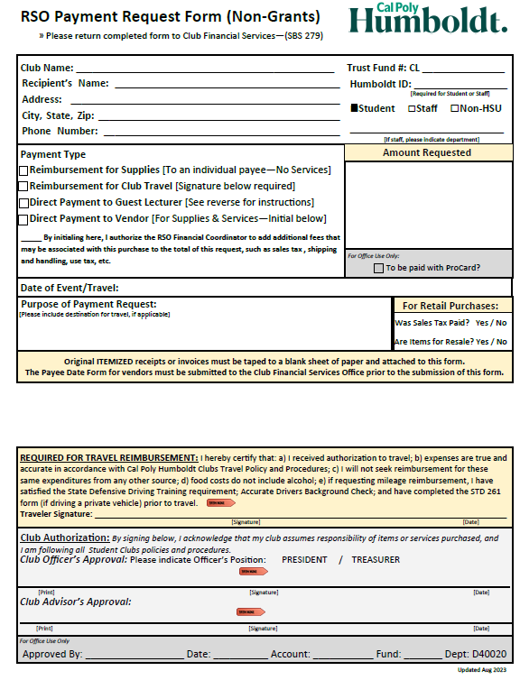
Spending Funds
No Third party apps allowed, the CSU does not allow the use of venmo, paypal, zelle. If a payment must be made with a third party app please get approval from your Financial Coordinator beforehand.
Once your club has raised enough funds, you can start making purchases.
Remember, State funds should not be used to purchase any Drugs, Tobacco, or Alcohol.
When making purchases, make sure all receipts are itemized and they should not include any personal purchases. If you are shopping for both, the club and yourself, make sure to make two separate purchases for separate receipts.
When making a purchase you will need to fill out a Payment Request Form which you can get from the clubs’ financial website. This form is used for both purchasing from vendors as well as Reimbursements to the students directly. We’ll learn about these methods later in the course.

Slide 16
Complete the Form
The top portion of the form will vary but it is important that you have
  Club Name
  CL#
  Humboldt ID number, if it is a student or faculty
The recipient’s name this is the person being paid. So, if it is a reimbursement to a student, it will be their full name. If it is a vendor, it would then be their business name. This is important when it comes to check reimbursements, because the information on this form must match the recipient’s information in the system.
Be sure to have the appropriate signatures. Your club advisor’s and, either, the President or Treasurer of the club signatures are required. If the payment request is for travel reimbursements it will require the traveler’s signature as well.

Slide 17
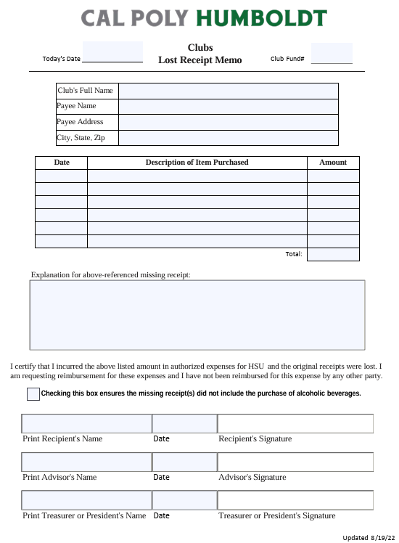
Lost Receipt
If a receipt is lost you need to fill out a Lost Receipt form and attach that to your payment request form.
This usually will happen with Gas receipts or damaged receipts. Please note that this is not supposed to be a normal practice. If a club turns in too many of these, they may get audited.
You may want to get an app or take a photo of your receipts as a back up incase you lose the original.
Like the Payment request form it requires the same signatures from your Treasure or President and your Advisor.

Slide 18
Making A Purchase
ProCard
The first option is direct payment to the vendor, which can be done online or over the phone, with a ProCard by the RSO Financial Coordinator.
While you can buy almost everything online with a ProCard, goods and services from vendors who receive payments only through PayPal and some other forms, are not allowed to be purchased with the ProCard. In this case, reach out to your RSO Financial Coordinator to see what other options are available.
If a vendor only accepts payment in check form, we can have a check printed and sent to them. This process takes longer because the request must go through additional steps and several departments for approval. Reach out to your RSO Financial Coordinator for help with the procedure.

Slide 19
Reimbursements
Cash or Check
The second option is the most common. The students make payments with their own money and afterwards they are reimbursed for the purchase.
Amounts under $300 will be reimbursed directly to the student using cash at the cashier’s window. Remember that you need to bring all receipts and a completed Payment Request form.
If the amount is more than $300 you will need to reach out to the RSO Financial Coordinator for assistance in getting reimbursed.
Any expenses that are part of an event or trip need to be approved beforehand. If you are driving you must also get an approval before the date of the trip or event. The RSO Financial Coordinator will not be able to reimburse clubs that do not have these approvals previously.

Slide 20
Travel
Currently, reimbursement for travel is done after the trip has completed. Be sure to save all your receipts and stubs as they are needed for your refund.
Once back, fill out a payment request form, attach all your receipts, and submit for review. The Club Financial Coordinator will check the items and will verify that you were approved to travel.
Items that may be reimbursed can be plane, train, bus, lift, uber, and rental cars. You may also get reimbursed for milage on your own personal vehicle at a rate set by the CSU system. Food, event registration, and other accommodations may be reimbursed as well. (Rental vehicle should be enterprise if possible?)
Each club can determine what they wish to reimburse their travelers for. Some may reimburse everything while others may just reimburse gas. Make sure to talk to your club officer before you travel to be in agreement to what will be reimbursed.

Slide 21
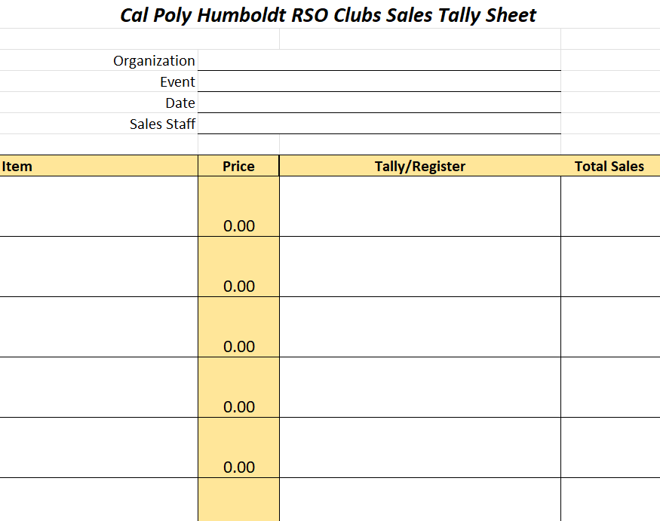
Deposits
Turning Funds In
Please try and deposit your monies as soon as possible after your event.
When making a deposit all monies should be put in a deposit bag with any transaction recording or tally sheet, as well as any receipts. It should have your Club name and CL#, and the name and date of the event.
If you have donations as well, you should put them in a separate deposit bag with the Club name and CL# with donation written on it. It is very important that donation deposits remain separate from any fundraising/merch sales.
Once you have secured your monies in a deposit bag you may drop them off at the SBS 285 cashiers office between 8am-4pm Monday through Friday.
If your event is outside of these hours, you may also drop off your deposit on the first floor of the SBS building in a small drop box on the wall across from the UPD window. If the building is locked you may have to call UPD at 707-826-5555 to let you in.
If your deposit is $1,000 or more, you are required to have an escort to drop off your deposit. Use the same number to request the escort. They will come and pick you up and drop you off at the SBS building.

Slide 22
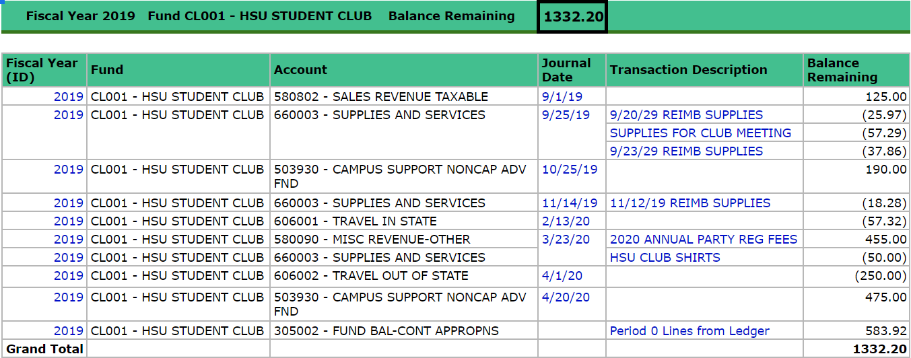
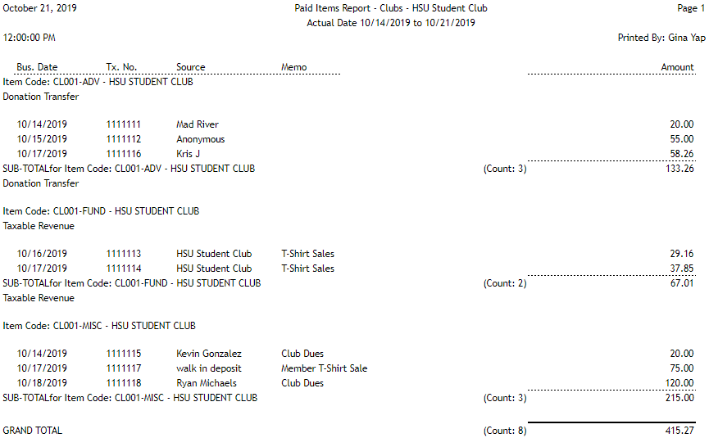
Reports
Transact and OBI
You may get two different reports sent to your club email.
One will be from OBI this report will reflect changes to your CL account. If have a CL account and are not receiving these reports please reach out to the club financial coordinator. They will be able to have the reports setup to report Weekly on Monday mornings.
The other Report you may receive is from Transact. This will be for those clubs that are utilizing the online store. Depending on the information you request to be collected from the store. Will determine what information will reflect in the report.

Slide 23
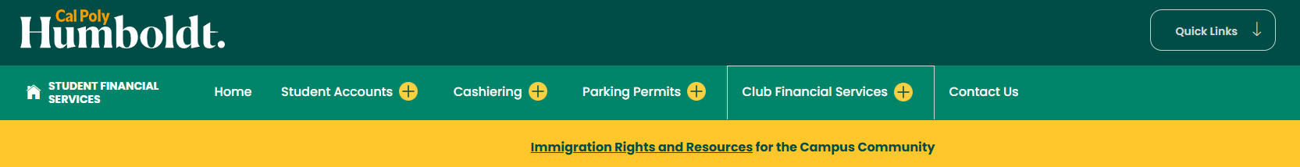
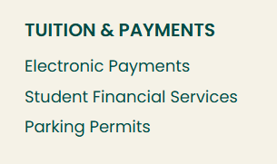
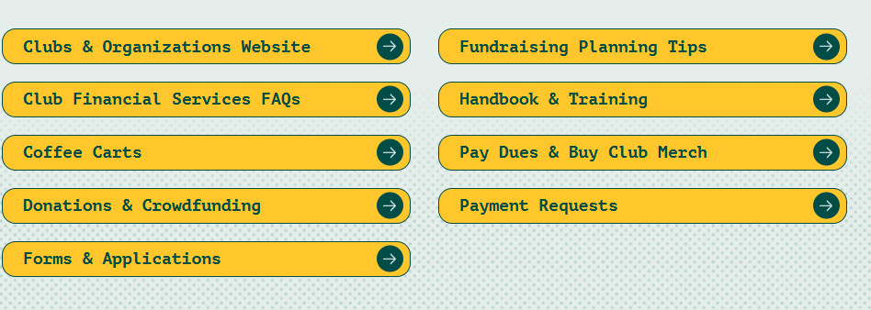
Form Locations
Here is an example on how to find the forms and resources from the Student Financial Website.
https://www.humboldt.edu/student-financial-services
You can also get there by clicking on Quick Links and then scroll down to the Tuition and Payments sections and click on Student Financial Services.
Once you are there you can click on the Club Financial Services tab at the top. This has all the forms and links for clubs, if you scroll to the bottom of the webpage, you can find useful links.
Or click here to go directly to the Clubs Financial Services

Slide 24

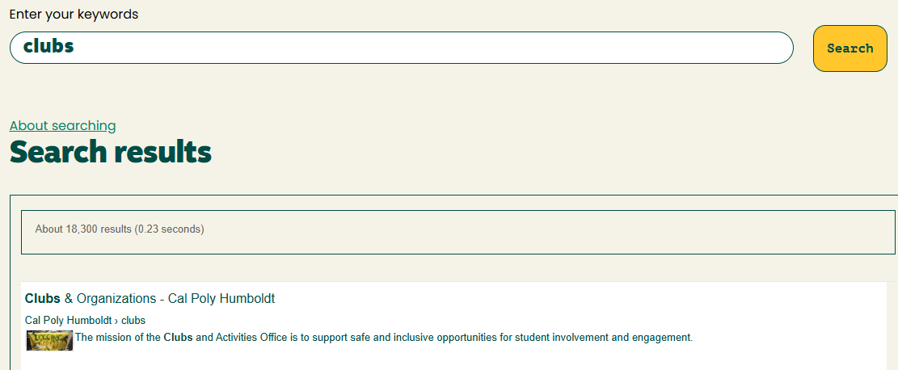
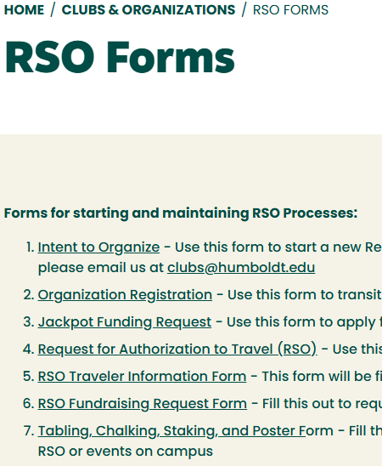
Form Locations
This is how you can find your way to the Clubs webpage for resources.
https://www.humboldt.edu/clubs
The best way to get here is to click on the Search button and type in “Clubs”. The first result is usually Clubs and Organizations that is the link you will want to use.
Once there you can click on the RSO Resources and that will bring you to a page that has a list of resources include the Fundraising request form.
Or click here to go to RSO Forms

Slide 25

Overall Process
Plan – Take Time to plan out your event, and things need.
Submit all Requests – Make sure to submit all your event request forms well before your event.
Record your event – Make sure to keep good records of sales and donations from your event. As well any receipts needed for reimbursement.
Deposit – Your monies into a deposit bag and make sure to include your Transaction recording. Include your CL# club name and date of the event.
Submit – any payment request forms needed for purchases or reimbursements.
Review your Event – Take the time to look at your past event and see if there was any places to improve, if it was successful. This could help determine any of your future events.

