Slide 1


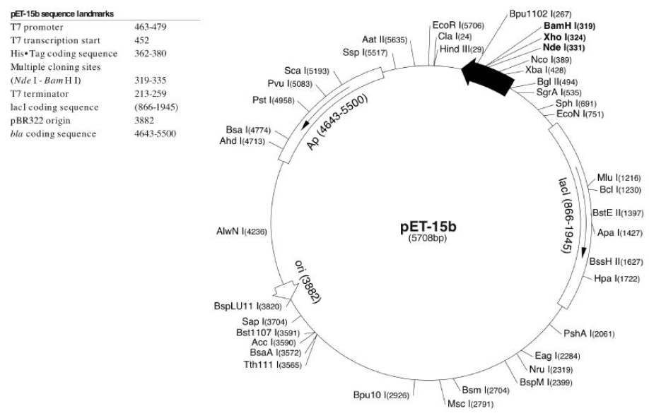
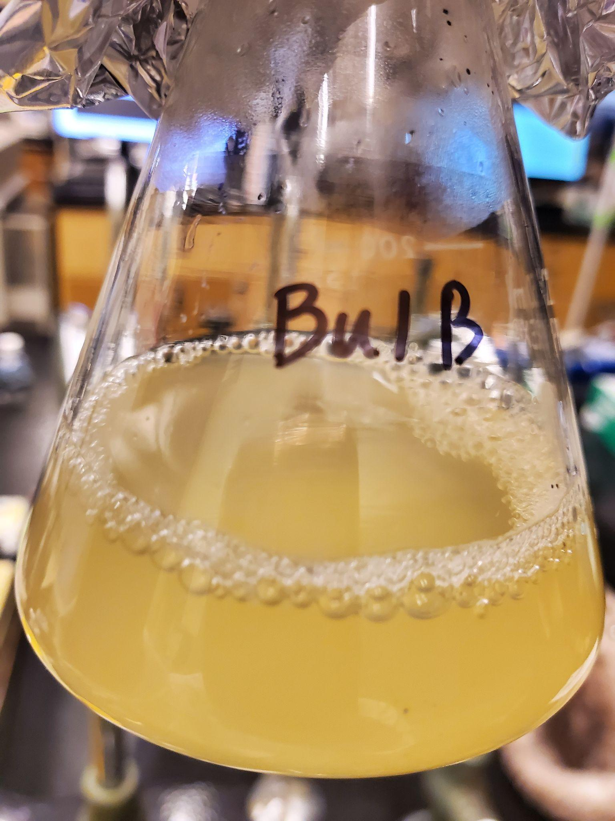
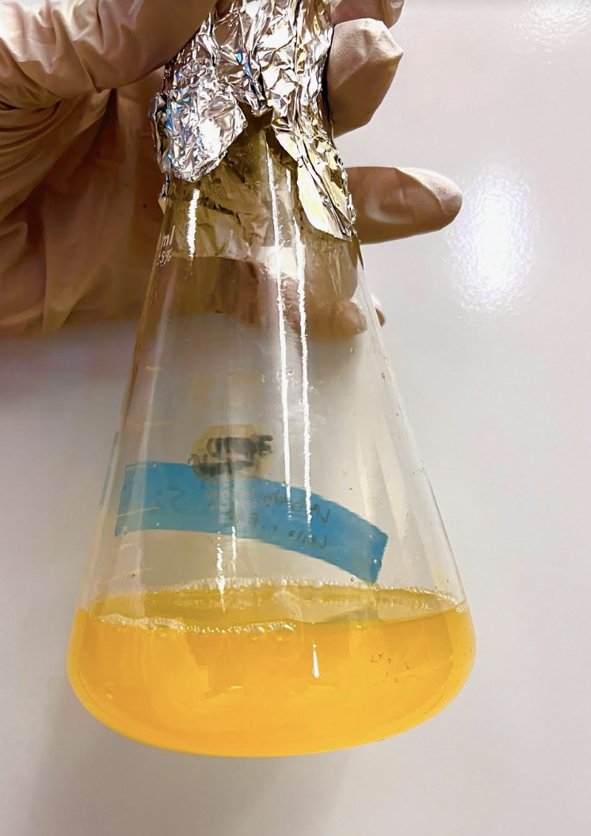
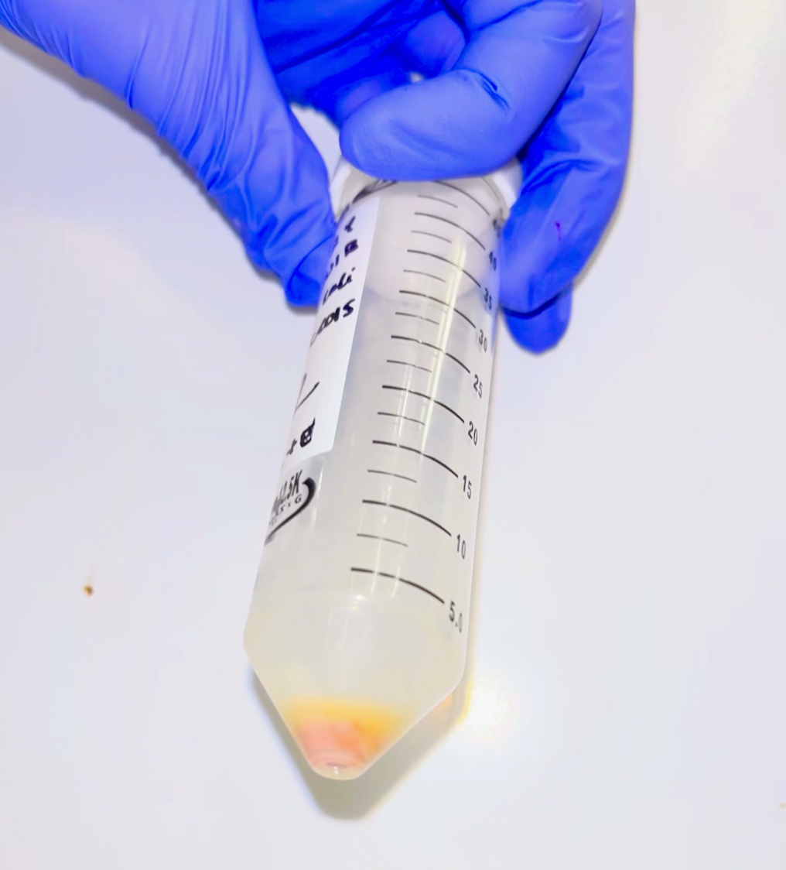
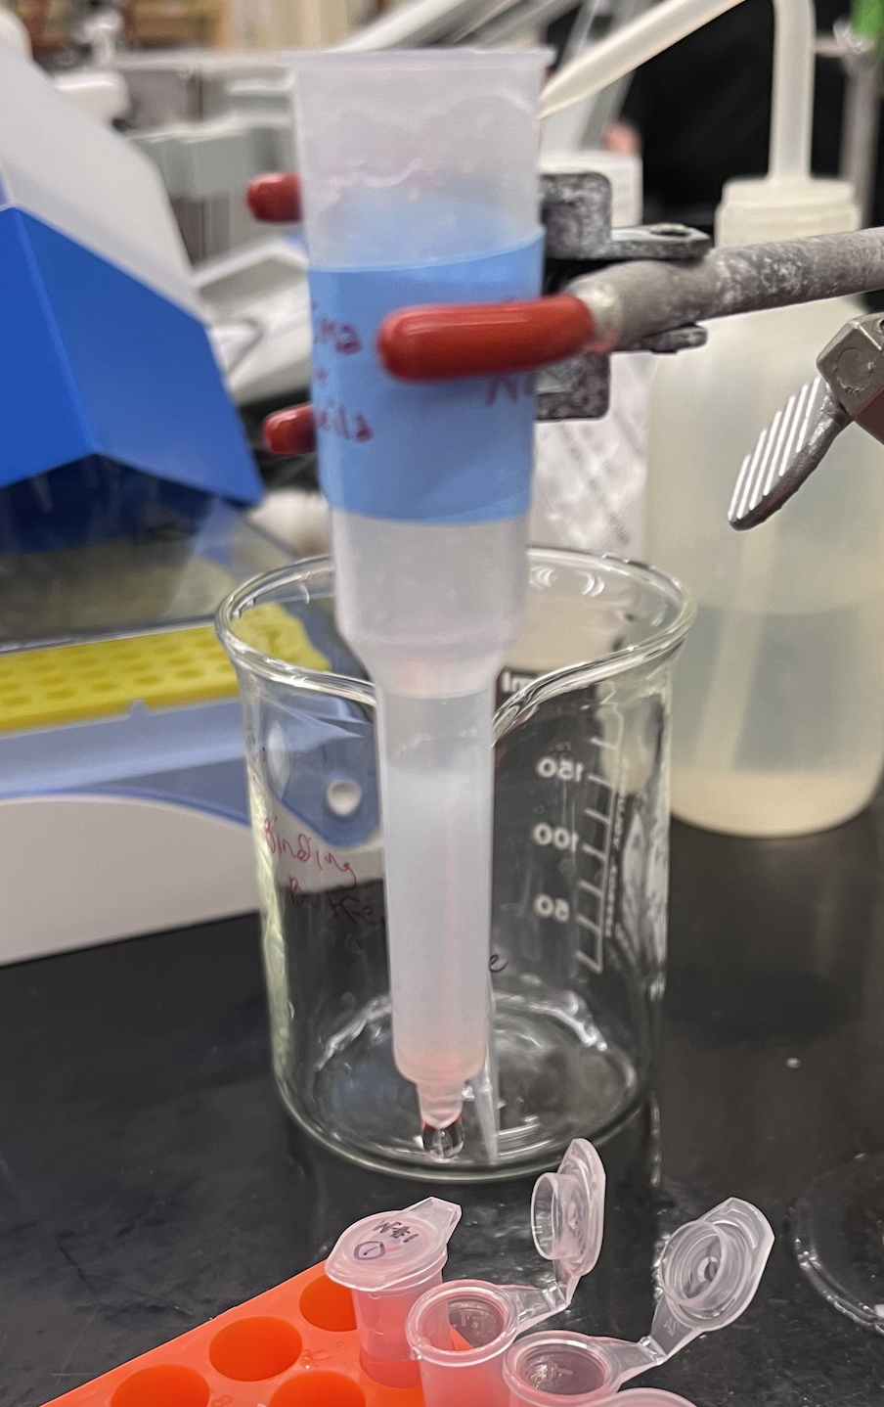
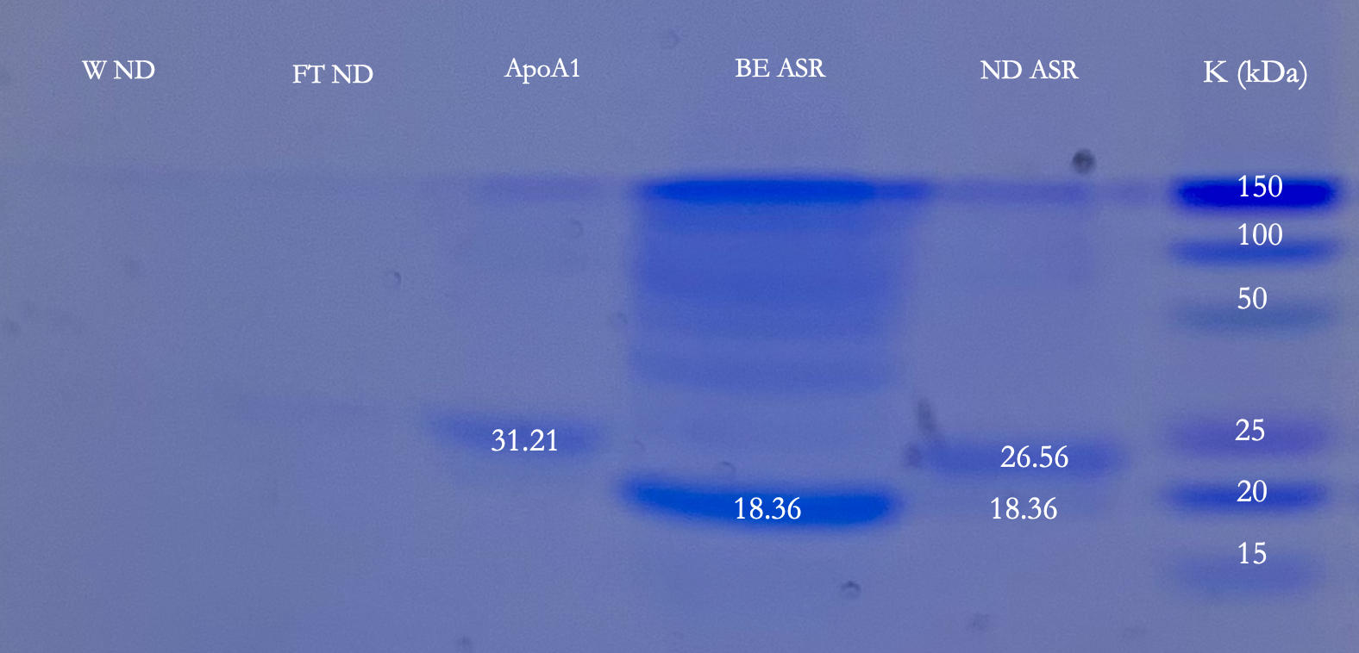
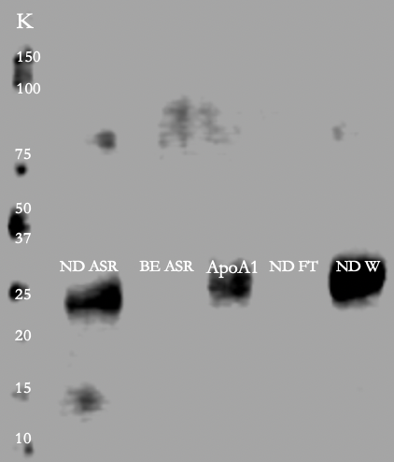
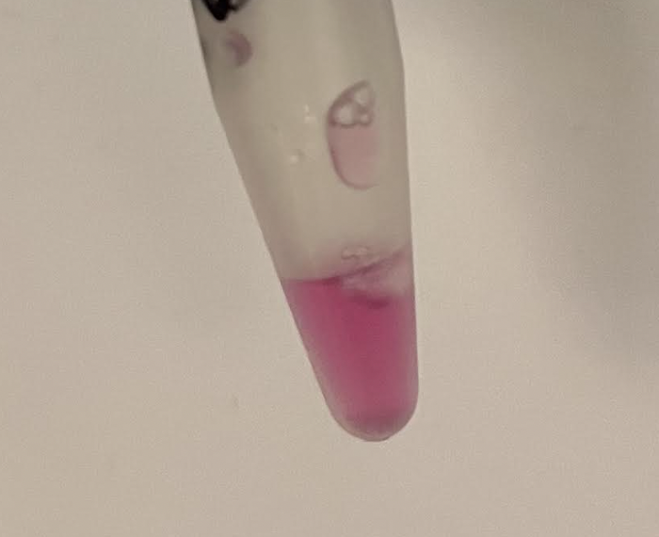

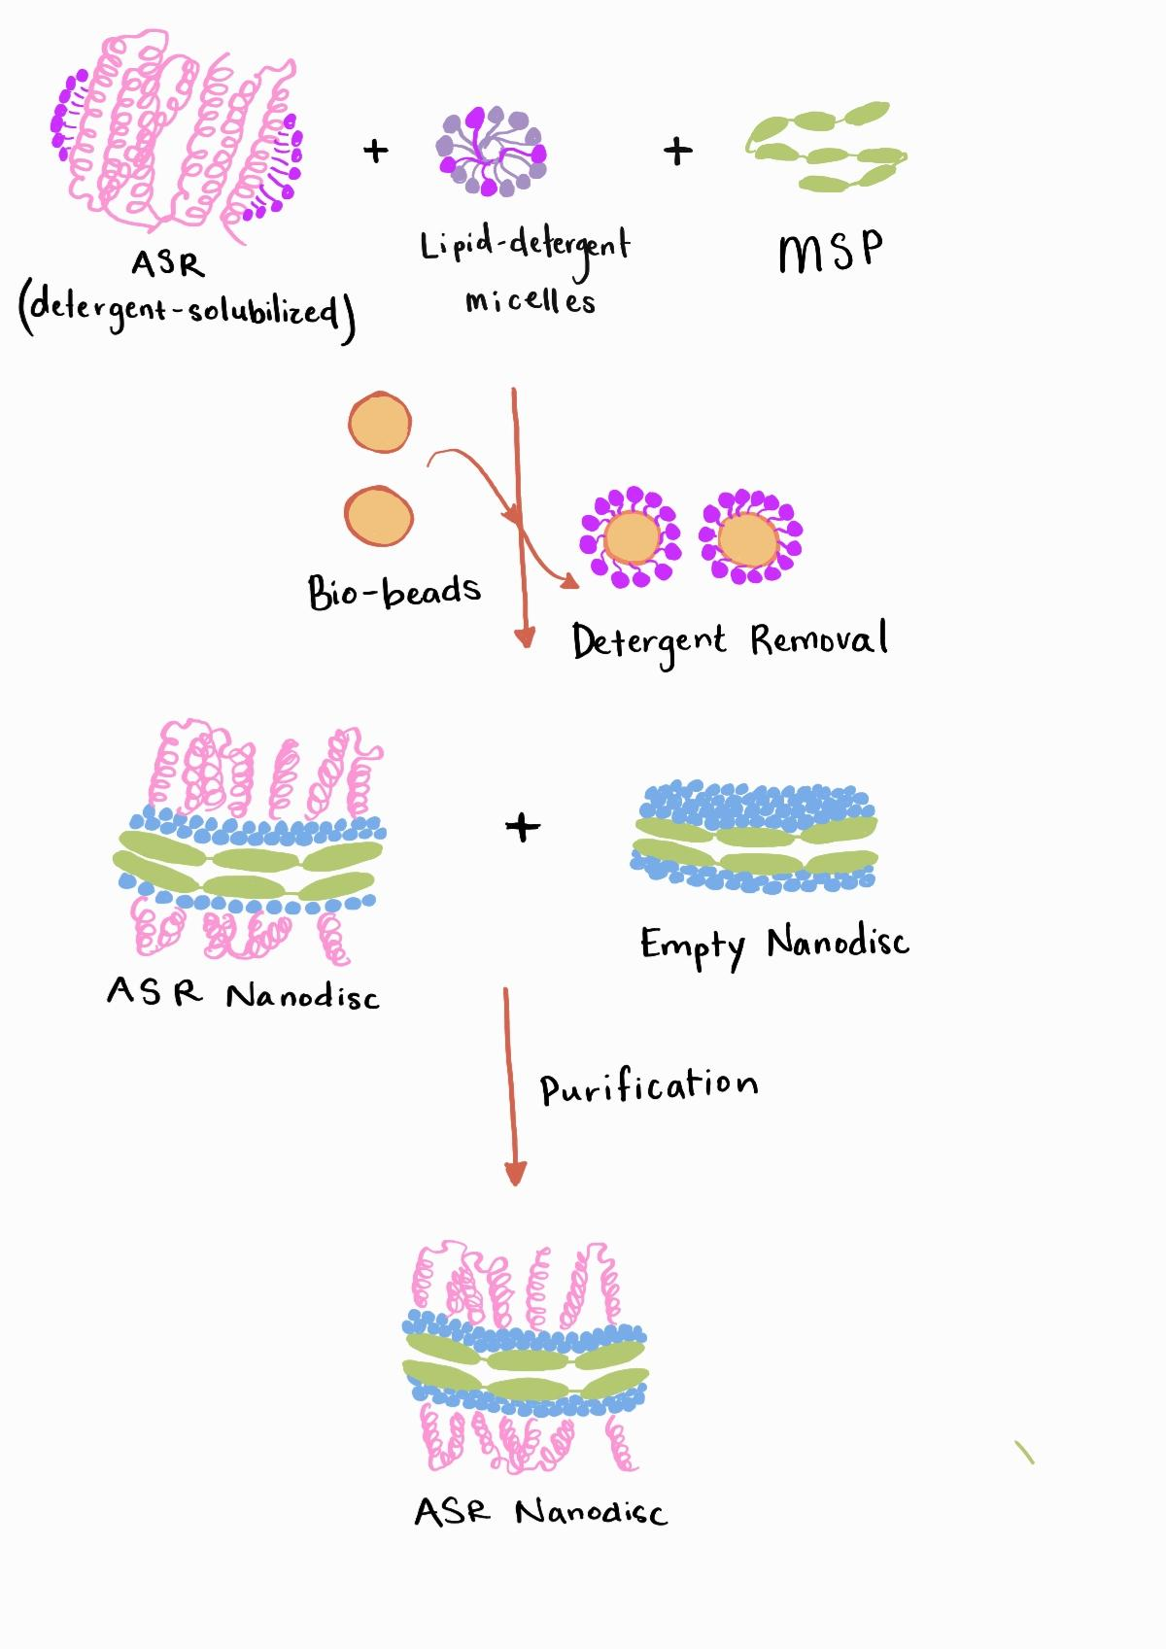
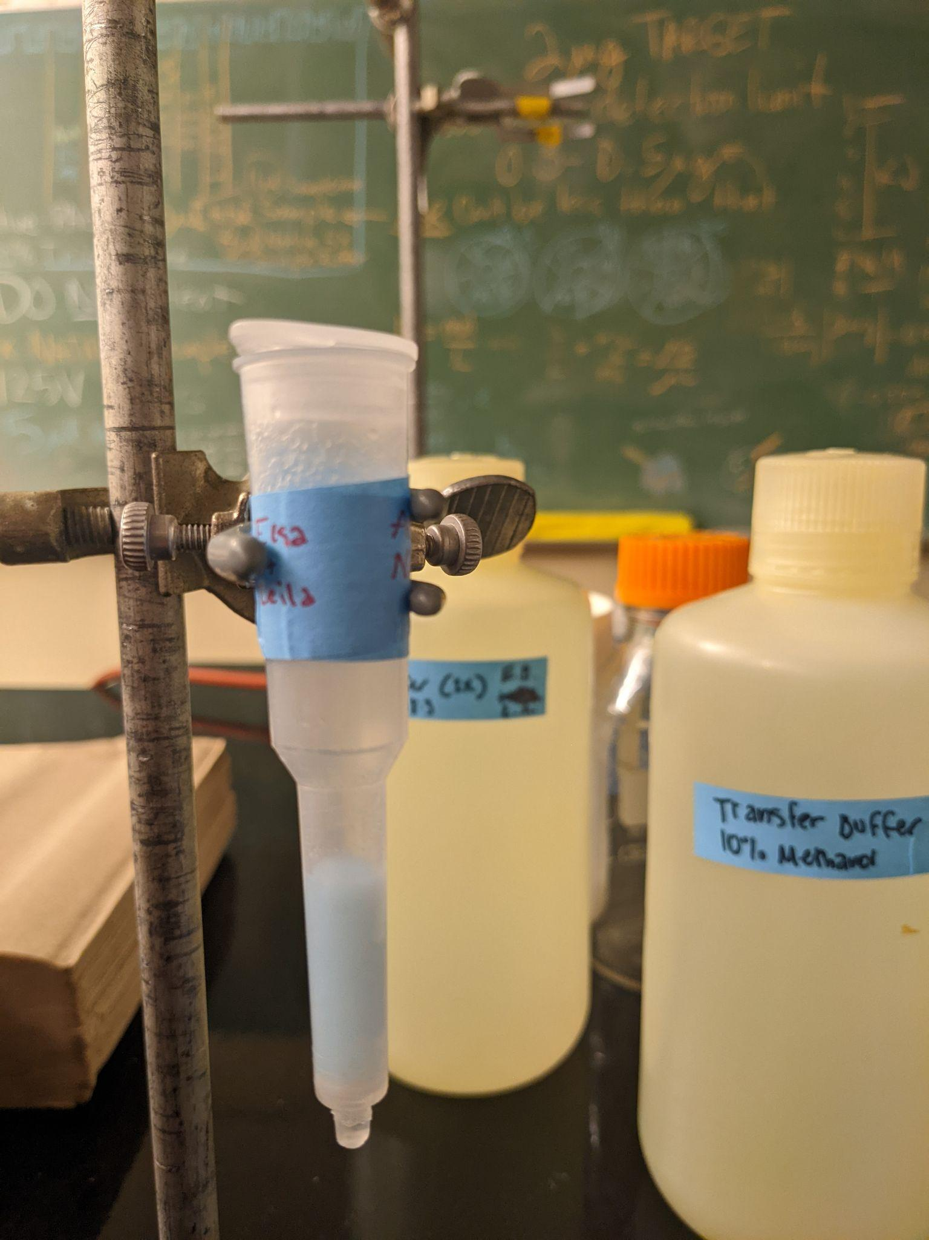
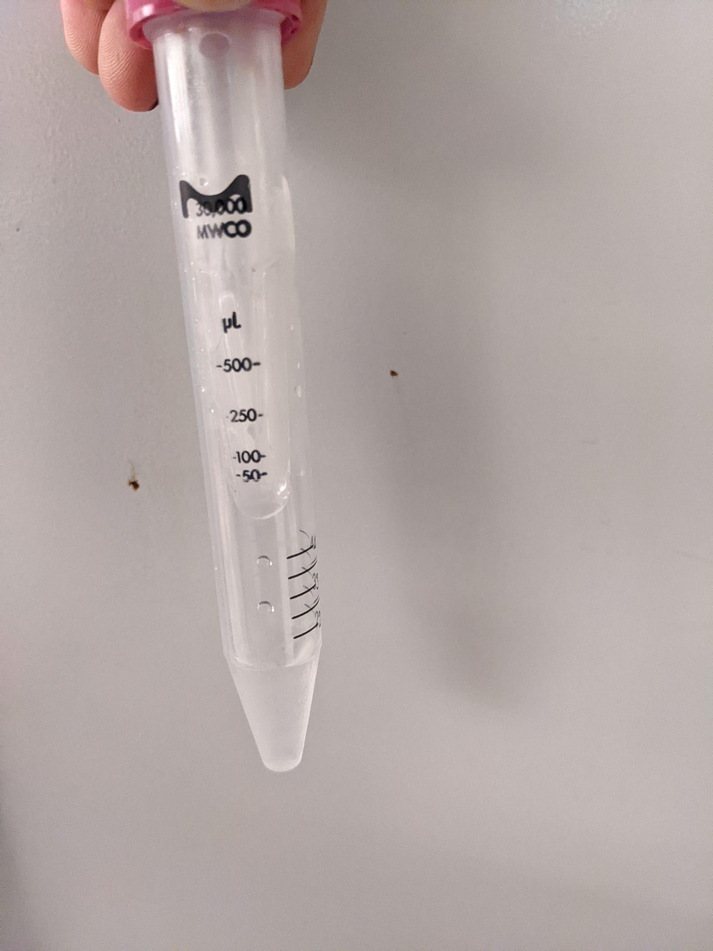
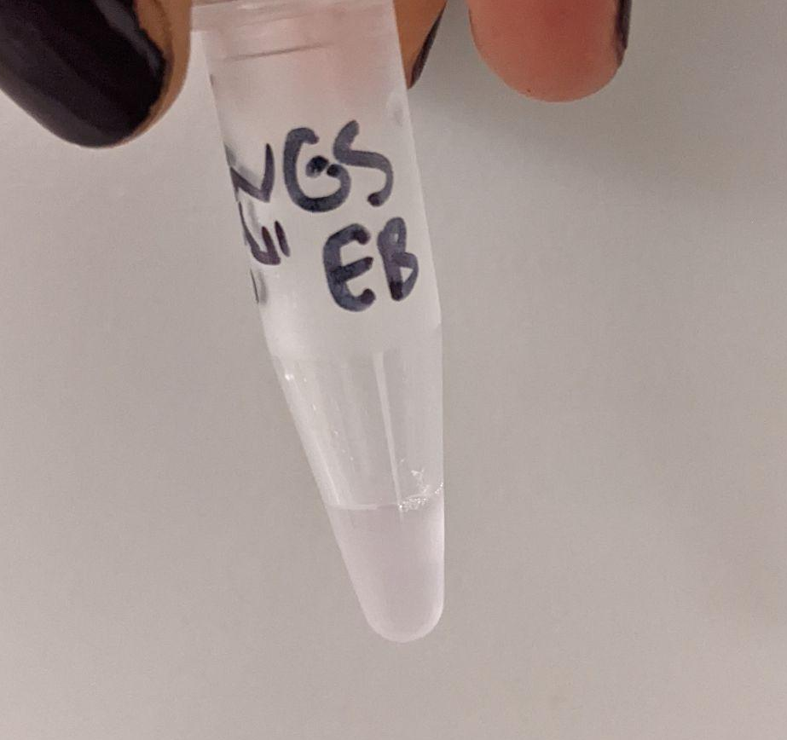
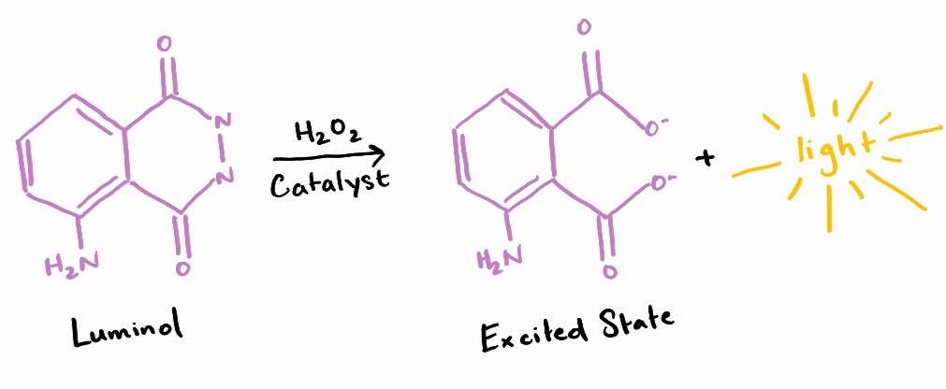
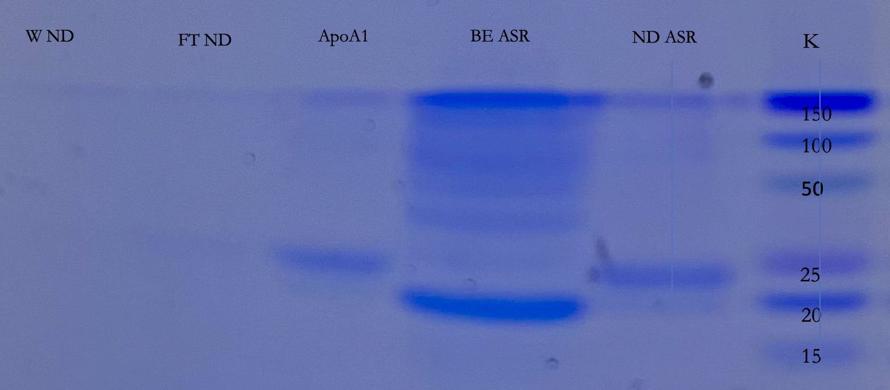
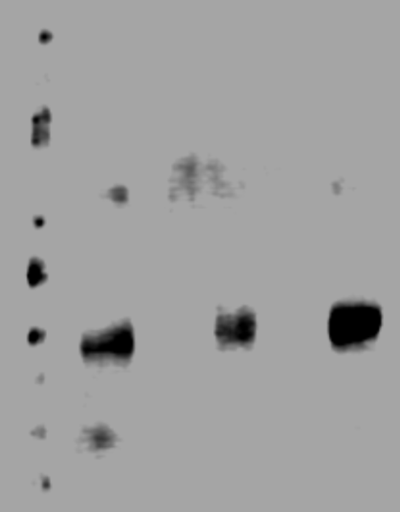
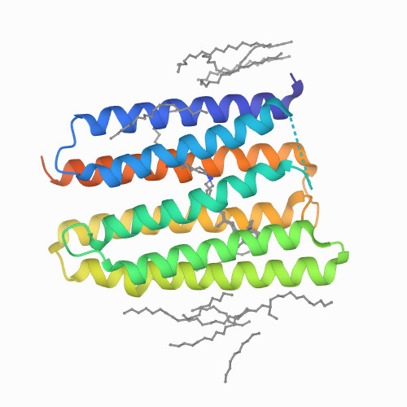
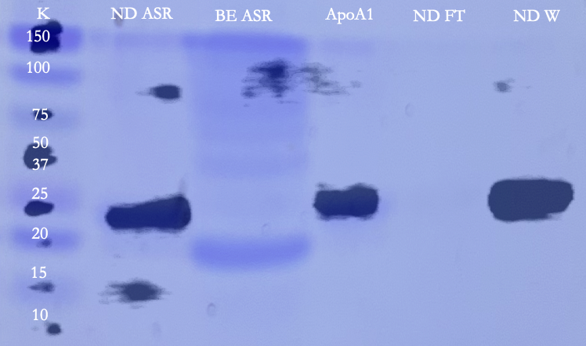
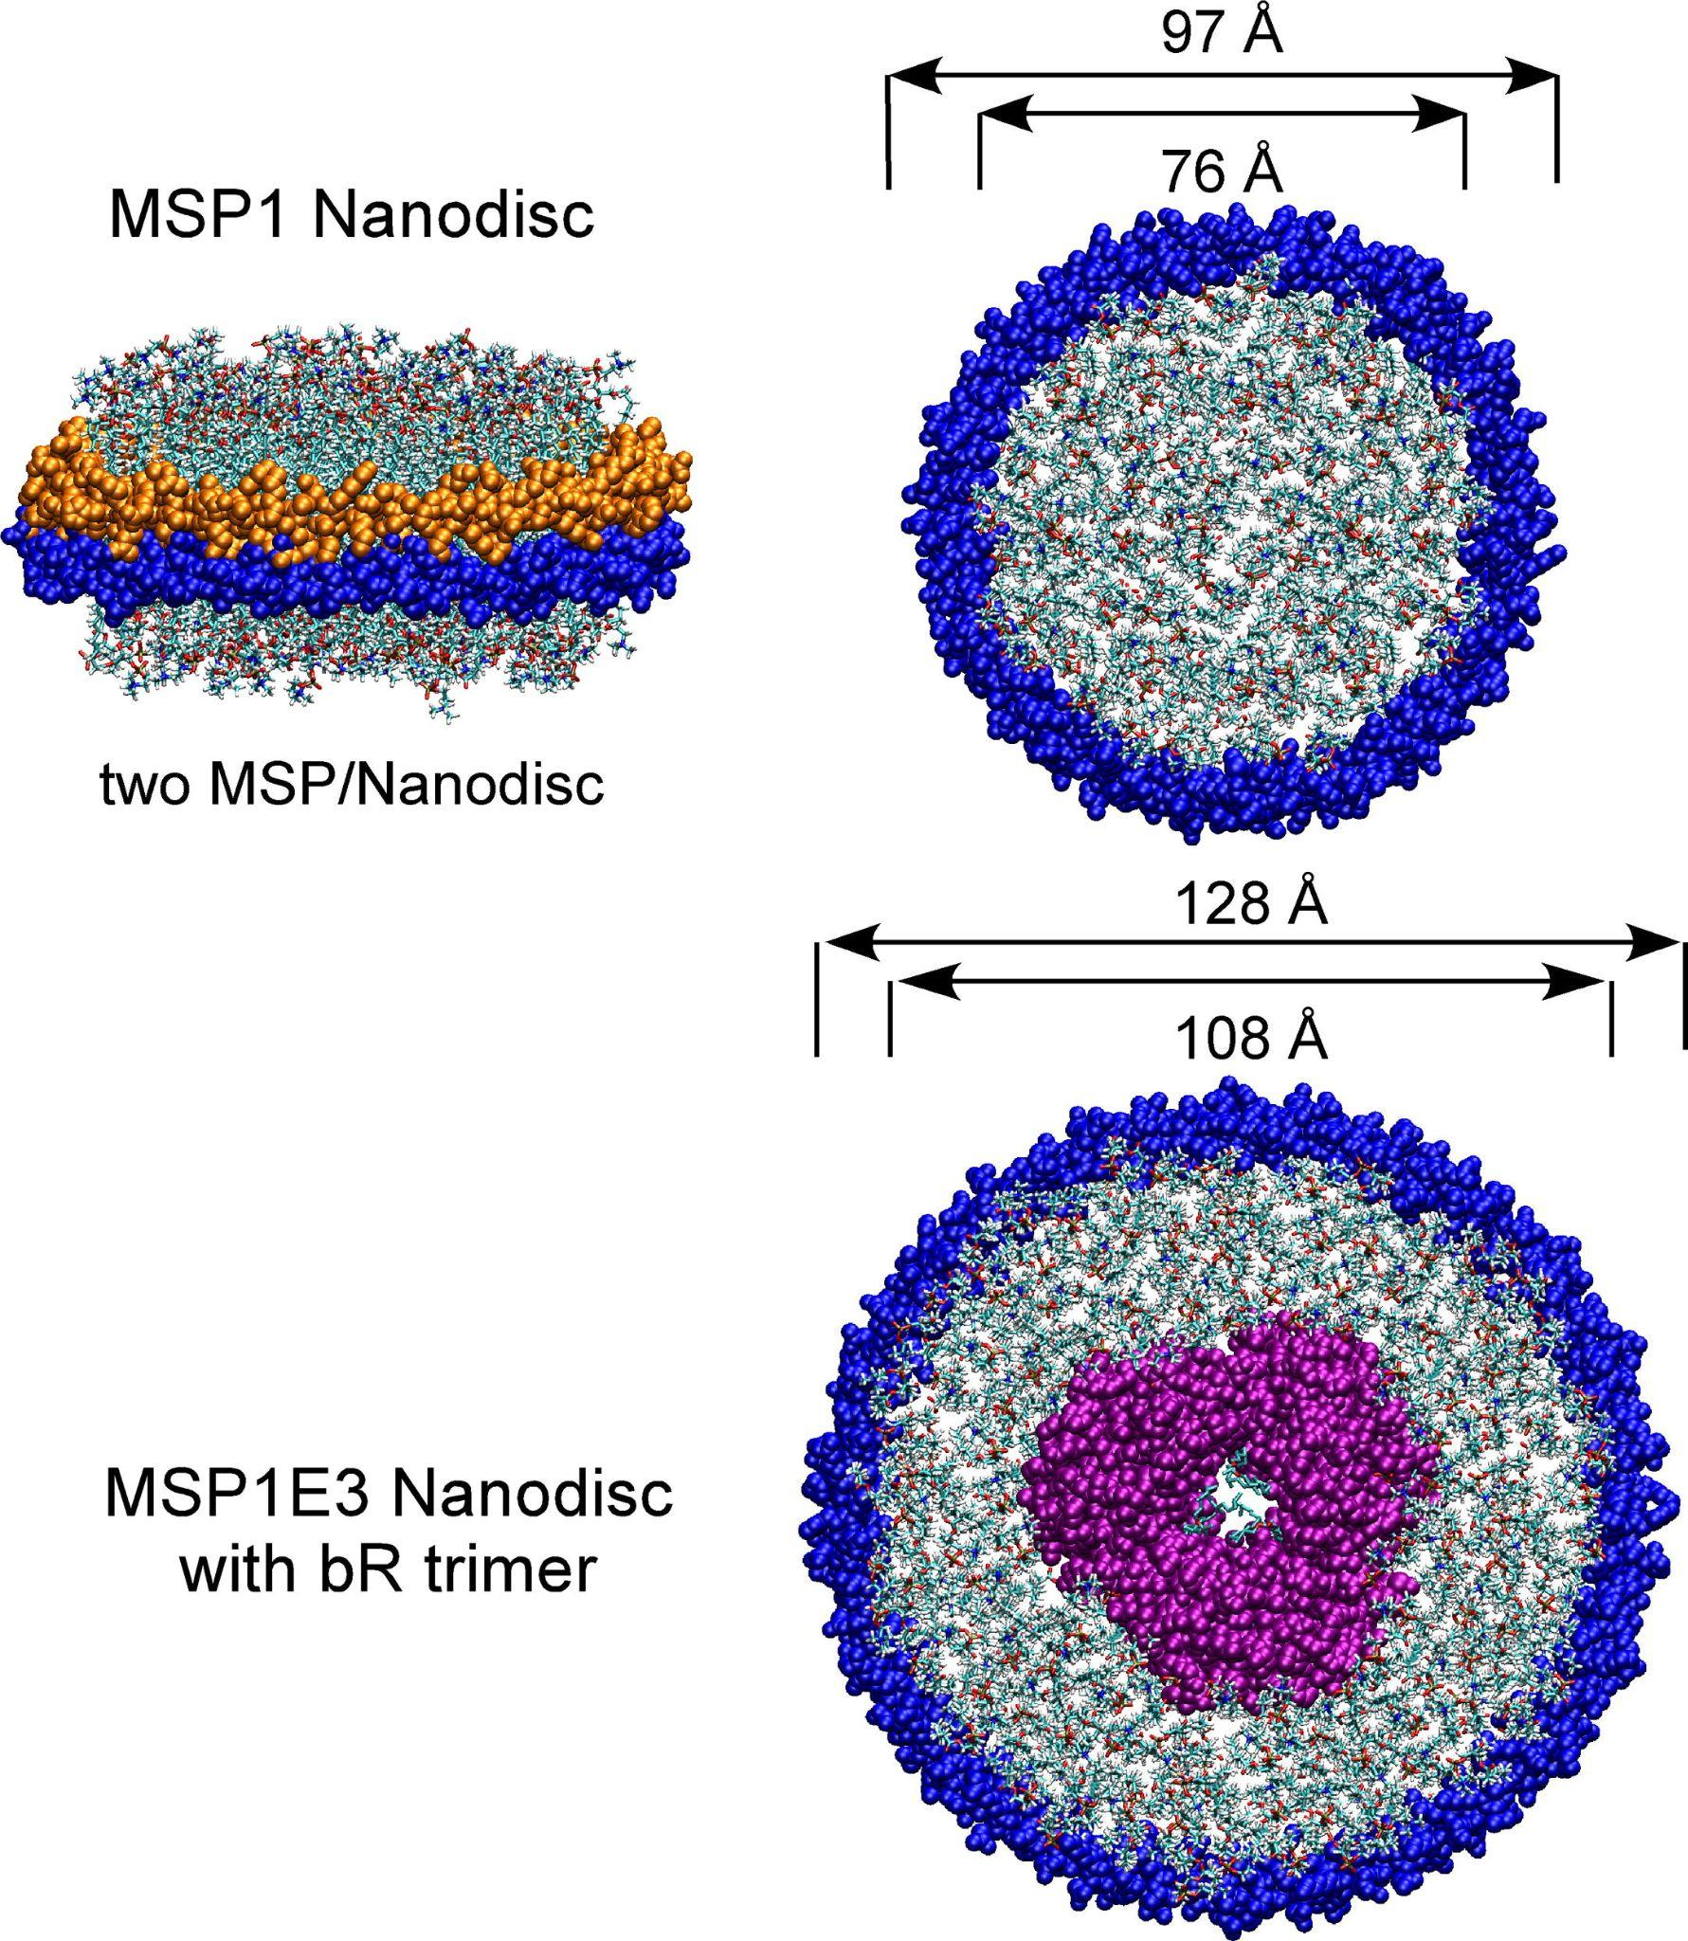
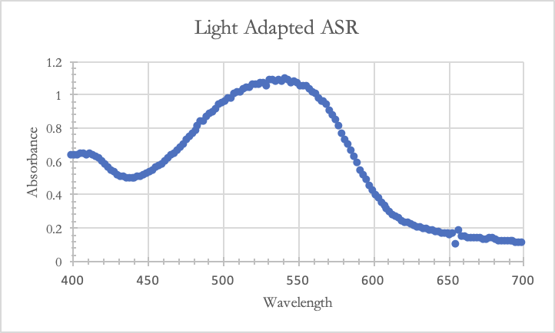

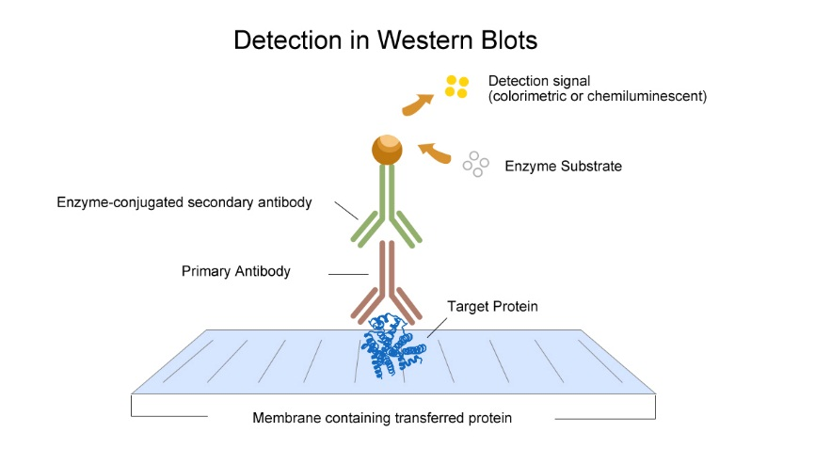
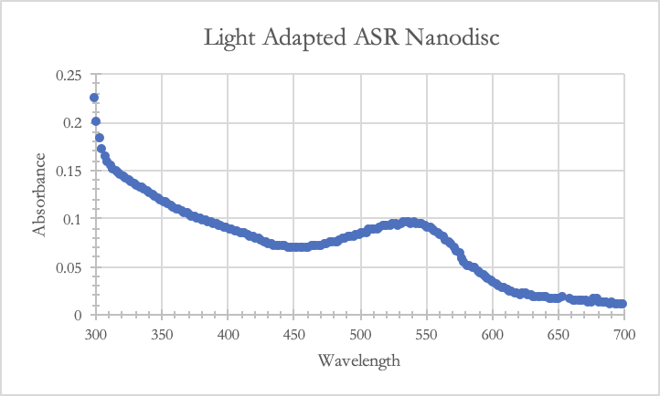
ASR Membrane Protein and ApoA1 Detection in Nanodisc via Western Blot Analysis
Department of Chemistry
Biochemistry
Leila Amrani, Elsa Balfe, Dr. Jeffrey Schineller¹, Dr. Jenny A. Cappuccio¹
¹ CHEM 435L - Biochemistry II Lab - Department of Chemistry, Humboldt State University, Arcata, CA, USA
Abstract
0
Methods
Results
Anabaena sensory rhodopsin (ASR), originally isolated in a cyanobacterium currently known as Nostoc, is a photoreceptor within the G protein coupled receptor (GPCR) family. Since GPCRs are embedded into the lipid membrane and contain both hydrophilic and hydrophobic regions, it is difficult to study their native activity. Nanodiscs serve to create an environment where membrane proteins can be stabilized and activated in a natural amphipathic environment. In the present study, 6x-His ASR was isolated, purified by Ni-NTA affinity chromatography, and assembled into a lipid rich nanodisc with the ApoA1 scaffold protein and DMPC lipid. The purified ASR and purified ASR nanodisc was studied by spectral, SDS-PAGE, and chemiluminescent western blotting analysis. Here we report that the ApoA1 scaffold protein was successfully detected in the ASR nanodisc. By SDS-PAGE, we found that our buffer exchanged ASR nanodisc was composed of ApoA1 scaffold protein (26.56 kDa) and that a less prominent band for ASR (18.26 kDa) was present. A distinctive and sharp band was observed for buffer exchanged ASR (18.26 kDa), suggesting presence of the protein. By chemiluminescent western blotting with the primary Anti-ApoA1 and secondary HRP antibodies, we detected chemiluminescence in our ASR nanodisc and our wash nanodisc aliquot from Ni-NTA purification. These results suggest that ApoA1 has been successfully inserted into the ASR nanodisc, although more evidence is required. Further studies would include conducting a Natve-PAGE with anti-ApoA1 to observe liposomal fractions. Additionally, next steps include detection of ASR via chemiluminescent western blotting using an anti 6x-His tag primary antibody and HRP conjugated secondary antibody. We desire to further investigate adequate construction of the biologically complex nanodisc.
Isolation and Purification of ASR Protein
SDS-PAGE of Ni-NTA Purified ASR & ASR ND Samples
Western Blot of Ni-NTA Purified ASR & ASR ND Samples
Plasmid containing ASR protein (pET015) transfected into E.coli strain HCe015
Inoculated 200 mL culture with 2 ml o/n culture & AMP
Induced 200 mL culture with IPTG & cofactor all-trans-retinal
Resuspended pellet in 50 mM Tris, 300 mM
sodium chloride
pH 6.8, 10% glycerol
Purification via Ni-NTA
Immobilized Metal Affinity
Chromatography with DDM
Purified Sample of Anabaena
Sensory Rhodopsin Protein
Nanodisc Assembly, SDS-PAGE, & Chemiluminescent Western Blot
Figure 4. SDS-PAGE of ASR, ApoA1, ASR nanodisc, and aliquots with discontinuous 4-15% gel. From left to right: Wash nanodisc (W ND), Flow through nanodisc (FT ND), ApoA1, Buffer exchanged ASR + DDM (BE ASR), Nanodisc ASR (ND ASR). ASR was recognized in the buffer exchange with prominence at ~18 kDa and recognized faintly in the ASR nanodisc at ~18 kDa, compared to theoretical value of ~18 kDa (Seputiene, 2003). ApoA1 was identified in the ASR nanodisc at ~27 kDa, compared to the theoretical molecular weight of ~29 kDa (Bayley, 2015).
Figure 5. SDS-PAGE Western blot with chemiluminescence detection via Li-Cor C-Digital Machine.. From left to right: ND ASR (ASR nanodisc), BE ASR (Buffer exchanged ASR + DDM), ApoA1, ND FT (Nanodisc flowthrough), ND ASR (nanodisc ASR). Membrane was incubated with the primary Anti-ApoA1 anti-mouse antibody and the secondary goat anti-mouse HRP antibody. Chemiluminescence is detected in the ND ASR, the ND W, and the control ApoA1. As expected, there is no chemiluminescence in BE ASR.
Introduction
luminol
SDS-PAGE: Denaturing Gel Electrophoresis
peroxide
SDS-PAGE & Western Blot Overlaid
Anabaena Sensory Rhodopsin (ASR)
Lipid Rich Nanodisc Assembly using SM-2 Biobeads for Detergent Removal
Purification via Ni-NTA
Immobilized Metal Affinity
Chromatography
Buffer Exchange into
TBS (10 mM Tris, pH 7.4;
0.15M NaCl;
0.25 mM EDTA)
Purified Sample of Anabaena
Sensory Rhodopsin in
Nanodiscs
Chemiluminescent western Blot with Apolipoprotein A1 antibody (primary) & goat anti-mouse HRP antibody (secondary)
Western Blot chemiluminescence confirms that secondary goat anti-mouse HRP antibody successfully attached to the primary mouse anti-human ApoA1 antibody
Denaturing gel electrophoresis confirms presence of ApoA1 & ASR
Characteristic band length of ~31 kDa for ApoA1 and ~27kDa for ApoA1 in the ASR nanodisc
Distinctive band length of ~18 kDa for BE ASR and light but distinguishing band length of ~18 kDa for ASR in the nanodisc
ASR is a 32 kDA integral membrane protein with 7 transmembrane α-helical segments. It was originally found and isolated from cyanobacterium Anabaena sp. (now known as Nostoc) PCC 7120.
ASR is a photoactive retinal protein attached by a lysine in the center to a coenzyme, all-trans-retinal. The chromophore retinal undergoes a conformational change from all-trans-retinal to 13-cis-retinal when exposed to orange light. The change reverts back when the chromophore is exposed to blue light.
This protein function allows the cyanobacterium to undergo chromatic adaptation, meaning it alters the composition of the psychobilisome complex, which harvests light, in response to light quality.
ASR is associated with a transducer protein (ASRT). These two proteins work in conjunction to create a photo-dissociable complex that is sensitive to orange light.
Figure 1. Flow chart of methods used to isolate and purify 6xHis-Anabaena Sensory Rhodopsin form the pET015 plasmid in E. coli, and methods for assembling and purifying nanodiscs. Once the proteins had been run through gel electrophoresis, they were transferred to a membrane where primary and secondary antibodies were used to detect them. WesternSure ® PREMIUM Luminol Enhancer Solution and Stable Peroxide Solution created a chemiluminescent reaction that emitted light waves, allowing for the visualization of the protein on the membrane using the Li-Cor-C-Digital Machine.
Results
Figure 6. SDS-PAGE with discontinuous 4-15% gel overlaid with the SDS-PAGE Western blot. From left to right: Nanodisc ASR (ND ASR), Buffer exchanged ASR (BE ASR), ApoA1, Nanodisc flowthrough (ND FT), Nanodisc wash (ND W).
Nanolipoprotein Particle (Nanodiscs)
Spectral Characterization of 6x–His ASR
Nanodiscs are nanoscale disc-shaped phospholipids held together by a membrane scaffolding protein (MSP).
These components form into soluble phospholipid bilayers that self assemble integral membrane proteins like ASR.
The MSP associated with nanodiscs is the Apolipoprotein AI (Apo AI). It is an amphipathic helical scaffold protein that wraps itself around the edges of the disc structure to form a “belt-like” configuration.
Nanodiscs are ideal for isolating membrane proteins because they have a defined size, a controlled phospholipid composition, and it can be tailored to suit the membrane protein of interest.
Other advantages of using nanodiscs include that they are a native bilayer unlike vesicles and micelles and that they encourage more efficient protein folding where both then N-terminal and C-terminal are accessible for cell signaling.
Conclusions & Future Work
Conclusions:
ASR was successfully isolated, purified, and characterized by spectral analysis
ASR was successfully identified in the buffer exchanged sample by spectral and SDS-PAGE analysis
ASR identification in the nanodisc was apparent but not to a satisfactory degree, therefore greater concentration of ASR is recommended in future experiments
As expected, ApoA1 was confidently identified in the ASR nanodisc by SDS-PAGE and Western blot analysis by use of primary and secondary antibodies
Figure 7. QR code with additional information and results. Interested in finding out more information about our project? Want to see future work contributed to this project? Scan this QR code to access a supplementary document with more details.
Figure 2. Light adapted ASR spectral data after buffer exchange. The absorbance at 544 nm was baseline corrected and the concentration was determined by Beer’s law to be 1.07 E -4.
Future Work:
Assemble lipid lean nanodiscs for comparison to lipid rich
Conduct SDS-PAGE Western blot with primary anti-6x His tag and secondary HRP conjugated antibody to confirm the presence of ASR
Conduct non-denaturing Native-PAGE Western blot with primary anti-ApoA1 antibody and secondary HRP conjugated antibody to identify ApoA1 presence in absence of liposomes
Conduct non-denaturing Native-PAGE Western blot with primary anti-6x His tag and secondary HRP conjugated antibody to identify presence of ASr in the nanodisc in the absence of liposomes
Spectral Characterization of 6x-His ASR in a Nanodisc
Primary and Secondary Antibody Detection
The main principle of the Chemiluminescent Western blot technique is to use primary and secondary antibodies to detect a specific protein from a sample.
The protein of interest (Apo A1) is first transferred to a membrane using an electric field that moves the protein from the SDS-PAGE gel into a membrane.
The membrane gets washed with primary antibody that is specific to the protein of interest, now transferred to the membrane.
The primary antibody binds to the protein and the remaining solution gets washed away. Then the secondary antibody solution, specific to the primary and tagged with an enzyme substrate, is placed on the membrane to bind the the primary antibody.
The tagged antibody with the enzyme substrate undergoes chemiluminescence detection to produce a light signal that identifies the protein of interest.
CSU-LSAMP is funded through the National Science Foundation (NSF) under grant #HRD-1302873 and the Chancellor's Office of the California State University. CSU-LSAMP is funded through the National Science Foundation (NSF) under grant #HRD-1302873 and the Chancellor's Office of the California State University.
Acknowledgments
References
Graham R. Bayly, et al. (2014). Lipids and disorders of lipoprotein metabolism, Clinical Biochemistry: Metabolic and Clinical Aspects (Third Edition), 702-736
CIRM Bridges 3.0 #EDUC2-12620
Dr. Brigitte Blackman
Dr. Amy Sprowles
Ghennya Shein
Seputiene V, Motiejūnas D, Suziedelis K, Tomenius H, Normark S, Melefors O, Suziedeliene E. (2003). Molecular characterization of the acid-inducible asr gene of Escherichia coli and its role in acid stress response, J Bacteriol, 185(8):2475-84.
Vogeley, L., Sineshchekov, O. A., Trivedi, V. D., Sasaki, J., Spudich, J. L., & Luecke, H. (2004). Anabaena sensory rhodopsin: a photochromic color sensor at 2.0 A. Science (New York, N.Y.), 306(5700), 1390–1393. https://doi.org/10.1126/science.1103943
Figure 3. Spectra of light adapted 6x His-ASR Nanodisc after purification. The concentration of the ASR nanodisc was determined by Beer’s law to be 1.76 E-6
Bayburt, T. H., & Sligar, S. G. (2010). Membrane protein assembly into Nanodiscs. FEBS letters, 584(9), 1721-1727.
Principles for Western Blot. Elabscience. (2017, June 24). Retrieved April 24, 2022, from https://www.elabscience.com/List-detail-306.html

