Slide 1
American Sign Language Coloring Book

Slide 2
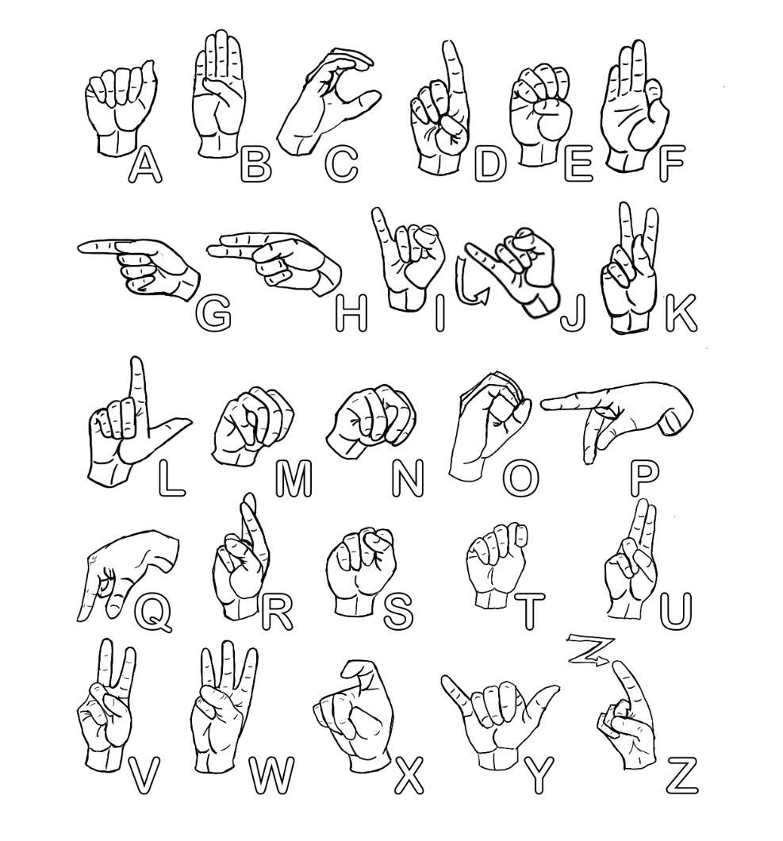

Slide 3
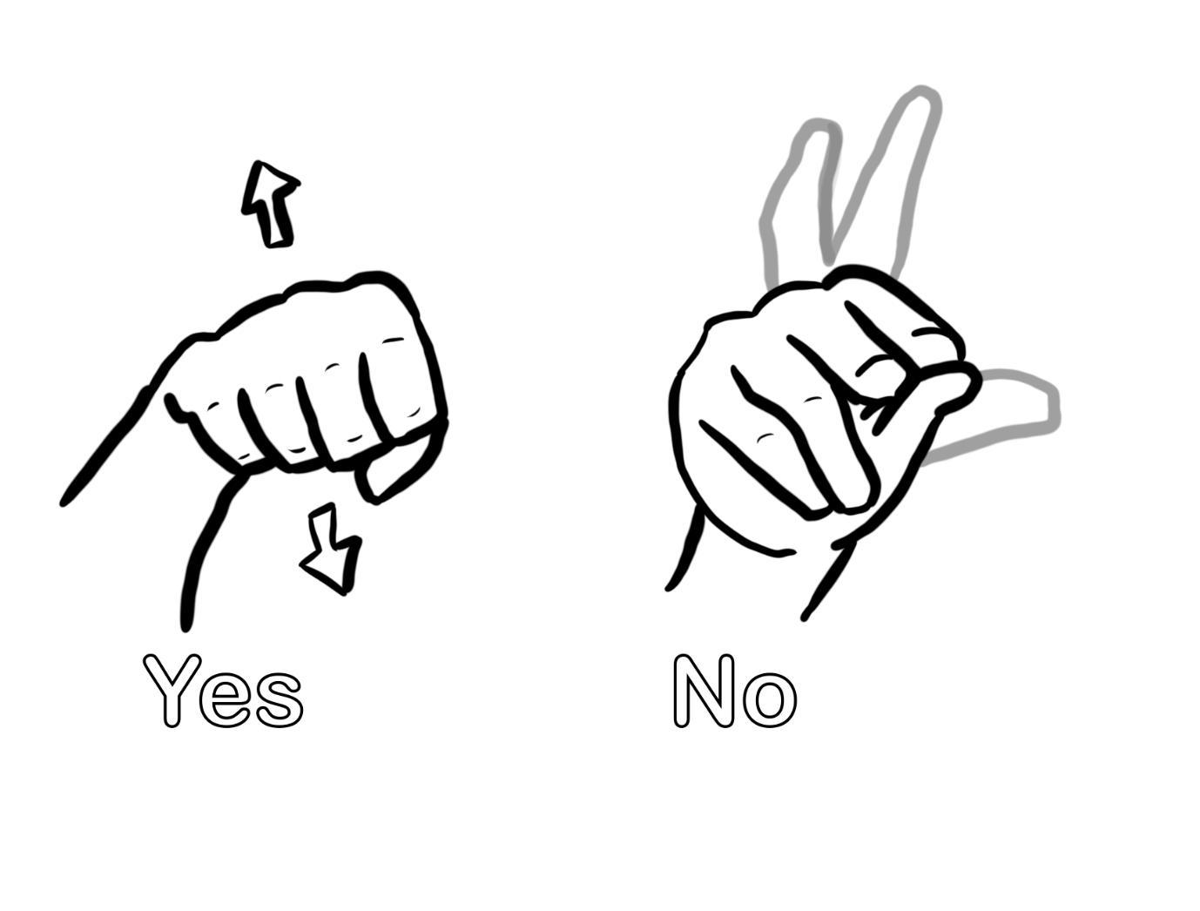

Slide 4


Slide 5

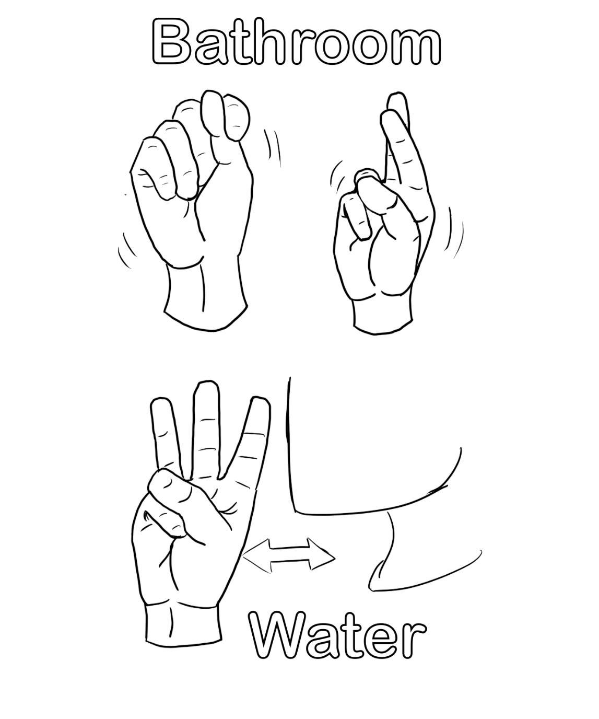

Slide 6
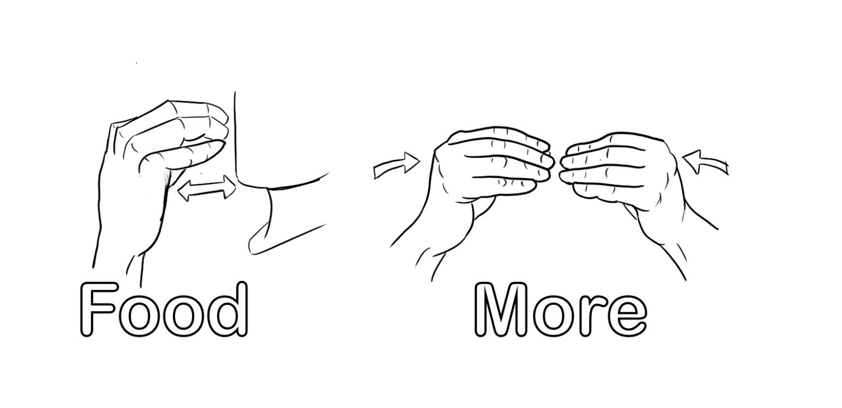

Slide 7
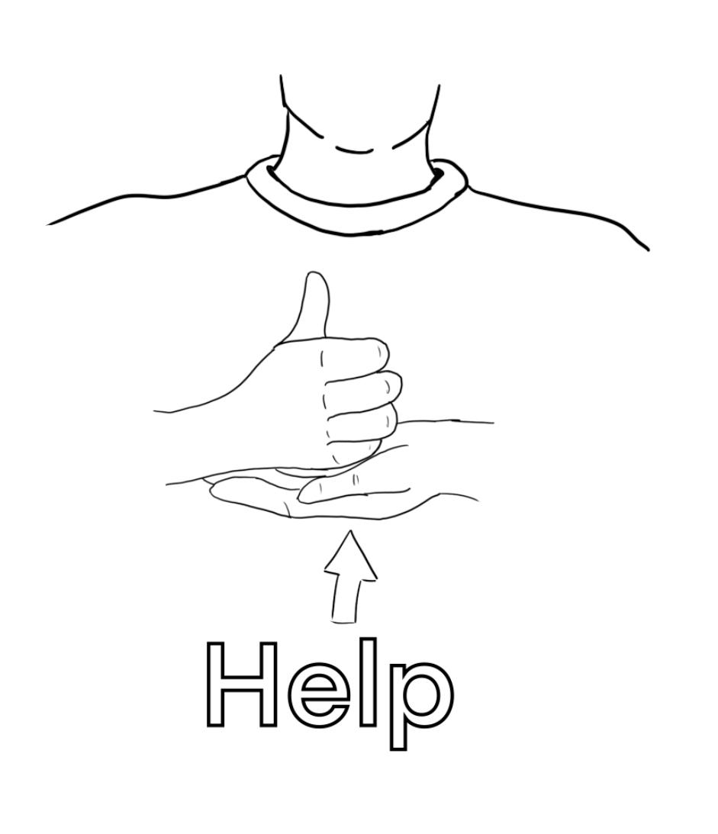
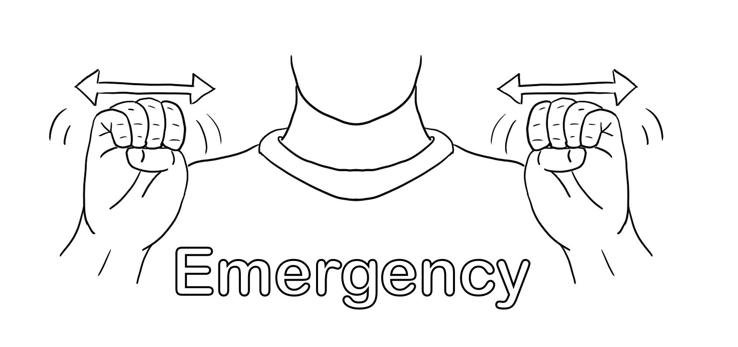

Slide 8
Information about American Sign Language
American Sign Language is a complex language that uses signs made with hands, body movements, positions of the body, and facial expressions. In 1817, Thomas Hopkins Gallaudet and Laurent Clerc introduced French Sign Language and established the first school for the deaf in Hartford, Connecticut. American Sign Language is based on French Sign Language, although they are very similar they can not be comprehended by each other. There are over 300 different sign languages used all over the world. Even within the same state, there are different accents within signs that cause variations within the regions. Although American Sign Language and English are very similar they use different grammar structures, punctuations, and order within a sentence. Deaf culture and community have a set value of beliefs and traditions which is influenced by deafness and using a form of sign language to communicate. Deaf people are proud to be deaf and have their own unique form of communication.

