Slide 1
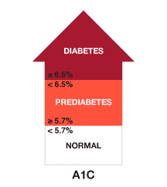
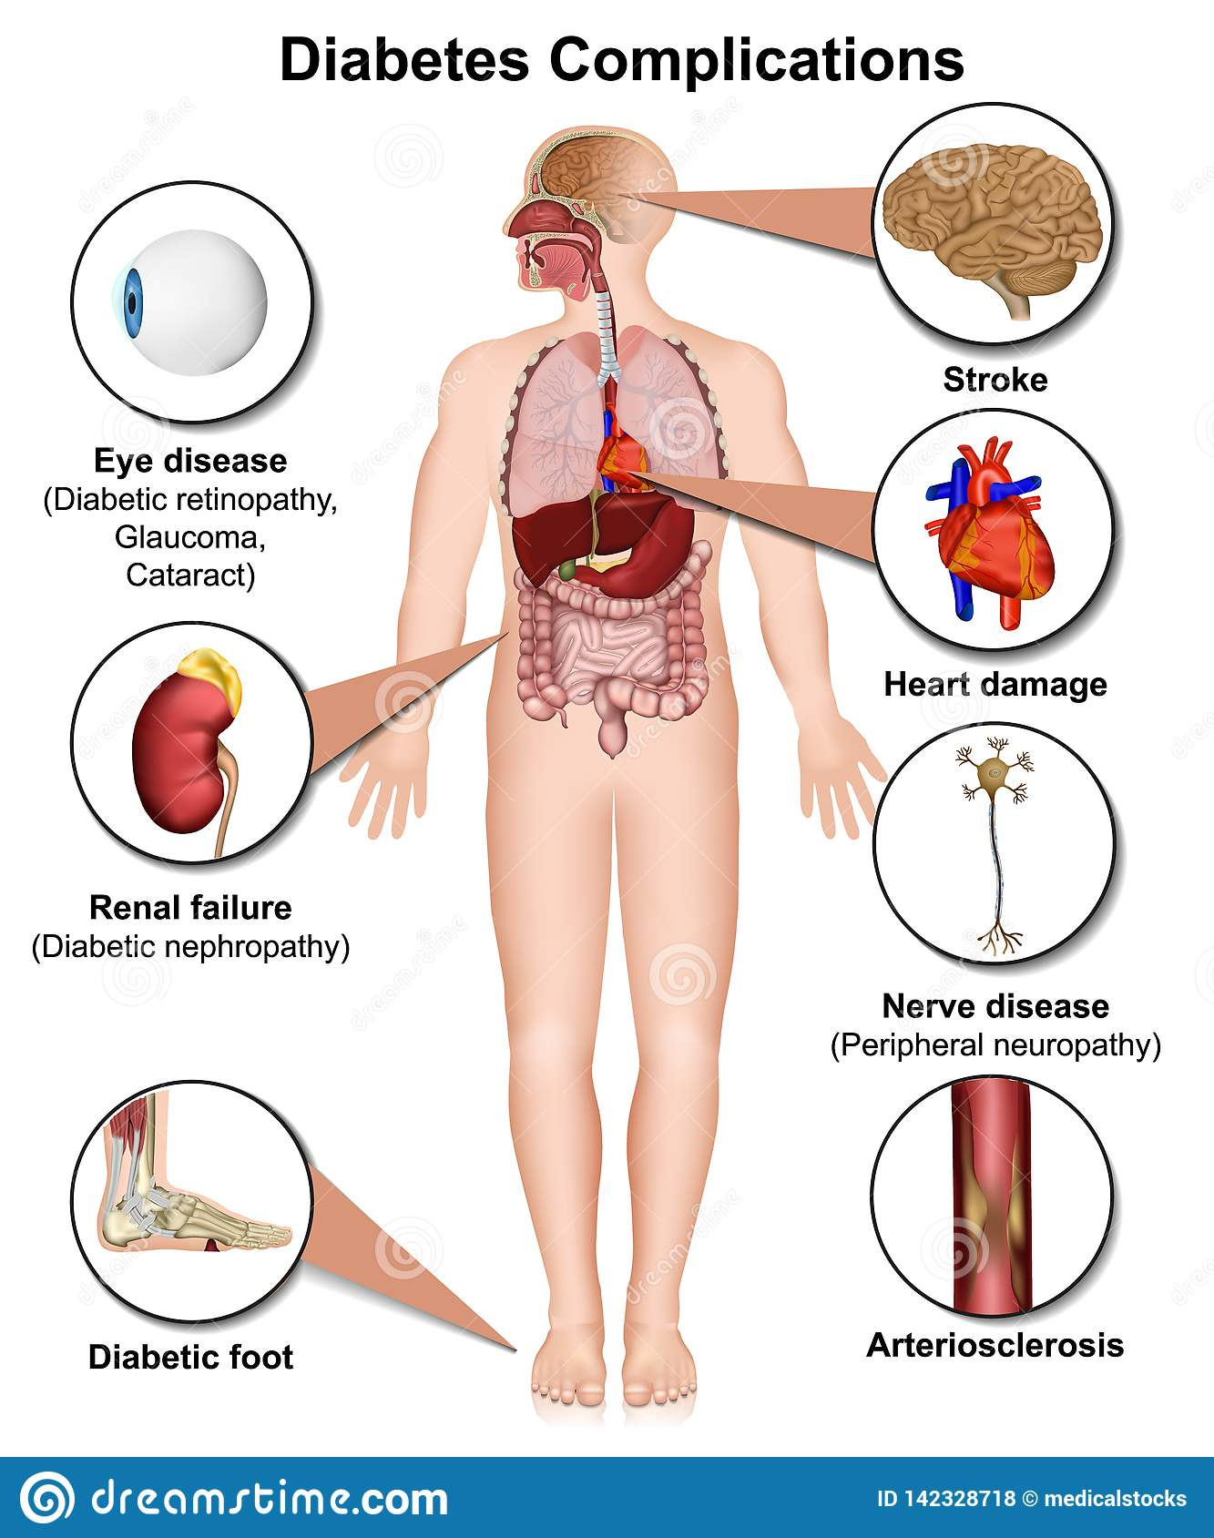

Targeted Education and Monitoring to Reduce
Diabetes Complications in Spanish-Speaking Patients on the North Coast
Background
Key Concepts & Outcomes
Key Players
Many Spanish-speaking patients (Pts) have type 2 diabetes and inconsistent follow-up with health care providers and increase their A1C level can result in unfavorable health outcomes.
Spanish-speaking patients with diabetes generally:
have less access to preventive care due to poverty, culture/language barriers
are underinsured (20% of pts with diabetes have no form of insurance)
have low income (35% of Hispanic pts with diabetes are “poor or near poor”)
do not get treated until in critical stage (Lai et al., 2017).
Goal: for Spanish-speaking Pts. with type 2 diabetes to have continuity of care, thus self-managing diabetes, reducing ER visits by 80% by 2025.
Goal: after diabetes education and A1C monitoring, Pts achieve <7% A1C levels in the first 6 months, have fewer diabetes complications.
Growing low income, underinsured Spanish-speaking population in Humboldt County. Many of these Spanish-speaking persons have type 2 diabetes (Humboldt County Department of Health & Human Services, n.d.; Lai et al., 2017).
Other players:
CGM manufacturers
CHWs
primary care providers
nurses
(American Diabetes Association, n.d.)
Interventions & Solutions
Evaluation
Importance of Issue
Process Evaluations
Electronic medical record (EMR) tracks all Pt. attendance at follow up appointments
CHWs delivered all sessions on schedule
Impact Evaluations
Pts’ A1C will remain under 7%
Pts’ attendance will help keep blood glucose stable
Interviews & surveys showed 80% of health care providers are interested in cultural humility and CGM training
Patients who do not get the proper treatment or have not controlled their diabetes end up in the hospital because of diabetes complications.
Spanish-speaking people with diabetes have worse health outcomes than the rest of the population because of health inequities.
Nurses need to:
practice cultural humility
provide patient- centered care
advocate for patient’s resource needs for optimum diabetes management.
By doing this, nurses are addressing the social determinants of health.
Individual: Pt. will schedule follow up appts with clinician in 2 weeks, 3 months, and 6 months with the goal to reduce A1C levels below 7%.
Community: Community health workers (CHWs) will teach 30 minutes about self-management of diabetes; nurses will teach usage of continuous glucose monitoring (CGM) during each visit for a 6-month period.
Policy: Clinic will adopt policy requiring all nurses to receive 3 hours of training on CGM usage and 2 hours of cultural humility training for all health providers.
Table 1
References
(Diabetes Complications Illustrations & Vectors, n.d.)
Intervention | Cause | Effect
Follow-up PCP | Scheduling appointment | Pt receives greater care
Patient education | Culturally competent and language appropriate delivery | Pt has greater understanding
A1C monitoring | More data on blood glucose | Fewer diabetes complications
American Diabetes Association. (n.d.). Understanding A1C: Diagnosis. https://www.diabetes.org/diabetes/a1c/diagnosis
Diabetes Complications Illustrations & Vectors. (n.d.). https://www.dreamstime.com/illustration/diabetes-complications.html
Humboldt County Department of Health & Human Services. (n.d.). 2018 Humboldt County community health
assessment: Data for planning and policy making. https://humboldtgov.org/DocumentCenter/View/71701/2018-Community-Health-Assessment-PDF
Lai, L.L., Alfaifi, A. & Althemery, A. (2017). Healthcare disparities in Hispanic diabetes care: A propensity score-matched study. Journal of Immigrant and Minority Health 19, 1001–1008. https://doi-org.ezproxy.humboldt.edu/10.1007/s10903-016-0505-0
Melnyk, B. M., & Fineout-Overholt, E. (2019). Evidence-based practice in nursing & healthcare: A guide to best practice (4th ed.). Wolters Kluwer.
Framework
The Iowa Model guides nurses in implementing evidence-based practice (EBP) research, helping to improve patient care. This model best aligns with the diabetes self-management education because nurses can:
address an important clinical issue through EBP process
form a team who develops, evaluates and implements EBP
decide if EBP change is necessary (Melnyk & Fineout-Overholt, 2019)
In this instance, the problem is described in the Background section above.
Table 1 describes cause and effect as applied to this project.→
Basilia López García, RN-BSN nursing student 2020-2022

