Slide 1
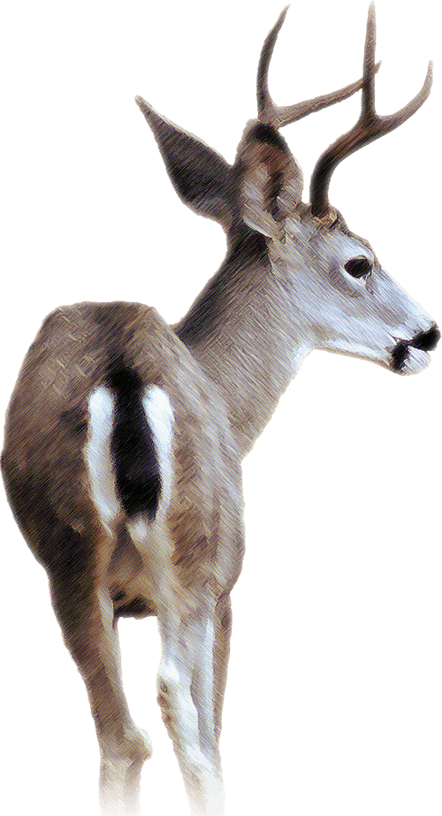

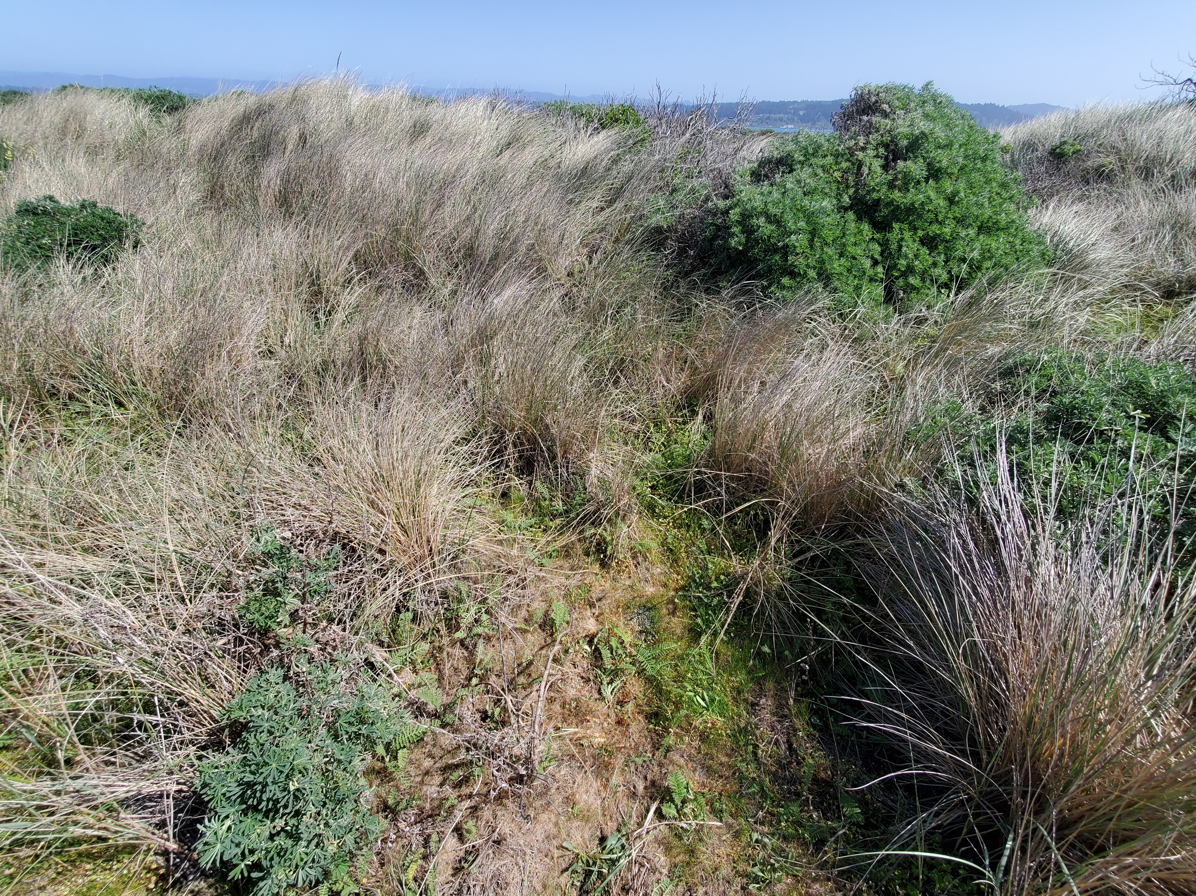
The influence of lupine (Lupinus arboreus) on habitat selection by black-tailed deer (Odocoileus hemionus) in coastal dunes
Ray Turner - Cal Poly Humboldt, Dept. of Wildlife
raykeaneturner@gmail.com
    Introduction
    Invasive plants in dune systems (Figure 1) pose a threat to native fauna and flora (Pickart et al. 1998). Ruminant habitat selection plays an important role in plant community composition and invasion (Averill et al. 2018).
    Plant invasion in California’s dunes is in part facilitated by the shade and nitrogen-fixing effects of coastal lupine (Lupinus arboreus, hereafter lupine) (Maron and Connors 1996). Indirect effects of ruminant herbivory on lupine have been shown to increase rate of nitrogenization in coastal dune soil (McNeil and Cushman 2005).
    In this study, I hypothesized that deer would select for food plants and proximity to lupine. I expected to see deer use concentrated in areas with food plants near lupine shrubs.
  Methods
  I followed a use vs. availability study design with deer pellets representing use. I located deer pellet piles and measured habitat characteristics in a 2x2m quadrat, as well as the characteristics of the nearest lupine shrub. These measurements were repeated in a random paired plot (random bearing and distance). Use plots were included upon a coin flip in order to randomize plots. Data were analyzed using paired t-tests and linear regressions.
Lupinus arboreus
P = 0.028
Ammophila arenaria
    Discussion
    The results of this study suggest that deer select for habitat in close proximity to tall lupine shrubs. Level of use (pellet count) increased with proximity to lupine, though its presence within the plot nor amount of fleshy foliage predicted use. This suggests deer are selecting for converted habitat over presence of lupine, and since browsing damage on lupine was observed, deer likely have a mixed diet in this system. A follow-up study on forage preference within the dune system would help determine whether deer select lupine over other available forage.
    Because deer alter lupine growth, reproduction, and local nitrogen availability (McNeil and Cushman 2005), and deer actively select for lupine, deer may be compounding the effects of lupine to facilitate plant invasion and increase the rate of succession in the coastal dune system.
  Figure 2. Deer (O. hemionus) selected for habitat closer to tall lupine shrubs. * significant difference
    Figure 1. Invasive plants (L. arboreus, Ammophila arenaria) inhabit much of California’s coastal dunes. A pile of deer pellets can be seen in the center.
    Figure 3. Level of deer use was higher near lupine shrubs.
    Results
    Distance from lupine was significantly different between use and random plots (Figure 2, t = -2.83, df = 46, P < 0.01). Height of lupine within plots also differed between use and random plots (Figure 2, t = 3.05, df = 46, P < 0.01). Deer use was negatively correlated with distance from lupine (Figure 3, R² = 0.61, n = 96, P < 0.05). Percentage cover of lupine did not differ between use and random plots (t = 0.20, df = 47, P = 0.42).
    Acknowledgments:
    Sean Mahoney- Project Advisor and Lecturer, Cal Poly Humboldt
  Literature Cited:
    Averill, K. M., D. A. Mortensen, E. A. Smithwick, S. Kalisz, W. J. McShea, N. A. Bourg, and V. A. Nuzzo. 2018. A regional assessment of white-tailed deer effects on plant invasion. AoB Plants 10:plx047.
    Maron, J. L., and P. G. Connors. 1996. A native nitrogen-fixing shrub facilitates weed invasion. Oecologia 105:302-312.
    McNeil, S. G. and J. H. Cushman. 2005. Indirect effects of deer herbivory on local nitrogen availability in a coastal dune ecosystem. Oikos 110:124–132.
    Pickart, A. J., L. M. Miller, and T. E. Duebendorfer. 1998. Yellow bush lupine invasion in northern California coastal dunes I. Ecological impacts and manual restoration techniques. Restoration Ecology 6:59-68.

