Slide 1


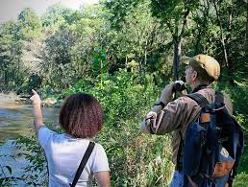
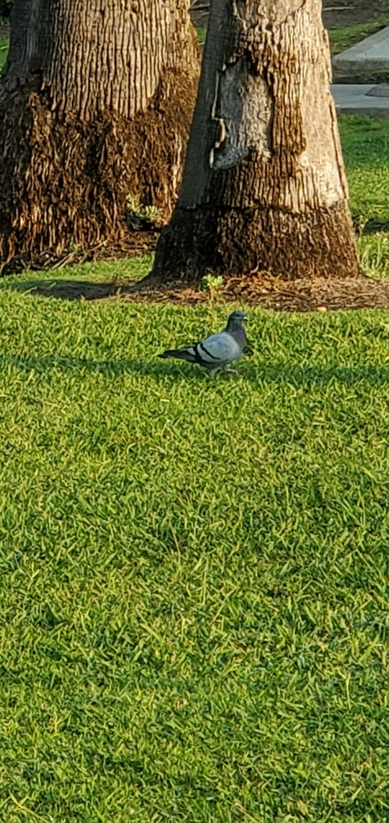
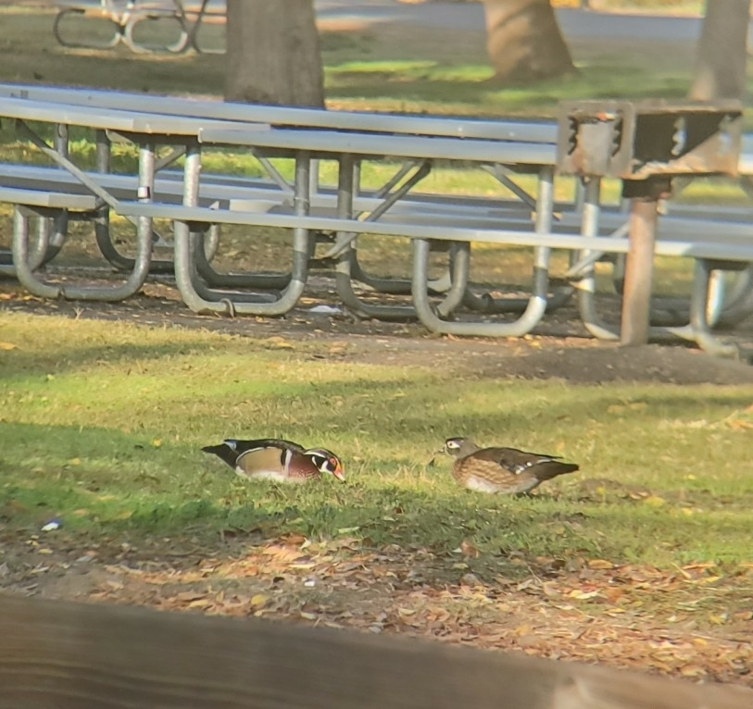
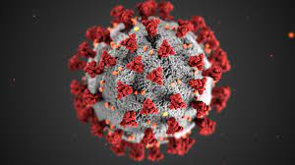


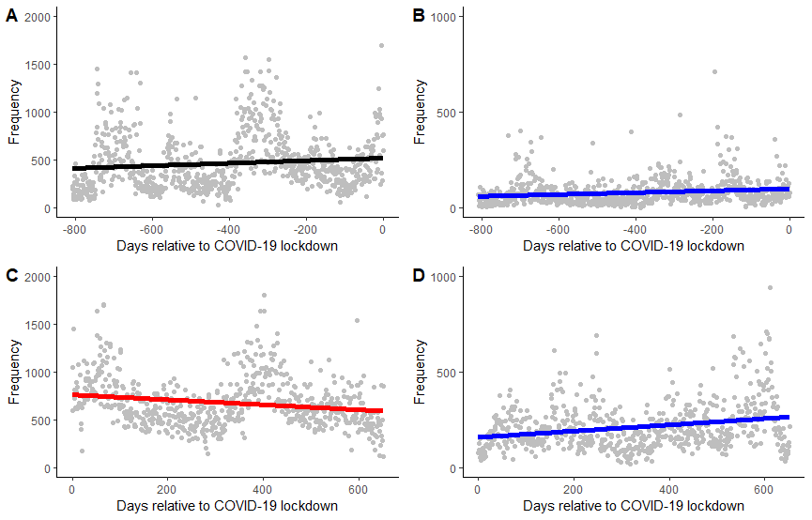
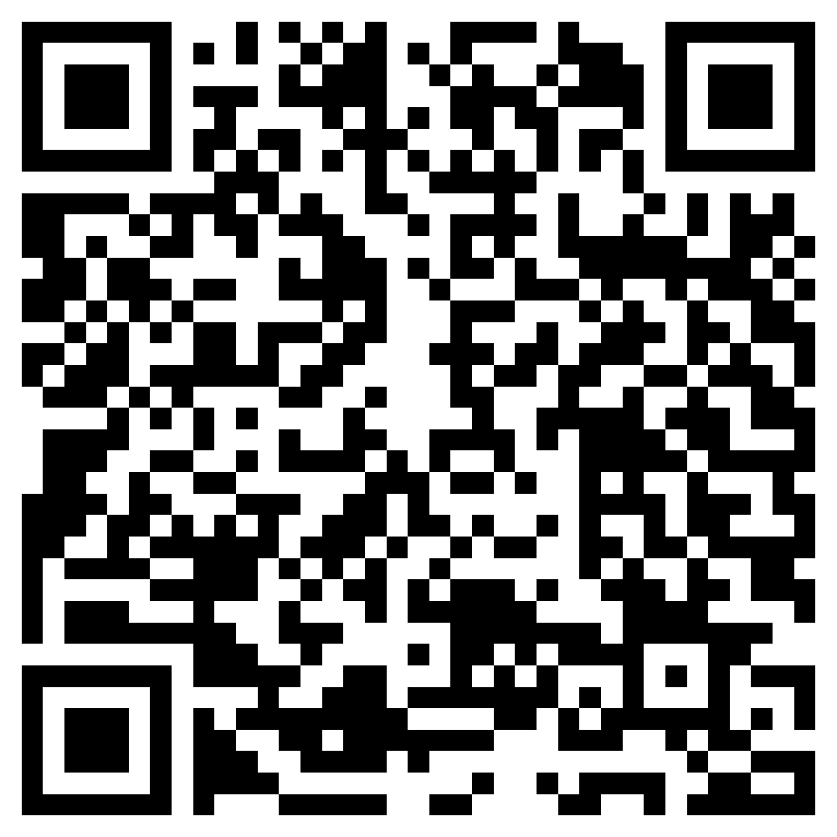
COVID-19 anthropause significantly altered community science participation
Jane Olshefsky
(olshefskyjane@gmial.com)
Department of Wildlife, Cal Poly Humboldt
INTRODUCTION
Anthropause: The era of lockdown; human activity came to a standstill as global lock downs took effect (Kadykalo et al 2020).
Time frame of California Anthropause: Statewide Lockdown/stay at home order March 19, 2020. Limited movement outside with only essential businesses open. State parks and beaches parking lots closed. Cycle of slow reopening and closing back down happened consistently until the state fully reopened June 15, 2021, with the requirement of masks (Cal Matters 2021).
Community science or citizen science programs are an important form of scientific research that are conducted by at least in part by amateur or volunteer scientists (Crimmins et al. 2021 and Hochachka 2021). Community science programs have become increasingly popular amongst the public, with one of program, iNaturalist, reporting that participation has doubled each year with strong bias in North America (iNaturalist 2020). Despite the global pandemic, community science programs were able to adapt when formal research and monitoring activities could not be performed during the lockdown (Crimmins et al. 2021 and Nugent 2018). However, in a study by Crimmins et al (2021) found that iNaturalist was one of four programs that exhibited the greatest decreases in observations and participants in the western parts of the United States. But even with those decreases, iNaturalist still exhibited the greatest number of participants and observations across all four programs, even with the decreases (Crimmins et al 2021). There was noticeable shift towards increased observations made in urban areas for iNaturalist in western states. Crimmins et al (2021) proposed accessibility to parks/green spaces may have helped observation numbers in urban areas. Yet, rural areas may have better access to green spaces (Gilbert et al 2016).
RESULTS
Before date of lockdown, Humboldt County had a very significant slight increase in observation numbers, while Los Angeles County’s trend, although seems to be slightly increasing, was not significant (Fig. 1B, r² = 0.023, P < 0.0001; Fig. 1A r² = 0.0001, P = 0.296).
After date of lockdown, both counties showed significant results, with observations decreasing in Los Angeles County and increasing in Humboldt County (Fig. 1C, r² = 0.018, P = 0.0003; Fig. 1D, r² = 0.061, P < 0.0001).
Pre-lockdown:
iNat contributions will
increase or remain consistent
Post-lockdown:
iNat contributions will
Increase in rural areas and decrease in urban areas
Rural
Frequency
Frequency
DISCUSSION
My results supported that pre-lockdown would demonstrate either no significant or an increasing relationship between the days relative to lockdown to the number of observations in both counties, and that the urban county (Los Angeles Co.) had a significant decrease in observations in comparison to the rural county (Humboldt County Co.) after lockdown.
Overall, my results differ from the similar study done in Crimmins et al (2021). A possible reason for why this might be, may have to do more with accessibility to green spaces, rather than being fully a discussion on urban versus rural. Because the regulations put into place during lockdown, people tended to not stray far from their homes. If there was not an open public park or green space nearby, people may not have gone and possibly not participated in community science programs such as iNaturalist. One study using eBird data found that the highest number of observations were often made in the shortest distance traveled (Hochachka 2021). Although there are not many studies done on the accessibility of green spaces in Humboldt County, it could be assumed that accessibility is high because there is 6.2 acres of green space for every 1,000 residents, or roughly 20% of the county is green space (Humboldt County 2014). In comparison, Los Angeles County’s number of green space per 1,000 residents is significantly lower being around 3.3 acres, with some areas of the county having less than 1 acre (NDSC 2017). Furthermore, studies have shown that Los Angeles County has disproportionate access to green spaces, mostly in areas of predominately BIPOC and lower income (Princetl 2005 and Wolch, et al 2005).
Additionally, there could be “biodiversity naivety” influencing what participants are recording. Biodiversity naivety is the absence of knowledge and awareness of wildlife species. Biodiversity naivety not only leads participants to not being able to recognized certain species but can ‘manifest’ mixed or negative attitudes towards these species (Niemiller et al 2021).
Urban
Days relative to COVID-19 lockdown
Days relative to COVID-19 lockdown
Methods: all records for Los Angeles and Humboldt County (2018-2021) off iNaturalist database
Frequency of observation vs Days relative to COVID-19 lockdown
Four linear regressions, two before lockdown and two after lockdown
Results
R² = 0.0001
P = 0.296
LA Co. pre-lockdown
n = 896,138
R² = 0.023
P < 0.0001
Humboldt Co. pre-lockdown
n = 206,904
R² = 0.018
P = 0.0003
LA Co. post-lockdown
n = 896,138
R² = 0.061
P < 0.0001
Humboldt Co. post-lockdown
n = 206,904
Figure 1. Relationship between frequency of observations and days relative to COVID-19 lockdown in Los Angeles (A, C) and Humboldt County (B, D), California, 2018-2021. The colors of the lines represent the relationships, blue for increasing, red for decreasing, and black for neither an increase in data. Outliers on the graphs were left off to better illustrate the relationships in each figure.
Literature Cited ->
ACKNOWLEDGMENTS I would acknowledge Dr. Sean M. Mahoney for his help on this study.

