Slide 1
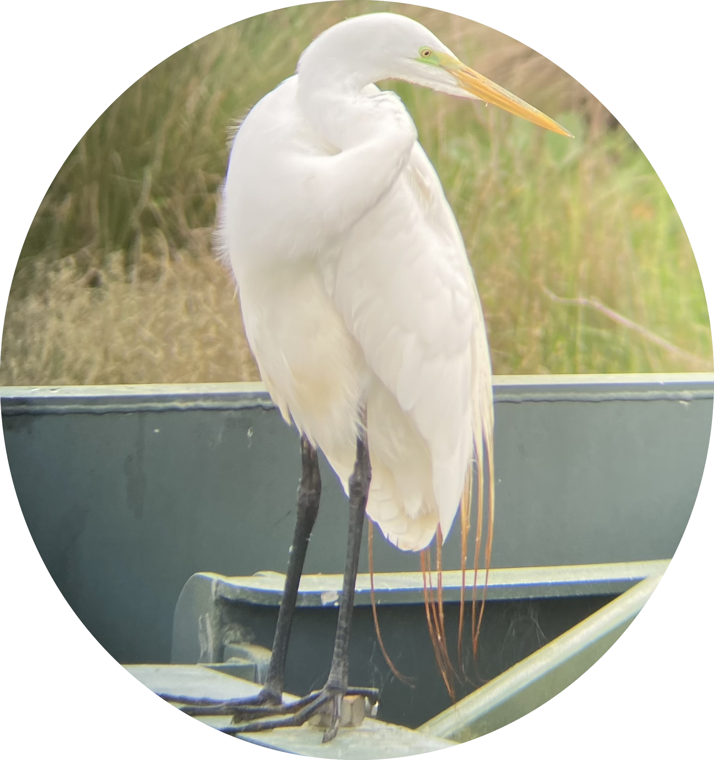
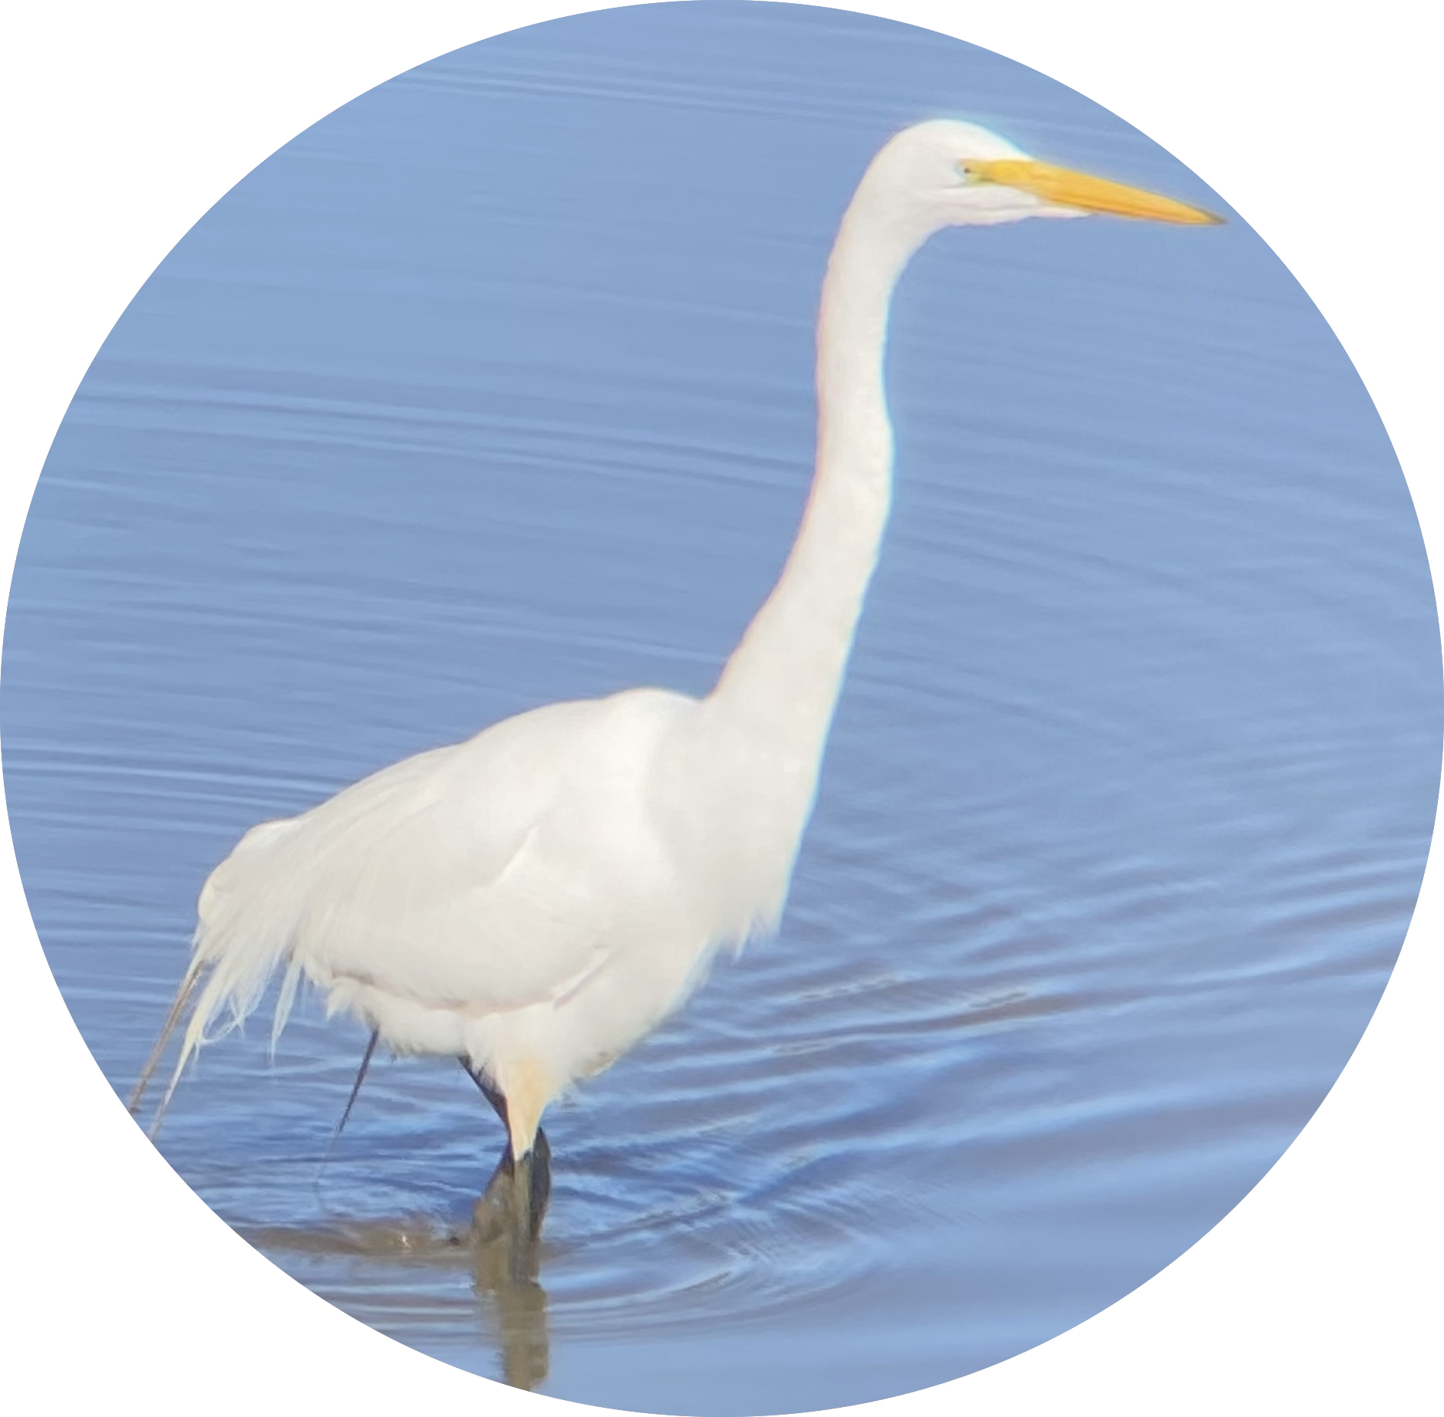

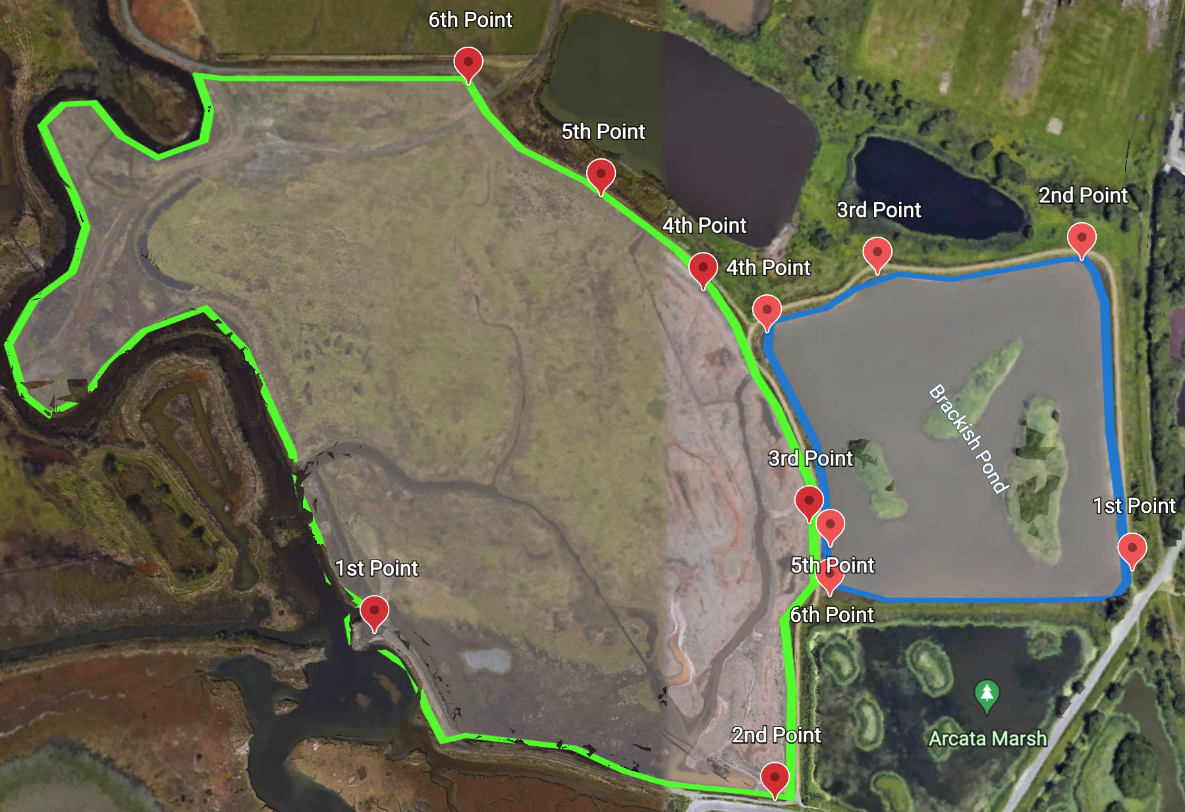
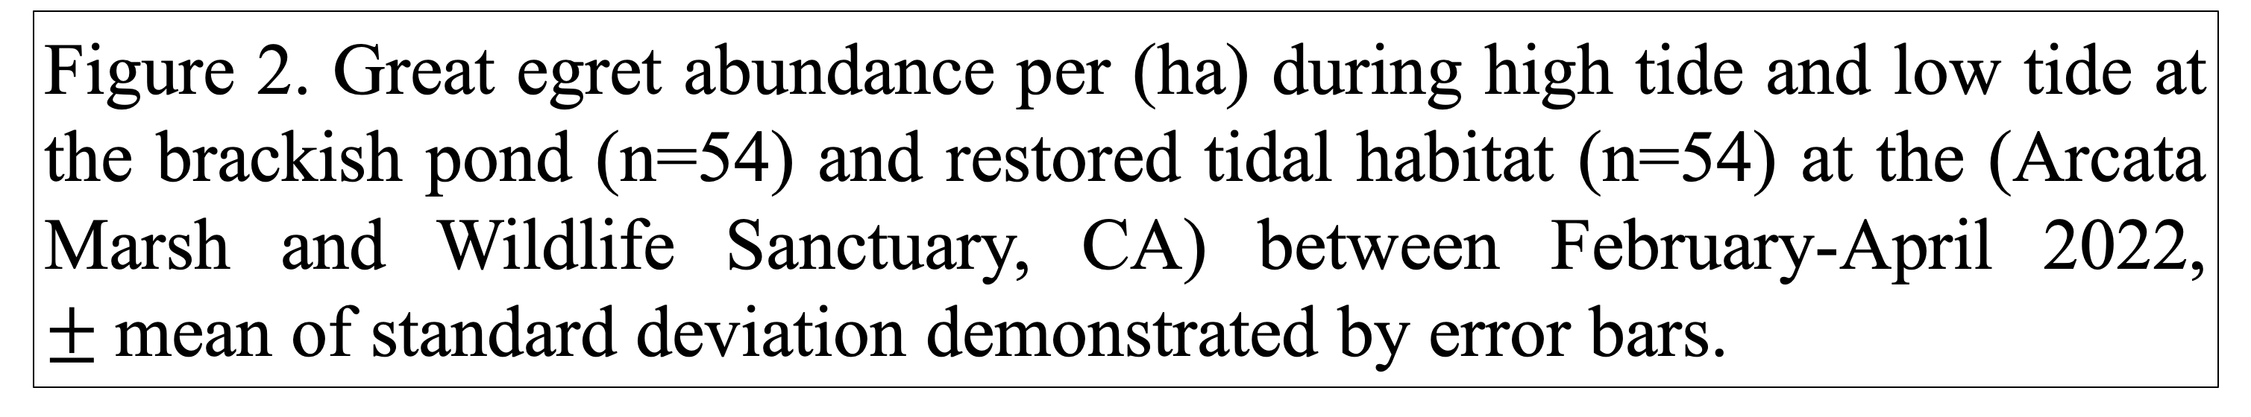
Great Egret (Ardea alba) Abundance Between the Brackish Pond and Restored Tidal Habitat During High Tide and Low Tide
Giselle Rangel
Department of Wildlife, Cal Poly Humboldt, 1 Harpst Street, Arcata, CA 95521
INTRODUCTION
Brackish and tidal habitats are one of many habitat types that support an extensive amount of bird populations in wetland ecosystems (Stolen et al. 2007). However, tidal fluctuations can be of an influence in abundance for Great egrets between many habitat types. The objective of this study is to understand if Great egret abundance is influenced between the brackish pond and the restored tidal habitat as well as certain tide periods of the day. I hypothesized (1): Restored tidal habitat had higher egret abundance compared to brackish pond (Trocki and Paton 2006). (2): Great egret abundance was higher at high tide relative to low tide in restored tidal habitat than brackish pond (Buchsbaum and Clark 2020).
RESULTS
Based on the ANOVA test, there was a significant difference in Great egret abundance during tidal fluctuations (F _{1,104} = 8.209, P= 0.005, Fig. 2). There was no significant difference in Great egret abundance between sites (F _{1,104} = 0.954, P= 0.330, Fig. 2). No significant interaction between tide and sites, indicating that Great egret abundance was similar between the sites and tide (F _{1,104} = 1.601, P= 0.208, Fig. 2).
Dependent variables:
Great egret abundance
Independent variables:
Habitat types
Tidal periods
DISCUSSION
Taken together, my results show RTH did not have higher egret abundance than BP and instead showed that tides predicted abundances. This is possibly because egrets are opportunistic feeders which may contribute to them not having a specific preference in habitat type (Buchsbaum and Clark 2020). Great egrets also use more open water during low tide, than high tide which may explain the reason of higher abundance during low tide at the RTH than BP (Trocki and Paton 2006). Observing 1 to 2 hours ± high and low tide may have also contributed to poor Great egret occurrence at sites. Similarities in egret abundance may also be due to similar food availability at both habitat types.
Figure 1. Restored tidal habitat highlighted in green and brackish pond in blue, sites located at the (Arcata Marsh and Wildlife Sanctuary, CA).
Tide: F _{1,104} = 8.209, P = 0.005
Habitat: F _{1,104} = 0.954, P = 0.330
Tide x habitat: F _{1,104} = 1.601, P = 0.208
METHODS
I conducted four observational point count surveys per week in each of the two habitat types at the Arcata Marsh and Wildlife Sanctuary, CA. During each survey effort, I visited 6 survey points, determined using convenience sampling (Fig. 1).
I conducted two-point count surveys on the same day between the two habitat sites during February-April 2022. I observed for 30 minutes 1 to 2 hours ± high tide and low tide. To control for variation in study site area, I calculated egret abundance/ha. I utilized a two-way ANOVA test to compare variation in Great egret abundance between habitats and tidal fluctuations.
Figure 2. Great egret abundance per (ha) during high tide and low tide at the brackish pond (n=54) and restored tidal habitat (n=54) at the (Arcata Marsh and Wildlife Sanctuary, CA) between February-April 2022, $±$mean of standard deviation demonstrated by error bars.
LITERATURE CITED
Buchsbaum, R., and W. Clark. 2020. Selection of estuarine feeding habitats by snowy and great egrets in the great marsh estuary, northeastern Massachusetts, USA. Waterbirds 43:251-262.
Stolen, E. D., J. A. Collazo, and H. F. Percival. 2007. Scale-dependent habitat selection of nesting great egrets and snowy egrets. Waterbirds: The International Journal of Waterbird Biology 30:384-393.
Trocki, C. L., and P. W. C. Paton. 2006. Assessing habitat selection by foraging egrets in salt marshes at multiple spatial scales. Wetlands 26:307-312.
FUNDING SOURCES
I would like to thank the Wildlife Department and the Ideafest for showcasing our work and covering our poster costs.
ACKNOWLEDGEMENTS
I want to thank Dr. Sean Mahoney and Ashlyn Thomas in helping with the statistical analysis and proofreading my draft as well as the WLDF 495 class with constructive feedback, Jeffrey Black for keeping me company, and Cal Poly Humboldt for the equipment used for my study.

