Slide 1
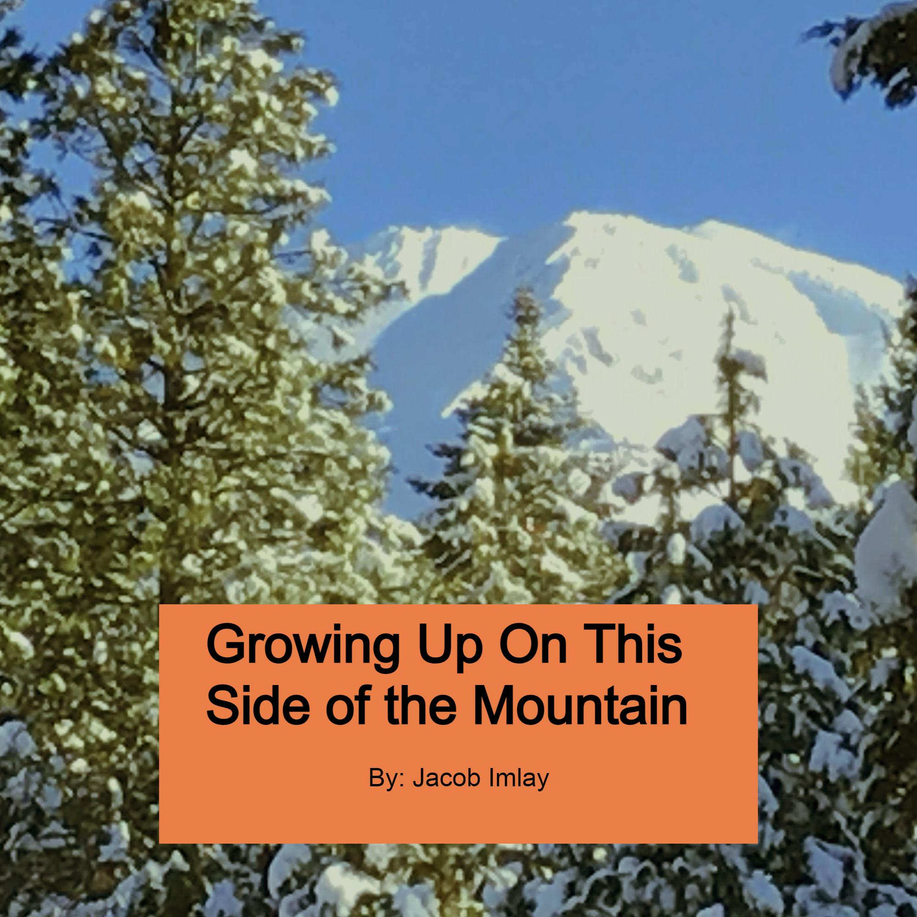

Slide 2
Growing On This Side Of The Mountain
Eagerness and wonderment
All that I felt at first
When I saw the teachers and the poster paper
Writing out stories in my head
And seeing it come to life on the page
So I waited
And continued waiting for my turn to tell these tales
Then when it was my chance to speak
My stomach would turn
In enjoyment at this moment
At the chance of sharing my view
But this opportunity was skipped
As I would be to nervous or was deemed to unimportant
We moved onto reading of those deemed important
And often I was told I couldn’t read it
That these stories were to important than me
That I couldn’t understand their complexity
And that I would be lucky to have a child
Who would have that chance
To see worlds that I couldn’t
And to live inside of these world’s
And to be free in them
So in this desperation
I developed the idea of writing my own
And in it I wrote one simple story
About a mountain
And a wolf
One which wished to have it’s story told
But nothing gets talked about on this side
For that chance exists for those deemed worthy
And able minded
And so the wolf weeps
Wishing for anyone to remember their story
The one that exists inside
And one which took a long time to feel
To read
To say
And to be realized
As these people deemed my stories unworthy
And to childish
So like that wolf’s voice it disappeared
Flying into the endlessness
With time and the wind remembering it

Slide 3
The Encouraging Words
Emptiness
Failure
Terribleness
All of these I felt
All of them I saw applied to me
Many teachers said I was done
That nothing worked
I was an impossible case
I wouldn’t listen
I just seemed to unimportant
To irregular
But all that it took to change this
Was just some encouraging words
As I didn’t enjoy school
As I was constantly told that
Broken breads broken
And that a family deems your value
And I crave my story to be told
So when I heard the words
Passing
Scholar
Exceeding
Amazing
And most importantly
Important
I started to enjoy academics
As one man decided I was worth his time
And taught me very important lessons
With the main one being
That writing matters for one thing
Your voice
Is the most important tool we have
So make sure you use it.

Slide 4
The Scholarly Momentum
History
Mathematics
World Studies
All of these courses
I was told I wouldn’t understand a thing
All of them I enjoy to this day
As a single person believed in me
I wouldn’t be interested in understanding the complexities of society
Or how being told I wasn’t a trouble child
Finally allowed me to be allowed to speak my story
But school will be a trouble thing for me
As all it takes is a change
And all momentum Ends
As encouraging words only had an impact
At things that finally cracked
But the wind still cried
For my story still needed to be told
But English and creativity
Were Not my strong suit
As the encouraging words ended there
And all that was left was the void
That I needed to prove them right
That I was something
That I mattered
And that I was important enough to speak
So I began to study everything
But It didn’t help me
As my voice was located in the middle school gradebook
And the struggle started all over again
As I’ve doomed myself into a endless cycle
That I only was important to the school
But the scholarly momenntum did eventually change
And I found some peace
Enough to start searching for it one last time
Enough to see something I haven’t had before
Support and love
And that was the foundation to build the trees
One’s which help with the floods
Ones which help build the environment to be stable
And to be able to last

Slide 5
The Speaking Tree
Tiredness and overall boredom
Sitting at the bland broken desk
Looking at a window
And inside was a lonely tree
One near death
But clinging on to life
And posters filled with a story
One’s which I remember making
Ones in which reminded me
That the story inside me completely worn out
Burned completely from this subject
That no one will care for this story
That I won’t be able to pass
Without giving something up in return
And then they entered
And just like a leaf
From the dead tree
Fully filled with life
Being ready to spread color
And bring the gloomy atmosphere to life
And with a month
And after all of this
I wrote
On that day
Years of pain
Years of waiting
Years of silence
I was finally able to speak
To tell my story
To learn how to describe it
How I can utilize
And finally rise above
As I told that my stories mattered
That I had potential
Without any caveats
I was able to describe my story
And show everyone I was here
That the boy who grew up on the bad side of the mountain
Was able to finally speak
And show the small town
I mattered
As we all do
And that no story doesn’t matter
As I finally learned how to speak

Slide 6
Those halls
I wonder what I will feel
walking down that hall with blue lockers and a giant window
will I feel joy and excitement for I will be leaving them and exploring the world
will I feel sad for I am leaving the only place where I ever felt joy
will I feel scared for I have to leave something that I have known for so long
I wonder how many people think about you
how many wonder what is in store when they walk through you for the first time in their life
do they feel the same as they leave
or is it a different feeling entirely
How many people have experienced what you bring
does it bring the same feeling that I feel
or is it different for others?
I wonder how much history was made in you that will be forever forgotten as time continues without any weight
I question if it’s possible to never leave what you bring
which is joy, life, and a sense of belonging
Then again
I have also experienced so much sadness in you
but is that a part of the happiness that you bring?
How many people have you seen that were just like me?
Am I the first one that you have ever seen
or am I just like the others?
So when I do see you for the last time
will I be happy, sad, scared, or indifferent
right now
I am scared because I don’t want to leave your sense of security and that sense of being a part of something.

Slide 7
Growing On This Side Of The Mountain
Throughout my life
I’ve always been surrounded by two things
negativity and mountains
I’ve always seen both as the opposite of each other as mountains always spoke to me
saying that things can last
that it’s okay to be still for a moment
that it’s okay to have faults as people will still find beauty in it
I never really noticed it before
that I’ve always been surrounded by them and I don’t know why but it gives me a sense of ease that I can be both calm and collected
I guess what I’m trying to say is that no single person sticks in my mind that I can say inspired me to be who I am
I like to believe that it was multiple people who had an impact on my life
those groups brought out the person inside me so I’m able to be myself
I hope that when I do leave the mountains soon
I remember the people who did change my life
but I kinda know that their presence still lingers both in me and in the landscape around me
so that I can remember them
as I do forget people's names easily
but it’s hard to forget that a mountain exists
and that’s the impact I both want and hope for
as my mountains are waiting for me.

