Slide 1



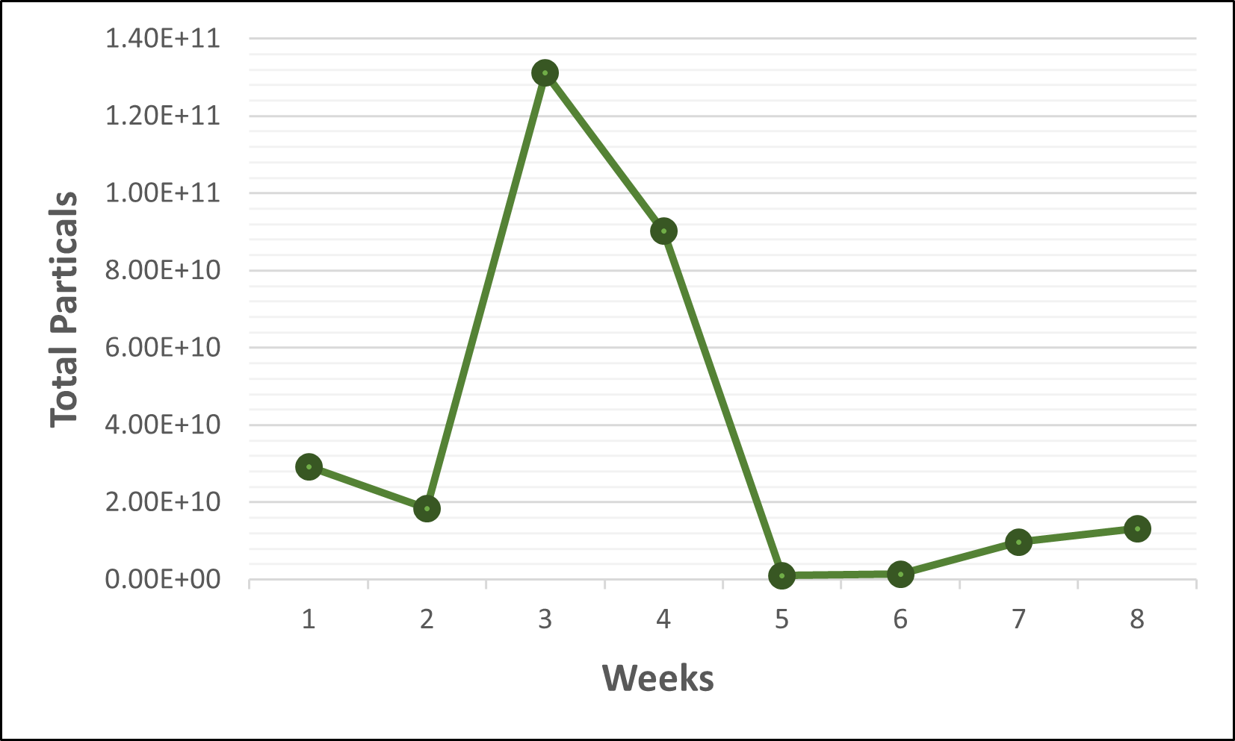
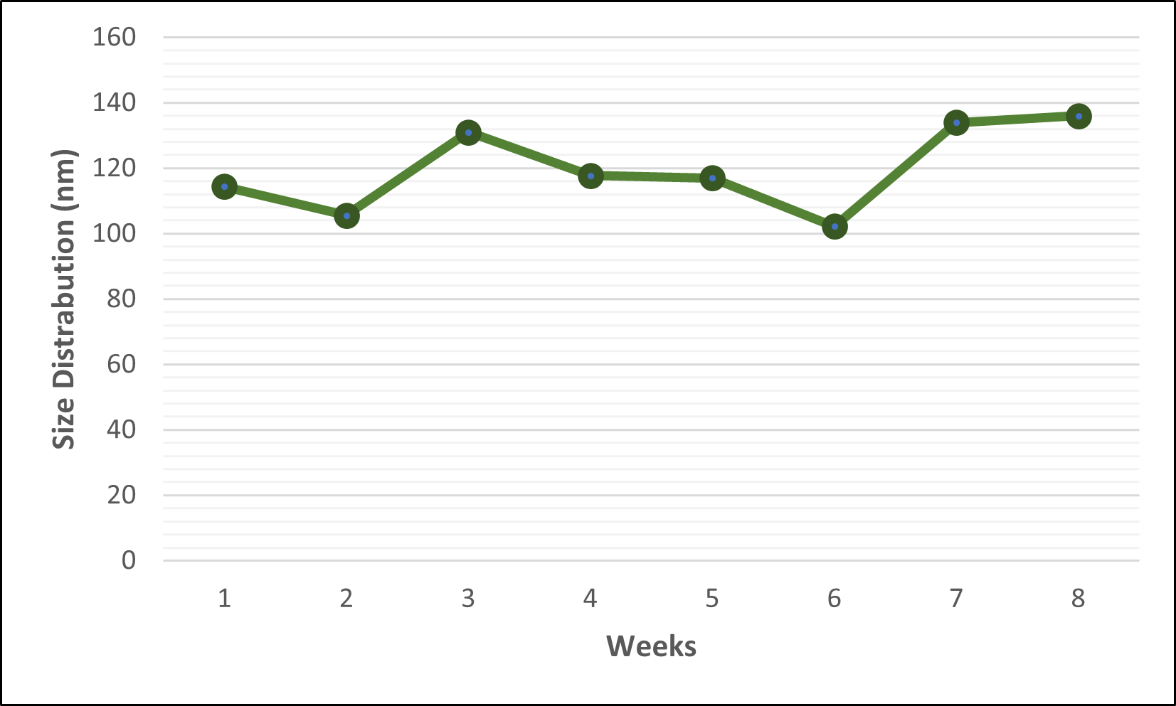
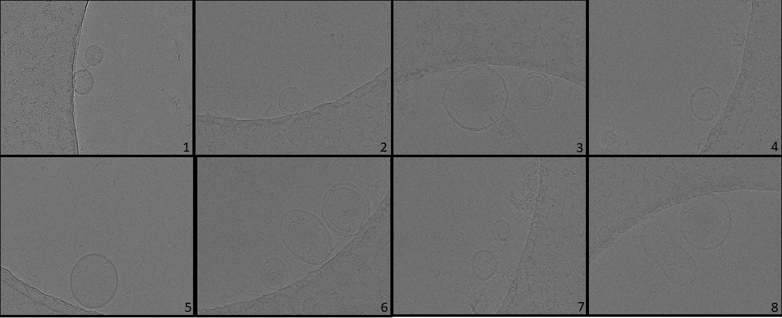
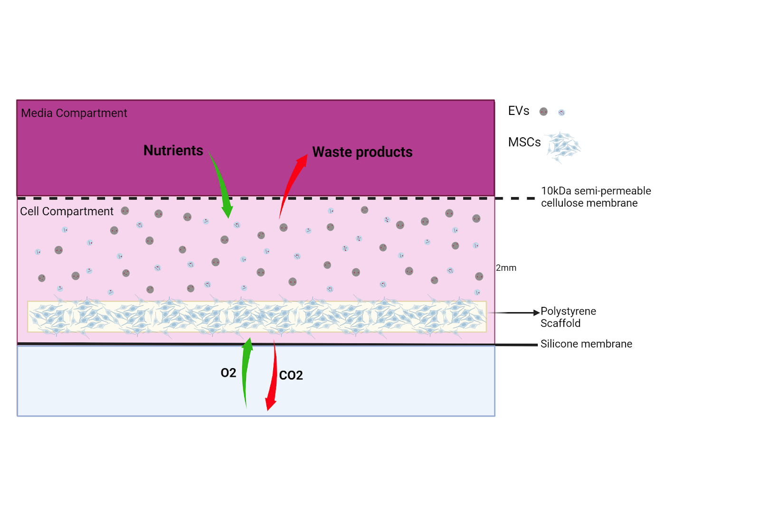
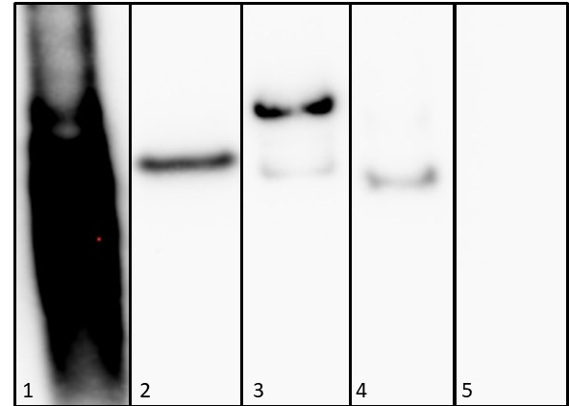
Developing a three-dimensional culture system to improve the yield of placental mesenchymal stem cell derived extracellular vesicles
CENTER FOR SURGICAL BIOENGINEERING
Juan-Maria Wammack Lopez^{1,2}, Dake Hao² Aijun Wang²
¹California Polytechnic University Humboldt, ²Center for Surgical Bioengineering UC Davis
Introduction
Placental mesenchymal stem cell (PMSC) derived extracellular vesicles (PMSC-EVs) are lipid-bound vesicles secreted from the cell through different biogenic pathways including membrane blebbing, budding, and endocytosis and exocytosis pathways. PMSC-EVs function through intercellular communication by distribution of their biologically functional cargo including DNA, RNA and proteins. This biologically functional material can trigger a multitude of physiological responses such as cellular regeneration and tissue damage response. They have also been shown to have less toxicity and immunogenicity, ability to encapsulate biologically active molecules, and ability to cross the blood brain barrier when compared to cell-based therapies. However, the current applications of PMSC-EVs is limited by their low yield when produced in conventional monolayer cell culture. The CELLine bioreactor, which can allow for a high-density three-dimensional (3D) cell culture within a semipermeable membrane, has been utilized as a large-scale tissue culture method for producing antibodies as well as for use in cancer EV related research. In this study, we propose to explore the application of the CELLine bioreactor as a novel approach to improve the production and yield of PMSC-EVs for regenerative medicine applications.
Results
Conclusion
The CELLine bioreactor represents a promising new approach to generate large scale PMSC-EVs. EVS concentrations and size distribution from the harvest of only 15 mL concentrated conditioned media shows the improvement and convenience EV isolation from concentrated 3D culture conditioned medium. When cultured over an extended time the presence of EV protein markers and morphologies of EVs remains consistent with EVs found in conventional culture methods. Although the CELLine bioreactor shows promise as an alternative method for the production of PMSC-EVs there are limitations in that we cannot readily view the cells with a conventional microscope making it difficult to evaluate the general health and status of the cells seeded on the polystyrene scaffold. Because the scaffold is encased in a compartment it is also difficult to get a total cell count.
Figure 2. NTA results showing total particle count and size distribution of PMSC-EVs
Materials/Methods
Next Steps
Real time cell behavior and status on the 3D matrix can be monitored by measuring the cell metabolomic activities of non-invasively sampled culture medium. Proteomics and RNA seq analyses of PMSC-EVs will also be conducted to further characterize of PMSC-EVs protein profile and molecular cargo. PMSC-EV’s neuroprotective function will also be characterized using established protocols to validate its therapeutic potency in vitro. To further increase the yield of EV isolation, we also plan to use new isolation methods, such as tangential flow filtration and size exclusion chromatography as alternative isolation methods than ultracentrifugation
Figure 1. Components of the 3D culture
Figure 3. CryoEM images of PMSC-EVs from weeks 1 to 8
PMSCs were cultured in the CELLine bioreactors, which is comprised of a polystyrene porous scaffold encased in a 10 kDa semipermeable membrane creating a cellular compartment with 15 mL Dulbecco’s Modified Eagle Medium (DMEM) supplemented with 10% fetal bovine serum that was pre-treated to deplete bovine serum EVs, epidermal growth factor (EGF), and fibroblast growth factor (FGF) One liter of DMEM supplemented with EGF and FGF sit above the cellular compartment in a medium compartment.
PMCS-EVs were isolated from the 15 mL EV rich medium in the cellular compartment using ultracentrifugation isolation method weekly
Nanoparticle tracking analysis (NTA) was used to quantify concentration. NTA was used to characterize PMCS-EVs size distribution and relative charge
Cryogenic electron microscopy (cryoEM) was used to confirm morphology
Western-blot was used to confirm exosome surface proteins CD9 and CD63 in addition to cytosolic proteins TSG101 and Alix.
CryoEM showed EVs present with morphologies mirroring those found in 2D cell culture
NTA results showed total particle number ranging from 1.03E9-1.31E11 with an initial increase in concentration from week 1 to week 3 and a decrease there after.
The size of EVs ranged from 102.2-184 nm all presenting a negative charged phenotype.
Western-blot revealed protein expression of EV biomarkers CD9, CD63, Alix, and TSG101.
Acknowledgments
Support for this project comes from CIRM Bridges 3.0 #EDUC2-12620, UC Davis Center for Surgical Bioengineering
Thank you to Amy Sprowles PHD, Brigitte Blackman PHD, Jenny Cappuccio PHD, and Nievita Bueno Watts PHD
Special thank you to Aijun Wang PHD, Dake Hao PHD and the whole UC Davis Center for Surgical Bioengineering
Figure 4. Western-Blot: 1-CD-63, 2-CD9, 3-Alix, 4-TSG101, 5-Calnexin (-)

