Slide 1


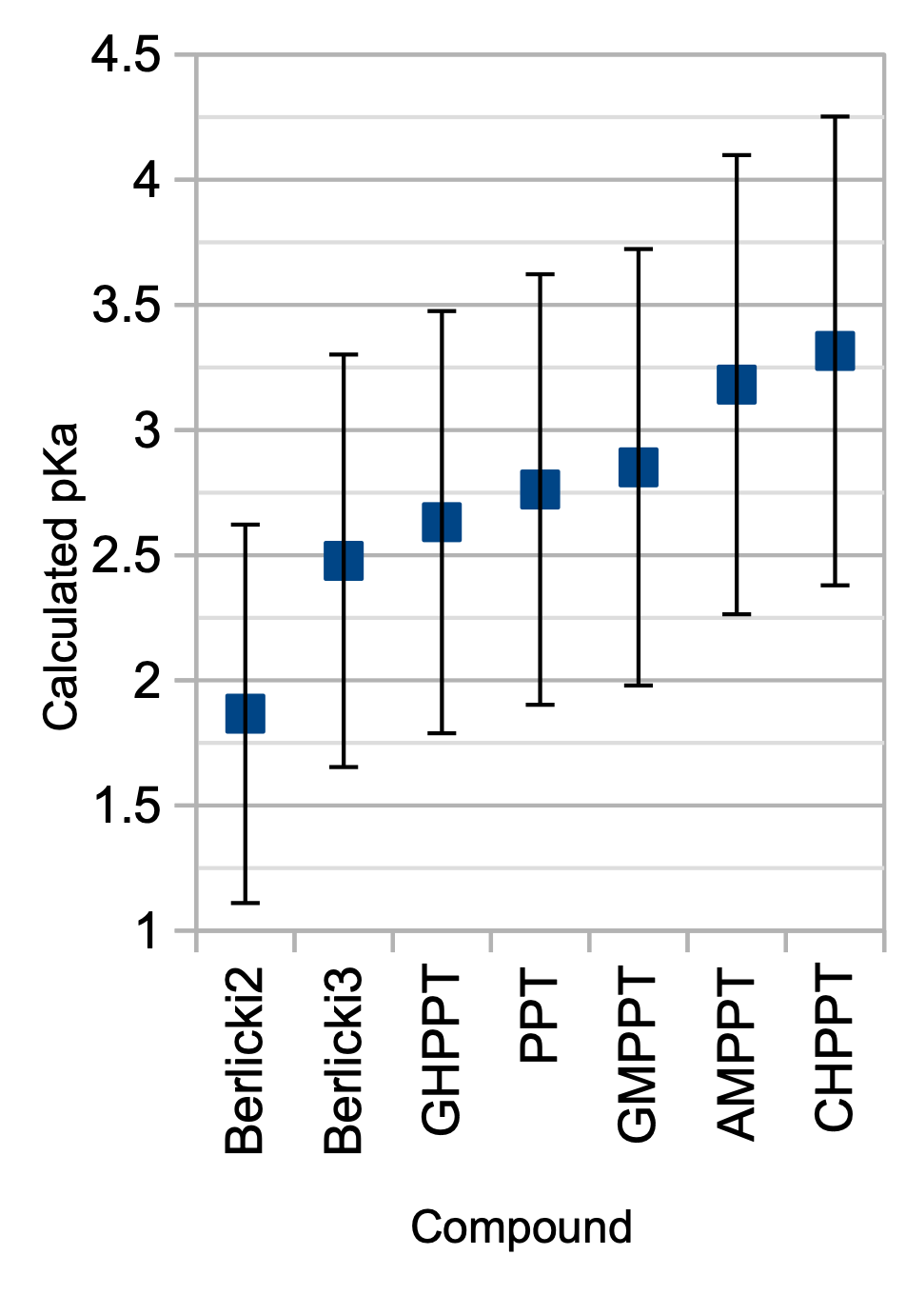
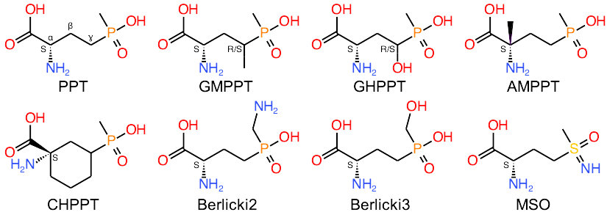
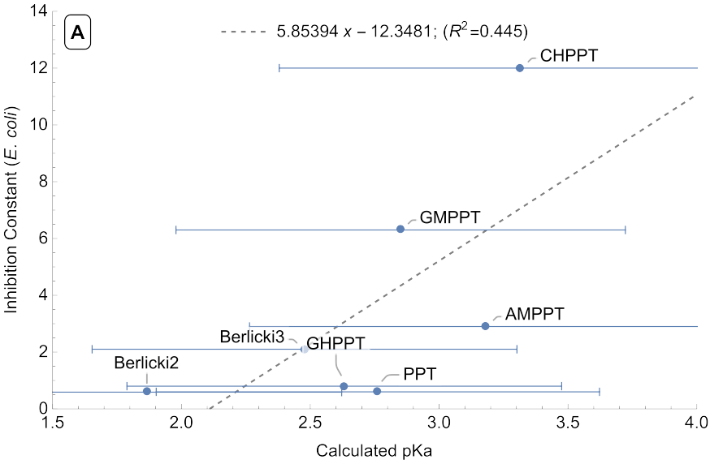
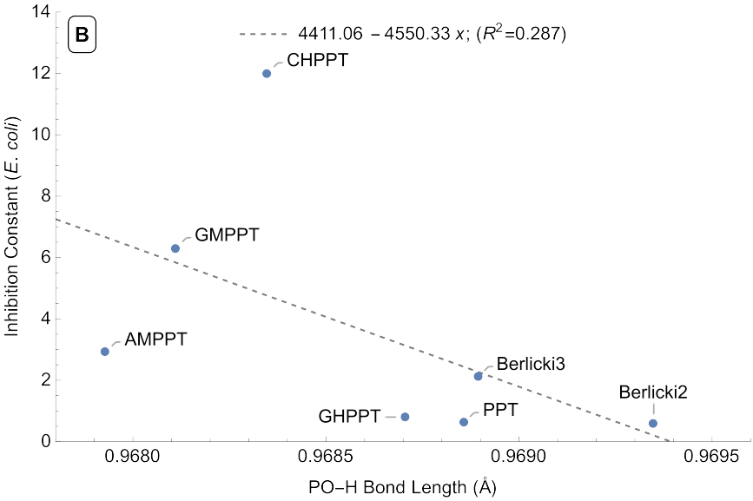
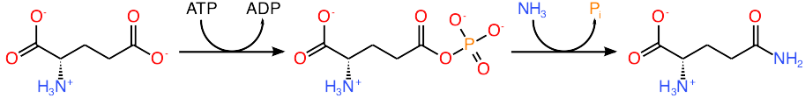
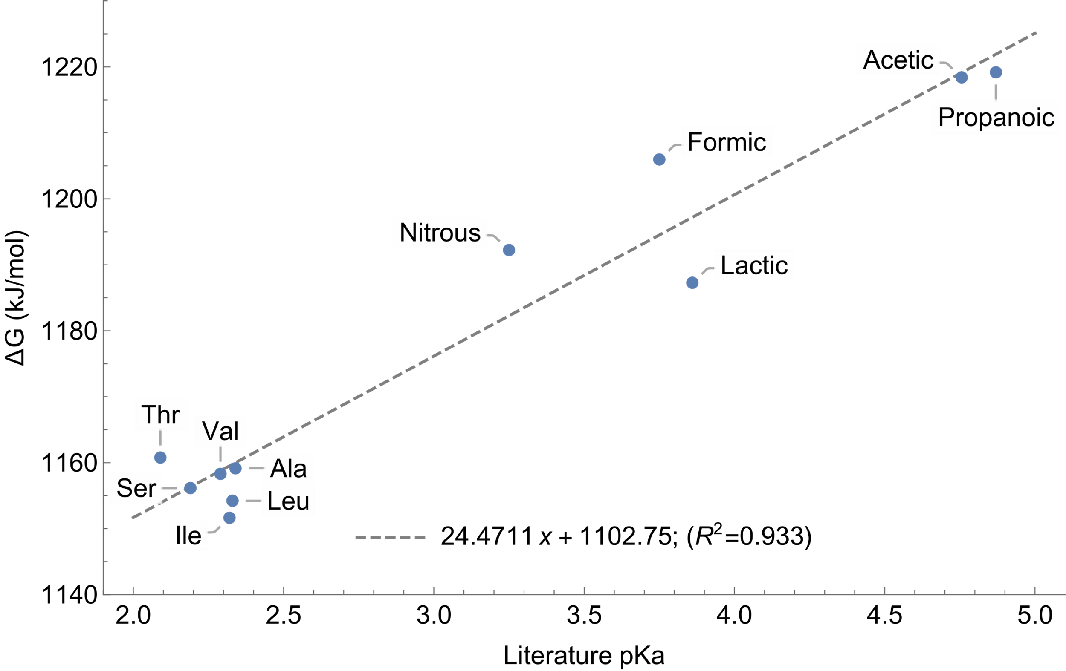
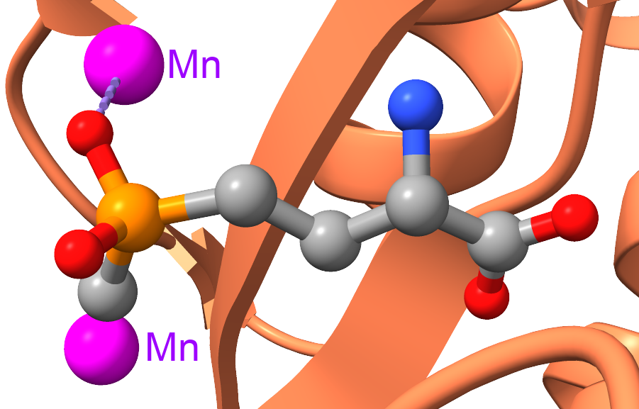
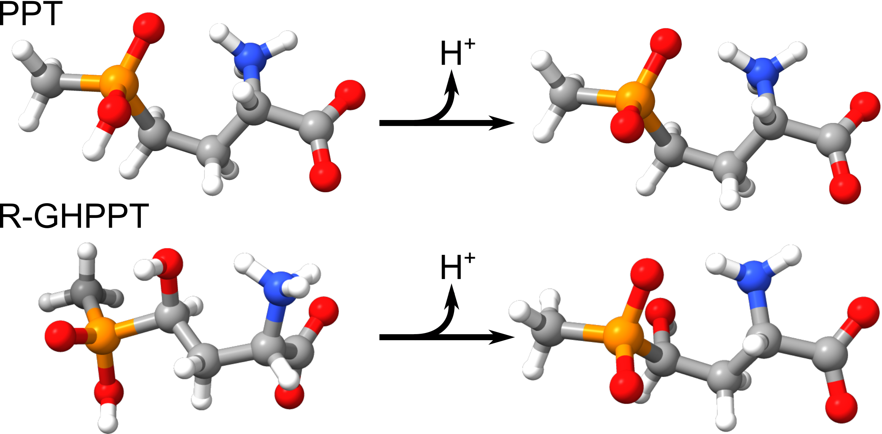
A Computational Study of the Acidity of Glufosinate Derivatives
Department of Chemistry
Biochemistry
Daniel N. Sabo, Dr. Jeffrey Schineller¹, Dr. Jenny A. Cappuccio¹
¹ CHEM 435L - Biochemistry II Lab - Department of Chemistry, Humboldt State University, Arcata, CA, USA
Abstract
0
Methods
Results
Glufosinate is a broad-spectrum herbicide that acts as an irreversible inhibitor of the glutamine synthetase enzyme. A critical step in its mechanism of inhibition is the phosphorylation of glufosinate within the active site, and we hypothesize that the acidity of the target hydroxy group might be predictive of the herbicidal activity of glufosinate derivatives. In this project we attempted to use computational methods to study how derivatization impacted this functional group computationally using a pair of linear regression models based on OH bond length and the ∆G of deprotonation. Density functional theory (DFT) calculations were performed using NWChem with the B3LYP functional, 6-311G** basis set, and the COSMO solvation model. Though the uncertainty of DFT calculations proved too large to discriminate between derivative compounds we were able to establish a reasonable range for the pKa in the face of conflicting literature values, as well as reveal that the steric effects on the aqueous conformation of the derivatives impact their ∆G values and may make aqueous pKa a poor predictor of the pKa within the enzyme active site.
All calculations used in the final models and analyses were performed on an Ubuntu Linux 21.10 desktop computer using NWChem⁸ 7.0.2 to perform DFT calculations using the B3LYP functional, 6-311G** basis set, and COSMO solvation model. Initial molecular geometries were generated using Avogadro¹⁰ 1.94.0 and in house structure editor to generate functional group substitutions. A similar set of calculations were attempted using Spartan’20¹¹ version 1.0.0 with the same functional and basis set in combination with the PCM solvation model. These calculations ultimately failed to find non-transition state geometries for the deprotonated forms of glufosinate or the derivative compounds in solution and therefor could not be used.
Two linear regression models were constructed to predict the pKa values of the analyte compounds. The first based on the Gibbs free energy change of deprotonation and the second on the bond length of the OH bond in the protonated POH group. Based on the most recent literature sources⁷ the glufosinate POH group was expected to have a pKa similar to a carboxylic acid in the range of 2-3 pKa units and so a collection of weak acids with pKa values in this range were selected to construct these models. Each reference compound was simulated in its protonated and deprotonated state and the values for the ∆G of deprotonation and the OH bond length were collected for each.
The deprotonation reaction was treated as a series of isodesmic reactions in which the ∆G value of the proton acceptor are assumed to be the same for all reactions. Based on the fundamental relation of ∆G° = -R*T*ln(K) and pKa = -log₁₀(K) the pKa value is expected to have a linear relation to the ∆G value of these reactions. For the second model the bond length is expected to correlated with bond strength¹² and therefor with the acidity of the bonded proton. While this correlation is not exact for the purpose of this model the relation was assumed to be roughly linear.
Glufosinate derivatives for analysis (Figure 3) were selected based on the availability of published inhibition constants^{4–6}. Initial geometry construction and geometry optimizations were performed as described above starting from the “3D Conformer” geometry for L-glufosinate available from PubChem¹³ with the amino acid functional group modified to its expected aqueous zwitterionic form. Additional rotational conformations around the C_{ɣ}-P bond as well as rotation around C_{β}-C_{ɣ} bond to bring the phosphate oxygens into proximity with the C_{α} amino group were explored for each compound (Figure 3: PPT).
Calculation of Derivative Properties.
The PO-H bond lengths of the glufosinate compounds were significantly shorter than expected when constructing the model, with a mean value of 0.9686 Å vs. 0.9727 Å for the reference compounds. This result was compared to calculated bond lengths of phosphoric acid using the same method (0.9694 Å in the H3PO4 state) which indicated that this was a reasonable result but meant that the bond length regression model was not applicable to these compounds and we would not be able to derive pKa values from it.
Calculations using the Gibbs free energy model produced a pKa for glufosinate of 2.8±0.9, which is in good agreement with the most recent literature value⁷ of 2.62 determined using potentiometric titration and much more basic than an earlier reported value¹⁵ of 0.8 pKa units. Unfortunately all derivatives except MSO have very similar pKa values and due to high uncertainty are statistically identical at the 95% confidence level (Figure 6). The sulfoximine derivative (MSO) had a calculated pKa of 7±2. This fell well outside the range considered in the standard curve and so it was excluded from the rest of the analysis. Calculated bond lengths and changes in free energy were also compared directly for the analyte compounds and found to be in rough agreement with each other (R2 = 0.744), indicating that both measure similar molecular properties as expected.
Analysis of Acidity vs. Inhibition.
These results were also compared to published inhibition values to look for any potential relation between acidity and inhibition activity. Based on this data there may be
Figure 6: Glufosinate derivative pKa values based on calculated ∆G of deprotonation. Error bars represent the 95% CI.
a weak correlation between these properties but none of the results are significant enough to overcome the high uncertainty of the calculated properties. A representative regression plot is shown in Figure 7, and while we do not have calculated uncertainties for the bond length values we would expect them to be of similar magnitude to those of the pKa calculations.
Introduction
Both models were then applied to the collected analyte data to predict the POH group pKa and determine if was correlated with the published inhibition constant (Ki) values. The PO-H bond length was found to be much longer than the CO-H bonds in the reference compounds so the bond lengths of phosphoric acid were calculated to validate this observation and found to be of similar length. While this showed the bond length regression model was not directly applicable to these compounds the length vs. acidity relation found when constructing the model is still expected to hold and so the calculated bond lengths for the glufosinate derivatives were instead directly compared to their published Ki values.
Glufosinate, also known as phosphinothricin, is a broad-spectrum herbicide that acts by blocking the action of the glutamine synthetase enzyme.¹ The agricultural use off glufosinate has increased over the past decade as resistance to glyphosate (Roundup) has become more common in weed species,² and modifications to its chemical structure can potentially be used to keep ahead of evolving resistances as well as increase its herbicidal effectiveness. Most modifications tested thus far produce less effective compounds, and a method of better predicting their effects would be valuable.
In its function as an herbicide glufosinate acts as an irreversible competitive inhibitor of the glutamine synthetase enzyme. This inhibition causes the buildup of both ammonia and reactive oxygen species within treated plants, ultimately killing them.¹ Acting on its natural substrate glutamine synthetase catalyzes a two step mechanism for the conversion of glutamate to glutamine (Figure 1). If glufosinate replaces glutamate in this reaction the first phosphorylation step will still occur, however the reaction can proceed no further and the phosphorylated glufosinate will remain tightly bound to the active site of the enzyme.³
The negatively charged oxygen of the deprotonated phosphinate hydroxy group acts as a nucleophile in this phosphorylation reaction, and the nucleophilicity of this functional group may be an important factor in determining inhibition effectiveness. As acidity is an important component of nucleophilicity the pKa of this hydroxy group may provide useful predictor of effectiveness of new glufosinate derivatives.
Because the pKa values for glufosinate derivatives are not available in literature and the published pKa values for glufosinate itself are inconsistent between sources we have undertaken a computational study of the acidity of the phosphinate hydroxy group of a small collection of glufosinate derivatives with known inhibition constants (Ki) for the glutamine synthetase enzymes of E. coli,^{4,5} Sorghum,⁶ and Spinach.⁶ Determination of these pKa values experimentally is challenging⁷ so here we attempt to predict them using two different parameters that can be determined computationally: the ∆G of deprotonation and the OH bond length of the protonated form.
All computations were performed using the NWChem⁸ density functional theory (DFT) module with the B3LYP functional, 6-311G** basis set, and the COSMO solvation model parameterized for water. Standard curves relating the ∆G of deprotonation and bond length to the pKa were first generated using a selection of weak acids with pKa values
Figure 3: Glufosinate (PPT) and the derivatives compounds analyzed in this study.
Results
Figure 7: Regression plots for E. coli glutamate synthetase inhibition vs. calculated pKa (A) and PO-H bond length (B). Error bars represent the 95% CI.
Model construction.
Originally we expected to use gas phase calculations for all compounds, as these would have been less computationally intensive and allowed direct comparison between values calculated in NWChem and Spartan. However when simulating the amino acid compounds we realized that the amino acid backbone groups do not act as zwitterions without the stabilization provided by a solvent. Lacking this stabilization the NH3+ group tends to deprotonate before the COOH group. Therefor the calculations for all compounds were repeated in solvent using the COSMO solvation model provided by NWChem. A similar set of calculations were also performed using Spartan and the PCM solvation model, however issues with optimizing the glufosinate and derivative compounds in Spartan ultimately prevented their use.
NWChem calculations produced the expected linear relations between pKa and both the isodesmic ∆G of reaction (R²=0.93) and bond length (R²=0.51)
Conclusions
Figure 1: The two step conversion of glutamate to glutamine as catalyzed by glutamine synthetase.
Ultimately this project was not able to provide useful insight into the original hypothesis due to the high uncertainty of the calculated values, though we were able to show that substitution makes relatively small changes to the acidity of the POH group of glufosinate. The 95% confidence interval also excludes older more acidic published pKa values for this group an indicates that the more recently published value of 2.26 pKa units for glufosinate⁷ is likely accurate.
In theory a more exhaustive model and more advanced computational algorithms may be able to reduce our error threshold sufficiently to distinguish the pKa values of these derivatives. The ±1 kcal/mol uncertainty achievable by CCSD(T) calculations¹⁶ would correspond to a pKa uncertainty of roughly 0.2 pKa units assuming a similar regression model, and at that resolution the differences between these derivative compounds may be detectable
When comparing the structures of the lowest energy conformers (Figure 5) steric factors that alter the interaction of the amino and phosphinate groups seem to have a noticeable impact on the ∆G of deprotonation, and substitutions that make this conformation unfavorable are likely to alter the acidity in solution. Because this kind of conformational change is not representative of the active site behavior where the charge on the phosphinate group will be stabilized by metal ions (Figure 2) the pKa in solution may be a poor indicator of the acidity of the group within the active site.
Figure 4: Standard curve calculated for pKa vs. isodesmic ∆G of deprotonation.
(Figure 4). The much poorer coefficient of determination for bond length is due primarily to formic acid being significant outlier, a behavior that was observed in both the NWChem and Spartan calculations. These regressions were then used to derive the corresponding equations for pKa from ∆G and bond length, which result in 95% confidence intervals of roughly ±0.8 pKa units. This uncertainty was higher than hoped for but is in line with the theoretical 2-3 kcal/mol uncertainty of DFT calculations.¹⁴ Given that two measurements are required to determine a ∆G value this would give a theoretical uncertainty of ±(0.5-0.7) pKa units.
Construction and DFT Simulation of Glufosinate Derivatives.
Initially compounds were calculated using both Spartan and NWChem, however Spartan proved unable to generate non‑transition state geometries for the deprotonated forms of any of the glufosinate derivatives. Instead it tended to generate
References
similar to the expected range for the phosphinate hydroxy group. The pKa of the derivative compounds was then calculated by computing their ∆G of deprotonation and OH bond lengths using the same parameters and applying the standard curve equation to the result. These values were then compared to the published Ki values to determine if a relationship existed, and the structural information derived from the DFT geometry optimizations was used to compare the aqueous conformation of glufosinate to its conformation within the enzyme active site (Figure 2).
geometries with both phosphinate oxygens in an unstable position equidistant from the amino group, and due to this all further calculations were performed in NWChem alone.
All compounds were found to have a lowest energy deprotonated conformation with the backbone of the molecule twisted to put the phosphorous oxygens in proximity to the amino group (Figure 5). Unmodified glufosinate and most derivatives were found to adopt a similar conformation in their protonated state but R-GHPPT and S-GMPPT, which have their substitution on the same side relative to the amino group, preferred different conformations when protonated.
(1) Takano, H. K.; Dayan, F. E. Glufosinate‐ammonium: A Review of the Current State of Knowledge. Pest Manag Sci 2020, 76 (12), 3911–3925. https://doi.org/10.1002/ps.5965.
(2) Zhang, C.; Yu, Q.; Han, H.; Yu, C.; Nyporko, A.; Tian, X.; Beckie, H.; Powles, S. A Naturally Evolved Mutation (Ser59Gly) in Glutamine Synthetase Confers Glufosinate Resistance in Plants. Journal of Experimental Botany 2022, 73 (7), 2251–2262. https://doi.org/10.1093/jxb/erac008.
(3) Unno, H.; Uchida, T.; Sugawara, H.; Kurisu, G.; Sugiyama, T.; Yamaya, T.; Sakakibara, H.; Hase, T.; Kusunoki, M. Atomic Structure of Plant Glutamine Synthetase. Journal of Biological Chemistry 2006, 281 (39), 29287–29296. https://doi.org/10.1074/jbc.M601497200.
(4) Logusch, E. W.; Walker, D. M.; McDonald, J. F.; Franz, J. E.; Villafranca, J. J.; DiIanni, C. L.; Colanduoni, J. A.; Li, B.; Schineller, J. B. Inhibition of Escherichia Coli Glutamine Synthetase by .Alpha.- and .Gamma.-Substituted Phosphinothricins. Biochemistry 1990, 29 (2), 366–372. https://doi.org/10.1021/bi00454a009.
(5) Berlicki, Ł.; Obojska, A.; Forlani, G.; Kafarski, P. Design, Synthesis, and Activity of Analogues of Phosphinothricin as Inhibitors of Glutamine Synthetase. J. Med. Chem. 2005, 48 (20), 6340–6349. https://doi.org/10.1021/jm050474e.
(6) Logusch, E. W.; Walker, D. M.; McDonald, J. F.; Franz, J. E. Inhibition of Plant Glutamine Synthetases by Substituted Phosphinothricins. Plant Physiol. 1991, 95 (4), 1057–1062. https://doi.org/10.1104/pp.95.4.1057.
(7) Li, Q.; Liu, B.; Mu, W.; Yu, Q.; Tian, Y.; Liu, G.; Yang, Y.; Li, X.; Luo, S. Protonation States of Glufosinate in Aqueous Solution. J Solution Chem 2018, 47 (4), 705–714. https://doi.org/10.1007/s10953-018-0751-y.
(8) Aprà, E.; et al. NWChem: Past, Present, and Future. J. Chem. Phys. 2020, 152 (18), 184102. https://doi.org/10.1063/5.0004997.
(9) Gill, H. S.; Eisenberg, D. The Crystal Structure of Phosphinothricin in the Active Site of Glutamine Synthetase Illuminates the Mechanism of Enzymatic Inhibition. Biochemistry 2001, 40 (7), 1903–1912. https://doi.org/10.1021/bi002438h.
(10) Hanwell, M. D.; Curtis, D. E.; Lonie, D. C.; Vandermeersch, T.; Zurek, E.; Hutchison, G. R. Avogadro: An Advanced Semantic Chemical Editor, Visualization, and Analysis Platform. J Cheminform 2012, 4 (1), 17. https://doi.org/10.1186/1758-2946-4-17.
(11) Spartan 20; Wavefunction Inc.: Irvine CA.
(12) Tro, N. J. Chemistry: A Molecular Approach, Fourth edition.; Pearson: Boston, 2017.
(13) Kim, S.; Chen, J.; Cheng, T.; Gindulyte, A.; He, J.; He, S.; Li, Q.; Shoemaker, B. A.; Thiessen, P. A.; Yu, B.; Zaslavsky, L.; Zhang, J.; Bolton, E. E. PubChem in 2021: New Data Content and Improved Web Interfaces. Nucleic Acids Research 2021, 49 (D1), D1388–D1395. https://doi.org/10.1093/nar/gkaa971.
(14) Bogojeski, M.; Vogt-Maranto, L.; Tuckerman, M. E.; Müller, K.-R.; Burke, K. Quantum Chemical Accuracy from Density Functional Approximations via Machine Learning. Nat Commun 2020, 11 (1), 5223. https://doi.org/10.1038/s41467-020-19093-1.
(15) Sadi, B.; Vonderheide, A.; Caruso, J. Analysis of Phosphorus Herbicides by Ion-Pairing Reversed-Phase Liquid Chromatography Coupled to Inductively Coupled Plasma Mass Spectrometry with Octapole Reaction Cell. Journal of Chromatography A 2004, 1050 (1), 95–101. https://doi.org/10.1016/S0021-9673(04)01313-5.
(16) Jensen, F. Introduction to Computational Chemistry, Third edition.; John Wiley & Sons: Chichester, UK ; Hoboken, NJ, 2017.
Figure 2: Crystal structure of glufosinate within the active site of the glutamine synthetase enzyme of Salmonella Typhimurium.⁹
Figure 5: Lowest energy conformations adopted by PPT and R‑GHPPT in their protonated and deprotonated states.

Slide 2


Slide 3
All calculations used in the final models and analysis were performed on an Ubuntu Linux 21.10 desktop computer using NWChem⁸ 7.0.2. Reference and analyte compounds were simulated using density functional theory (DFT) with the B3LYP functional and 6-311G** basis set with solvation provided by the COSMO solvation model configured for water and with the do_gasphase option set to false to reduce calculation times. Frequency calculations used to derive Gibbs free energy were performed at the default temperature of 298.15 K and initial molecular geometries were generated using Avogadro¹⁰ 1.94.0 and in house structure editor to generate functional group substitutions. The NWChem documentation notes that do_gasphase can result in unphysical results for some compounds so reference compounds and analytes were spot checked to verify final energies and geometries were identical with the additional calculations enabled.
A similar set of calculations were also attempted using Spartan'20¹¹ version 1.0.0 using the same functional and basis set in combination with the PCM solvation model. Unfortunately the Spartan geometry optimization algorithm was unable to find non-transition state geometries for the deprotonated forms of glufosinate or the derivative compounds in solution and therefor could not be used.
Two linear regression models were constructed to predict the pKa values of the analyte compounds. The first based on the Gibbs free energy change of deprotonation and the second on the bond length of the OH bond in the protonated POH group. Based on the most recent literature sources⁷ the glufosinate POH group was expected to have a pKa similar to a carboxylic acid in the range of 2-3 pKa units and so a collection of weak acids with pKa values in this range were selected to construct these models. Each reference compound was simulated in its protonated and deprotonated state and the values for the ∆G of deprotonation and the OH bond length were collected for each.
The deprotonation reaction was treated as a series of isodesmic reactions in which the ∆G value of the proton acceptor are assumed to be the same for all reactions. Based on the fundamental relation of ∆G° = -R*T*ln(K) and pKa = -log₁₀(K) the pKa value is expected to have a linear relation to the ∆G value of these reactions. For the second model the bond length is expected to correlated with bond strength¹² and therefor with the acidity of the bonded proton. While this correlation is not exact for the purpose of this model the relation was assumed to be roughly linear.
Glufosinate derivatives for analysis (Figure 3) were selected based on the availability of published inhibition constants^{4–6}. Initial geometry construction and geometry optimizations were performed as described above starting from the “3D Conformer” geometry for L-glufosinate available from PubChem¹³ with the amino acid functional group modified to its expected aqueous zwitterionic form. Additional rotational conformations around the C_{ɣ}-P bond as well as rotation around C_{β}-C_{ɣ} bond to bring the phosphate oxygens into proximity with the C_{α} amino group were explored for each compound (Figure 3: PPT).
Both models were then applied to the collected analyte data to predict the POH group pKa and determine if was correlated with the published inhibition constant (Ki) values. The PO-H bond length was found to be much longer than the CO-H bonds in the reference compounds so the bond lengths of phosphoric acid were calculated to validate this observation and found to be of similar length. While this showed the bond length regression model was not directly applicable to these compounds the length vs. acidity relation found when constructing the model is still expected to hold and so the calculated bond lengths for the glufosinate derivatives were instead directly compared to their published Ki values.
Model construction.
Originally we expected to use gas phase calculations for all compounds, as these would have been less computationally intensive and allowed direct comparison between values calculated in NWChem and Spartan. However when simulating the amino acid compounds we realized that the amino acid backbone groups are not stable as a zwitterion without the stabilization provided by a solvent, and lacking this the NH3+ group tends to deprotonate before the COOH group. Therefor the calculations for all compounds were repeated in solvent using the COSMO solvation model provided by NWChem. A similar set of calculations were also performed using Spartan and the PCM solvation model, however issues with optimizing the glufosinate and derivative compounds in Spartan ultimately prevented their use.
NWChem calculations produced the expected linear relations between pKa and both the isodesmic ∆G of reaction (R2=0.93) and bond length (R2=0.51) (Figure 4). The much poorer coefficient of determination for bond length is due primarily to formic acid being significant outlier, a behavior that was observed in both the NWChem and Spartan calculations. These regressions were then used to derive the corresponding equations for pKa from ∆G and bond length (Table 1), which result in 95% confidence intervals of roughly ±0.8 pKa units. Given that DFT calculations have a theoretical uncertainty14 of 2-3 kcal/mol and the determination of ∆G requires taking the difference of two calculations this uncertainty is in line with the theoretical expectations of ±(0.5-0.7) pKa.
Construction and DFT Simulation of Glufosinate Derivatives.
Initially compounds were calculated using both Spartan and NWChem, however Spartan proved unable to generate non‑transition state geometries for the deprotonated forms of any of the glufosinate derivatives. Instead it tended to generate geometries with both phosphinate oxygens in an unstable position equidistant from the amino group, and due to this all further calculations were performed in NWChem alone.
All compounds were found to have a lowest energy deprotonated conformation with the backbone of the molecule twisted to put the phosphorous oxygens in proximity to the amino group (Figure 4). Unmodified glufosinate and most derivatives were found to adopt a similar conformation in their protonated state but R-GHPPT and S-GMPPT, which have their substitution on the same side relative to the amino group, preferred different conformations when protonated.
Calculation of Derivative Properties.
The PO-H bond lengths of the glufosinate compounds were significantly shorter than expected when constructing the model, with a mean value of 0.9686 Å vs. 0.9727 Å for the reference compounds. This result was compared to calculated bond lengths of phosphoric acid using the same method (0.9694 in the H3PO4 state), which indicated that this was a reasonable result but meant that the bond length regression model was not applicable to these compounds and we would not be able to derive pKa values from it.
Calculations using the Gibbs free energy model produced a pKa for glufosinate in good agreement with the a recent literature value7 of 2.62 determined using potentiometric titration and much more basic than an earlier reported value16 of 0.8 pKa units. Unfortunately all of the derivatives except MSO have similar pKa values and due to high uncertainty are statistically identical at the 95% confidence level (Table 2). The sulfoximine derivative (MSO) appears to be highly basic and fell well outside the range considered in the standard curve and so was excluded from the rest of the analysis. Calculated bond lengths and changes in free energy were also compared directly for the analyte compounds and found to be in rough agreement with each other (R2 = 0.744), indicating that both measure similar molecular properties as expected.
Analysis of Acidity vs. Inhibition.
These results were also compared to published inhibition values (Table 1) to look for any potential relation between acidity and inhibition activity. Based on this data there may be a weak correlation between these properties but none of the results are significant enough to overcome the high uncertainty of the calculated properties. A representative regression plot is shown in Figure 4, and while we do not have calculated uncertainties for the bond length values we would expect them to be of similar magnitude to those of the pKa calculations.
Ultimately this project was not able to provide useful insight into the original hypothesis due to the high uncertainty of the calculated values, though we were able to show that substitution makes relatively small changes to the acidity of the POH group of glufosinate. The 95% confidence interval also excludes older more acidic published pKa values for this group an indicates that the more recently published value of 2.26 pKa units for glufosinate7 is likely accurate.
In theory a more exhaustive model and more advanced computational algorithms may be able to reduce our error threshold sufficiently to distinguish the pKa values of these derivatives. The ±1 kcal/mol uncertainty achievable by CCSD(T) calculations16 would correspond to a pKa uncertainty of roughly 0.2 pKa units assuming a similar regression model, and at that resolution the differences between these derivative compounds may be detectable.
A better method of exploring all possible conformations would also be valuable to future work. Over the course of this project we did not discover the lowest energy twisted conformations until more than half way through the initial derivative energy calculations, and due to time constraints can not rule out the possibility that lower energy twisted conformations may exist for the R-GHPPT and S-GMPPT derivatives. While the Spartan “Equilibrium Conformer” function can provide some help with this in the gas phase it is not compatible with solvation models and we could not locate any freely available tools with similar functionality.
When comparing the structures of the lowest energy conformers steric factors that alter the interaction of the amino and phosphinate groups also seem to have a significant impact on the ∆G of deprotonation, and substitutions that make this conformation unfavorable are likely to alter the acidity in solution. Because this kind of conformational change is not representative of the active site behavior where the charge on the phosphinate group will be stabilized by metal ions the pKa in solution may be a poor indicator of the acidity of the proton within the active site.
Model construction.
Originally we expected to use gas phase calculations for all compounds, as these would have been less computationally intensive and allowed direct comparison between values calculated in NWChem and Spartan. However when simulating the amino acid compounds we realized that the amino acid backbone groups are not stable as a zwitterion without the stabilization provided by a solvent, and lacking this the NH3+ group tends to deprotonate before the COOH group. Therefor the calculations for all compounds were repeated in solvent using the COSMO solvation model provided by NWChem. A similar set of calculations were also performed using Spartan and the PCM solvation model, however issues with optimizing the glufosinate and derivative compounds in Spartan ultimately prevented their use.
NWChem calculations produced the expected linear relations between pKa and both the isodesmic ∆G of reaction (R2=0.93) and bond length (R2=0.51) (Figure 4). The much poorer coefficient of determination for bond length is due primarily to formic acid being significant outlier, a behavior that was observed in both the NWChem and Spartan calculations. These regressions were then used to derive the corresponding equations for pKa from ∆G and bond length (Table 1), which result in 95% confidence intervals of roughly ±0.8 pKa units. Given that DFT calculations have a theoretical uncertainty14 of 2-3 kcal/mol and the determination of ∆G requires taking the difference of two calculations this uncertainty is in line with the theoretical expectations of ±(0.5-0.7) pKa.
Construction and DFT Simulation of Glufosinate Derivatives.
Initially compounds were calculated using both Spartan and NWChem, however Spartan proved unable to generate non‑transition state geometries for the deprotonated forms of any of the glufosinate derivatives. Instead it tended to generate geometries with both phosphinate oxygens in an unstable position equidistant from the amino group, and due to this all further calculations were performed in NWChem alone.
All compounds were found to have a lowest energy deprotonated conformation with the backbone of the molecule twisted to put the phosphorous oxygens in proximity to the amino group (Figure 4). Unmodified glufosinate and most derivatives were found to adopt a similar conformation in their protonated state but R-GHPPT and S-GMPPT, which have their substitution on the same side relative to the amino group, preferred different conformations when protonated.
Calculation of Derivative Properties.
The PO-H bond lengths of the glufosinate compounds were significantly shorter than expected when constructing the model, with a mean value of 0.9686 Å vs. 0.9727 Å for the reference compounds. This result was compared to calculated bond lengths of phosphoric acid using the same method (0.9694 in the H3PO4 state), which indicated that this was a reasonable result but meant that the bond length regression model was not applicable to these compounds and we would not be able to derive pKa values from it.
Calculations using the Gibbs free energy model produced a pKa for glufosinate in good agreement with the a recent literature value7 of 2.62 determined using potentiometric titration and much more basic than an earlier reported value16 of 0.8 pKa units. Unfortunately all of the derivatives except MSO have similar pKa values and due to high uncertainty are statistically identical at the 95% confidence level (Table 2). The sulfoximine derivative (MSO) appears to be highly basic and fell well outside the range considered in the standard curve and so was excluded from the rest of the analysis. Calculated bond lengths and changes in free energy were also compared directly for the analyte compounds and found to be in rough agreement with each other (R2 = 0.744), indicating that both measure similar molecular properties as expected.
Analysis of Acidity vs. Inhibition.
These results were also compared to published inhibition values (Table 1) to look for any potential relation between acidity and inhibition activity. Based on this data there may be a weak correlation between these properties but none of the results are significant enough to overcome the high uncertainty of the calculated properties. A representative regression plot is shown in Figure 4, and while we do not have calculated uncertainties for the bond length values we would expect them to be of similar magnitude to those of the pKa calculations.

