Slide 1
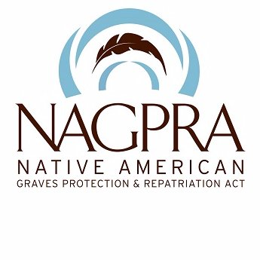
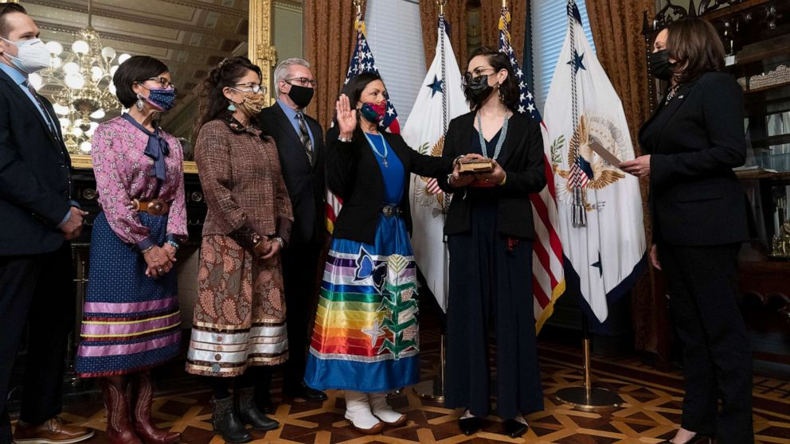
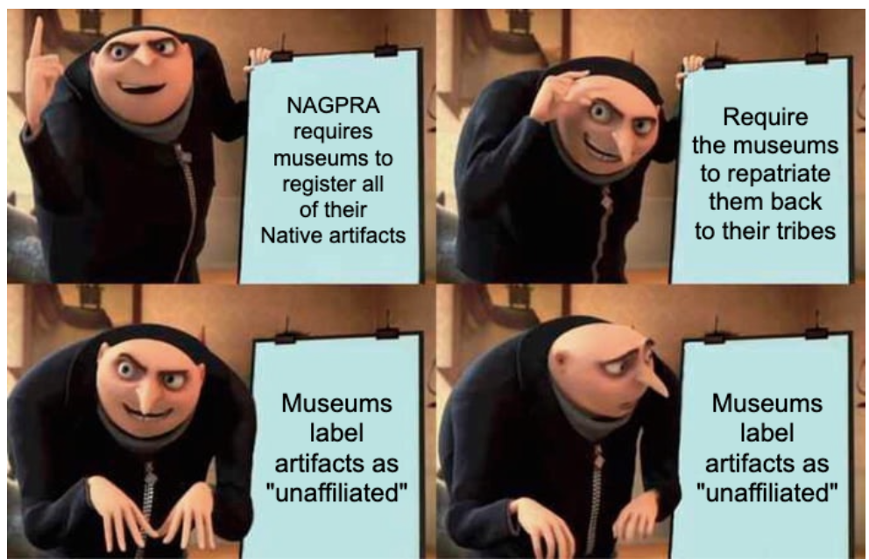
Definition:
NAGPRA stands for the Native American Graves Protection and Repatriation Act. This Act requires museums and institutions that receive federal funds to transfer Native remains and cultural items back to their descendants.
By: Dawn Nystrom, Charlene Duty, and Virginia Vance
History:
NAGPRA was signed into law in 1990 by President George HW Bush. At this time “Congress recognized that human remains of any ancestry "must at all times be treated with dignity and respect." The federal law was designed to ensure that human remains, and other cultural items are returned to their lineal descendants within Native American and Native Hawaiian nations. The law gave museums and institutions with these items 5 years to identify and repatriate items, but many institutions have been given extensions.
(Deb Haaland of the Laguna Pueblo tribe, pictured here as she becomes the first native American woman to ever be sworn in as Secretary of Interior.)
The Legislation Process:
Descendants of federally recognized Native American tribes or native Hawaiian organizations send repatriation request claims to the review committee.
Inadvertent discoveries must stop immediately and notify the Federal Agency or local tribe.
  Federal agencies include the Interior’s Bureau of Indian Affairs (BIA), Bureau of Land Management (BLM), Bureau of Reclamation (BOR), U.S. Fish and Wildlife Service (FWS) and NPS, Agriculture’s U.S. Forest Service, and of course the coroner office.
Intentional Excavations are far more involved.
In situ preservation should be considered but not required under NAGPRA.
Weaknesses:
Enforcement:
If a tribe is not federally recognized NAGPRA doesn’t apply.
If more than one tribe claims the artifact the process halts.
Items may be considered “culturally unidentifiable” and are then exempt from repatriation requirements.
Objects considered “indispensable to a scientific study” are exempt from repatriation requests.
NAGPRA is enforced by the Secretary of Interior with help from the NAGPRA review committee.
The NAGPRA review committee consists of two tribal members and one ad hoc member.
The current Secretary of Interior is Deb Haaland of the Laguna Pueblo tribe, she is the first native American ever to be elected into this office!
WHITE v. UNIVERSITY OF CALIFORNIA
Background:
In 1976, two human skeletons in a double burial site were discovered by a professor at University of California - Los Angeles on the Chancellor's official residence at University of California - San Diego. These are called the La Jolla remains. They are between 8977 - 9603 years old. The property these were found on was aboriginally occupied by members of the Kumeyaay Nation, which has several federally recognized Indian tribes. These remains have remained in custody of the University since their discovery. This case addresses disputes over custody of the remains. The tribes and their representatives requested several times since 2007 the repatriation of the La Jolla remains. This repatriation is opposed by Timothy White, Robert L. Bettinger, and Margaret Schoeninger, three professors working at different UC campuses who wish to study them, who are referred to as the Plaintiffs or The Scientists. Their main argument was that the remains were classified as “culturally unidentifiable” by the University and yet were filed under NAGPRA’s Notice of Inventory Completion as being “Native American”.
The Case:
The case itself, White v. University of California, is an appeal of a lower court’s judgment to dismiss the Plaintiff’s Petition for Writ of Administrative Mandamus and complaint in “California state court alleging causes of action for (1) violations of NAGPRA, (2) breach of the public trust, and (3) violation of Plaintiffs' First Amendment rights.” The Plaintiff’s claim that “the University failed to make a formal and adequate finding that the La Jolla remains were “Native American” within the meaning of NAGPRA...”. The university moved to dismiss the complaint based on jurisdiction because “(1) the Repatriation Committee and the twelve Kumeyaay tribes are necessary and indispensable parties who cannot be joined under Federal Rule of Civil Procedure 19 because they are immune from suit, (2) Plaintiffs lack standing under Article III, and (3) Plaintiffs' public trust and First Amendment claims are unripe.” The district court granted the motion to dismiss, and so the Plaintiffs appealed to a higher court.
Outcomes:
On August 27, 2014, the United States Court of Appeals, Ninth Circuit, declared agreement with the lower court’s dismissal of the case, and concluded that, “NAGPRA did not abrogate the Tribes' sovereign immunity; that, as an arm of the Tribes, the Repatriation Committee was entitled to sovereign immunity, and had not waived it by filing a separate lawsuit or by incorporating in California; that the Tribes and the Repatriation Committee were necessary and indispensable parties under Fed.R.Civ. P. 19; and that the public interest exception to Rule 19 did not apply. Therefore, the district court did not err by dismissing the action.”
Penalties and Repatriation:
There was no mention of penalties, though the case itself was an appeal, so that might be why. As for the remains, the courts dismissed the Plaintiff’s objection to the Repatriation, but record of the repatriation is not found, and the most recent articles talking about the case from 2016 say that the Plaintiffs will be attempting to appeal once more. Nothing more recent has been found in research for this project.

