Slide 1
Minority Stress and Psychological Adjustments Moderated by Stress Appraisals
Bernardo Sosa-Rosales, April Perez, Edgar Jimenez-Madora, Emilia Bumgardner, & Maria I. Iturbide
Cal Poly Humboldt
Introduction
The beginning of the pandemic triggered a series of academic, structural, social, and personal stressors for students. Some students experienced abrupt closure of colleges and universities (Maiya et al., 2021; Magson et al., 2021), while others reported not having access to needed resources for remote online learning (i.e., internet connection; Yip, 2020).
Furthermore, students reported undergoing stress about falling behind in class, the inability to socialize with their friends, participate in leisure activities, and the fear of a loved one becoming ill (Loon et al., 2021).
Stressed experienced by students of color was exacerbated by their minority status. These compounded stressors may have a negative impact on underrepresented students' mental health which we know is already impacted by ethnic minority stress (Arbona & Jimenez, 2014; Ancis et al., 2000).
Hypotheses/Research Questions
Challenge-focused stress appraisals (i.e., viewing stressful experiences as an opportunity) would moderate the associations between students of color achievement stress on self-esteem and academic sense of belonging.
Method
Participants and Procedures​
Undergraduate students (N = 192) completed an online survey and received course credit for their participation
78% women; Mage = 21.90; SD = 4.49; 43.1% Latinx, 36.5% White, 9.1% Other, 5.1% African American, 4.1% Asian, and 2% Native American)
Measures ​
Minority Stress Scale (EMSS; Borden et al., 1993): 33-items assess students ethnic minority stress (e.g., The university does not have enough professors of my race/ethnicity); rated 0 (does not apply) to 5 (extremely stressful); α = .97.
Stress Appraisal Measure (Roesch & Rowley, 2005): 7-items subscale assess the beliefs, attitudes, and emotions related to experiences of stress across challenge appraisal (e.g., I can positively attack stressors); rated 0 (not at all) to 4 (strongly agree); α = .92.
School Connectedness: 5-items assess perceptions of school connectedness (e.g., I feel close to people at my school); rated 1 (strongly disagree) to 5 (strongly agree); α = .77.
Results
Results showed that challenge stress appraisals significantly predicted higher self-esteem (β = .61; p < .001) and academic sense of belonging (β = .27; p < .01).
Minority student achievement stress did not predict self-esteem (β = -.05; p = .56) or academic sense of belonging (β = -.09; p = .31).
Challenge stress appraisals did not moderate the association between minority stress and self-esteem (β = -.05; p =.54) or academic sense of belonging (β = .08; p =.39).
Discussion
Preliminary analyses indicated that challenge stress appraisals did not moderate the association between minority stress and self esteem or academic sense of belonging; however, challenge stress appraisals was found to be a highly consistent predictor for higher self esteem and academic sense of belonging. Minority student achievement stress
Further research needs to examine the specific stressors associated in relation to the COVID-19 pandemic which may have exceeded those stressors associated with ethnic minority status. Further analyses will examine if associations are different for students of color and White students.
Limitations and Future Directions
This may warrant future research examining other factors (e.g., student ethnic/racial breakdown of the university, amount of interaction with faculty and students, whether a post-secondary institution is a minority serving institution) that influence and potentially explain this difference.
The sample was non-representative and was collected during a historical period in our educational infrastructure.
In the COVID-19 pandemic may have influenced a student’s beliefs, attitudes, and emotions related to challenge appraisal stressors as needs and strategies are shifted to address immediately new overarching stressors.
During this time, distanced learning (e.g., off-campus teaching and learning) may have impacted minority student achievement stress as the magnitude of these questions shift due to uncertainty and change into a virtual learning capacity.
Table 1.
Variables | 1 | 2 | 3 | 4 | Mean (SD)
Minority Stress - Achievement | -- | -.21 | -.14 | -.10 | 1.30 (0.90)
2. Challenge Stress Appraisals | -.29* | -- | .41** | .63** | 3.38 (0.93)
3. Academic sense of belonging | .17 | .25** | -- | .23* | 3.81 (0.66)
4.Self-esteem | -.38** | .61** | .47** | -- | 2.83 (0.55)
Mean (SD) | 1.79 (1.60) | 3.24 (0.93) | 3.57 (0.68) | 2.73 (0.55) | -
NOTE: top right hand corner non-SOC; lower left SOC

Slide 2
Table 2. Depression and Self-esteem moderated by School Connectedness
 | Depression |  |  | Self-esteem |  |  | GPA
 | Step 1 | Step 2 | Step 3 | Step 1 | Step 2 | Step 3 | Step 1 | Step 2 | Step 3
Acculturative stress | -.26** | -.07 | -.09 | .40** | .22** | .25** | -.12 | -.11 | -.12
School Connectedness |  | .39** | .42** |  | -.38** | -.42** |  | .01 | .02
Interaction |  |  | -.15* |  |  | .18** |  |  | -.04
R² | .07 | .18 | .20 | .16 | .27 | .30 | .01 | .01 | .02
R² change | .07** | .12** | .02* | .16** | .11** | .03** | .01 | .00 | .00
Model F | 13.16** | 20.94** | 15.87** | 36.05** | 34.81** | 26.72** | 2.50 | 1.25 | 0.92
Note: Standardized Betas reported. *p < .05, **p < .01
Table 2. ran as is
 | School Connectedness |  |  | Self-esteem
 | Step 1 | Step 2 | Step 3 | Step 1 | Step 2 | Step 3
Minority Achievement Stress | -.16 | -.08 | -.09 | -.21* | -.05 | -.04
Challenge Stress Appraisal |  | .28** | .27** |  | .61** | .61**
Interaction |  |  | .07 |  |  | -.04
R² | .03 | .10 | .10 | .05 | .39 | .39
R² change | .03 | .07* | .006 | .05* | .34** | .002
Model F | 3.12 | 6.40** | 4.50** | 5.68 | 37.04** | 24.69**
Note: Standardized Betas reported. *p < .05, **p < .01
Variables | 1 | 2 | 3 | 4 | Mean (SD)
Minority Stress - Achievement | -- | -.21 | -.14 | -.10 | 1.30 (0.90)
2. Challenge Stress Appraisals | -.29* | -- | .41** | ..63** | 3.38 (0.93)
3. Academic sense of belonging | ,17 | .25** | -- | .23* | 3.81 (0.66)
4.Self-eteem | -.38** | .61** | .47** | -- | 2.83 (0.55)
Mean (SD) | 1.79 (1.60) | 3.24 (0.93) | 3.57 (0.68) | 2.73 (0.55) | -
NOTE: top right hand corner non-SOC; lower left SOC
Table 2. Depression and Self-esteem moderated by School Connectedness
 | nonSOC |  |  |  |  |  | SOC
 | School Connectedness |  |  | Self-esteem |  |  | School Connectedness |  |  | Self-esteem
 | Step 1 | Step 2 | Step 3 | Step 1 | Step 2 | Step 3 | Step 1 | Step 2 | Step 3 | Step 1 | Step 2 | Step 3
Minority Achievement stress | -.14 | -.07 | -.08 | -.07 | .07 | .10 | -.17 | -.12 | -.114 | -.41** | -.27* | -.27*
Challenge Stress Appraisal |  | .35** | .35** |  | .70** | .68** |  | .19 | .11 |  | .45** | .40**
Interaction |  |  | .04 |  |  | -.10 |  |  | .19 |  |  | .11
R² | .02 | .13 | .14 | .005 | .47** | .48 | .03 | .06 | .09 | .16 | .35 | .36
R² change | .02 | .12 | .002 | .005 | .47** | .01 | .03 | .03 | .03 | .16* | .18** | .01
Model F | 1.28 | 5.20** | 3.46* | .32 | 30.19** | 20.51** | 1.53 | 1.65 | 1.65 | 9.65* | 12.74** | 8.67*
Note: Standardized Betas reported. *p < .05, **p < .01
Table 2. with the soc_nonsoc variable
 | School Connectedness |  |  |  | Self-esteem
 | Step 1 | Step 2 | Step 3 | Step 4 | Step 1 | Step 2 | Step 3 | Step 4
Minority Achievement Stress | -.16 | -.16 | -.09 | -.10 | -.21* | -.22* | -.06 | -.06
Soc_nonSoc |  | -.004 | .02 | .03 |  | .01 | .07 | .07
Challenge Stress Appraisal |  |  | .28** | .27** |  |  | .61** | .62**
Interaction |  |  |  | .08 |  |  |  | -.04
R² | .03 | .03 | .10 | .10 | .05 | .05 | .39 | .39
R² change | .03 | .00 | .07* | .01 | .05* | .00 | .34** | .29
Model F | 3.12 | 1.55 | 4.26* | 3.38* | 5.68* | 2.82 | 25.01** | 18.72**
Note: Standardized Betas reported. *p < .05, **p < .01

Slide 3
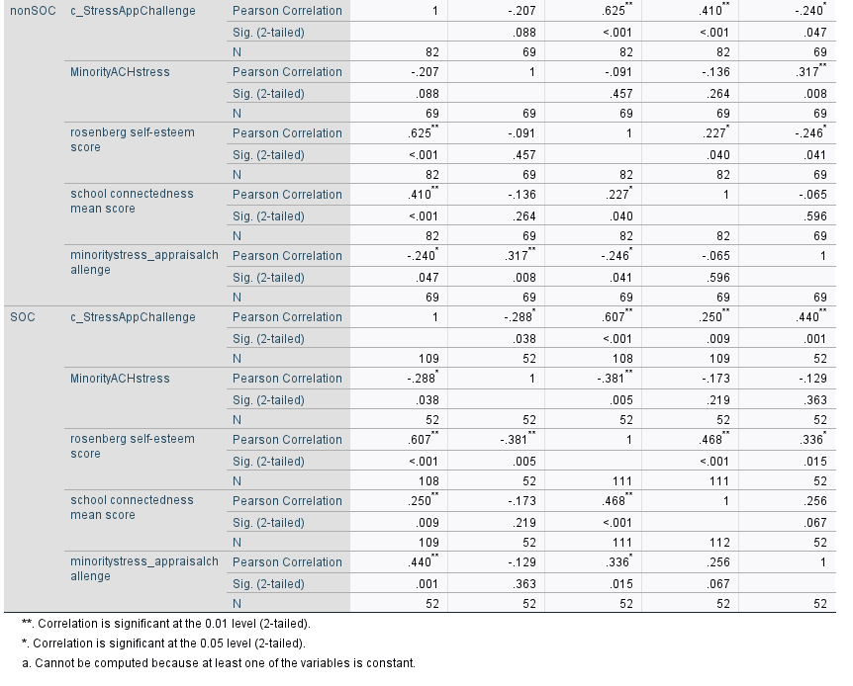

Slide 4
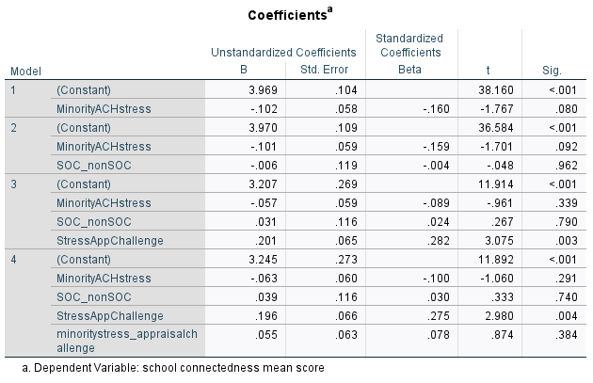
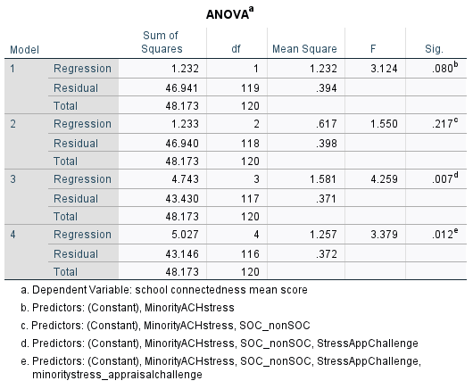
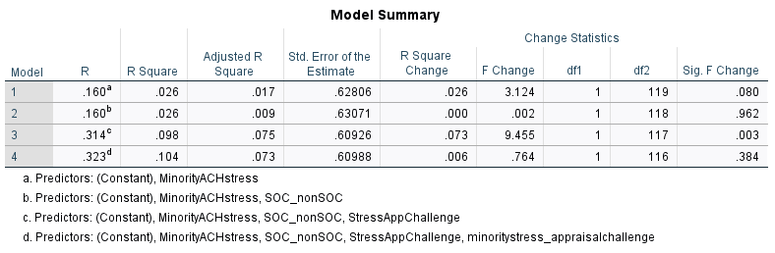
Discussion
Challenge stress appraisals did not moderate the association between minority stress and study outcomes, however, challenge stress appraisals was found to be a significant predictor for higher self esteem and academic school connectedness.
WHY - WHAT CAN BE INFERRED???
Limitations and Future Directions
We were not able to control for COVID related stress.
This may warrant future research to collect larger datasets to examine factors such as (e.g., student ethnic/racial breakdown of the university, amount of interaction with faculty and students, whether a post-secondary institution is a minority serving institution) that influence and potentially explain this difference.
Due to the sample coming from our specific university’s community during a historical period in our educational infrastructure, the results cannot be generalized to university communities outside of our own, and replication studies should be conducted in the future. Students may have had differing experiences depending on the concentration of COVID cases within their immediate community.
The COVID pandemic may have influenced a student’s beliefs, attitudes, and emotions related to challenge appraisal stressors, as needs and strategies are shifted to address immediately new overarching stressors. Due to the overwhelming nature of the pandemic, students’ capacity for reappraising stressful circumstances may have been rendered less effective.
We only focus on ethnic minority stress in which minority stress goes beyond looking at culture to other diverse identities in which could be does not take into account the intersectionality of identities whom may still be experiencing stress
At the time of the study, Ethnic minority stress was focused on one identity rather than the diverse set of identities that minority stress could be applicable considering the intersectionality of

Slide 5
Table 2. ran as is
 | School Connectedness |  |  | Self-esteem
 | Step 1 | Step 2 | Step 3 | Step 1 | Step 2 | Step 3
Minority Achievement Stress | -.16 | -.08 | -.09 | -.21* | -.05 | -.04
Challenge Stress Appraisal |  | .28** | .27** |  | .61** | .61**
Interaction |  |  | .07 |  |  | -.04
R² | .03 | .10 | .10 | .05 | .39 | .39
R² change | .03 | .07* | .006 | .05* | .34** | .002
Model F | 3.12 | 6.40** | 4.50** | 5.68 | 37.04** | 24.69**
Note: Standardized Betas reported. *p < .05, **p < .01
Table 2. School connectedness as predicted by Minority Achievement Stress and Challenge Stress Appraisals
Variables | nonSOC (n =) |  |  | SOC (n =) |  |  | Entire Sample (N =)
 | Step 1 | Step 2 | Step 3 | Step 1 | Step 2 | Step 3 | Step 1 | Step 2 | Step 3
SOC Status | – | – | – | – | – | –
Minority stress | -.14 | -.07 | -.08 | -.17 | -.12 | -.114
Appraisal |  | .35** | .35** |  | .19 | .11
Interaction |  |  | .04 |  |  | .19
R² | .02 | .13 | .14 | .03 | .06 | .09
R² change | .02 | .12 | .002 | .03 | .03 | .03
Model F | 1.28 | 5.20** | 3.46* | 1.53 | 1.65 | 1.65
Note: Standardized Betas reported. *p < .05, **p < .01
Table 2. Minority Achievement Stress and School Connectedness by Challenge Stress Appraisals
 | nonSOC (n =) |  |  |  |  |  | SOC (n=) |  |  |  |  |  | Entire Sample (N=)
 | School Connectedness |  |  | Self-esteem |  |  | School Connectedness |  |  | Self-esteem |  |  | School Connectednes |  |  | Self-esteem
 | Step 1 | Step 2 | Step 3 | Step 1 | Step 2 | Step 3 | Step 1 | Step 2 | Step 3 | Step 1 | Step 2 | Step 3 | Step 1 | Step 2 | Step 3 | Step 1 | Step 2 | Step 3
Minority stress | -.14 | -.07 | -.08 | -.07 | .07 | .10 | -.17 | -.12 | -.114 | -.41** | -.27* | -.27*
Appraisal |  | .35** | .35** |  | .70** | .68** |  | .19 | .11 |  | .45** | .40**
Interaction |  |  | .04 |  |  | -.10 |  |  | .19 |  |  | .11
R² | .02 | .13 | .14 | .005 | .47** | .48 | .03 | .06 | .09 | .16 | .35 | .36
R² change | .02 | .12 | .002 | .005 | .47** | .01 | .03 | .03 | .03 | .16* | .18** | .01
Model F | 1.28 | 5.20** | 3.46* | .32 | 30.19** | 20.51** | 1.53 | 1.65 | 1.65 | 9.65* | 12.74** | 8.67*
Note: Standardized Betas reported. *p < .05, **p < .01
Table 3. Self-esteem as predicted by Minority Achievement Stress and Challenge Stress Appraisals
 | nonSOC (n =) |  |  | SOC (n =) |  |  | Entire Sample (N =)
 | Step 1 | Step 2 | Step 3 | Step 1 | Step 2 | Step 3 | Step 1 | Step 2 | Step 3
SOC Status | – | – | – | – | – | –
Minority stress | -.07 | .07 | .10 | -.41** | -.27* | -.27*
Appraisal |  | .70** | .68** |  | .45** | .40**
Interaction |  |  | -.10 |  |  | .11
R² | .005 | .47** | .48 | .16 | .35 | .36
R² change | .005 | .47** | .01 | .16* | .18** | .01
Model F | .32 | 30.19** | 20.51** | 9.65* | 12.74** | 8.67*
Note: Standardized Betas reported. *p < .05, **p < .01

Slide 6
Minority Stress and Psychological Adjustments Moderated by Stress Appraisals
Bernardo Sosa-Rosales, April Perez, Edgar Jimenez-Madora, Emilia Bumgardner, Kevin D. Cherry & Maria I. Iturbide
Cal Poly Humboldt
Introduction
The beginning of the pandemic triggered a series of academic, structural, social, and personal stressors for students
  inability to access needed resources for remote online learning (Yip, 2020) and socialize with their friends; fear of a loved one becoming ill (Loon et al., 2021)
The stress appraisal(s) process follows a variety of stressors (i.e., primary: threat, challenging, or centrality) and the evaluation to cope with said stressors.
For students of color, COVID related stress was exacerbated by their Minority status (MS). These compounded stressors may have a negative impact on underrepresented students' mental health which we know is already impacted by ethnic minority stress (Arbona & Jimenez, 2014; Ancis et al., 2000).
Hypotheses/Research Questions
Challenge-focused stress appraisals (APP; i.e., viewing stressful experiences as an opportunity) would moderate the associations between students of color Achievement stress on Self-esteem and Academic sense of belonging.
Method
Participants and Procedures​
Undergraduate students (N = 192) completed an online survey and received course credit for their participation
78% women; Mage = 21.90; SD = 4.49; 43.1% Latinx, 36.5% White, 9.1% Other, 5.1% African American, 4.1% Asian, and 2% Native American)
Measures ​
Minority Stress Scale (EMSS; Borden et al., 1993): 6-item; rated 0 (does not apply) to 5 (extremely stressful); α = .97.
Stress Appraisal Measure (Roesch & Rowley, 2005): 7-items rated 0 (not at all) to 4 (strongly agree); α = .92.
School Connectedness: 5-items rated 1 (strongly disagree) to 5 (strongly agree); α = .77.
Results
For Students of Color (SOC), all bivariates were significant ( p < .01) except for stress appraisal and minority stress ( p < .05), school connectedness and minority stress, which was not significant (see Table 1).
For non-SOC, all bivariates were significant at ( p < .01) except for sense of belonging and self esteem ( p < .05) and minority stress which was not significant with anything(see Table 1).
Results showed that challenge stress appraisals significantly predicted higher self-esteem and school connectedness (see Table 2)..
Minority student achievement stress did not predict self-esteem or school connectedness..
Challenge stress appraisals did not moderate the association between minority stress and self-esteem or school connectedness.
Table 1. Descriptive Statistics and Bivariate Correlations for Study Variables (N = 192)
Variables | 1 | 2 | 3 | 4 | Mean (SD)
Minority Stress (MS) | -- | -.21 | -.14 | -.10 | 1.30 (0.90)
2. Challenge Stress Appraisal (APP) | -.29* | -- | .41** | .63** | 3.38 (0.93)
3. School Connectedness (SC) | .17 | .25** | -- | .23* | 3.81 (0.66)
4.Self-esteem | -.38** | .61** | .47** | -- | 2.83 (0.55)
Mean (SD) | 1.79 (1.60) | 3.24 (0.93) | 3.57 (0.68) | 2.73 (0.55) | -
NOTE: top right hand corner non-SOC; lower left SOC
Discussion
Challenge stress appraisals did not moderate the association between minority stress and study outcomes, however, did predict the study outcome.
Students who view stress as a challenge tend not to get discouraged as easily when faced with a predicament and being able to positively attack those stressors may positively influence their self-esteem and school connectedness.
Limitations and Future Directions
The results cannot be generalized to communities outside of the university.
Study did not control for COVID related stress.
The study only focused on an aspect of ethnic minority stress, where as minority stress goes beyond just looking at culture and can be applied to other diverse identities (e.g., gender, abilities, orientation) and the intersectionality of those identities. These individuals may experience disproportionate amounts of stress.
COVID highlighted and exacerbated existing disparities among people of diverse identities and background. It could be that COVID related stress superseded the negative impact of minority stress.
Future research should expand the study by evaluating other stress appraisal(s) (i.e., centrality or threat) that may yield more understanding on the SOC academic sense of belonging and self-esteem.
Table 2. School connectedness and Self-Esteem as predicted by Minority Achievement Stress and Challenge Stress Appraisals
Variables | School Connectedness |  |  | Self-esteem
 | Step 1 | Step 2 | Step 3 | Step 1 | Step 2 | Step 3
SOC Status | .02 | .03 | .04 | .07 | .07 | .08
MS | -.09 | -.10 | -.09 | -.06 | -.06 | -.05
APP | .28** | .27** | .26** | .61*** | .62*** | .60***
MS X APP |  | .08 | .09 |  | -.04 | -.04
SOC X MS APP |  |  | .06 |  |  | .06
R² | .10 | .10 | .11 | .39 | .39 | .39
R² change | .07** | .01 | .003 | .34*** | .002 | .003
Model F | 4.26** | 3.38** | 2.78* | 25.01*** | 18.72*** | 15.02***
Note: Standardized Betas reported. *p < .05, **p < .01, ***p< .001

