Slide 1
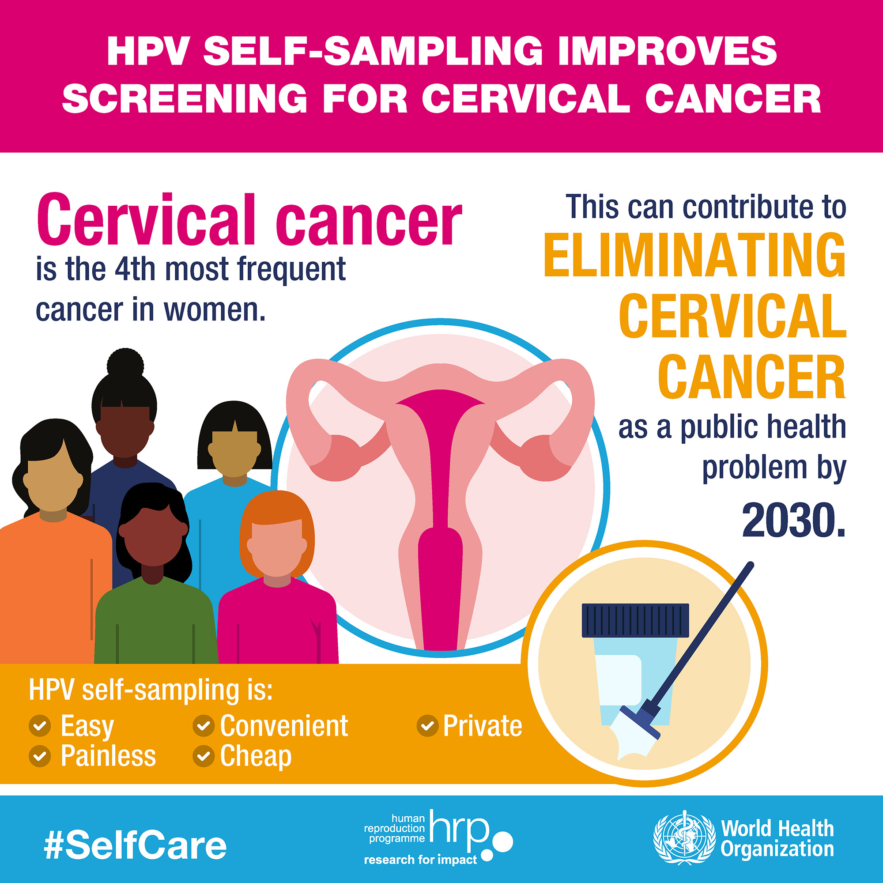

Increase Cervical Cancer Screening Participation in a Rural FQHC
Background & Importance of Issue
Key Concepts & Outcomes
Key Players
Cervical cancer is the 4th most common cancer in individuals with a cervix (WHO, n.d.)
Approximately 93% of cervical cancers are preventable (CDC, 2020)
Persistent infection with high risk HPV (HPV16 & HPV18) is the cause of almost all cervical cancers (Fontham et al., 2020)
The majority of all cervical cancers are found in individuals who have never received screening before or who are behind on screening frequency (Salville et al., 2018)
Lack of cervical cancer screening in 2021 in Humboldt County with >40% unscreened in the local FQHC
Primary hrHPV testing every 5 years is the preferred screening option for average-risk individuals aged 25–65 years (ACS, 2021)
Patients: individuals with a cervix, age 25 to 65 years old, due for cervical cancer screening, with no history of abnormal testing, and who decline practitioner collected Pap
Other Key Players:
Primary care providers – MD, DO, FNP, PA
Clinical support staff – RN, LVN, MA, Lab tech
Laboratory services who offer vaginal HPV testing
QI team member
Insurance & billing personnel
Evaluation
Supporting Evidence
To evaluate goal of increase in cervical cancer screening among patients declining Pap, EMR reports will be generated to determine number who declined Pap and number who completed self-collection
Patients who decline Pap are significantly more likely to participate in screening if offered vaginal self-swab by 2.14 (Racey et al., 2013)
Vaginal self-swab has higher sensitivity in detecting HPV than practitioner collected samples and higher specificity (>95%) for HPV16 and HPV18 (Saville et al., 2020)
Individuals with positive HPV self-test are likely to participate in follow-up practitioner led testing and treatment (Lilliecreutz et al., 2020)
OUTCOME: There will be a 75% increase in cervical cancer screening participation in patients who decline Pap/cervical cytology screening services by December 2023
PROCESS EVALUATION Attendance of nurse trainings Attendance and agenda of policy workgroup meetings | IMPACT EVALUATION Pre & post test of nursing knowledge Policy completion and implementation
Interventions & Solutions
Patients who decline Pap testing are encouraged to participate in vaginal self-swabbing to detect presence of HPV
All RN staff will attend training with following agenda:
Identify patients who qualify for HPV self-swab
How to educate patient on self collection technique
How to complete RN visit that is appropriate for patient and clinic
How to handle positive results and needed follow-up
Policy allowing RN to order HPV testing as a standing order
Form a workgroup of key players to follow the John Hopkins Nursing Evidence-Based Practice Model QI framework
References
Framework
  American Cancer Society. (2021, April 22). The American Cancer Society Guidelines for the prevention and early detection of cervical cancer. Retrieved April 24, 2022, from https://www.cancer.org/cancer/cervical-cancer/detection-diagnosis-staging/cervical-cancer-screening-guidelines.html
  Centers for Disease Control and Prevention. (2020). Cervical cancer is preventable. Vital Signs. https://www.cdc.gov/vitalsigns/cervical-cancer/index.html#:~:text=As%20many%20as%2093%25%20of,HPV%20(human%20papillomavirus)%20vaccination.&text=In%202012%2C%208%20million%20US,in%20the%20last%205%20years.
  Fontham, E. T., Wolf, A. M., Church, T. R., Etzioni, R., Flowers, C. R., Herzig, A., Guerra, C. E., Oeffinger, K. C., Shih, Y. C. T., Walter, L. C., Kim, J. J., Andrews, K. S., DeSantis, C. E., Fedewa, S. A., Manassaram‐Baptiste, D., Saslow, D., Wender, R. C., & Smith, R. A. (2020). Cervical cancer screening for individuals at average risk: 2020 guideline update from the American Cancer Society. CA: A Cancer Journal for Clinicians, 70(5), 321–346. https://doi.org/10.3322/caac.21628
  Lilliecreutz, C., Karlsson, H., & Spetz Holm, A. C. (2020). Participation in interventions and recommended follow-up for non-attendees in cervical cancer screening -taking the women’s own preferred test method into account—a Swedish randomised controlled trial. PLOS ONE, 15(7). https://doi.org/10.1371/journal.pone.0235202
  Racey, C. S., Withrow, D. R., & Gesink, D. (2013). Self-collected HPV testing improves participation in cervical cancer screening: A systematic review and meta-analysis. Canadian Journal of Public Health, 104(2), e159–e166. https://doi.org/10.1007/bf03405681
  Saville, M., Hawkes, D., Mclachlan, E., Anderson, S., & Arabena, K. (2018). Self-collection for under-screened women in a national cervical screening program: Pilot study. Current Oncology, 25(1), 27–32. https://doi.org/10.3747/co.25.3915
  Saville, M., Hawkes, D., Keung, M. H. T., Ip, E. L. O., Silvers, J., Sultana, F., Malloy, M. J., Velentzis, L. S., Canfel l, K., Wrede, C. D., & Brotherton, J. M. L. (2020). Analytical performance of HPV assays on vaginal self-collected vs practitioner-collected cervical samples: The scope study. Journal of Clinical Virology, 127, 104375. https://doi.org/10.1016/j.jcv.2020.104375
  World Health Organization. (n.d.). Cervical cancer. Retrieved February 24, 2022, from https://www.who.int/health-topics/cervical-cancer#tab=tab_1
John Hopkins Nursing Evidence-Based Practice Model helps nurses translate best evidences into their own practice to elicit change
Practice Question – as a team define the problem and develop the EBP question
Evidence – conduct research to find evidence to support the best practice & develop recommendations for change
Translation – implement recommendations and evaluate outcomes, then disseminate findings
Jennifer Webster, RN
Associate Degree in Nursing
RN-BSN Student

