Slide 1
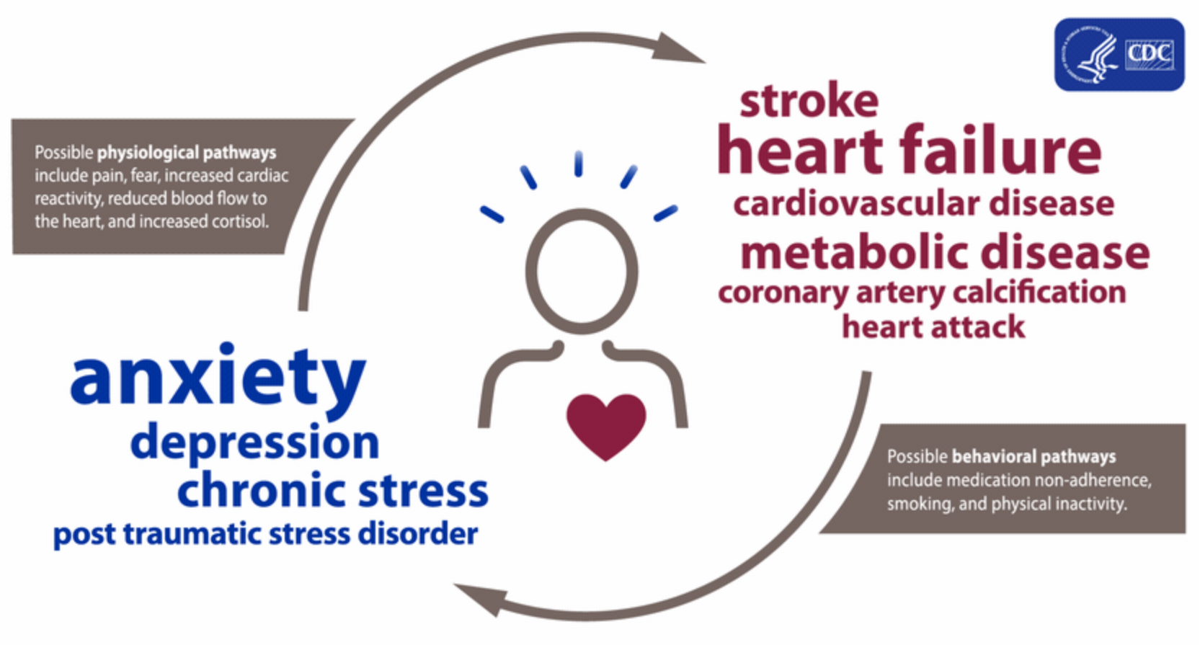
Improving Health Outcomes for Rural Parent Caregivers of Neurodiverse Children
Background
Key Concepts & Outcomes
Key Players
1/3 to 2/3 of parent caregivers of neurodiverse children experience clinical levels of parenting stress (Roberts et al., 2019)
Parents in rural communities are especially affected by lack of support and mental health access (Robinson et al., 2017)
Healthy People 2030 Objective: “reduce the prevalence of anxiety or depression among family caregivers of people with disabilities,” (Office of Disease Prevention & Health Promotion, n.d.)
Strength-based, family-focused care can help address the mental health needs of parent caregivers and children in rural communities (Heflinger and Christens, 2006, as cited in Robinson et al., 2017).
SMART Goal: By November 2023, 80% of parents of neurodiverse children living in rural California will report improved health access, overall wellbeing, and greater quality of life.
Rural parent caregivers of neurodiverse children, their families, and personal support networks
Primary care providers, behavioral health clinicians, nurses, care coordinators, and administrative staff.
Local and state advocacy organizations, legislators and Regional Centers
Evaluation
Process evaluations:
Track Mindfulness program participation among patients (goal 80% attendance) and subsequent mental health assessment rates
Audit and track performance of vital signs and lab work
Impact evaluations:
Assessments: PHQ-ADS, quality of life indicators
Results of vital signs (performed every visit) and lab work/biomarkers (e.g., annual cortisol)
Patient satisfaction surveys; primary care and behavioral health appointment utilization
Importance of Issue
Stress increases risk for hypertension and cardiovascular disease (World Health Organization, 2013, as cited in Foody et al., 2014).
Mindfulness training (Roberts et al., 2019), & increased health assessment and screenings can offset the detrimental effects of chronic stress (Foody et al., 2014).
Interventions & Solutions
Eight-week Mindfulness training course provided to parent caregivers (in-person/virtually/hybrid)
Increase awareness: train nurses and staff to identify parent caregivers in patient population. Increase mental health assessments, vital sign screening (including ambulatory B/P), and annual stress biomarker screening
Pass SB-316 and enable Federally Qualified Health Centers to provide primary and mental health care in the same day.
Nurse Advocacy: Expand and improve access to integrative mental health in rural clinics across California
References
Foody, C., James, J. E., & Leader, G. (2014). Parenting stress, salivary biomarkers, and ambulatory blood pressure: A comparison between mothers and fathers of children with autism spectrum disorders. Journal of Autism and Developmental Disorders, 45(4), 1084–1095. https://doi.org/10.1007/s10803-014-2263-y
Roberts, L. R., Boostrom, G. G., Dehom, S. O., & Neece, C. L. (2019). Self-reported parenting stress and cortisol awakening response following mindfulness-based stress reduction intervention for parents of children with developmental delays: A pilot study. Biological Research For Nursing, 22(2), 217–225. https://doi.org/10.1177/1099800419890125
Robinson L.R., Holbrook J.R., Bitsko R.H., et al. (2017). Differences in health care, family, and community factors associated with mental, behavioral, and developmental disorders among children aged 2-8 years in rural and urban areas – United States, 2011-2012. MMWR Surveill Summ; 66(8): 1-11. doi:10.15585/mmwr.ss6608a1
Framework
The Iowa Model is a Quality Improvement framework that promotes evaluation and implementation of evidence-based practice in order to address clinical “triggers” and pilot new strategies. Patient and interdisciplinary team perspectives guide this framework.
Amy Neff, RN
Nursing (RN to BSN)
Spring 2022

