Slide 1


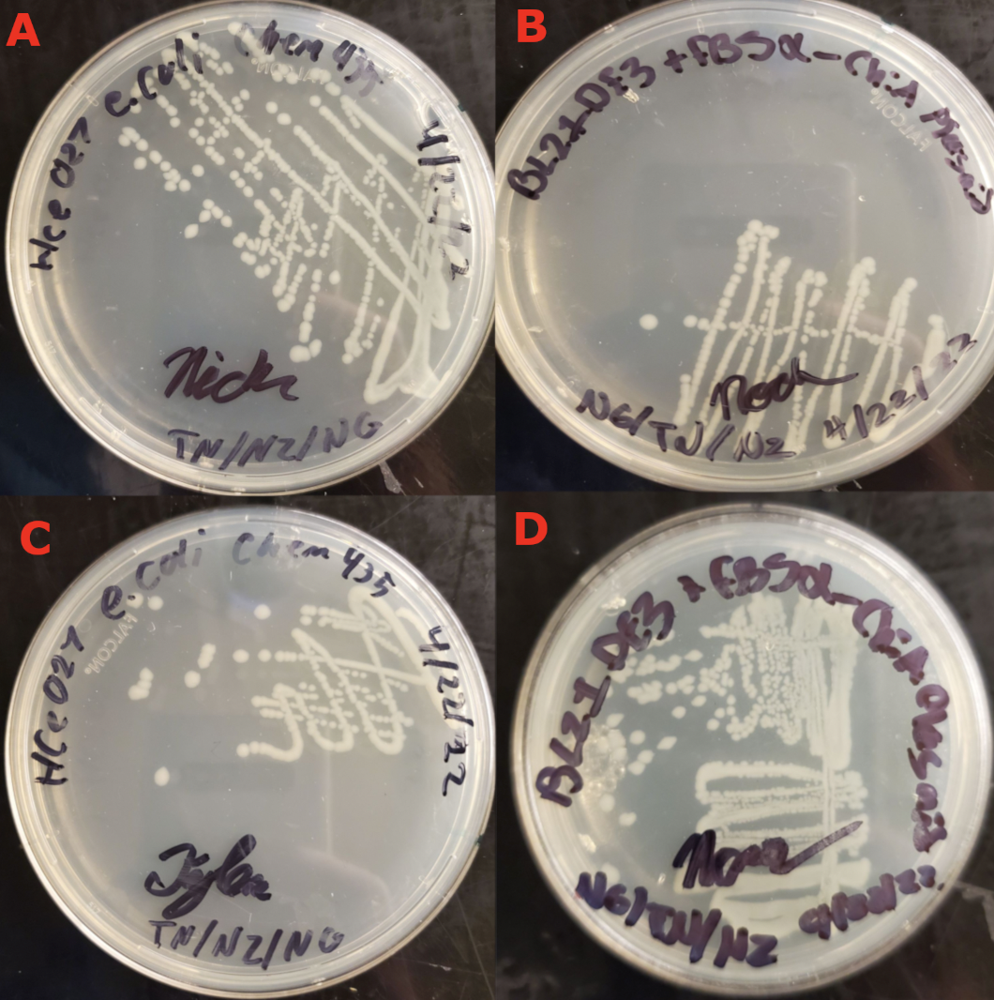
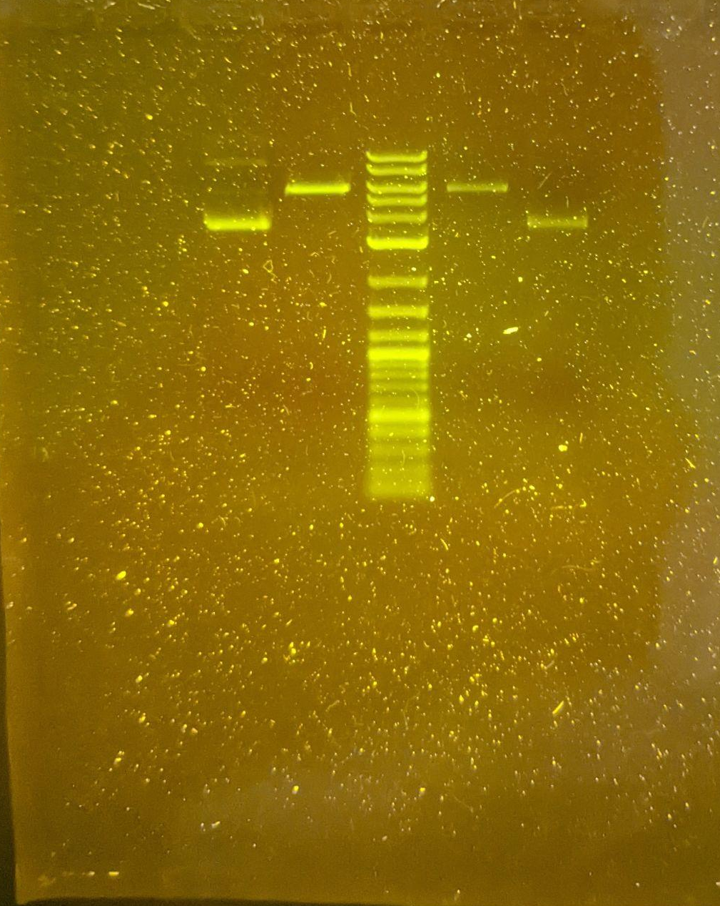
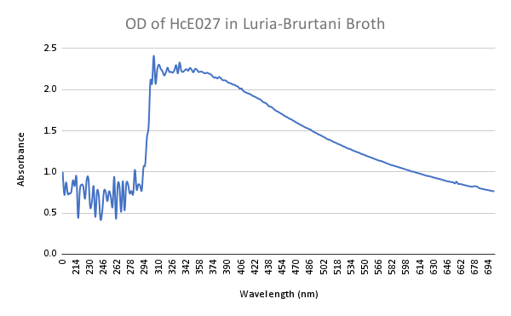
Electroporation of E. coli and Agar Gel Electrophoresis of FB5⍺
Department of Chemistry &
Biochemistry
Noah Glick, Nick Zuniga, Tyler Nagle, Dr. Jeffrey Schineller¹, Dr. Jenny A. Cappuccio¹
¹ CHEM 435L - Biochemistry II Lab - Department of Chemistry, Humboldt State University, Arcata, CA, USA
Chitin is a ubiquitous biopolymer that is the second-most abundant polysaccharide after cellulose. It is a rich source of nitrogen and reduced carbons which is currently underutilized and wasted more than need be. Chitinases – enzymes that digest chitin to its constituent monomers – have the potential to put this natural, sustainable resource to use. The applications range from the production of biofuel and fertilizers to uses within the medical field, being implicated in pertinent epidemiological topics such as asthma and COVID-19. As such, chitinases are a rife topic in research. In this experiment, a pET28a(+) plasmid purported to contain the ChiA endochitinase gene from S. marcescens with a 6x His tag was extracted from an FB5-alpha strain of E. coli. This plasmid was analyzed using agar gel electrophoresis to determine that the gene was not present in the plasmid. The plasmid was electroporated into a BL21(DE3) strain of E. coli, and confirmed to have been transformed by growth on kanamycin-containing media. Isolation of the ChiA protein will be attempted by immobilized metal affinity chromatography, and the protein samples will be analyzed by SDS-PAGE to verify whether the gene was expressed as the recombinant protein.
Experiment began with the growth of Escherichia coli; strain HCe-027 (BL21 DE3) and strain HCe-029 (FB5α ChiA) in sterile LB broth overnight. Both strains were quadrant streaked onto LB/Agar plates without antibiotics for colony extraction.
FB5α ChiA Plasmid Preparation
E. Coli strain HCe-029 colonies from the growth plate were selected and placed in 250mL of LB-Broth with 11.5mg of Kanamycin antibiotic for selection for cells with the FB5α ChiA plasmid. Once broth culture growth was determined to have an OD600 of 0.59AU, the broth was then separated into 6 - 50mL centrifugation tubes with 40mL of culture broth in each. These tubes were centrifuged down into pellets with supernatant discarded. All tubes were resuspended in SuperQ water and consolidated into 2 - 50mL tubes and re-centrifuged. These cells were stored at -20°C. The next day, isolation of the plasmid was performed with the ThermoFisher GeneJET Plasmid Miniprep Kit. Nanodrop IR reader used to analyze concentration of samples. 200 ng of sample plasmids were digested with 1μL of HindiII, 1μL of BamHI enzymes, and 1μL 10x Fast Digest. These samples were digested for 5 minutes in a heating block at 37°C. Once finished, 2μL 6x DNA loading buffer was added and vortexed. In a prepared 1% agarose block, the plasmids were loaded, digested and undigested along with Log 2 Ladder for confirmation of plasmids as well as the gene for ChiA.
E. Coli BL21 DE3 Electrocompetency Preparation
Strain HCe-027, colonies from the growth plates were selected and grown in 250mL of LB broth without Kanamycin. Cells were centrifuged and pelleted down at 4000 RCF at 4°C for 10 minutes. Rinsing of cells commenced with gentle resuspension in MilliQ water and centrifuged at 4000 RCF at 4°C for 10 minutes; rinsing was performed twice.
Transformation and Cloning of Plasmids
Electroporation using 6μL (495pg) of plasmid and 94μL of electrocompetent HCe-027 cells were transformed at 2.5kV in a dry electroporation cuvette. Sample was added to 2mL of sterile LB Broth and allowed to grow in an incubator for 24 hours. Cells were plated on LB/Agar plates with Kanamycin to restrict growth to only the cells containing the plasmids. Control plate was also streaked without Kanamycin for confirmation of living cells if Kanamycin plates did not grow.0d
No notable setbacks occurred until the first agarose gel run. In order to achieve the requisite amount of DNA in the digest, several dozen microliters were needed due to the low concentration. As such, all of the plasmid samples were combined and concentrated by evaporating the solvent. This used all the prepared plasmid, so more FB5-alpha cells were grown to harvest the plasmid from, delaying progress of the experiment. Additionally, the electrocompetent cells which were prepared from the BL21(DE3) vector strain were stored at 4 degrees celsius, instead of the required -80. This led to all of the electrocompetent cells lysing, not leaving any viable cells to electroporate, again necessitating regrowth of cells. Care was taken in future preparations of competent cells to add 10% glycerol and store at -80 before use.
Upon observation of the results from the agarose gel electrophoresis, it appeared that our restriction enzymes did not show evidence of the ChiA endochitinase gene within the plasmid. After regrowing the bacteria and re-extracting the plasmid, a second electrophoresis procedure was carried out. Running the agarose gel a second time yielded similar results. Electroporation of a new batch of electrocompetent cells with the plasmid did not yield the expected results, as none of these cells showed sign of kanamycin resistance when plated. The electroporator was set to 200 V instead of 2,500 V, which likely led to a lack of pore formation, and no uptake of the plasmid.
A third gel was set up and ran using residual plasmid, but error was made in the buffer used. MilliQ water instead of 1x TEA buffer led to the gel showing streaking in the kaleidoscope ladder, and no sign of the plasmid. A fourth gel accompanied by longer incubation time, and higher concentration of the restriction enzymes along with an undigested control showed similar results to the first and second. This could indicate a number of things, but the most likely is that the ChiA endochitinase gene is not in the FB5-alpha plasmid. Nonetheless, a third and final batch of electrocompetent cells were prepared, and electroporated at the correct voltage (2500) with sufficient plasmid.
Streaking on kanamycin plates post the correct electroporation yielded positive results for growth. This is clear evidence of a successful electroporation as previous attempts did not yield positive results
Abstract
Methods
Discussion
Serratia marcescens is currently the most active organism for the production of chitinase (1). BJL200 is a known gene of interest present in Serratia marcescens that encodes for the production of chitinase has been isolated and expressed in E.coli as well as S. marcescens. In S. marcescens, chitinase isolate from the cloned version of the gene had shown the export of the enzyme did not show any processing at the N-terminus (2). It is possible that S. marcescens can mutate to overproduce chitinase during tandem gene duplication. Mutation in IMR-E1 was shown to create the overproduction property of S. marcescens through manipulation of IMR-E1 one could manipulate the production of Chitanase (3). However, chitinase is also present in mammalian cells as well as the surrounding environment.
Mammalian chitinases include chitotriosidase, which is found in humans and when dysfunctional causes Gaucher disease (4). Human acidic mammalian chitinase, another human chitinase, is implicated in asthma (5). Among these and the other mammalian chitinases, there is a conserved structure in the catalytic domain of this class of chitinases. The essential mechanism involves protonation of the β 1:4 glycosidic bond by a glutamate residue (6).
There have been several attempts to carry out production of chitinases in E. coli from several species of microorganisms (7). One of these proteins (which is the same one used in this experiment) is called ChiA, and has been harvested from bacteria before (5, 7). Tagged recombinant chitinases can be overexpressed and isolated by insertion into a suitable plasmid (8). Cleavage of the tag results in purified protein, which can be used for further analysis.
One of the potential uses of chitinases include the breaking down of chitin from biowaste into its constituent monomer (n-acetyl-glucosamine) (9). N-acetylglucosamine has a large number of possible uses, including as an anti-inflammatory drug to treat COVID-19 (10). Chitinases themselves also have important medical applications, as they have been implicated in asthma, with chitinase inhibitors proving efficacious in treatment (11).
There are multiple uses of chitinases, with only selections from the medical field being discussed. The applications are diverse, and as a result chitinases have multiple applications in research. This experiment aims to quantitatively characterize the kinetics of chitinase from S. marcescens. As a relatively broad approach, there are broad applications with this methodology being intended as a foundational step in the study of chitinases.
Introduction
Results
Our tests have confirmed the absence of our target gene in our provided plasmid sample FB5⍺. This revelation is preventing evidence for accepting or rejecting our hypothesis as there is no means to produce ChiA endochitinase for use in studying its kinetic properties.
Conclusions
After the second round of electroporation, the vector bacteria showed distinct kanamycin resistance. The bacteria which were plated on LB/kan plates produced colonies (n3.a, n3.b, n3.c), with no apparent hampering of growth in comparison to the positive control plate which had no kanamycin (n3.d).
Digested samples of stock plasmids 2 and 1 were placed in lanes 5 and 7, respectively. Undigested plasmids 2 and 1 were placed in lanes 4 and 8 respectively. The ladder was placed in lane 6. The digested plasmids showed to be unstressed from the lack of supercoiling, therefore further behind the supercoiled plasmids on the outer lanes of the gel.
Our optical density (OD) of HcE027 taken after culturing cells in 37 degree incubation for 24 hours. Our absorbance at 600 nm was 1.020309448 abs. This is double of what was required for our electroporation. After taking this OD we diluted the cells 1:2 in Luria-Bertani (LB) broth.
Brandon Wilcox:
Chemistry Stockroom Technician
https://www.ncbi.nlm.nih.gov/pmc/articles/PMC3612335/
https://www.microbiologyresearch.org/content/journal/micro/10.1099/00221287-141-1-123
https://journals.asm.org/doi/abs/10.1128/aem.41.3.664-669.1981
https://pubmed.ncbi.nlm.nih.gov/16984816/
https://pubmed.ncbi.nlm.nih.gov/16584180/
https://www.ncbi.nlm.nih.gov/pmc/articles/PMC3612335/
https://www.ncbi.nlm.nih.gov/pmc/articles/PMC1082530/
https://pubmed.ncbi.nlm.nih.gov/15629422/
Biochem textbook pp 243
https://www.sciencedirect.com/science/article/pii/S2049080121005240#:~:text=N%2Dacetylglucosamine%20(NAG)%20is,osteoarthritis%20%5B15%2C16%5D.
https://www.ncbi.nlm.nih.gov/pmc/articles/PMC7509760/#:~:text=CHITINASE%20INHIBITORS,-Zhu%20et%20al&text=demonstrated%20 chitinase%20 inhibitors%20to%20have,and%20allergic%20rhinitis%20%5B51%5D.
Acknowledgments
References

