Slide 1


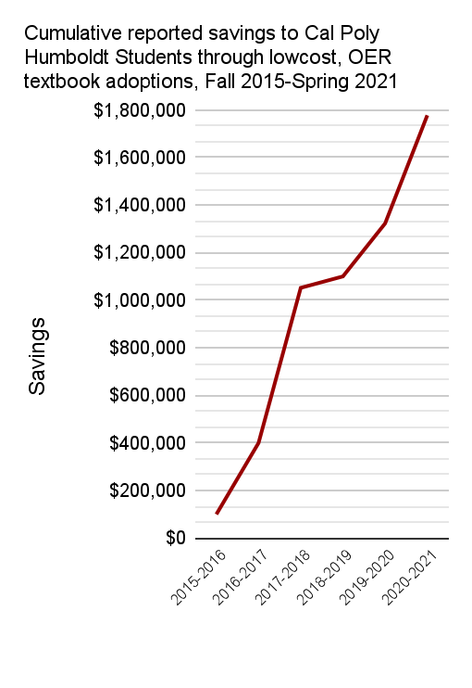
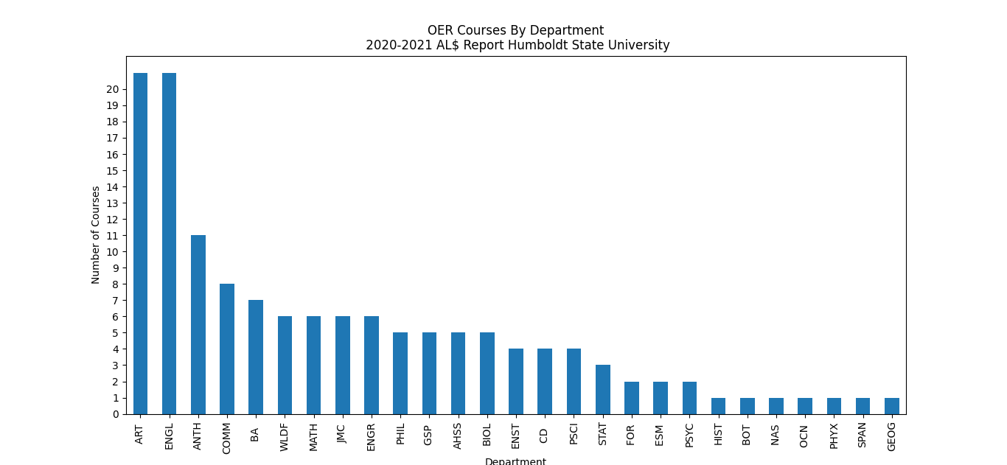
Sustainable Learning for Student Success
California State Polytechnic University Humboldt
Mendez. J, Morgan. K, Stelter. K
An Unsustainable Model
Cal Poly Humboldt Success
OER Facts and Future
Student success: Textbook costs are “negatively impacting student access to required materials” (66.6% reported not purchasing a required textbook) and learning (37.6% reported earning a poor grade as a result; 19.8% failing a course).”¹
Graduation rate: Because of textbook costs, students reported taking fewer courses (47.6%); not registering for a course (45.5%); dropping a course (26.1%), or withdrawing from a course (20.7%).”¹
Equity: A study reported a one-third reduction in DFW rate among minoritized and Pell-eligible students in courses which switched to OER. ³ Another reported that textbook costs have a “disproportionately negative effect among racial/ethnic minorities, low-income students, and first-generation college students.” ⁴
Open Educational Resources (OER) documents and media that :
● freely accessible
● openly licensed
● affordable
OER are useful for:
● teaching
● learning
● assessment
● research
Class design: Requiring students to buy a textbook means an obligation to use the textbook and teach to its goals. Conversely, OER can be tailored to meet the course-specific goals for the class.
Recruitment: Students want and look for courses with free course materials.
Learning Outcomes: A recent synthesis of 16 studies found that students achieve the same or better learning outcomes when using OER.²
References
Statistics provided by the 2016 Student Textbook and Course Materials Survey (2016), Textbook Affordability Workgroup: Final Report and Recommendations (2015), and Fixing the Broken Textbook Market (2014).
Hilton, J. Open Educational Resources, Student Efficacy, and User… (2019).
Colvard, N., C.E. Watson, H. Park. The Impact of Open Educational… (2018)
CSU Channel Islands. White Paper: Textbook Affordability and Student… (2018)
Contact information
Kimberly Stelter (707) 826-4958
Kimberly.Stelter@humboldt.edu
Kyle Morgan (707) 826-5602
Kyle.Morgan@humboldt.edu
Data compiled from faculty responses to Annual Campus AL$ OER Report

