Slide 1

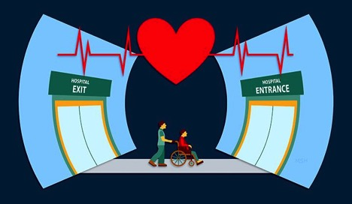
Decreasing Patient Readmission Rates
Anna Branson, RN.
Key players
Patients discharged from the hospital.
Key players- Unit managers, discharge planning, nursing, providers, and patients.
Community participants- Primary care facilities, home health agencies, families of patients.
Key outcomes
Decreased readmission rates.
Improved patient satisfaction and confidence post-discharge.
Improved patient outcomes.
Improved transition from hospital to primary care setting.
Background
Patient readmission rates have risen yearly since 2011 in Northern California .
Lack of patient follow up post discharge, limited primary care providers, and a rural setting can increase the likelihood that a patient will be re-hospitalized.
Importance of issue
A single patient readmission can cost a hospital upwards of $15,000.
Usatisfactory patient outcomes.
increased mortality rates .
Impact on hospital & healthcare workers
  More patients.
  Increased burnout.
Evaluation
Evaluation- identify readmission rates via electronic health records after three months.
Process evaluations-
  discharge calls are made within 48 hours.
  post discharge follow up by primary care provider within 10 days.
Impact evaluations-
  Survey sent to patients & primary care provider 30 days post discharge.
Interventions and solutions
Individual- The patient will receive a post discharge call within 48 hours of discharge. This call will review discharge instructions, medication regimens, and any worsening symptoms.
Community- The patient will have a follow-up appointment with a primary care provider within 10 days of discharge.
Policy- The hospital will implement a policy outlining the structure of the post discharge call and A script that will ensure patient safety.
References
Brea Health Services. Tag: 30 day hospital readmission rates.2015. https://briahs.com/tag/30-day-hospital-readmission-rates/
California Health & Human Services Agency. (2021, March 9). All-Cause Unplanned 30-Day Hospital Readmission Rate, California (LGHC Indicator). https://data.chhs.ca.gov/dataset/all-cause-unplanned-30-day-hospital-readmission-rate-california
Weiss, A. J, & Jiang, J. H. (2021, July 20). Overview of clinical conditions with frequent and costly hospital readmissions by payer, 2018. Agency for Healthcare Research and Quality. https://www.hcup-us.ahrq.gov/reports/statbriefs/sb278-Conditions-Frequent-Readmissions-By-Payer-2018.pdf
Altibi, A. M., Prousi, G., Agarwal, M. et al. (2020, January 2). Readmission-free period and in-hospital mortality at the time of first readmission in acute heart failure patients—NRD-based analysis of 40,000 heart failure readmissions. Heart Fail Rev 26, 57–64 (2021). https://doi-org.ezproxy.humboldt.edu/10.1007/s10741-019-09912-z
Framework
The model that best suits this project is the Iowa model.
Issue Identification.
Information gathering.
Team formation: Implementation & evaluation.
Flexible in the need for redesign throughout process.

