Slide 1
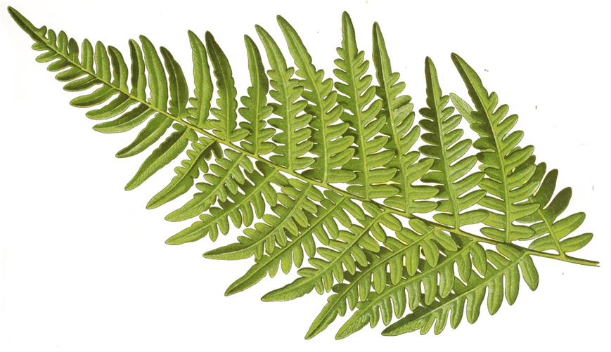
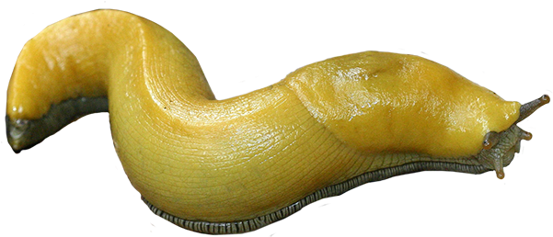

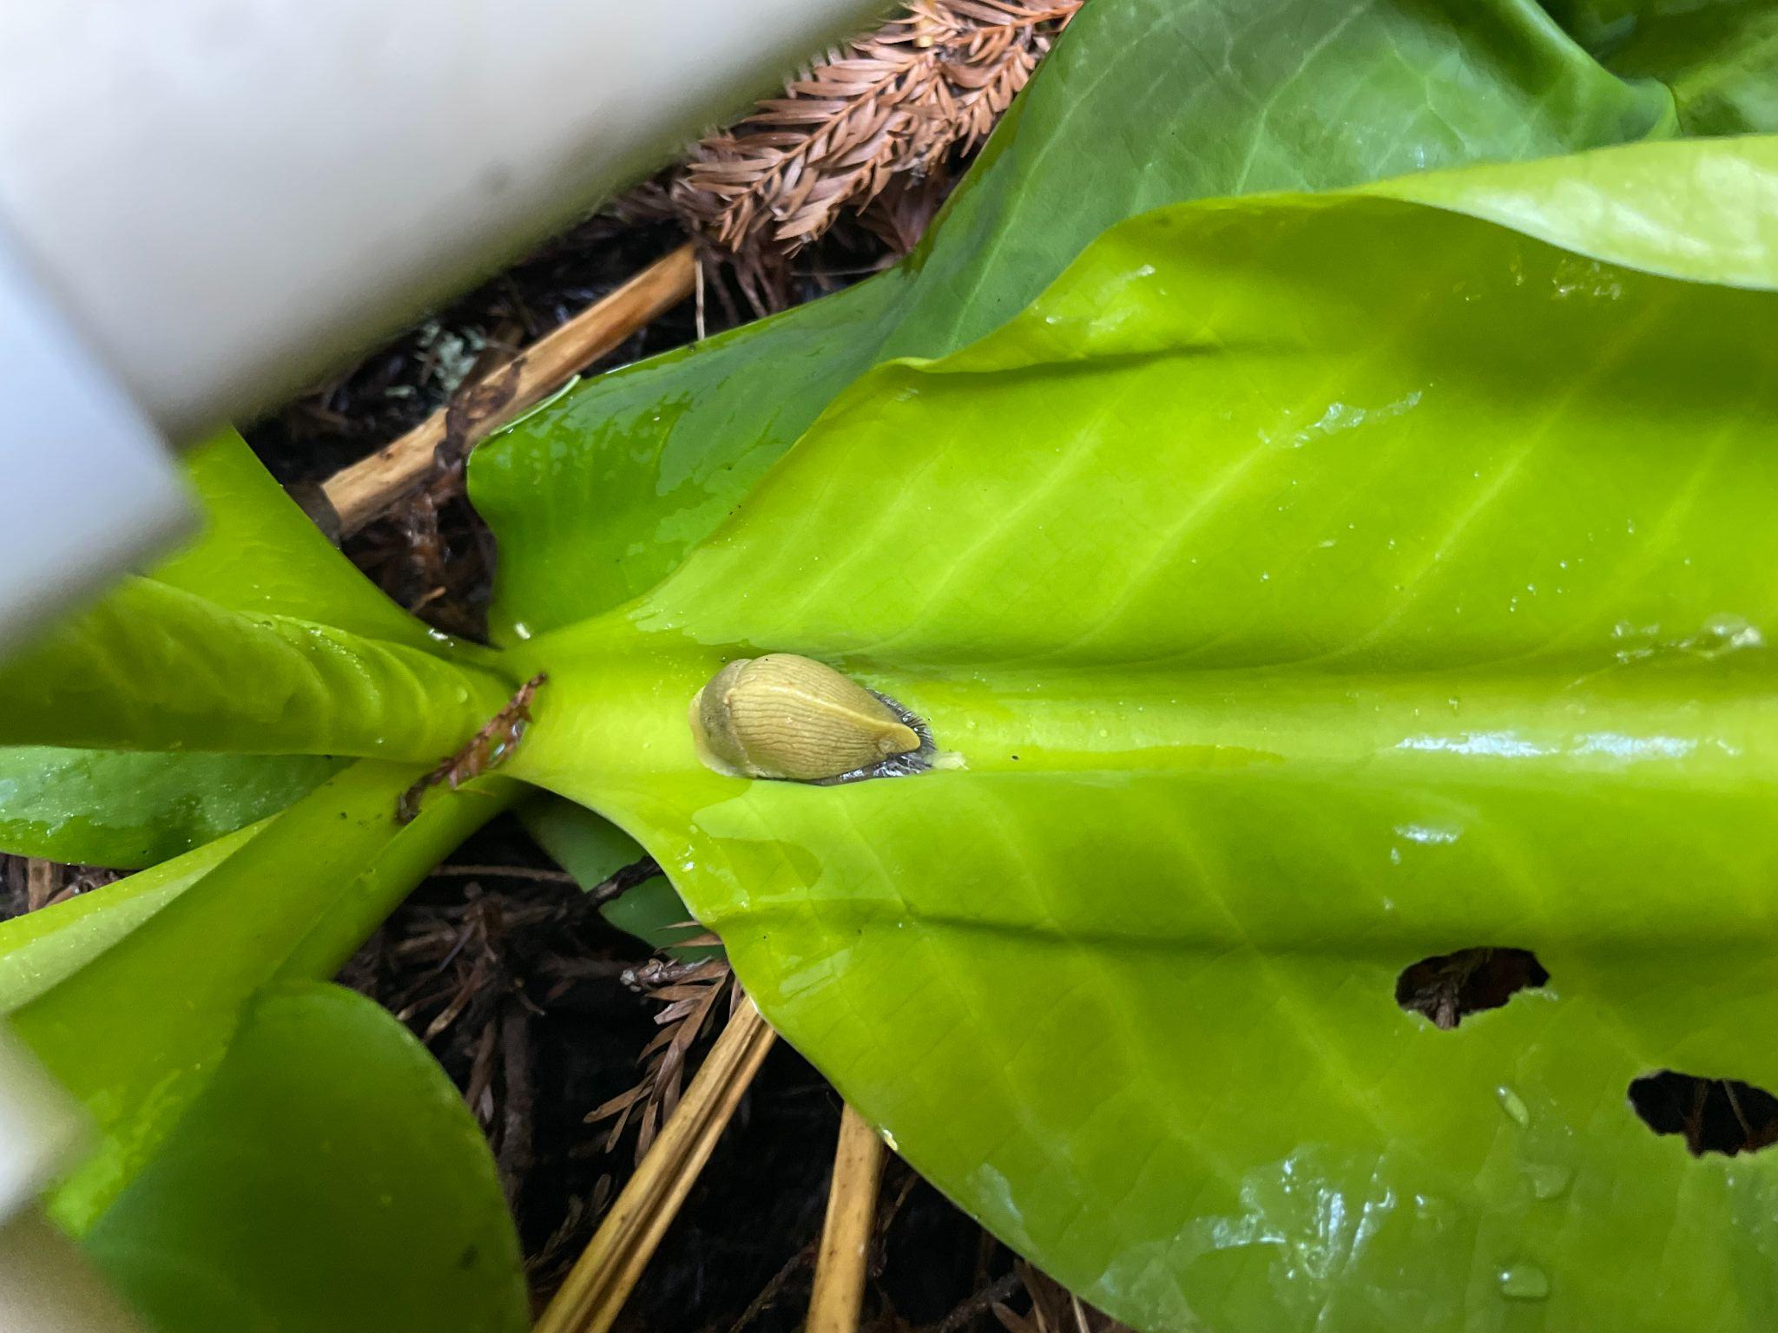
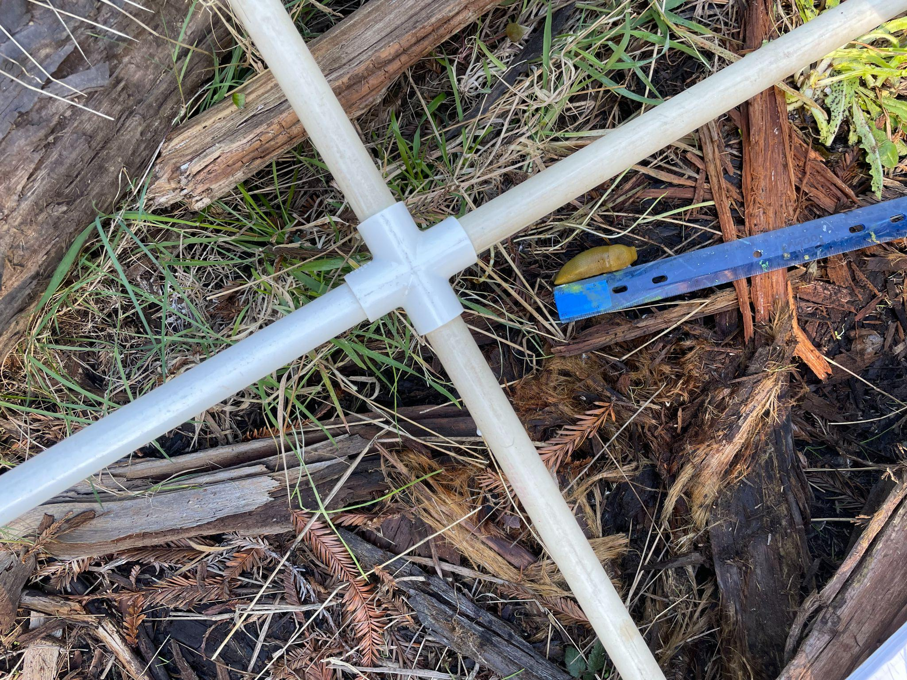
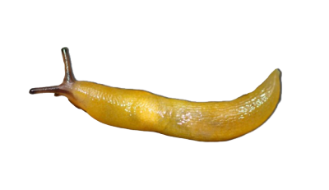
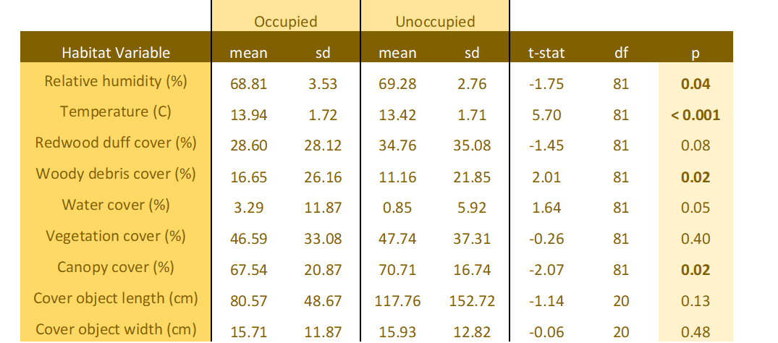
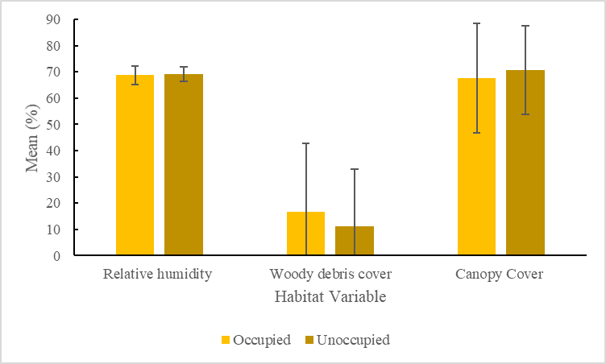
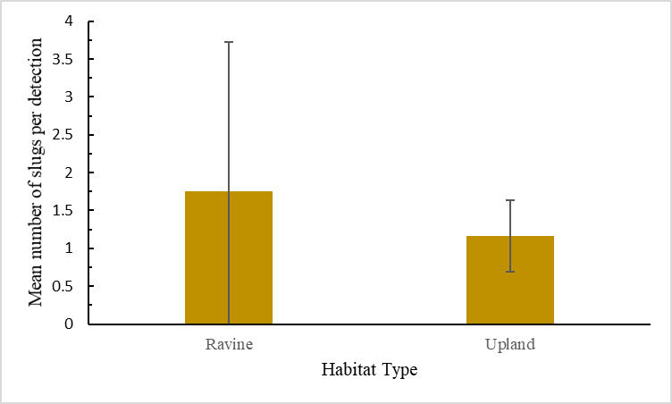
Pacific Banana Slug Habitat Selection using occupied and paired-random microhabitat analysis in the Arcata Community Forest
Rainey Strippelhoff
Department of Wildlife, Cal Poly Humboldt
INTRODUCTION
Banana slugs are a key detrivore and herbivore in Pacific Northwest forests. The Pacific banana slug (Ariolimax columbianus) is the largest out of the six banana slug species.They are identifiable with their various color morphs that range from green to yellow to white and often have brown spots that give them an appearance similar to a ripe banana (Harper 1988). Pacific banana slugs are native and endemic to the Pacific Coast of North America stretching from Alaska to California (South, 1992). As of 2021, they were the most commonly observed species of their genus on iNaturalist (Pacific Banana Slug (Ariolimax columbianus)).
Despite their prevalence in this region, there are relatively few studies of this species (Pearson et al., 2006). Understanding how this species utilizes different habitats in a heterogenous forest is important from a management perspective due to their wide distribution, abundance in the Pacific Northwest, and significant ecological roles in nutrient cycling, seed dispersal, and endemic predators.
I hypothesized that banana slugs will show habitat selection within a heterogenous forest. I predicted that A. columbianus would be larger, less numerous, and make more use of cover objects in upland habitats compared to ravine habitats. Additionally, I predicted that banana slugs will select for areas associated with higher canopy cover, higher percent cover of live vegetation, higher percent cover of woody debris, and higher percent cover of live vegetation in ravine areas. I also expected to see banana slugs select for areas with higher relative humidity.
RESULTS
I collected data on 82 plots and 129 slugs. My null hypothesis predicted no differences between occupied and unoccupied habitat variables.
When occupied and unoccupied sites were analyzed using a paired t-test, several habitat variables showed significant differences, supporting the alternate hypothesis (Table 1). The slugs selected for lower relative humidity and lower canopy coverage (p=0.04, t-stat=-1.75, df=81; p=0.02, t-stat=-2.07, df=81). Woody debris cover was higher in slug-occupied sites than unoccupied (p=0.02, t-stat=2.01, df=81) (Fig 1). Temperature was also higher in occupied plots (p<0.001, t-stat=5.70, df=81). No other habitat variables showed evidence of habitat selection (Table 1). The average mass of slugs in upland sites was higher (7.05g) than the slugs located in ravine sites (5.30 g). However, the difference was insignificant and any slug weighing less than 0.5g could not be weighed. There were 12 slugs from ravine sites and only 2 from the upland habitat that were below the weight limit. Banana slugs were more abundant in ravine habitat compared to upland habitat, with more mean slugs per detection (Fig 2).
Table 1. A summary of the paired t-test between habitat characteristics of occupied and unoccupied plots. Significant p-values are in bold.
DISCUSSION
I hypothesized that banana slugs would show habitat selection within a heterogenous forest, the Arcata Community Forest. The paired t-test revealed significant differences between occupied and available habitats for relative humidity, temperature, woody debris cover, and canopy cover (Fig 1).
I predicted that banana slugs would select for places associated with higher relative humidity, higher percent cover of woody debris, and higher canopy cover. As expected, woody debris cover was higher in occupied habitat than paired unoccupied sites. However, the results for relative humidity and canopy cover was opposite of what I predicted. They were both lower in the occupied sites than in the paired, “available” sites.
Due to the risk of desiccation, I expected banana slugs to be found in areas of higher humidity and the reason they were not is unclear. There may be other factors influencing banana slug selection that I did not take into account which would cause them to choose places of lower relative humidity.
Canopy cover may have been lower in occupied sites due to the slug’s proximity to a body of water. Ponds and creeks create a gap in in the canopy above. Site 1 was characterized by a creek, and site 3 was the location of Fern Lake, a large pond bordered by a small wetland on one side. These two locations made up a majority of the detections in my data collection. This could be further investigated by comparing a slug’s proximity to a body of water to a paired-random site of available habitat. If slugs are shown to select for a closer proximity to water, then it could explain why they were found in areas with less canopy cover.
Based on the data I collected, banana slugs exhibited habitat selection within a heterogeneous forest of upland and ravine habitats. Given that banana slugs select habitat, it is possible that the variables they select for are different between habitats within a heterogenous forest--such as upland and ravine habitats. I found that the mean number of slugs per detection was higher in ravine habitat than upland (Fig 2). This suggests that slugs are more abundant in ravine sites and it raises questions about the differences between the two habitat types. Additionally, upland slug detections were associated with cover objects more often than ravine slug detections.
Future studies should examine if banana slugs utilize their available habitat differently depending on the habitat type.
This could help ecologists better understand the role that banana slugs play in the heterogenous forests of the Pacific Northwest.
**
**
**
STUDY LOCATION
Within the Arcata community forest, I utilized four study sites that characterize different ravine and upland habitats available to banana slugs.
Site 1: 14th Street trailhead to Redwood Park (40.8707, -124.0742), Ravine.
Site 2: North-East from Redwood Park (40.8703, -124.0695), Upland
Site 3: Fern Lake, (40.8750, -124.0678), Ravine
Site 4: Frisbee Golf Course in addition to a nearby logged area (40.8748,
-124.07109), Upland
Figure 1. The mean percent value of habitat variables in occupied and paired-random unoccupied plots with standard deviation. Refer to Table 1 for statistical values.
METHODS
I used an occupied and paired-random sampling method to determine ‘used’ and ‘available’ habitat respectively.
Using a Kestrel, I recorded the relative humidity percentage and temperature in Celsius of a detected slug. A densiometer app (CanopyApp) was used to measure canopy cover. A hanging balance was used to measure its mass in grams. A square meter hoop with a grid of four equal sections was used to estimate ground cover percentages immediately surrounding the slug. The species of vegetation was also noted. If there was more than one slug per detection, the number was recorded and the mass was averaged. This was repeated with a paired unoccupied site.
I used a paired t-test to analyze the data for difference between used and available plots and a t-test to analyze differences in number of slugs per detection between ravine (site 1 and 3) and upland (site 2 and 4) habitat types.
**
LITERATURE CITED
Harper, A. B., and D. Harper. 2004. The banana slug: A close look at a giant forest slug of western North America. Otter B. Books, Santa Cruz, CA.
Pearson, A. K., O. P. Pearson, and P. L. Ralph. 2006. Growth and activity patterns in a backyard population of the banana Slug, Ariolimax
columbianus. The Veliger 48:143–150.
South, A. 1992. Terrestrial slugs: Biology, ecology and Control. First edition. Chapman & Hall, London, Great Britain
ACKNOWLEDGMENTS
I want to thank the Wildlife Stockroom staff for help with lending materials and tools needed to conduct the research as well as Dr. Mahoney, Senior project adviser, for helpful input and constructive feedback.
Figure 2. A comparison of the mean number of banana slugs per detection between Ravine (sites 1 and 3) and Upland (sites 2 and 4) habitats ( p=0.02, t-stat=2.15, df=69).

