Slide 1




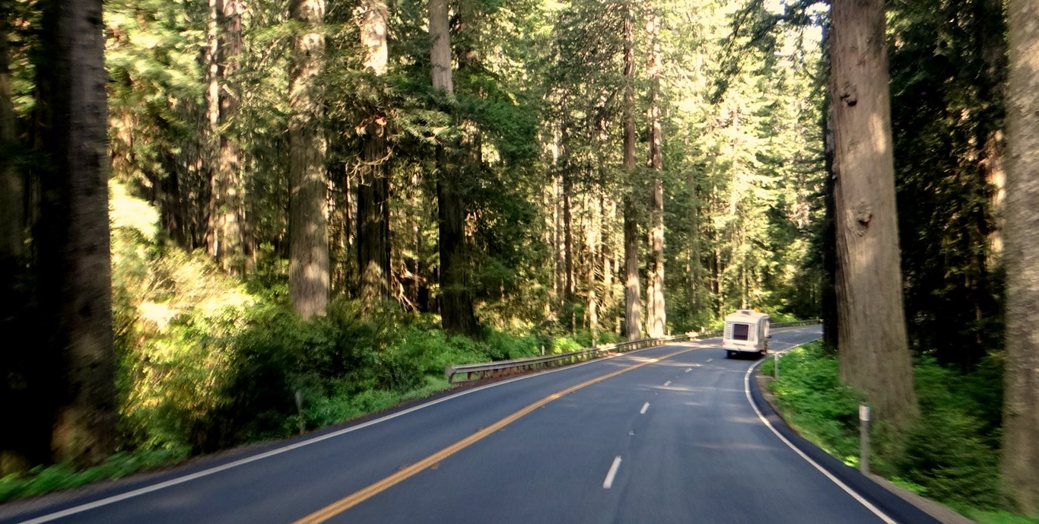
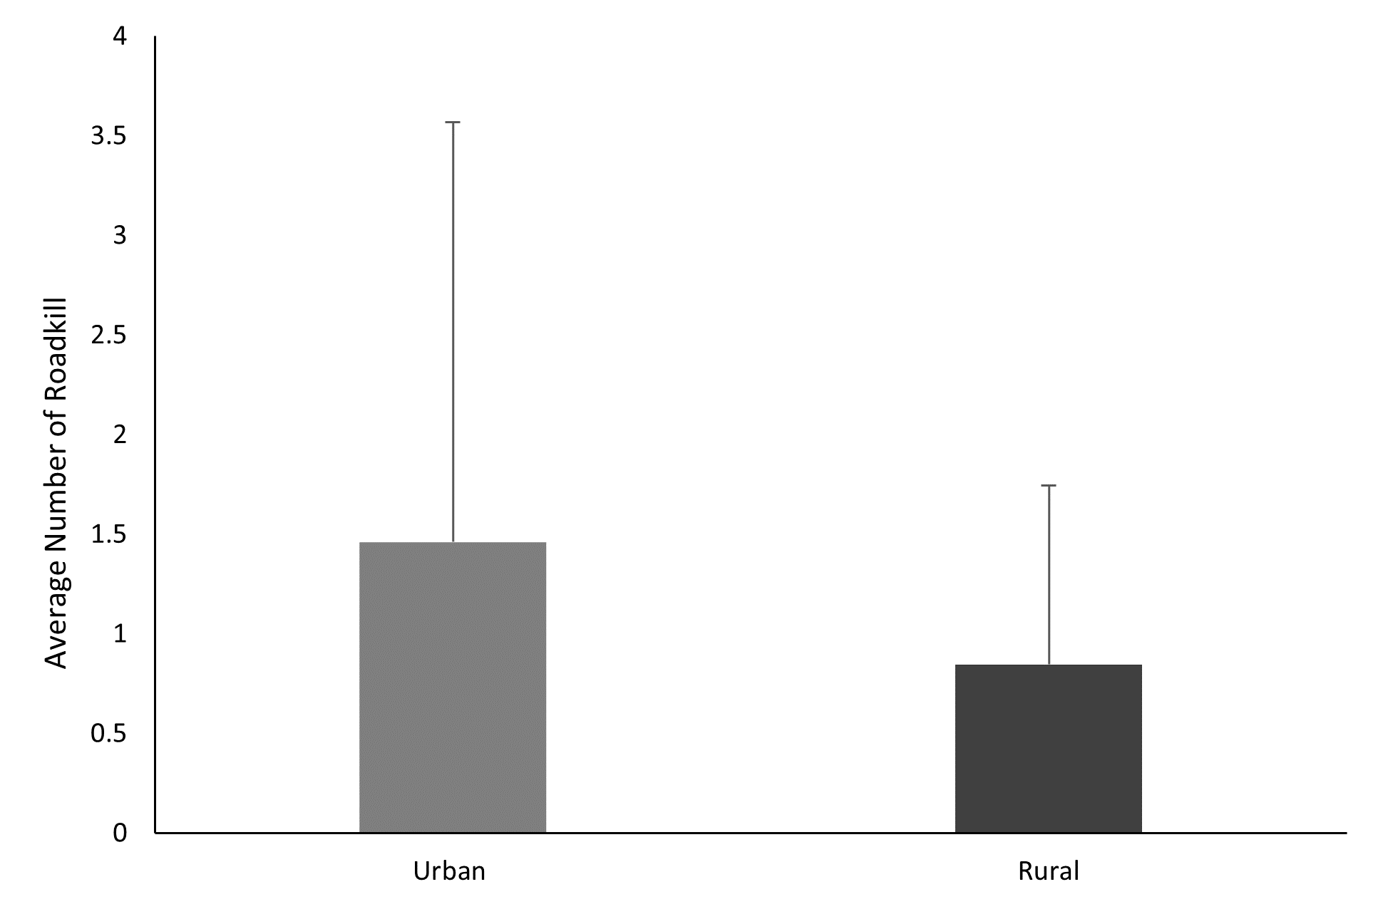
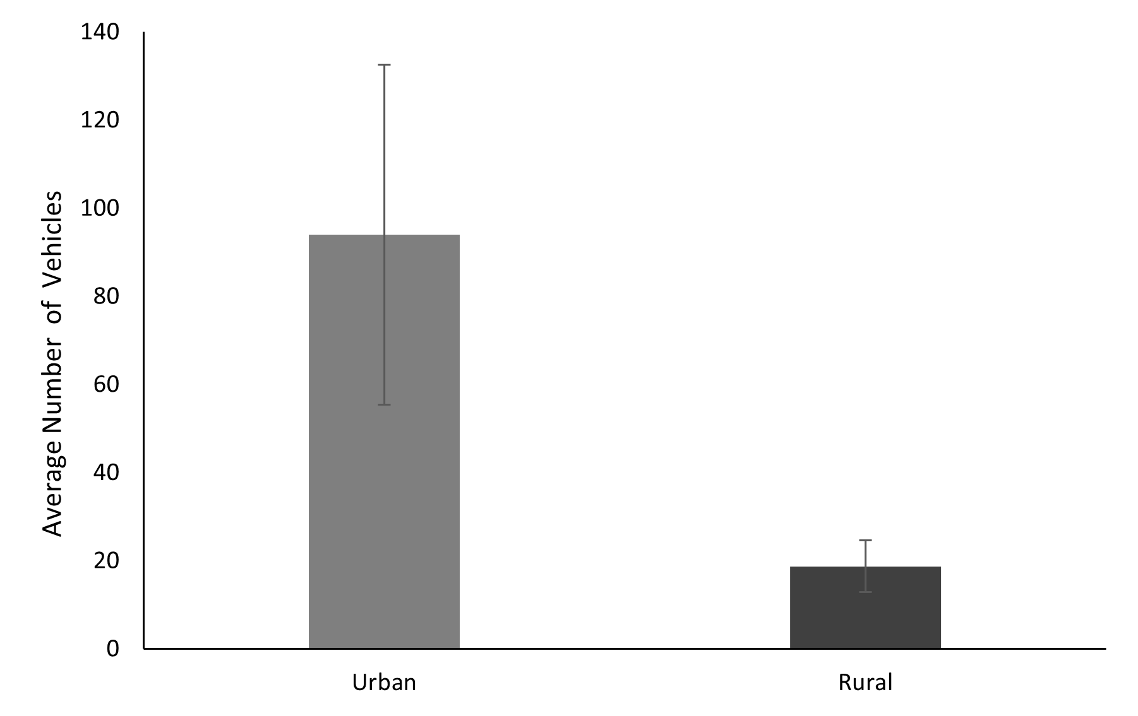
Comparing Roadkill Abundance Between Urban and Rural Transects
Emily D. Cook
edc53@humboldt.edu
Cal Poly Humboldt, Wildlife
INTRODUCTION
The biggest impact of roads on wildlife is roadkill; roughly 1 million vertebrates are killed each day in the United States (Forman and Alexander 1998, Huijser et al. 2008). As human population growth increases, roads are constructed to accommodate the masses of humans traveling throughout the landscape in their vehicles (Forman and Alexander 1998, Snyder 2014). Occurrence of wildlife vehicle collisions in the city of Arcata is high because it is the urbanized microcosm of a massive, forested landscape filled with wildlife.
For my study I predicted that an urban highway would have greater roadkill abundance because of increased traffic levels due to surrounding road density in comparison to a rural highway with lower levels traffic.
RESULTS
I found no significant difference in roadkill abundance between the urban and rural highway transects (Fig. 1, t-value = 0.97, df = 16, P = 0.17).
Despite there being no real difference in the amount of roadkill, traffic levels on the urban transect had roughly 5x the number of cars compared to the rural transect (Fig. 2, t-value = 3.86, df = 3, P = 0.02).
t-value = 0.97
P = 0.17
DISCUSSION
Road density did not appear to have any effect on roadkill abundance. The results did not fully support the predictions I made before the study was conducted, there was no significant difference in the amount of roadkill between the urban and rural transects. However, my hypothesis did account for the drastic difference in average vehicle count between the two transects due to road density.
Possible reasons for these results: Higher traffic levels may detour animals from attempting to cross the highway (Jacobson et al. 2016). Because of high traffic levels my view was obstructed by other vehicles on the road making it more likely to miss new roadkill (Collison 2013).
Figure 1. Average roadkill abundance shows no significant difference between the urban and rural highway transects (t-value = 0.97, df = 16, P = 0.17).
METHODS
I used a vehicle-based survey method to count roadkill. I used Google Earth to collect the coordinates of each individual roadkill documented in effort to prevent double counting. To control for time effects on roadkill presence, I alternated the direction of each survey, to the best my best of my abilities.
To quantify traffic levels, I counted passing vehicles over a 3-minute interval at two locations on each transect.
To analyze my data, I used a standard t-test.
t-value = 3.86
P = 0.02
Work Cited
Forman, R. T., and L. E. Alexander. 1998. Roads and their major ecological effects. Annual Review of Ecology and Systematics 29:207-231.
Huijser, M. P., P. McGowan, A. P. Clevenger, R. Ament, W. T. Institute, and I. L. Berger. 2008. Wildlife-vehicle collision reduction study: best practices manual: Report to Congress.
Snyder, S. A. 2014. Examining the impacts of state route 101 on wildlife using roadkill surveys and remote cameras. Thesis, California Polytechnic State University, San Luis Obispo, California, USA. 98 p.
Jacobson, S.L., L.L. Bliss-Ketchum, C.E. de Rivera, and W.P. Smith. 2016. A behavior-based framework for assessing barrier effects to wildlife from vehicle traffic volume. Ecosphere 7(40): 1–15.
Collinson, W.J. 2013. A standardized protocol for roadkill detection and the determinants of roadkill in the greater Mapungubwe transfrontier conservation area, Limpopo Province, South Africa. Thesis, Rhodes University, Grahamstown, South Africa.
Acknowledgements
I’d like to thank Dr. Mahoney for his support and guidance in helping me complete my project this semester, and Aliah Guerrero and Sophia Nielsen for helping me with data collection.
Figure 2. The average number of vehicles during a three-minute time span shows a significant difference between the urban and rural highway transects (t-value = 3.86, df = 3, P = 0.02).

