Slide 1



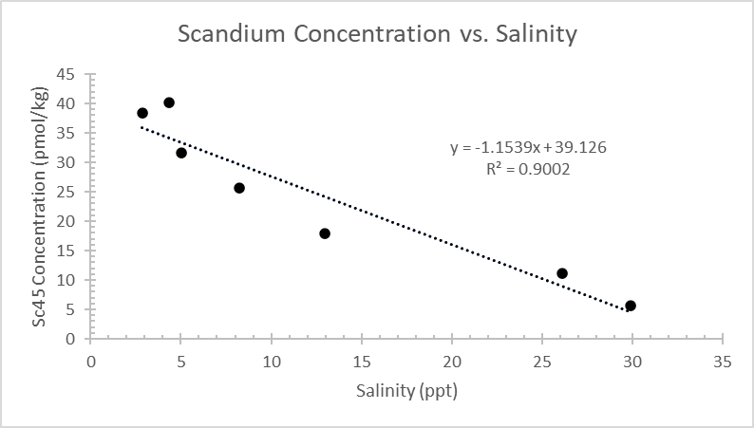
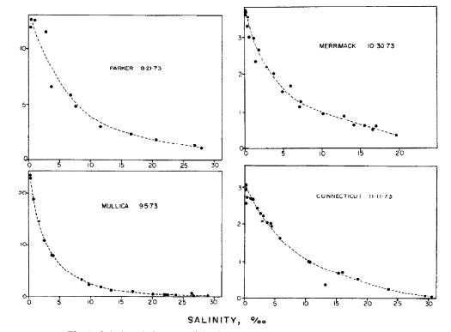
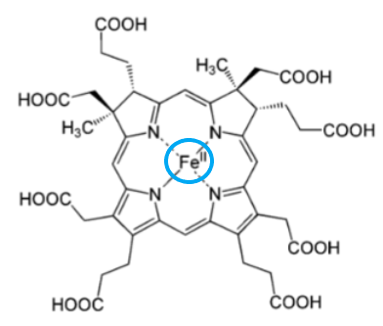

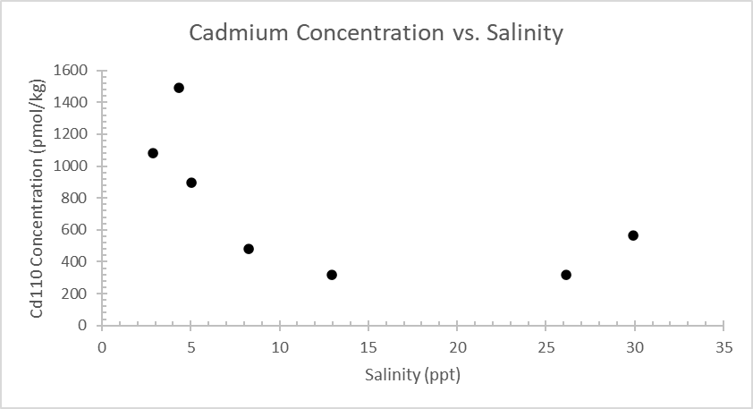
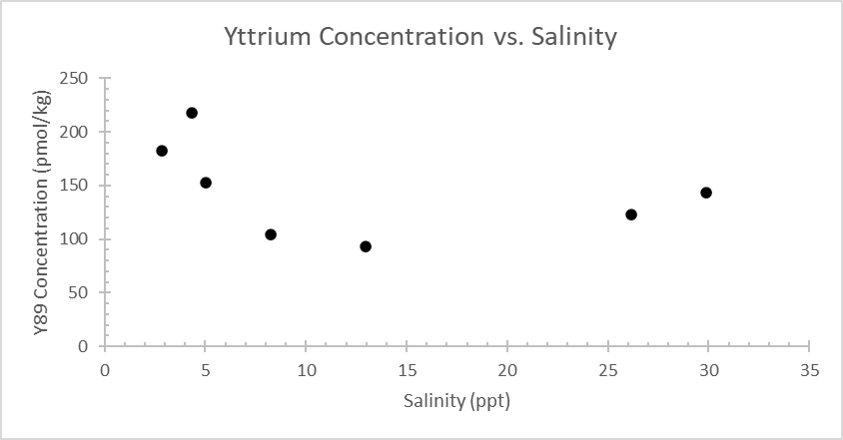
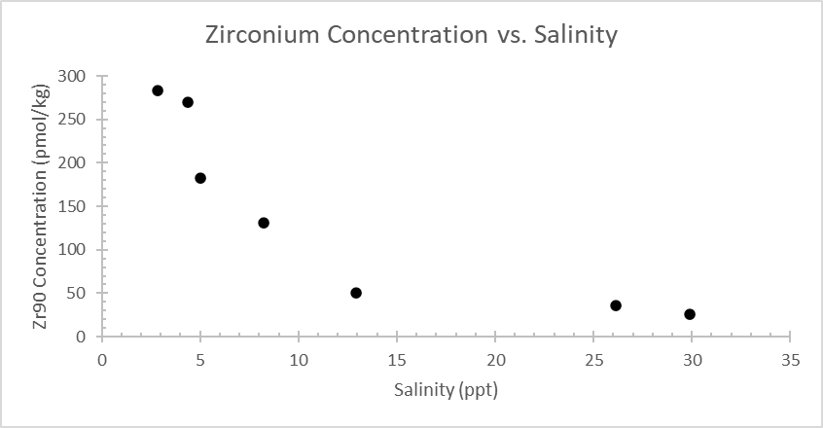
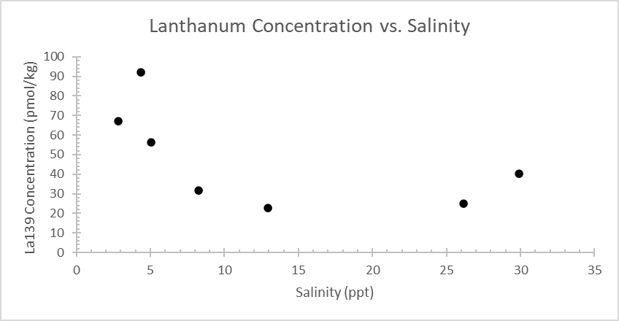
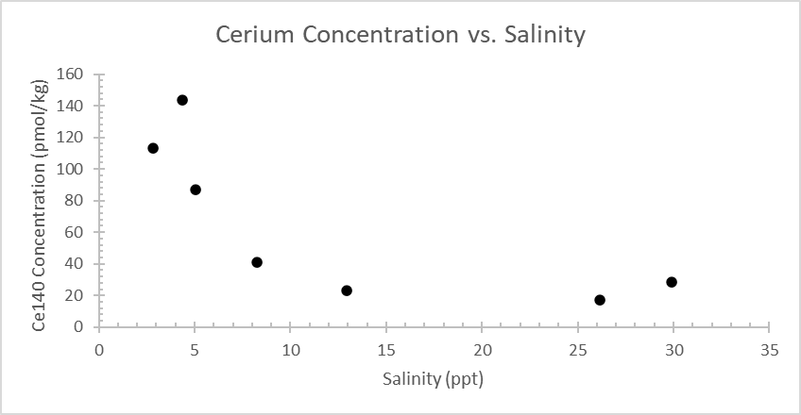
The Effect of Salinity on the Concentration of Various
Trace Metals in The Little River Estuary
Shelby C. Bishop¹, Claire P. Till²
¹Oceanography Department, California State Polytechnic University, Humboldt , CA
²Chemistry Department, California State Polytechnic University Humboldt, CA
Abstract:
Trace metals, although found in very small concentrations, are crucial to many biological processes in marine environments. In estuaries, iron displays an exponential relationship with salinity which indicates that it is being actively removed. A linear relationship indicates that mixing is the main determinant of concentration. This preliminary data was found by collecting water samples along rivers that fed into the ocean, preconcentrating the samples, and then analyzing them for trace metal concentration with an HR ICP-MS. It was expected that scandium would have the same exponential relationship with salinity as iron due to their similar ionic size, however, scandium displayed a linear relationship while elements that were expected to be linear were exponential. Because so few studies have been done on trace metals and their relationship with salinity in rivers, the reasons for these surprising relationships are not fully known. To the author’s knowledge, this data represents the first river and estuary measurements of scandium, cerium, zirconium, and lanthanum.
Results:
Lanthanum, cerium, zirconium, and yttrium were also elements of interest in this study because very little data could be found on the effect of salinity on their concentrations or in rivers at all. It was hypothesized that these metals would have a linear relationship with salinity because no removal method was known to affect these elements. If this was true, then their concentration curves would be linear, suggesting the main determinant of their concentration is mixing. However, it was found that these elements seem to have some removal term, but what exactly that is remains unclear (Figure 4). One possibility could be that they react with molecules in a similar way to iron, and once those molecules reach salt water they precipitate out in a similar fashion to iron.
Figure 2 shows the relationship between salinity and concentration of scandium in The Little River estuary. Scandium was the main element of interest in this study because of its similar ionic size and properties to iron, and because iron is a limiting nutrient in many marine environments. Iron’s relationship with salinity is shown in Figure 3. A hypothesis of this study was that Sc would appear to be removed in a very similar manner to Fe, however, the data suggests that they do not share a removal term. Further, the data suggests that scandium is not at all actively removed from freshwater and its concentration is mainly determined by mixing. Because there is so little data regarding scandium’s behavior in rivers it is not known why scandium does not precipitate when salinity increases like iron does. It may be that although scandium binds to the organic molecules that remove iron, perhaps scandium does not react with these molecules enough to change its bulk concentration. Or, it may not bind with these Fe-binding molecules at all since these reactions have only been observed in lab settings, and it is not confirmed that scandium binds to organic molecules in the same manner in the environment.
Figure 2: A graph showing the relationship between scandium-45 concentration and salinity.
Background:
Iron binds to organic molecules, like humic acid, in rivers and
other sources of freshwater into the ocean (Figure 1). When fresh
river water eventually enters the ocean the salts in seawater make
these organic molecules insoluble, causing them to precipitate,
taking the iron with them. Because of this precipitation it is well-
established that iron concentration decreases with an increase in
salinity. Scandium has a similar ionic size to iron, and is expected to
bind to these organic molecules in the same way, but little is known
about scandium’s behavior in rivers. However, it is logical to assume
that because scandium can bind with the same organic molecules that
remove iron from the water, its concentration curve would appear to be very similar to iron’s. Other trace metals, like lanthanum, cerium, zirconium, and yttrium do not have removal methods that are known of, and they are not expected to bind to the same organic molecules that iron and scandium do. Therefore, a logical assumption would be that their concentration is determined by mixing: their concentration decreases with salinity because it is essentially being diluted into the seawater, not because it is actively being taken out. As stated above, there is very little data about trace metal concentrations and their behavior in rivers, and no data sets were able to be found regarding how lanthanum, cerium, zirconium, or scandium behave in rivers. This preliminary data suggests the exact opposite of what was expected and the assumptions discussed above, scandium displayed a linear relationship with salinity while other elements that were expected to be linear were exponential.
Figure 1: An example of an organic molecule that both scandium and iron (circled) can be in. Taken from Hogle et al., 2014.
Figure 3: Calorimetric iron vs salinity for several U.S. east coast estuaries taken from E.A. Boyle &
J. M. Edmond 1977.
Figure 4: The relationship between salinity and concentration of cadmium-110, yttrium-89, zirconium-90, lanthanum-139, and cerium-140.
Main Takeaways:
Scandium and iron do not share the same removal term like previously thought
Scandium’s concentration is primarily controlled by mixing, its removal term is not yet known
Cadmium, Yttrium, Zirconium, Lanthanum, and Cerium are actively removed from the water, but their removal term is not yet known
Brief Methods:
Samples were collected along The Little River estuary. Samples were then analyzed using the method described in Biller and Bruland (2012) with adaptations mentioned in Parker et al. (2016). This includes preconcentrating the metals in 24mL of sample with a chelating resin column and then eluting (removing the concentrated metals from the column) with 1mL of nitric acid. The samples were then analyzed with a HR ICP-MS (High Resolution Inductively Coupled Plasma Mass Spectrophotometer) at the UC Santa Cruz campus. A series of standards with known concentrations were made in seawater, river water, and nitric acid, and those calibration curves were used to find the concentration of the samples.
References:
Biller D.V. & Bruland K.W (2012). Analysis of Mn, Fe, Co, Ni, Cu, Zn, Cd, and Pb in seawater using the Nobias-chelate PA1
resin and magnetic sector inductively coupled plasma mass spectrometry (ICP-MS), Marine Chemistry, 130-131, 12-20. https://doi.org/10.1016/j.marchem.2011.12.001.
Boyle E. A. & Edmond J.M. (1977). The Mechanism of Iron Removal in Esturaries, Geochimica et Cosmochimica Acta, 41, 1313-1324.
Parker C.E., Brown M.T. & Bruland K.W. (2016). Scandium in the open ocean: A comparison with other group 3 trivalent metals, Geophysical Research Letters. 43(6), 2758-2764. https://doi.org/10.1002/2016GL067827
Notes:
Questions:
Is the results section laid out well? Is having the graphs ‘staggered’ okay? Might make it more visually interesting but might be confusing?
Are the text boxes off center enough or just annoying?
More citations?

