Slide 1
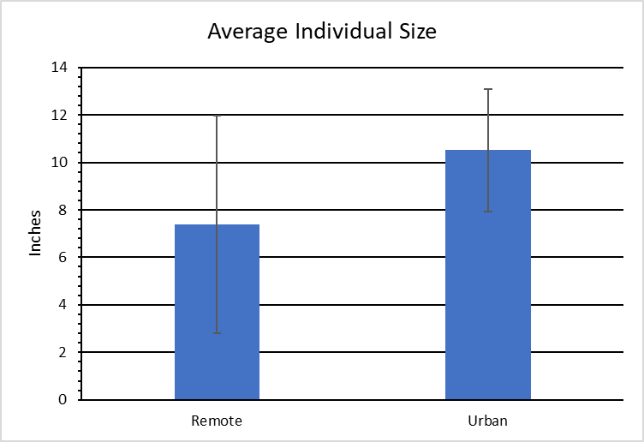
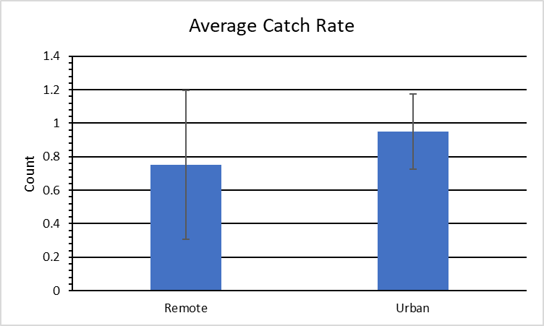
Redtail Surfperch Population Dynamics in Humboldt County
INTRODUCTION
Urbanization is drastically changing the world’s shorelines. With coastal towns continuing to develop and expand, recreational fishing in these areas also increases. This is likely due to lengthening the radius of convenient fishing zones for recreational anglers. Northern California marine sandy beaches and adjoining surf zones exhibit dynamic environments with extraordinary natural, monetary, and cultural value (Succow 2017). Utilizing this unique opportunity to sample both urbanized and rural regions; samples from each zone were drawn to better understand the population dynamics of redtail surfperch. Following the common trend showcasing negative population dynamics in urbanized habitats, my hypothesis predicted lower average size and catch rates in urban sites.
Jonathan Kang
Department of Wildlife, Humboldt State University
RESULTS
Based on the one-tail t-test, data yielded significant results contrasting initial hypotheses. Individuals were found to be significantly larger on average in urban sites vs. remote (Fig. 1., t=-2.65, df= 30, p= 0.006). The average catch rate analyses results were also significant, demonstrating average catch rates were higher in urban sites than remote (Fig. 2., t= -1.80, df= 28, p= 0.04).
DISCUSSION
Average individual size and average catch rate proved to both be significantly greater from urbanized beaches versus remote. However, data may be biased this sampling season due to a variety of unique variables.
An algal bloom was seen from Mad River Beach; some theories for this anomaly include unusual amount of sunlight during this time of year, or bacterial spikes in freshwater runoff from the Mad River estuary. Catch rates declined drastically around the time of the algal bloom, March. In CA, algal blooms have the most prevalence in the drier seasons, normally starting seaward and moving inland when upwelling winds calm (Lewitus et al. 2012). Rainfall was noticeably lower this year, which may have been an attributing factor to the bloom. However, sand grain size was not considered when selecting sites. There is a high possibility that sediment size plays a key factor for redtail surfperch habitat selection as their primary prey Emerita analoga (pacific mole crab) favor finer substrate. Larger grain size is unfavorable due to increased burrowing difficulty (Dewi et al. 2019).
Figure 1: Individuals were on average larger at urban sites, opposite of initial predictions.
METHODS
A total of four sites were selected for sampling. Half of the sites were picked to represent the effects of urbanization; the other half were selected to represent remote areas. The two urban sites were Mad River Beach and Samoa Beach. The Two remote sites were Centerville Beach and Dry Lagoon Beach. Each site was visited an equal number of times. Hook and line sampling began 1 hour before and 1 hour after high tide consistently. Fish length was measured from tip of snout to tip of tail.
Literature Cited
Dewi, W. K., S. Suryanti, and P. W. Purnomo. 2019. Habitat Preferences and Abundance of Mole Crab at Spring and Neap Tide In Coastal Area Of Purworejo Central Java, Indonesia. Pages 383–394 in. International Journal of Applied Environmental Sciences (IJAES). Fourth edition. Volume 14. essay, Research India Publications.
Lewitus, A. J., R. A. Horner, D. A. Caron, E. Garcia-Mendoza, B. M. Hickey, M. Hunter, D. D. Huppert, R. M. Kudela, G. W. Langlois, J. L. Largier, E. J. Lessard, R. RaLonde, J. E. Jack Rensel, P. G. Strutton, V. L. Trainer, and J. F. Tweddle. 2012. Harmful algal blooms along the North American West Coast Region: History, trends, causes, and impacts. Harmful Algae 19:133–159.
Succow, M. L. 2017. Population characteristics and trophic interactions between Pacific mole crabs and redtail surfperch on Northern California Sandy Beaches. thesis.
Sponsorships
I would like to thank Abu Garcia, Salty Crew, and Strike King for their generous donations.
ACKNOWLEDGMENTS
Jose R Marin Jarrin for IACUC permit support and Sean Mahoney for comments and assistance on early drafts and analyses.
Figure 2: Catch rates were on average higher in urban sites, opposite of initial predictions.

