Slide 1


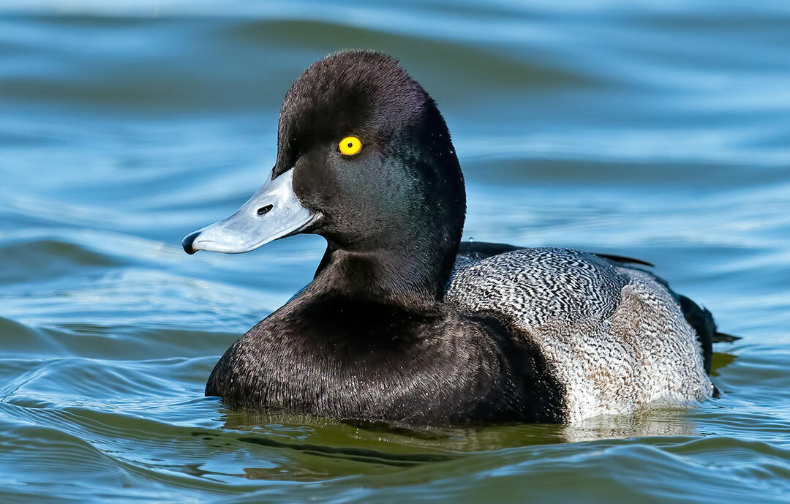

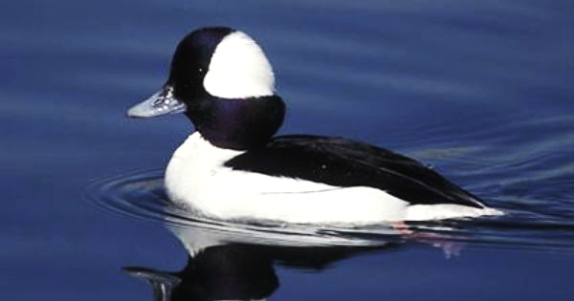
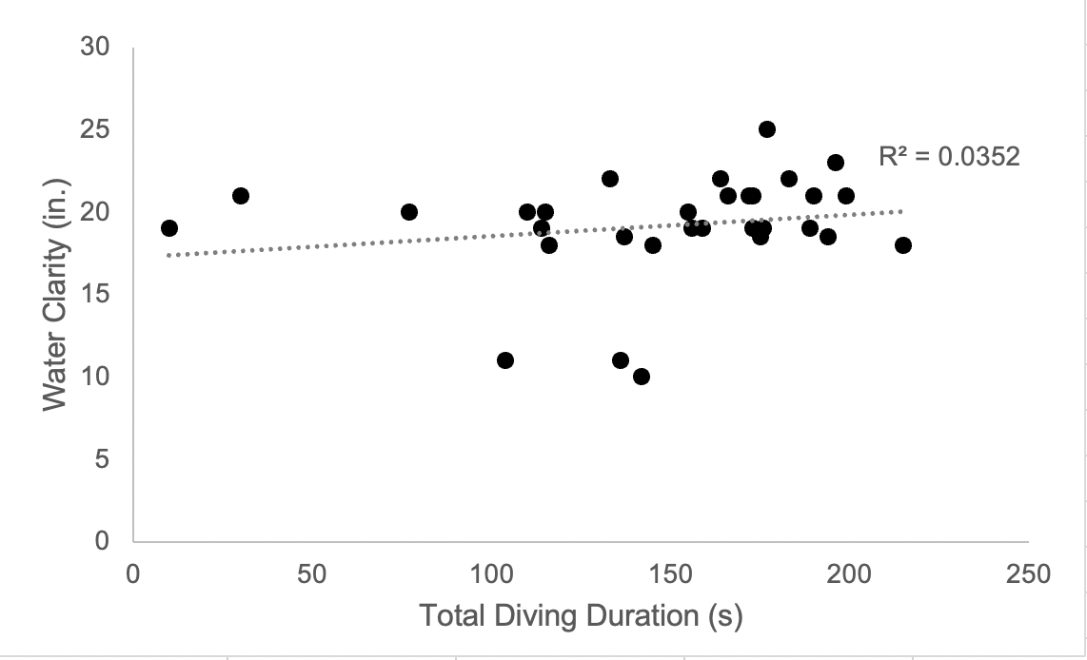
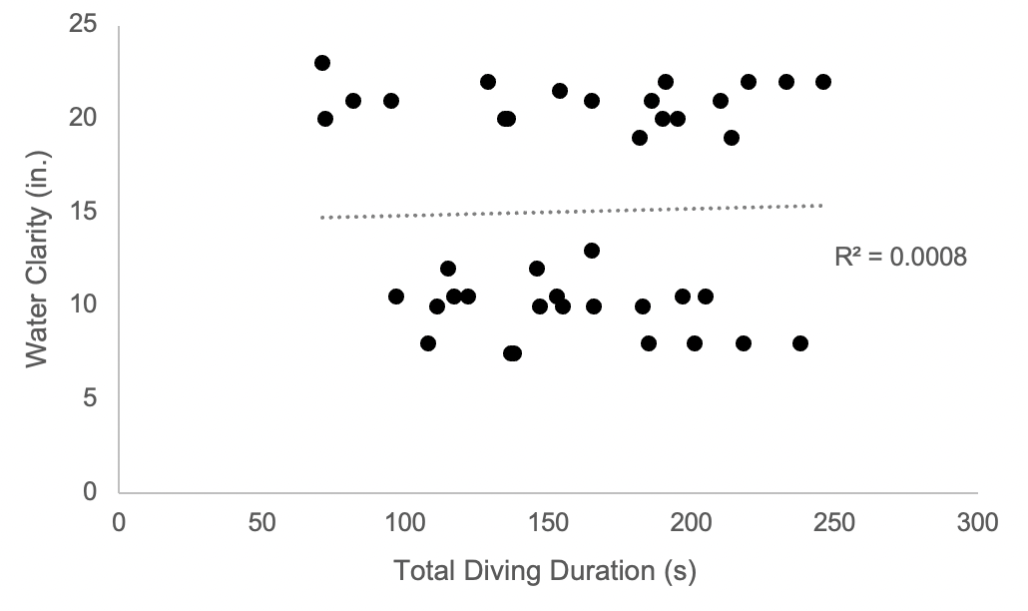
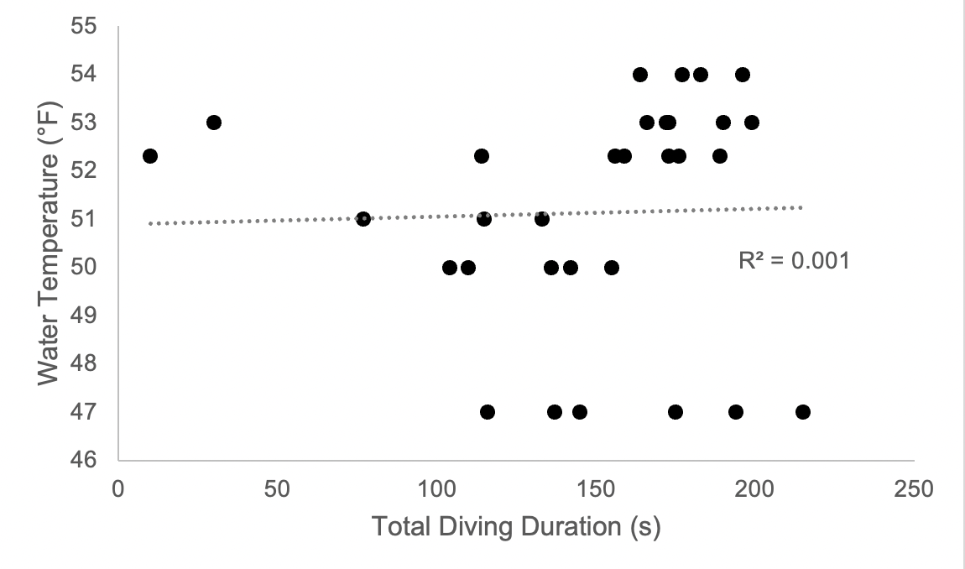
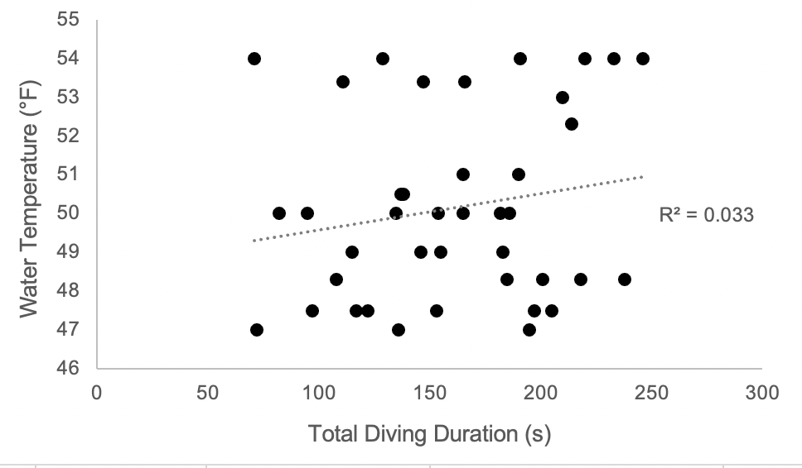
Water Temp & Clarity Effects on Diving Ducks Duration Under Water
INTRO
For this study I looked at Bufflehead ducks (Bucephala albeola) and Greater Scaups (Aythya marila). These ducks are often found around saltwater bays and freshwater (Thompson 1973). Diving duck diets consist of aquatic invertebrates and plant matter (Thompson 1973). I specifically picked these two diving duck species due to their similar foraging style and difference in their body size and eye diameter. A bufflehead’s eye measures out to be 9mm, meanwhile the greater scaups eye diameter is 13.3mm (Boyle 2019, Lisney et al. 2013). The objective of this study was to determine if the water temperature or water clarity at the Arcata Marsh had any influence on how long these two species of diving ducks need to forage. Even though a large portion of diving duck’s time is spent to feeding (Adair et al. 1996), there was hardly any studies done about possible factors that may affect the foraging of diving ducks. I predicted the colder the water, the shorter amt of time would be spent in the water, but if water clarity has more of an effect on their diving time, then they will spend more time in the water if the clarity was low.
RESULTS
Regarding the greater scaup, there was no correlation between water clarity and diving duration(Fig. 1, R=0.035, P = 0.859) ; as well as no correlation between water temperature and diving duration (Fig. 3, R=0.001, P=0.263). This goes for the same for the bufflehead, there was no correlation between the water clarity and diving duration (Fig. 2, R=0.0008, P=0.311); as well as no correlation between water temperature and diving duration (Fig 4, R= 0.033, P = 0.863). When conducting the t-test, I conducted a two-sample assuming unequal variances to analyze any difference between the two species diving times, but there seemed to be no correlation (t-stat= -1.11, df=65, P two-tail > 0.05).
Kayli Tibbs
Cal Poly Humboldt Wildlife Department
Greater Scaup:
Buffle Head:
DISCUSSION
The results found from this study do not support the idea that water temperature or water clarity has much effect on diving duck duration. An explanation for the results could have been due to lack of variety in sample area, not enough data, limited space to measure water clarity, or human-error due to manually starting and stopping the stopwatch. When looking at a similar study done, they found that diving ducks, even under challenging thermal conditions, can substitute heat from active muscles for thermogenesis; the longer the dive, the greater the heat loss the ducks experience (Kaseloo 2005). When looking at Kaseloo’s (2005) study, it’s clear diving ducks do lose lots of body heat from cold water, but it could be that temperature effects diving depths for these ducks. Another similar study found that diving ducks could be influenced by the available oxygen in their body- (70-95% of oxygen being from locomotor muscles and 35-60% being from their respiratory system) (Butler 2004). My study could have just scratched the surface of what effects a diving duck’s submerging times. Even though the results were not significant, ways I would improve on this study would be to have multiple locations to collect data from so it’s not location biased, and sample different times throughout the day to get more variety in temperature and clarity.
METHODS
I used the focal sampling method; this method required me to observe only one individual for a set period of time. I looked at the two diving duck species for five minutes at a time and used my stopwatch to figure out the total amount of time spent under water, starting the watch when they are fully submerged and stopping the clock when they came back up. I also used an aquatic thermometer to determine the water temperature, I checked the temperature at the beginning of each data collection. I also used a secchi disk to determine the water clarity; I measured the water clarity before each focal sampling period. Lastly, I used binoculars to be able to view the animals from a far distance. The data analysis I used to analyze my results was the linear regression model and the t-test.
Fig. 1. Linear regression model of water clarity (inches) at the Arcata Marsh, Arcata, CA, USA; and the Greater Scaup’s total diving duration(s).
Fig 2. Linear regression model of water clarity (inches) at the Arcata Marsh, CA, USA; and the Buffle Head’s total diving duration(s).
LIT. CITED
Douglas Thompson. 1973. Feeding Ecology of Diving Ducks on Keokuk Pool, Mississippi
River. The Journal of Wildlife Management. 37:367-381
Kaseloo P., Lovvorn, J. 2005. Substitution of heat from exercise and digestion by ducks
diving for mussels at varying depths and temperatures. Journal of Comparative
Physiology.176:265-275.
Patrick Butler. 2004. Metabolic Regulation in Diving Birds and Mammals. University of
Birmingham. 141:297-315.
Scott Boyle. 2019. Bird Eye Chart. < https://bigfootcarvingtools.com/blogs/useful
information-tips-1/bird-eye-chart>. Accessed 26 Feb 2019
Thomas Lisney, Stecyk, K., Kolominsky, J., Schmidt, B., Corfield, J., Iwaniuk, A., Wylie, D.,
Ecomorphology of Eye Shape and Retinal Topography in Waterfowl (Aves: Anseriformes: Anatidae) With Different Foraging Modes. Journal of Comparative Physiology
Fig 4. Linear regression model of water temperature (°F) at the Arcata Marsh, Arcata, CA, USA; and the Buffle Head’s diving duration(s).
ACKNOWLEDGEMENTS
Thank you, Sean Mahoney, Patrick Riley, Wildlife Department, the Arcata Marsh for granting me access, the Wildlife Stockroom for providing me materials, and my colleagues for helping me with this research .
Fig. 3. Linear regression model of water temperature (°F) at the Arcata Marsh, Arcata, CA, USA; and the Greater Scaup’s diving duration(s).
Notes:
Studies by Clauss, 2013 and Geist 1987 do novalidate Bergmann's rule as an accurate measure of body size evolution in mammals
Lit Cited
Clauss, M., Dittmann, M. T., Müller, D. W. H., Meloro, C., & Codron, D. 2013. Bergmann′s rule in mammals: a cross-species interspecific pattern. Oikos 1-8.
Geist, V. 1987. Bergamann’s rule is invalid. Canadian Journal of Zoology. 65: 1035-1038.

